Slide 1
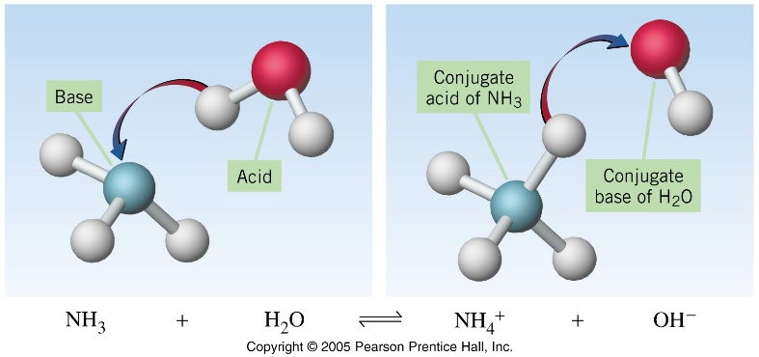
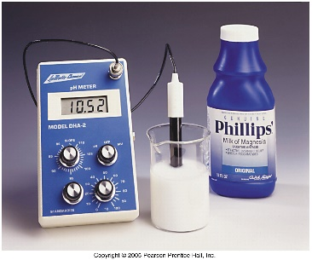
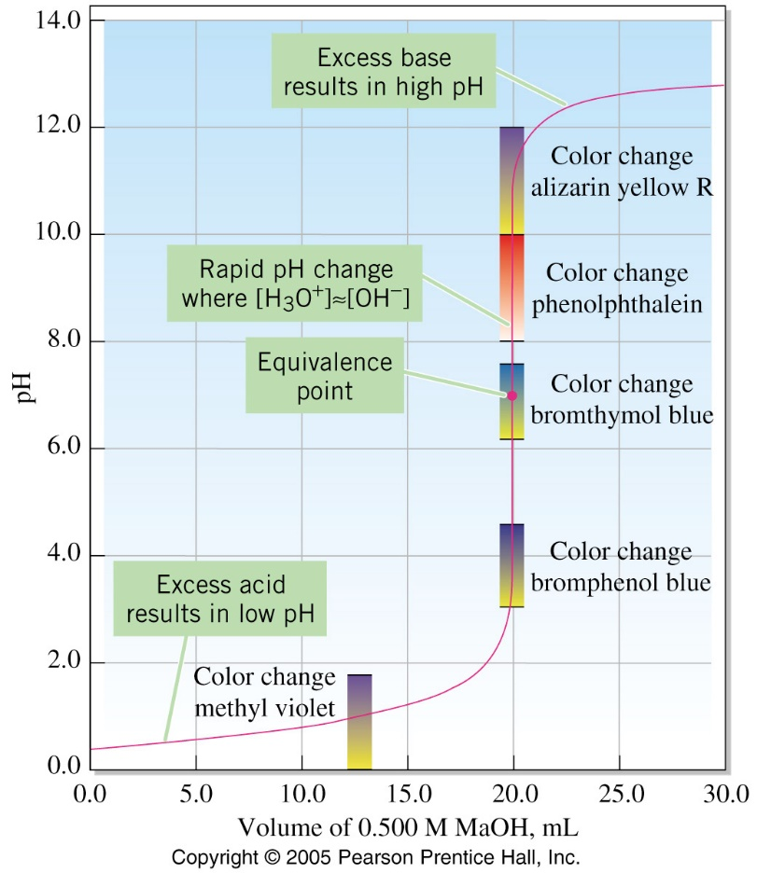
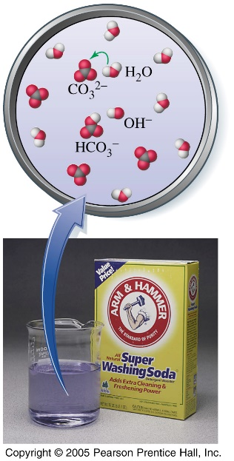
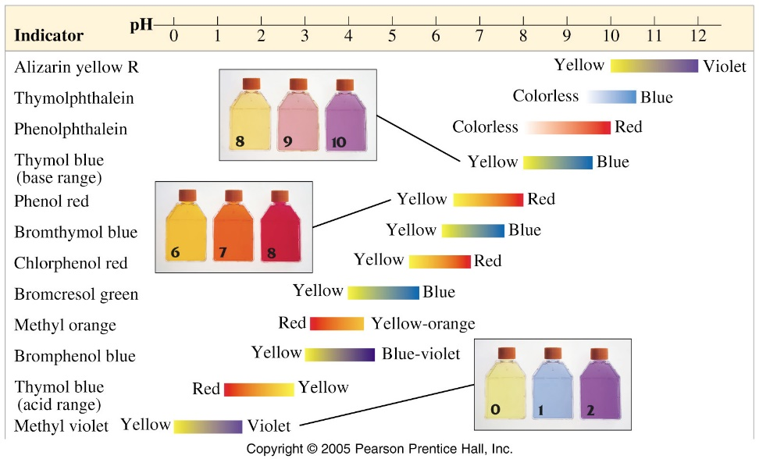
Acids, Bases, and
Acid–Base Equilibria

Slide 2
Introduction

Slide 3
Acids and Bases - Introduction
8.1 The Characteristic Properties of Acids and Bases
Describe neutrality and relative acidity and alkalinity in terms of pH measured using Universal Indicator paper (whole numbers only)
Describe the characteristic properties of acids as reactions with metals, bases, carbonates and effect on litmus and methyl orange
Describe the characteristic properties of bases as reactions with acids and with ammonium salts and effect on litmus and methyl orange
4.1 Stoichiometry
Construct word equations and simple balanced chemical equations

Slide 4

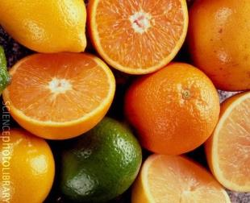
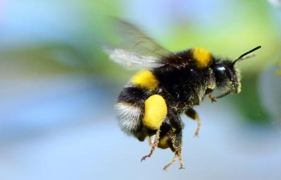
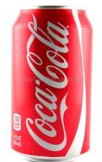
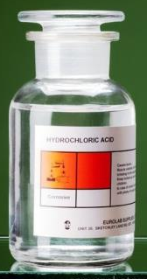
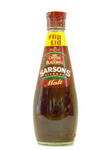
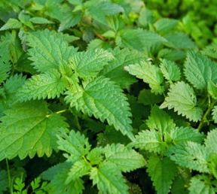
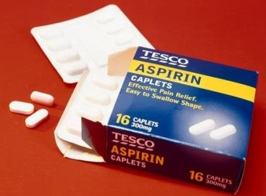
Acids

Slide 5

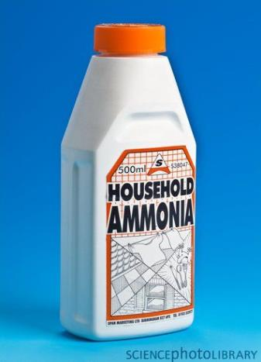
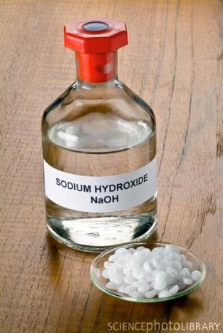
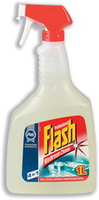

Alkalis

Slide 6
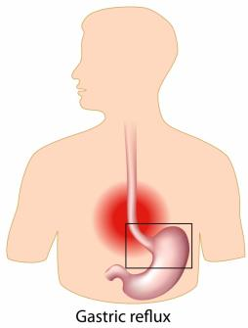
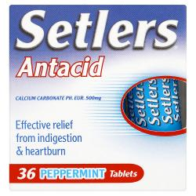

Indigestion tablets
for stomach acid

Slide 7
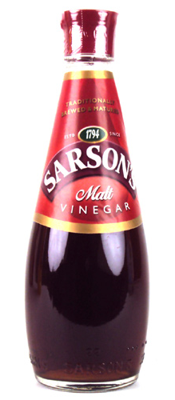
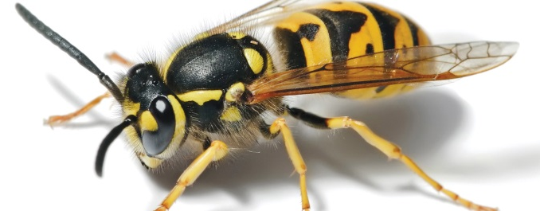
Vinegar on wasp stings

Slide 8
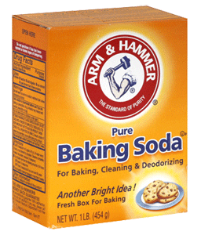
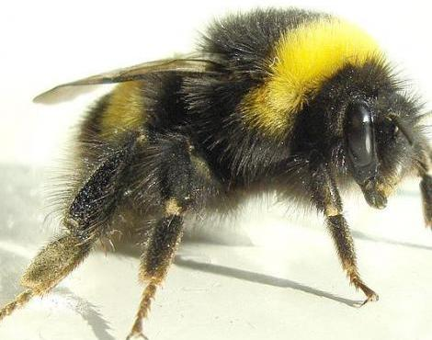
Bicarbonate of soda / baking
powder on bee stings

Slide 9

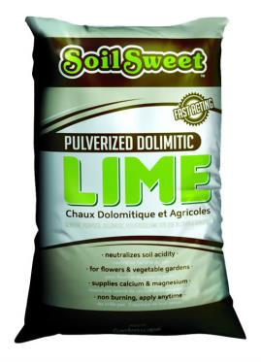
Lime for acidic fields

Slide 10
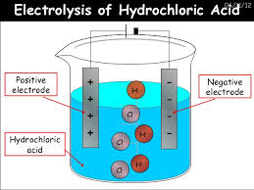
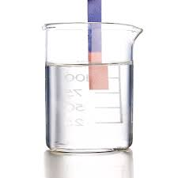
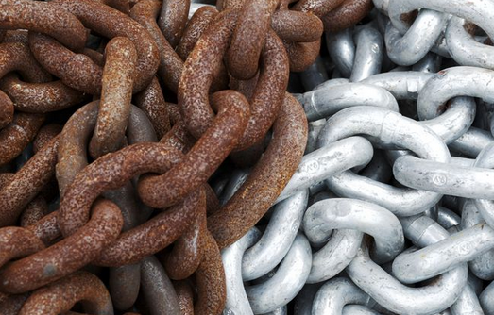
Acids - Introduction
Produce H⁺ (H₃O⁺) ions in water
Taste sour
Corrode metals
Electrolytes
React with bases to form a salt and water
pH is less than 7
Turns blue litmus paper to red

Slide 11
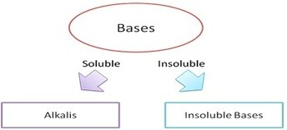
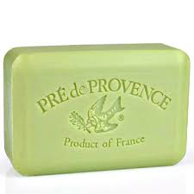
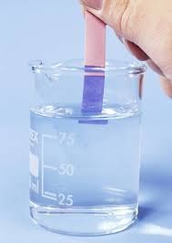
Bases - Introduction
Produce OH⁻ ions in water
Taste bitter, chalky
Are electrolytes
Feel soapy, slippery
React with acids to form salts and water
pH greater than 7
Turns red litmus paper to blue
NaOH sodium hydroxide lye
KOH potassium hydroxide liquid soap
Ba(OH)₂ barium hydroxide stabilizer for plastics
Mg(OH)₂ magnesium hydroxide milk of magnesia
Al(OH)₃ aluminum hydroxide antacids

Slide 12

Bases and Alkalis
Bases = substances that react with acids to form a salt and water
Metal oxides e.g. CaO
Metal hydroxides e.g. Ca(OH)₂
Metal carbonates e.g. CaCO₃
e.g. NaOH, Ca(OH)₂
Magnesium Oxide (6.2 mg/L)
Copper (II) Oxide
Lead(II) Oxide
Iron (III) Oxide
Iron (II) Oxide

Slide 13
Common Equations to Learn

Slide 14
Common Equations to Learn
metal + water → metal hydroxide + hydrogen
metal + acid → salt + hydrogen
metal oxide + acid → salt + water
metal hydroxide + acid → salt + water
metal carbonate + acid → salt + water + carbon dioxide

Slide 15
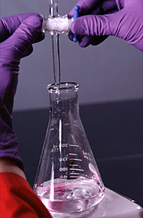
Acid + Alkali - Neutralisation
ACID + ALKALI → SALT + WATER
hydrochloric acid + sodium hydroxide
→ sodium chloride + water
sulfuric acid + ammonia
→ ammonium sulfate + water
Always exothermic

Slide 16
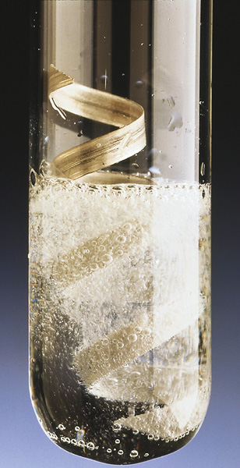
Acids and Metals
ACID + METAL → SALT + HYDROGEN
phosphoric acid + magnesium
→ magnesium phosphate + hydrogen
ethanoic acid + sodium
→ sodium ethanoate + hydrogen
Very reactive metals may do this explosively
Some metals e.g. gold and lead do not react

Slide 17
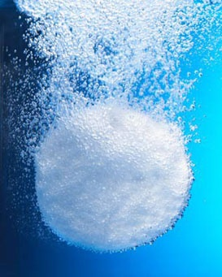
Acids and Carbonates
ACID + CARBONATE
→ SALT + CARBON DIOXIDE + WATER
hydrochloric acid + calcium carbonate
→ calcium chloride + carbon dioxide + water
nitric acid + sodium carbonate
→ sodium nitrate + carbon dioxide + water

Slide 18
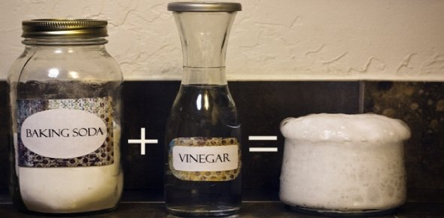
Acids and Hydrogencarbonates
ACID + HYDROGENCARBONATE
→ SALT + CARBON DIOXIDE + WATER
hydrochloric acid + calcium hydrogencarbonate
→ calcium chloride + carbon dioxide + water
nitric acid + sodium hydrogencarbonate
→ sodium nitrate + carbon dioxide + water

Slide 19
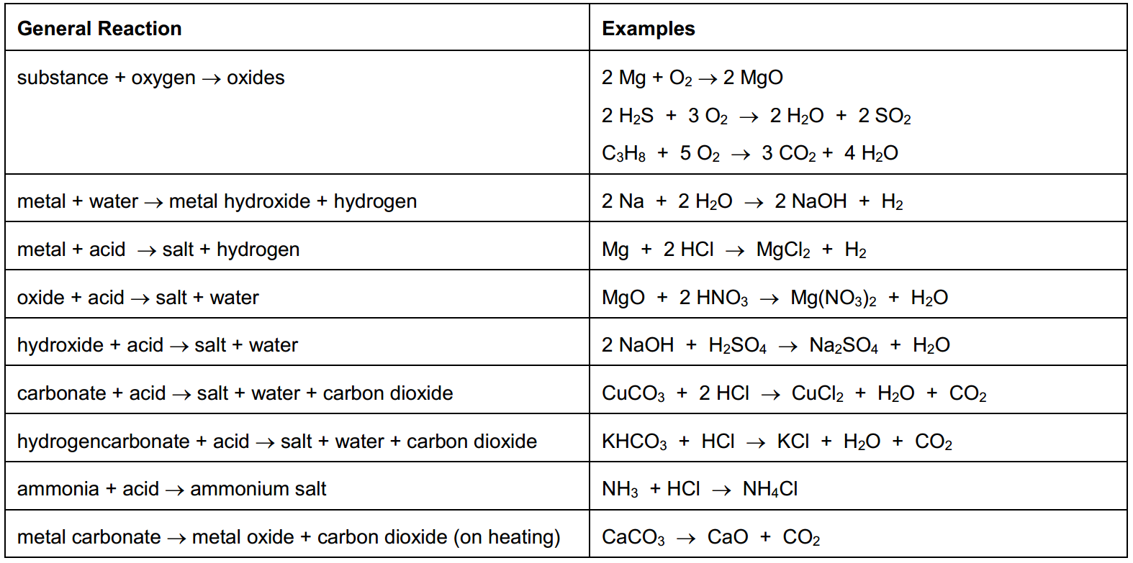
COMMON EQUATIONS TO LEARN

Slide 20
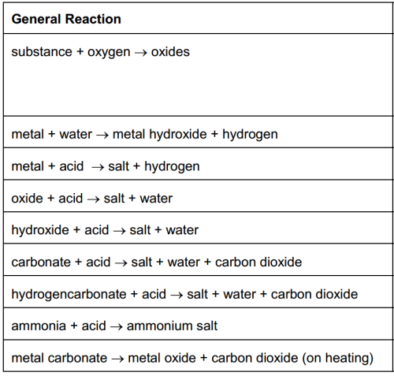
COMMON EQUATIONS TO LEARN

Slide 21
COMMON EQUATIONS TO LEARN

Slide 22
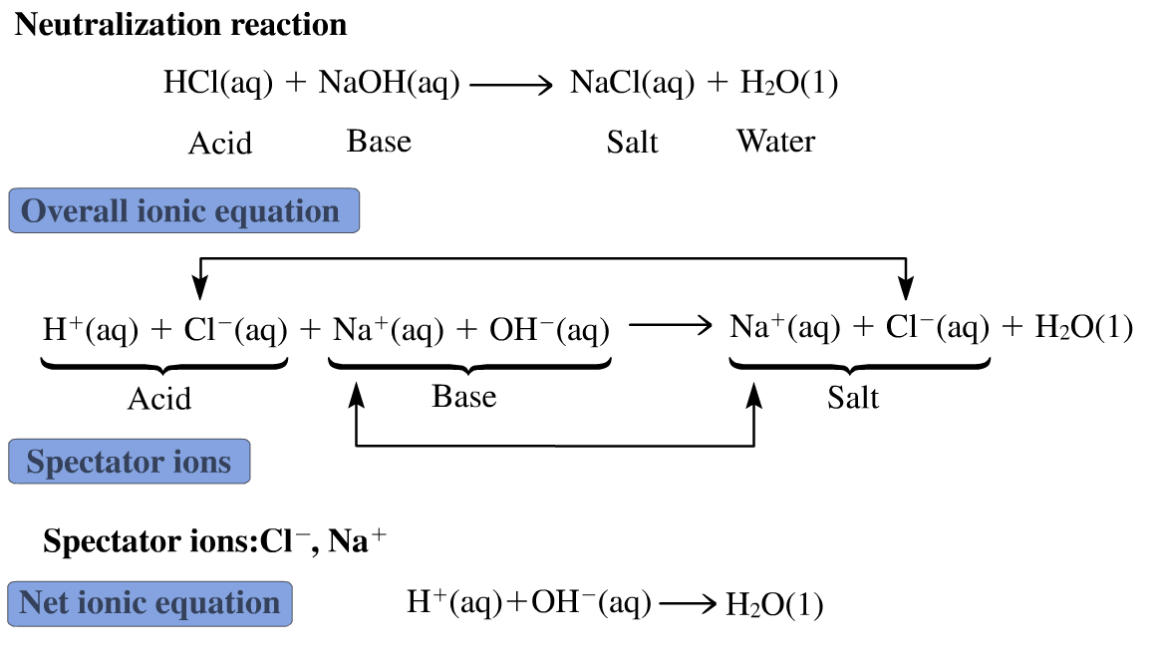
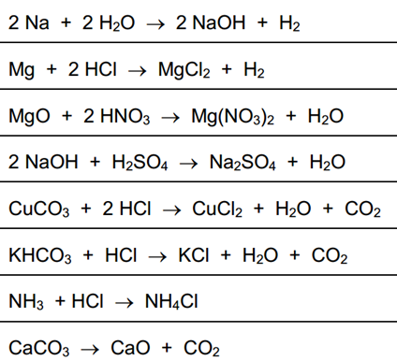
Ionic Equations
What are the ionic equations for these reactions?

Slide 23
pH

Slide 24
pH scale
0 | 1 | 2 | 3 | 4 | 5 | 6 | 7 | 8 | 9 | 10 | 11 | 12 | 13 | 14
More acidic
More alkaline
neutral
© www.chemsheets.co.uk GCSE 1126 27-Dec-2016

Slide 25
Hydrogen ion concentration [H+(aq)]
pH = - log₁₀ [H⁺(aq)] or [H⁺(aq)] = 10^{-pH}
pOH = - log₁₀ [OH¯(aq)] or [OH⁻(aq)] = 10^{-pOH}
[ ] represents the concentration in mol dm⁻³
[H⁺]
10⁰
10⁻¹
10⁻²
10⁻³
10⁻⁴
10⁻⁵
10⁻⁶
10⁻⁷
10⁻⁸
10⁻⁹
10⁻¹⁰
10⁻¹¹
10⁻¹²
10⁻¹³
10⁻¹⁴
OH¯
10⁻¹⁴
10⁻¹³
10⁻¹²
10⁻¹¹
10⁻¹⁰
10⁻⁹
10⁻⁸
10⁻⁷
10⁻⁶
10⁻⁵
10⁻⁴
10⁻³
10⁻²
10⁻¹
10⁻⁰
pH
0
1
2
3
4
5
6
7
8
9
10
11
12
13
14
STRONGLY ACIDIC
WEAKLY ACIDIC
NEUTRAL
WEAKLY ALKALINE
STRONGLY ALKALINE

Slide 26
Indicators

Slide 27
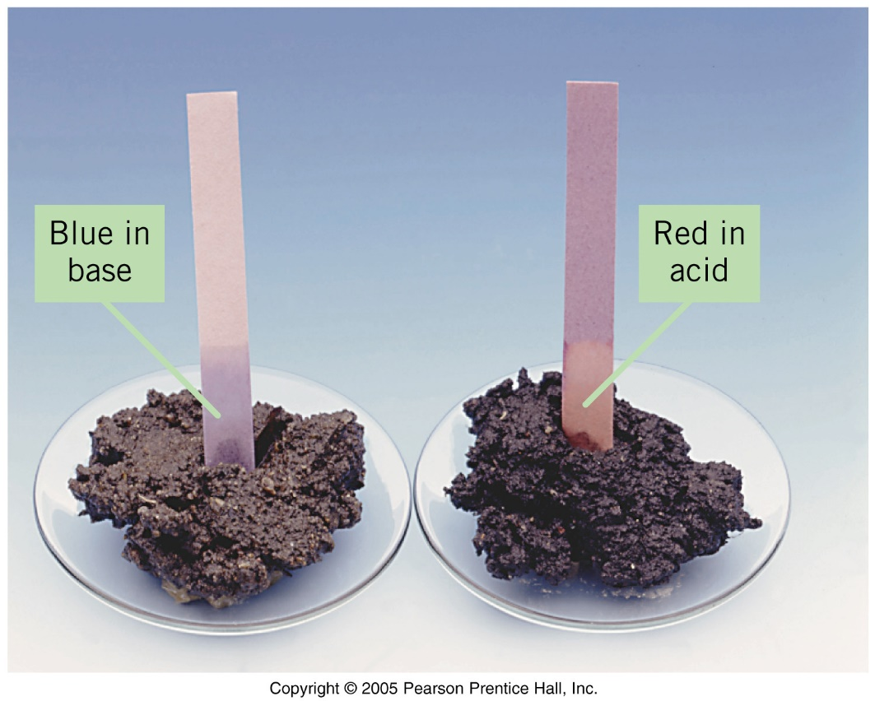
Indicators - Litmus

Slide 28
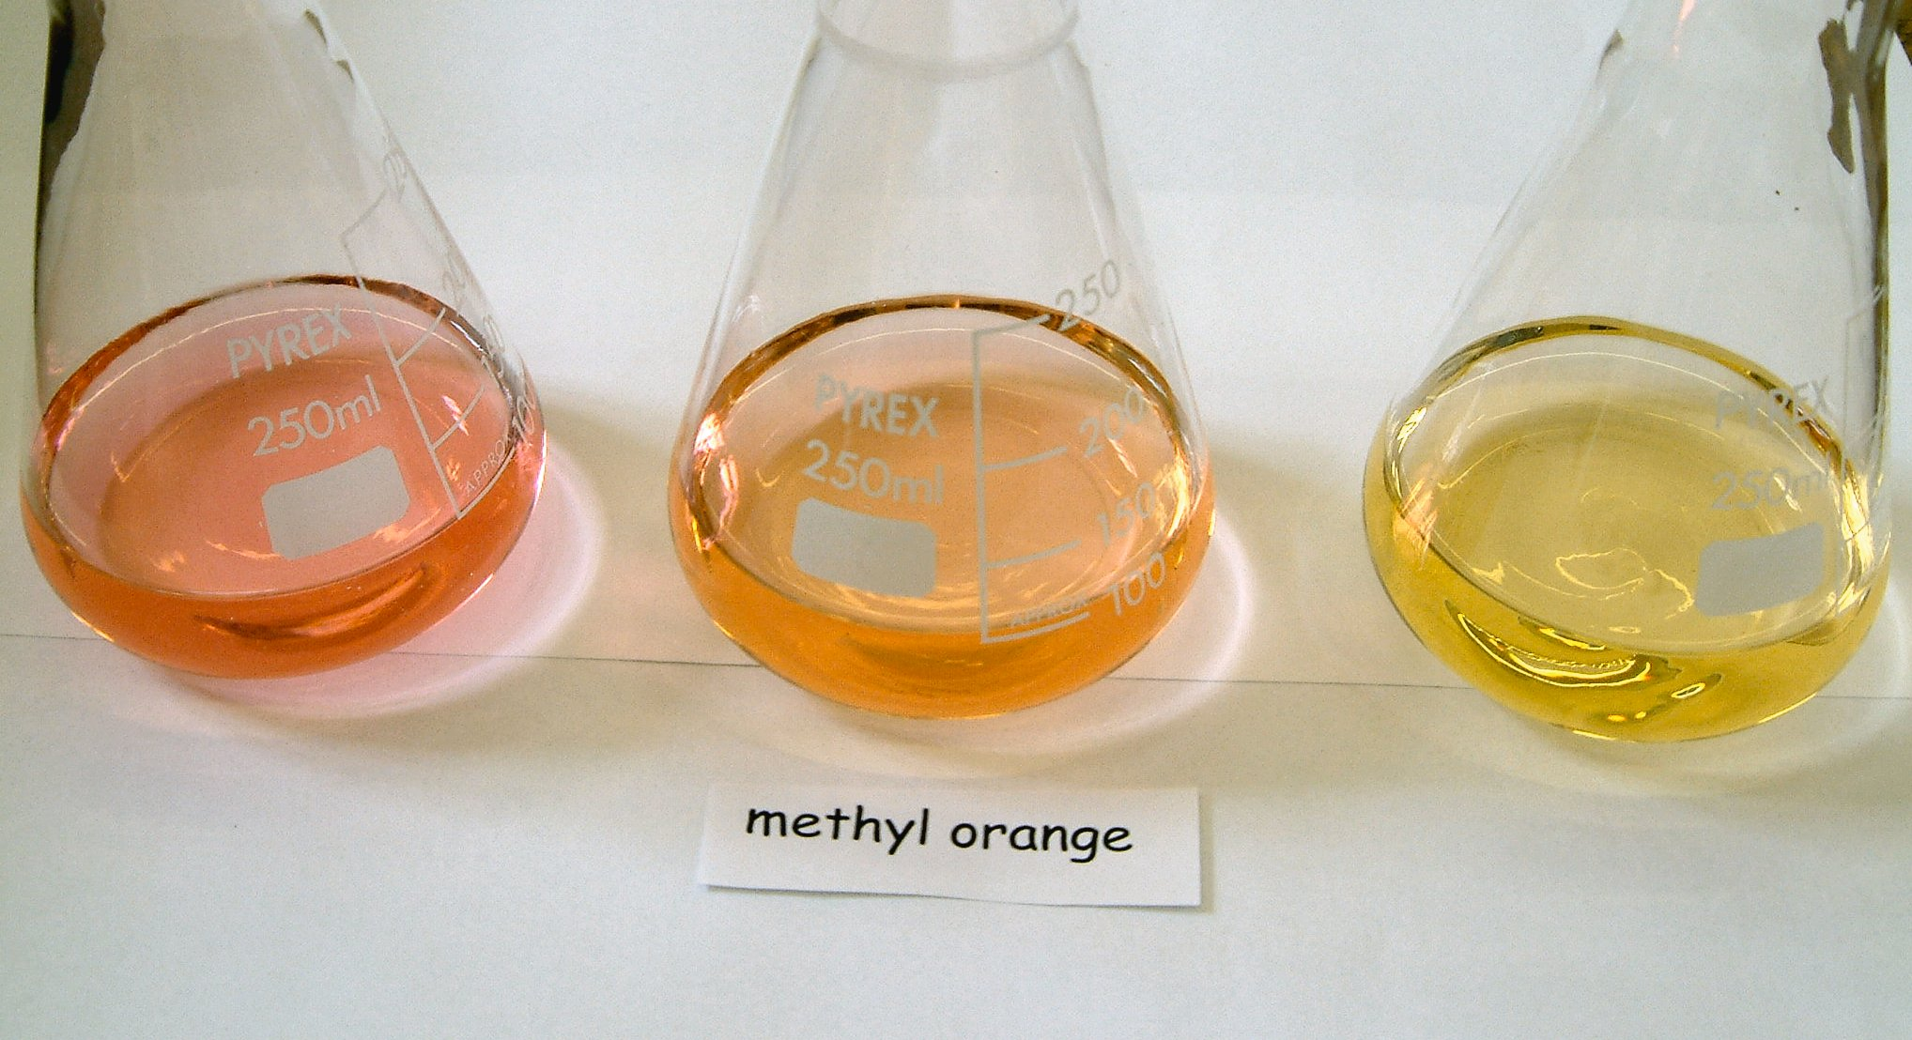
Indicators - Methyl Orange
⇌
pH < 3.2
pH > 4.4

Slide 29
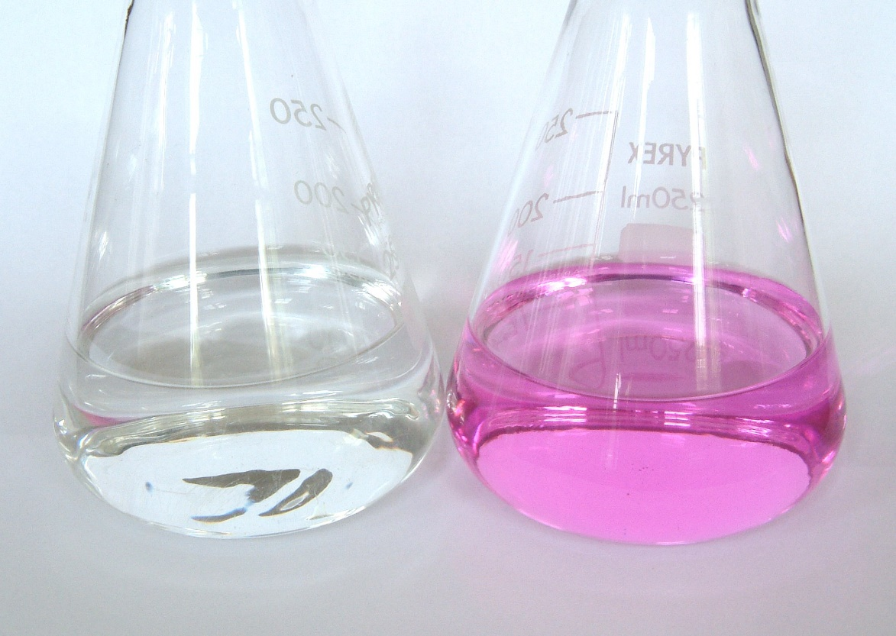
Indicators - Phenolpthalein
⇌
pH < 8.2
pH > 10.0

Slide 30
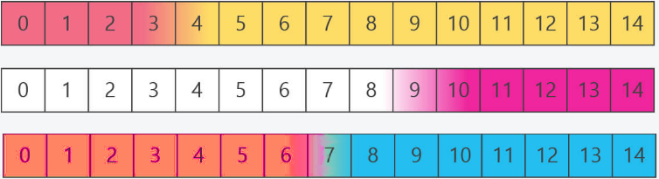
Indicators - Phenolpthalein
Methyl Orange
Phenolpthalein
Litmus

Slide 31
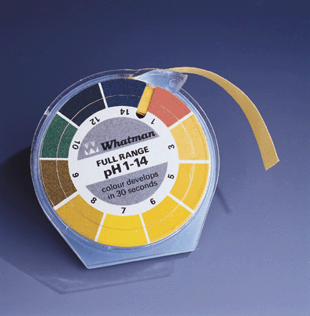
Universal Indicator
Universal indicator is a mixture of dyes which shows different colours at different pH.
pH paper is a piece of filter paper soaked with universal indicator.

Slide 32
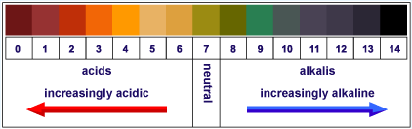
Universal indicator

Slide 33
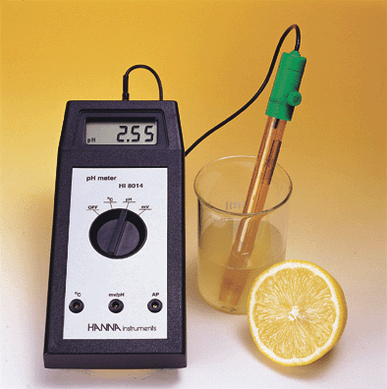
pH meter
pH meter is an instrument which can measure the pH values of solutions directly.
The meter is connected to a glass electrode which is sensitive to [H₃O⁺] together with a reference electrode.

Slide 34
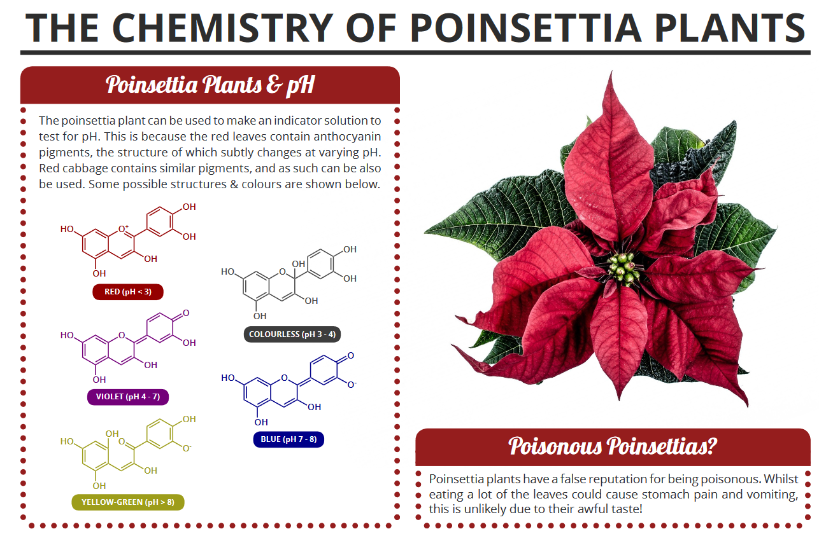
Indicators

Slide 35
Acids and Bases - Theories
8.1 The Characteristic Properties of Acids and Bases
Define acids and bases in terms of proton transfer, limited to aqueous solutions
Describe the meaning of weak and strong acids and bases

Slide 36
Theories

Slide 37
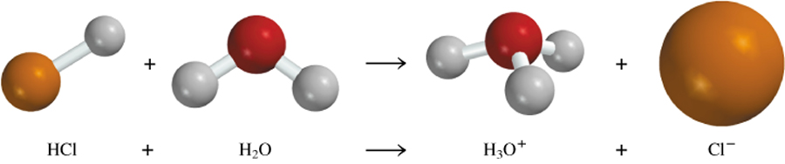
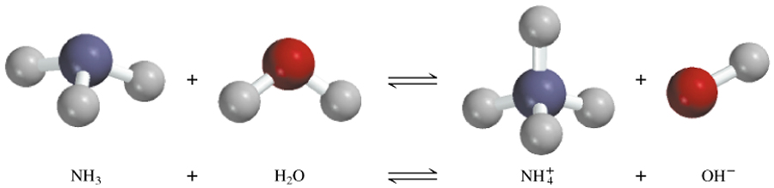
The Arrhenius Theory
Arrhenius acid is a substance that produces H⁺ (H₃O⁺) in water
Arrhenius base is a substance that produces OH⁻ in water

Slide 38
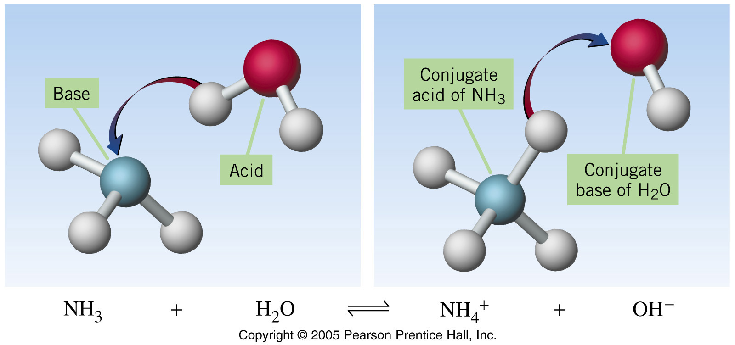
The Brønsted-Lowry Theory
A Brønsted-Lowry acid is a proton donor
A Brønsted-Lowry base is a proton acceptor

Slide 39
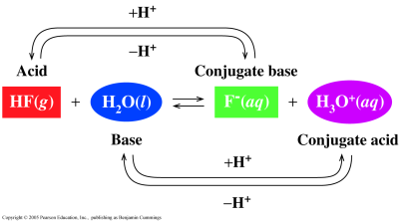
The Brønsted-Lowry Theory

Slide 40
The Brønsted-Lowry Theory
Example
A. Write the conjugate base of the following.
1. HBr
2. H₂CO₃
B. Write the conjugate acid of the following.
1. NO₂⁻
2. NH₃
Identify the Brønsted–Lowry acids and bases and their conjugates in:
(a) H₂S + NH₃ ⇌ NH₄⁺ + HS–
(b) OH– + H₂PO₄– ⇌ H₂O + HPO₄^{2–}

Slide 41
Strong and Weak Acids and Bases

Slide 42
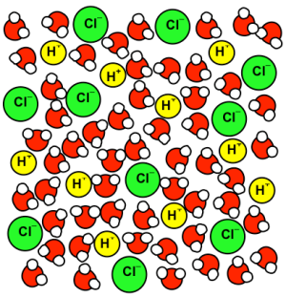
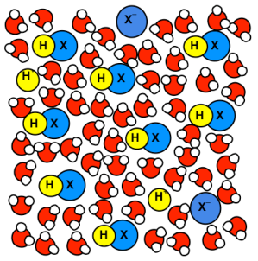

STRONG acid
HCl → H⁺ + Cl⁻
All molecules ionise
© www.chemsheets.co.uk GCSE 1126 27-Dec-2016

Slide 43

CONCENTRATED acid
Lots dissolved
DILUTE acid
Small amount dissolved
© www.chemsheets.co.uk GCSE 1126 27-Dec-2016

Slide 44

 | STRONG (all of the molecules break down into ions) | WEAK (small fraction of the molecules break down into ions)
CONCENTRATED (a lot of acid is dissolved)
DILUTE (small amount of acid dissolved)

Slide 45

Strong and Weak Acids and Bases

Slide 46

The Brønsted-Lowry Theory
Weak acids and bases exist in an equilibrium

Slide 47
Strong and Weak Acids and Bases
Strong acids and bases completely dissociate (split up) into ions in aqueous solution
e.g. HCl → H⁺(aq) + Cl¯(aq)
NaOH → Na⁺(aq) + OH¯(aq)
Weak acids and bases partially dissociate into ions in aqueous solution
e.g. ethanoic acid CH₃COOH(aq) + H₂O (l) ⇌ CH₃COO¯(aq) + H⁺(aq)
ammonia NH₃ (aq) + H₂O (l) ⇌ NH₄⁺ (aq) + OH¯ (aq)
The weaker the acid or base the less it dissociates

Slide 48


Strong Acids
Completely ionize in water.
The strong acids are leveled to the same strength—to that of H₃O⁺—when they are placed in water.

Slide 49

Strengths of Binary Acids
Acid strength is inversely proportional to H—X bond-dissociation energy.
A weaker H—X bond = a stronger acid.
Acid strength is directly proportional to anion radius.
A larger X radius = a stronger acid.

Slide 50
Acids and Bases - Oxides
8.2 Types of Oxides
Classify oxides as either acidic or basic, related to metallic and non-metallic character
Further classify other oxides as neutral or amphoteric

Slide 51

Acids and Bases - Oxides
What is the general pattern?
Bases
Amphoteric
Acidic
acts as an acid and base
Metal Oxides
Some Metal Oxides: GPII,III,IV
Non-Metal Oxides

Slide 52
www.CHEMSHEETS.co.uk
PERIOD 3 OXIDES
© www.chemsheets.co.uk A2 1075 26-Jun-2016

Slide 53

Acids and Bases - Oxides
Metal Oxides
Bases
No Reaction
No Reaction
Non- Metal Oxides
Acids

Slide 54

Sodium oxide Na₂O
IONIC
Na⁺
O²⁻

Slide 55
Sodium oxide Na₂O
IONIC
+ Water | + Acids | + Alkalis
© www.chemsheets.co.uk A2 1075 26-Jun-2016

Slide 56
Sodium oxide Na₂O
IONIC
+ Water | + Acids | + Alkalis
The Na⁺ and O²⁻ ions dissolves in water and then the O²⁻ ions react with water: O²⁻ + H₂O → 2 OH⁻ “Dissolves” (i.e. dissolves and then reacts with water to form a solution) Na₂O + H₂O → 2 NaOH(aq) pH 14
© www.chemsheets.co.uk A2 1075 26-Jun-2016

Slide 57
Sodium oxide Na₂O
BASIC
IONIC
+ Water | + Acids | + Alkalis
The Na⁺ and O²⁻ ions dissolves in water and then the O²⁻ ions react with water: O²⁻ + H₂O → 2 OH⁻ “Dissolves” (i.e. dissolves and then reacts with water to form a solution) Na₂O + H₂O → 2 NaOH(aq) pH 14 | Na₂O + 2 H⁺ → 2 Na⁺ + H₂O
© www.chemsheets.co.uk A2 1075 26-Jun-2016

Slide 58

Magnesium oxide MgO
IONIC
IONIC
Mg²⁺
O²⁻
mpt 2900°C

Slide 59
Magnesium oxide MgO
IONIC
+ Water | + Acids | + Alkalis
© www.chemsheets.co.uk A2 1075 26-Jun-2016

Slide 60
Magnesium oxide MgO
IONIC
+ Water | + Acids | + Alkalis
“Slightly soluble” (i.e. some dissolves and then reacts with water to form a solution) Some Mg²⁺ and O²⁻ ions dissolve in water (less soluble than Na₂O due to 2+ charge on Mg) and then the O²⁻ ions react with water: O²⁻ + H₂O → 2 OH⁻ MgO + H₂O → Mg(OH)₂(aq) pH 10
© www.chemsheets.co.uk A2 1075 26-Jun-2016

Slide 61
Magnesium oxide MgO
BASIC
IONIC
+ Water | + Acids | + Alkalis
“Slightly soluble” (i.e. some dissolves and then reacts with water to form a solution) Some Mg²⁺ and O²⁻ ions dissolve in water (less soluble than Na₂O due to 2+ charge on Mg) and then the O²⁻ ions react with water: O²⁻ + H₂O → 2 OH⁻ MgO + H₂O → Mg(OH)₂(aq) pH 10 | MgO + 2 H⁺ → Mg²⁺ + H₂O
© www.chemsheets.co.uk A2 1075 26-Jun-2016

Slide 62
Aluminium oxide Al₂O₃
IONIC
+ Water | + Acids | + Alkalis
© www.chemsheets.co.uk A2 1075 26-Jun-2016

Slide 63
Aluminium oxide Al₂O₃
IONIC
+ Water | + Acids | + Alkalis
Insoluble due to very strong ionic bond
© www.chemsheets.co.uk A2 1075 26-Jun-2016

Slide 64
Aluminium oxide Al₂O₃
IONIC
+ Water | + Acids | + Alkalis
Insoluble due to very strong ionic bond | Al₂O₃ + 6H⁺ → 2Al³⁺+ 3H₂O
© www.chemsheets.co.uk A2 1075 26-Jun-2016

Slide 65
Aluminium oxide Al₂O₃
AMPHOTERIC
IONIC
+ Water | + Acids | + Alkalis
Insoluble due to very strong ionic bond | Al₂O₃ + 6H⁺ → 2Al³⁺+ 3H₂O | Al₂O₃ + 2OH⁻ + 3H₂O → 2 Al(OH)₄⁻
© www.chemsheets.co.uk A2 1075 26-Jun-2016

Slide 66

Silicon(IV) oxide SiO₂
GIANT
COVALENT
IONIC
Si
O
mpt 1610°C

Slide 67
Silicon(IV) oxide SiO₂
GIANT
COVALENT
IONIC
+ Water | + Acids | + Alkalis
© www.chemsheets.co.uk A2 1075 26-Jun-2016

Slide 68
Silicon(IV) oxide SiO₂
GIANT
COVALENT
IONIC
+ Water | + Acids | + Alkalis
Insoluble due to lattice of atoms linked by strong covalent bonds that would have to be broken
© www.chemsheets.co.uk A2 1075 26-Jun-2016

Slide 69
Silicon(IV) oxide SiO₂
ACIDIC
GIANT
COVALENT
IONIC
+ Water | + Acids | + Alkalis
Insoluble due to lattice of atoms linked by strong covalent bonds that would have to be broken |  | SiO₂ + 2OH⁻ → SiO₃²⁻ + H₂O (must be hot, concentrated NaOH)
© www.chemsheets.co.uk A2 1075 26-Jun-2016

Slide 70

Phosphorus oxide P₄O₁₀
MOLECULAR
IONIC
mpt 580°C

Slide 71
Phosphorus oxide P₄O₁₀
MOLECULAR
IONIC
+ Water | + Acids | + Alkalis
© www.chemsheets.co.uk A2 1075 26-Jun-2016

Slide 72
Phosphorus oxide P₄O₁₀
MOLECULAR
IONIC
+ Water | + Acids | + Alkalis
Reacts violently P₄O₁₀ + 6H₂O → 4H₃PO₄ H₂O molecules attach the d+ P atoms, leading to the release of H⁺ ions from the water molecules.
© www.chemsheets.co.uk A2 1075 26-Jun-2016

Slide 73
Phosphorus oxide P₄O₁₀
ACIDIC
MOLECULAR
IONIC
+ Water | + Acids | + Alkalis
Reacts violently P₄O₁₀ + 6H₂O → 4H₃PO₄ H₂O molecules attach the d+ P atoms, leading to the release of H⁺ ions from the water molecules. |  | P₄O₁₀ + 12OH⁻ → 4PO₄³⁻ + 6 H₂O
© www.chemsheets.co.uk A2 1075 26-Jun-2016

Slide 74

Sulfur(IV) oxide SO₂
MOLECULAR
IONIC
mpt -75°C

Slide 75
Sulfur(IV) oxide SO₂
MOLECULAR
IONIC
+ Water | + Acids | + Alkalis
© www.chemsheets.co.uk A2 1075 26-Jun-2016

Slide 76
Sulfur(IV) oxide SO₂
MOLECULAR
IONIC
+ Water | + Acids | + Alkalis
“Dissolves” (i.e. dissolves and then reacts with water to form a solution SO₂ + H₂O → H₂SO₃
© www.chemsheets.co.uk A2 1075 26-Jun-2016

Slide 77
Sulfur(IV) oxide SO₂
ACIDIC
MOLECULAR
IONIC
+ Water | + Acids | + Alkalis
“Dissolves” (i.e. dissolves and then reacts with water to form a solution SO₂ + H₂O → H₂SO₃ |  | SO₂ + 2OH⁻ → SO₃²⁻ + H₂O
© www.chemsheets.co.uk A2 1075 26-Jun-2016

Slide 78

Sulfur(VI) oxide SO₃
MOLECULAR
IONIC
mpt 17°C

Slide 79
Sulfur(VI) oxide SO₃
MOLECULAR
IONIC
+ Water | + Acids | + Alkalis
© www.chemsheets.co.uk A2 1075 26-Jun-2016

Slide 80
Sulfur(VI) oxide SO₃
MOLECULAR
IONIC
+ Water | + Acids | + Alkalis
Reacts violently SO₃ + H₂O → H₂SO₄ pH 0
© www.chemsheets.co.uk A2 1075 26-Jun-2016

Slide 81
Sulfur(VI) oxide SO₃
ACIDIC
MOLECULAR
IONIC
+ Water | + Acids | + Alkalis
Reacts violently SO₃ + H₂O → H₂SO₄ pH 0 |  | SO₃ + 2OH⁻ → SO₄²⁻ + H₂O
© www.chemsheets.co.uk A2 1075 26-Jun-2016

Slide 82
Identification of Ions and Gases
8.4 Identification of Ions and Gases
Describe the following tests to identify gases:
ammonia (using damp red litmus paper)
carbon dioxide (using limewater)
chlorine (using damp litmus paper)
hydrogen (using lighted splint)
oxygen (using a glowing splint)
and sulfur dioxide (using aqueous potassium manganate(VII)

Slide 83








Testing for Gases

Slide 84
Ammonia
Chlorine
Damp blue litmus paper. first turns red showing an acidic nature and is then bleached white.
Damp, red litmus paper turns blue.

Slide 85

Oxygen
Hydrogen
This burns with a squeaky pop when a lighted splint is used
A glowing splint, relights

Slide 86
Test for Carbon Dioxide
CO₂ bubbled through limewater: Ca(OH)₂
1) turns the water cloudy
2) returns to clear
1) Ca(OH)₂(aq) + CO₂(g) ⇒ CaCO₃(s) + H₂O(l)
2) CaCO₃(s) + H₂O(l) + CO₂(g) ⇒ Ca(HCO₃)₂(aq)

Slide 87





Test for Sulfur Dioxide
Drop potassium manganate(VII) onto a piece of filter paper
The purple colour will turn red then orange and finally it will be bleached

Slide 88
Gas Summary
ammonia, NH₃ | turns damp red litmus paper blue
carbon dioxide, CO₂ | gives a white ppt. with limewater (ppt. dissolves with excess CO₂)
chlorine, Cl₂ | turns damp blue litmus paper red and then bleaches it
hydrogen, H₂ | ‘pops’ with a lighted splint
oxygen, O₂ | relights a glowing splint
sulfur dioxide, SO₂ | turns aqueous potassium manganate(VII) from purple to orange and then white (bleached)

Slide 89
Identification of Ions and Gases
8.4 Identification of Ions and Gases
Describe the following tests to identify anions:
carbonate (by reaction with dilute acid and then limewater)
chloride, bromide and iodide (by reaction under acidic conditions with aqueous silver nitrate)
nitrate (by reduction with aluminium)
sulfate (by reaction under acidic conditions with aqueous barium ions)
and sulfite (by reaction with dilute acids and then aqueous potassium manganate(VII))

Slide 90


Testing for Anions

Slide 91

Test for carbonates
Bubble carbon dioxide gas through lime water
Ca(OH)₂ (aq) + CO₂ (g) → CaCO₃ (s)
Add a dilute acid. Fizzing shows a positive result.

Slide 92

Test for sulphates
BaCl₂ (aq) + SO₄²⁻ (aq) → BaSO₄ (s) + 2Cl⁻ (aq)
Add barium chloride solution acidified with HCl.
A white precipitate shows a positive result.
Why add acid?
It removes carbonates which also precipitate with Ba

Slide 93


Test for sulphites
Add acid to the sulphite
Warm Gently
Test the gas produced with KMnO₄ on filter paper
The purple colour will turn red then orange and finally it will be bleached

Slide 94
Test for Halides

Slide 95




Test for Halides + AgNO₃
CHLORIDE
BROMIDE
IODIDE
Nitric acid
Removes CO₃²⁻ prevents PPT
Silver Nitrate
Forms Halide PPT
Dilute Ammonia
Dissolves chloride PPT
Concentrated Ammonia
Dissolves bromide PPT
ADD SOME DILUTE NITRIC ACID
ADD SILVER NITRATE SOLUTION
WHITE PRECIPITATE OF SILVER CHLORIDE AgCl
CREAM PRECIPITATE OF SILVER BROMIDE AgBr
YELLOW PRECIPITATE OF SILVER IODIDE AgI
ADD DILUTE AMMONIA SOLUTION
WHITE PRECIPITATE OF SILVER CHLORIDE - SOLUBLE
CREAM PRECIPITATE OF SILVER BROMIDE - INSOLUBLE
YELLOW PRECIPITATE OF SILVER IODIDE - INSOLUBLE
ADD CONCENTRATED AMMONIA
SOLUBLE
SOLUBLE
INSOLUBLE

Slide 96
Test for Halides + AgNO₃
Ion | Action of AgNO₃ | Effect of adding excess dilute NH₃ | Effect of adding excess conc. NH₃ | Effect of Standing in sunlight
Cl⁻ | White ppt. | White ppt. dissolves | White ppt. dissolves | Turns purple-grey
Br⁻ | Pale yellow ppt. | Pale yellow ppt. slightly dissolves | Pale yellow ppt. dissolves | Turns yellowish creamy grey
I⁻ | Yellow ppt. | Yellow ppt. | Yellow ppt. | Remains yellow

Slide 97




Test for Nitrates
Test for the nitrate ion
Add a few drops of dilute sodium hydroxide
Add some aluminium powder.
Heat
This produces ammonium ions which break down to form ammonia.
Test with damp red litmus paper → blue
Ca(NO₃)₂ (aq) + NaOH (aq) + Al (s)
→ NH₃ (g) + others that you don't need to know

Slide 98

What is the test?

Slide 99
Anion Summary
carbonate, CO₃²⁻ | CO₂ liberated by dilute acids
chloride, Cl⁻ (aq) | gives white ppt. with Ag⁺(aq) (soluble in NH₃(aq)) gives white ppt. with Pb²⁺(aq)
bromide, Br⁻ (aq) | gives cream ppt. with Ag⁺(aq) (partially soluble in NH₃(aq)) gives white ppt. with Pb²⁺(aq)
iodide, I⁻ (aq) | gives yellow ppt. with Ag⁺(aq) (insoluble in NH₃(aq)) gives yellow ppt. with Pb²⁺(aq)
nitrate, NO₃⁻ (aq) | NH₃ liberated on heating with OH⁻(aq) and Al foil
sulfate, SO₄²⁻ (aq | gives white ppt. with Ba²⁺(aq) or with Pb²⁺(aq) (insoluble in excess dilute strong acids)
sulfite, SO₃⁻ (aq) | heat powder with acid, the gas produced turns aqueous potassium manganate(VII) from purple to orange and then white (bleached)

Slide 100


Slide 101
Which is the correct test for sulphates
✓
Add barium chloride solution acidified with hydrochloric acid. White precipitate shows a positive result.
Add a dilute acid. Fizzing shows a positive result.
Add a few drops of silver nitrate solution acidified with nitric acid. White precipitate shows a positive result.
✗
✗

Slide 102
Which is the correct test for chlorides
✗
Add a dilute acid. Fizzing shows a positive result.
Add barium chloride solution acidified with hydrochloric acid. White precipitate shows a positive result.
Add a few drops of silver nitrate solution acidified with nitric acid. White precipitate shows a positive result.
✗
✓

Slide 103
Which is the correct test for carbonates
✓
Add a dilute acid. Fizzing shows a positive result.
Dip a Palintest strip into the solution. A colour change is a positive result.
Add a few drops of silver nitrate solution acidified with nitric acid. White precipitate shows a positive result.
✗
✗

Slide 104
Which is the correct test for nitrates
✗
Add a dilute acid. Add AgNO₃. Heat and add aluminium
Add NaOH and some powdered Al. A colour change is a positive result.
Add NaOH and some powdered Al. Ammonia gas is a positive result.
Add NaOH, a white precipitate is a positive result.
✗
✓
✗

Slide 105


Slide 106


What Am I?
I'm form a white ppt. With Ag⁺ ions
My ppt. dissolves in dilute NH₃
Cl⁻

Slide 107
What Am I?
I fizz with dilute acids
CO₃²⁻

Slide 108

What Am I?
I'm form a yellow ppt. With Ag⁺ ions
My ppt. does not dissolve in dilute NH₃
My ppt. does not dissolve in conc. NH₃
I⁻

Slide 109
What Am I?
I'm form ammonia gas when heated with powdered Al and NaOH
NO₃⁻

Slide 110

What Am I?
I'm form a ppt. With Ag⁺ ions as shown
My ppt. changes colour on exposure to light as shown
Br⁻

Slide 111
What Am I?
The addition of dilute nitric acid and then barium chloride forms a white ppt.
SO₄²⁻

Slide 112

What Am I?
I'm form a ppt. With Ag⁺ ions as shown
My ppt. changes colour on exposure to light as shown
Cl⁻

Slide 113
Identification of Ions and Gases
8.4 Identification of Ions and Gases
Describe the following tests to identify cations:
use of the flame test to identify:
lithium
sodium
potassium
and copper(II)

Slide 114

Flame Tests

Slide 115


Flame Tests
Clean a platinum wire by alternately dipping it into concentrated hydrochloric acid and then holding it in a hot Bunsen flame until the wire does not produce a flame colour.
Dip the clean wire into fresh concentrated acid and then into a small amount of the test solid or solution. Return the wire to the flame and observe the flame colour.

Slide 116


Flame Colours for Group 1 Cations
 | Flame Colour
Li⁺ | Red
Na⁺ | Yellow
K⁺ | Lilac (pale purple)
Rb⁺ | Red
Li⁺
Na⁺
K⁺
Rb⁺

Slide 117



Flame Colours for Group 2 Cations
 | Flame Colour
Ca²⁺ | Brick Red
Sr²⁺ | Crimson (bright red)
Ba²⁺ | Light Green
Ca²⁺
Sr²⁺
Ba²⁺

Slide 118

Flame Colour for Copper
 | Flame Colour
Cu²⁺ | Green-Blue
Cu²⁺

Slide 119

What am I?
Na⁺
Ca²⁺

Slide 120

What am I?
Ba²⁺
Ba²⁺

Slide 121

What am I?
Sr²⁺
Li⁺

Slide 122
What am I?
Cu²⁺
Cu²⁺

Slide 123

What am I?
Na⁺
Na⁺

Slide 124

What am I?
Li⁺
Sr²⁺

Slide 125

What am I?
K⁺
K⁺

Slide 126

What are we?
K⁺ & Li⁺
K⁺
Sr²⁺

Slide 127
What are we?
Cu²⁺ & Na⁺
Cu²⁺
Na⁺

Slide 128

What are we?
Ba²⁺ & Na⁺
Ba²⁺
Na⁺

Slide 129

What are we?
Rb⁺ & K⁺
Rb⁺
K⁺

Slide 130
What am I?

Slide 131

A flame test gave
the colour below
Testing with acid and then
Lime Water gave the result
below
Sodium Carbonate
Na₂CO₃

Slide 132

A flame test gave
the colour below
Testing with silver nitrate only
gave the result below, the ppt.
dissolved in dilute NH₃
Barium Chloride
BaCl₂

Slide 133
A flame test gave
the colour below
Testing with silver nitrate only
gave the result below, the ppt.
dissolved in dilute NH₃
Sodium Chloride
NaCl

Slide 134

Testing with silver nitrate only
gave the result below, the ppt.
did not dissolve in NH₃
A flame test gave
the colour below
Rubidium Iodide
RbI

Slide 135
Testing with silver nitrate only
gave the result below, the ppt.
did not dissolve in NH₃
A flame test gave
the colour below
Potassium Iodide
KI

Slide 136

A flame test gave
the colour below
The result below was obtained
on adding barium chloride
Calcium Sulphate
CaSO₄

Slide 137


Lithium Bromide
LiBr
What am I?
Test with silver nitrate
→ cream ppt. and the
ppt. should dissolve in
conc. NH₃
Red flame
during a flame test

Slide 138

A flame test gave
the colour below
Testing with NaOH + Al and heat
produced NH₃ gas
Potassium Nitrate
KNO₃

Slide 139
What tests would you do to prove you had:
strontium bromide (SrBr₂)
and what would the results be?
Test with silver nitrate
→ cream ppt. and the
ppt. should dissolve in
conc. NH₃
Bright red flame
during a flame test

Slide 140
What tests would you do to prove you had:
copper sulfate (CuSO₄)
and what would the results be?
Cu²⁺
Blue-green flame
during a flame test
A white ppt. on adding
barium chloride (BaCl₂)

Slide 141
NOW!
In pairs write down 2 problems of your own and then ask other students to solve your question.
e.g. What compound is this? A red flame was produced during a flame test and on addition of acid a gas was evolved which turned lime water cloudy.

Slide 142
Identification of Ions and Gases
8.4 Identification of Ions and Gases
Describe the following tests to identify aqueous cations:
using aqueous sodium hydroxide and aqueous ammonia as appropriate. (Formulae of complex ions are not required)
aluminium
ammonium
calcium
chromium(III)
copper(II)
iron(II)
iron(III)
and zinc

Slide 143

Aqueous Cations

Slide 144

Ammonium ions, NH₄⁺
Warming with dilute sodium hydroxide solution releases ammonia gas. This is an alkaline gas so turns damp red litmus paper blue. It also has a characteristic smell of urine.
NH₄⁺(aq) + OH⁻(aq) ⇒ NH₃(g) + H₂O(l)

Slide 145

M²⁺(aq) + 2 OH⁻(aq) → M(OH)₂(s)
aq. ion NaOH Excess NaOH NH₃
Copper (II), insoluble in excess NaOH, soluble in NH₃
Iron (II), insoluble in all
Iron (III), insoluble in all
Zinc (II), soluble in excess NaOH and NH₃
Calcium (II), insoluble in excess NaOH soluble in NH₃

Slide 146


M³⁺(aq) + 3 OH⁻(aq) → M(OH)₃(s)
aq. ion NaOH Excess NaOH NH₃
Chromium (III), soluble in excess NaOH, insoluble in NH₃
Alumunium (III), soluble in excess NaOH, insoluble in NH₃

Slide 147

Hydroxide and Ammonia Tests Summary

Slide 148

?
?
?
?
?
?
?
?
?
?
?
?

Slide 149

?
?
?
?
?
?
?
?
?
?
?
?

Slide 150
Making Salts

Slide 151
8.3 Preparation of Salts
Demonstrate knowledge and understanding of preparation, separation and purification of salts as examples of some of the techniques specified in Section 2.2.2 and the reactions specified in Section 8.1
Demonstrating knowledge and understanding of the preparation of insoluble salts by precipitation
Suggest a method of making a given salt from suitable starting material, given appropriate information
2.2.2
Describe and explain methods of purification by the use of a suitable solvent, filtration, crystallisation and distillation
Suggest suitable purification techniques, given information about the substances involved
8.1
Acids as reactions with metals, bases, carbonates
Bases as reactions with acids and with ammonium salts

Slide 152





SALTS ARE USEFUL
Diarrhoea tablets
Loperamide hydrochloride
Iron tablets
Iron sulphate
Barium meal
Barium sulphate
© www.chemsheets.co.uk GCSE 1128 27-Dec-2016

Slide 153



SALTS ARE USEFUL
Dental anaesthetic
Lignocaine hydrochloride
Toothpaste
Sodium lauryl sulphate
Sodium flouride
© www.chemsheets.co.uk GCSE 1128 27-Dec-2016

Slide 154



SALTS ARE USEFUL
Common salt
Sodium chloride
Lo salt
Potassium chloride
Sodium chloride
© www.chemsheets.co.uk GCSE 1128 27-Dec-2016

Slide 155



SALTS ARE USEFUL
Fertiliser
Ammonium nitrate
Plaster
Calcium sulphate
© www.chemsheets.co.uk GCSE 1128 27-Dec-2016

Slide 156
Common Equations to Learn
metal + water → metal hydroxide + hydrogen
metal + acid → salt + hydrogen
metal oxide + acid → salt + water
metal hydroxide + acid → salt + water
metal carbonate + acid → salt + water + carbon dioxide
Not all metals are suitable
some are too reactive
others are do not react

Slide 157
WHAT IS MADE WHEN ACIDS REACT?
1) Na + 2 HCl → 2 NaCl + ??
2) Na₂O + 2 HCl → 2 NaCl + ??
3) NaOH + HCl → NaCl + ??
4) Na₂CO₃ + 2 HCl
→ 2 NaCl + ??
H₂
H₂O
H₂O
H₂O + CO₂
© www.chemsheets.co.uk GCSE 1128 27-Dec-2016

Slide 158
Making Salts
HYDROCHLORIC ACID
+
SODIUM
HYDROXIDE
AMMONIA
ZINC
METAL
COPPER
OXIDE
SODIUM
CHLORIDE
AMMONIUM
CHLORIDE
MAGNESIUM
CARBONATE
ZINC
CHLORIDE
COPPER
CHLORIDE
MAGNESIUM
CHLORIDE

Slide 159
Making Salts
SULFURIC ACID
+
SODIUM
HYDROXIDE
AMMONIA
ZINC
METAL
COPPER
OXIDE
SODIUM
SULFATE
AMMONIUM
SULFATE
MAGNESIUM
CARBONATE
ZINC
SULFATE
COPPER
SULFATE
MAGNESIUM
SULFATE

Slide 160
 | nitric acid, HNO₃ | hydrochloric acid, HCl | sulphuric acid, H₂SO₄
Type of salt formed
sodium carbonate, Na₂CO₃
magnesium, Mg
potassium oxide, K₂O
copper hydroxide, Cu(OH)₂
ammonia, NH₃
nitrate
chloride
sulphate
Sodium nitrate
Sodium chloride
Sodium sulphate
Magnesium nitrate
Magnesium chloride
Magnesium sulphate
Potassium nitrate
Potassium chloride
Potassium sulphate
Copper nitrate
Copper chloride
Copper sulphate
Ammonium nitrate
Ammonium chloride
Ammonium sulphate

Slide 161
 | hydrochloric acid | acid 9 | acid 17
calcium | salt 1 + 2 | calcium nitrate + 10 | salt 18 + 19
sodium oxide | salt 3 + 4 | salt 11 + 12 | salt 20 + 21
zinc carbonate | salt 5 + 6 | salt 13 + 14 | zinc sulphate + 22
potassium hydroxide | salt 7 + 8 | salt 15 + 16 | salt 23 + 24
nitric acid
sulphuric acid
calcium chloride
calcium nitrate
+ hydrogen
+ hydrogen
+ hydrogen
sodium chloride
sodium nitrate
sodium sulphate
+ water
+ water
+ water
zinc chloride
zinc nitrate
+ carbon dioxide + water
+ carbon dioxide + water
+ carbon dioxide + water
potassium chloride
potassium nitrate
potassium sulphate
+ water
+ water
+ water

Slide 162
 | hydrochloric acid | acid 9 | acid 17 | phosphoric acid
magnesium | salt 1 + 2 | magnesium sulphate + 10 | salt 18 + 19 | salt 25 + 26
calcium oxide | salt 3 + 4 | salt 11 + 12 | salt 20 + 21 | calcium phosphate + 27
lead carbonate | salt 5 + 6 | salt 13 + 14 | lead nitrate + 22 | salt 28 + 29
sodium hydroxide | salt 7 + 8 | salt 15 + 16 | salt 23 + 24 | salt 30 + 31
sulphuric acid
nitric acid
magnesium chloride
magnesium nitrate
magnesium phosphate
+ hydrogen
+ hydrogen
+ hydrogen
+ hydrogen
calcium chloride
calcium sulphate
calcium nitrate
+ water
+ water
+ water
+ water
lead chloride
lead sulphate
lead phosphate
+ H₂O + CO₂
+ H₂O + CO₂
+ H₂O + CO₂
+ H₂O + CO₂
sodium chloride
sodium sulphate
sodium nitrate
sodium phosphate
+ water
+ water
+ water
+ water

Slide 163

Making Salts - Solubility
Water is produced in neutralization reactions
Salts are either soluble or insoluble in water

Slide 164

Red means insoluble
Green means soluble
The units are moles soluble in 100g of water.
Can you spot any trends?
List 4 trends
Alkali metals sol.
Nitrates sol.
Ethanoates sol.
Carbonates insol.
Group II less sol.

Slide 165

Can you spot any trends? List 4...
Alkali metals sol.
Nitrates (NO₃⁻) sol.
Ethanoates (CH₃CO₂⁻) sol.
Carbonates (CO₃²⁻)insol.
Group II less sol.

Slide 166
Making Salts - Metal Oxide Solubility
4 Rules that are ALWAYS true
Soluble Cations: Na⁺, K⁺, NH₄⁺
Soluble Anions: NO₃⁻
4 Rules that are GENERALLY true
Soluble Anions: SO₄²⁻ Cl⁻/Br⁻/I⁻
Insoluble Anions: CO₃²⁻ OH⁻ O²⁻
Except Ba²⁺ Pb²⁺
Except Ag⁺ Pb²⁺
Except Na⁺ K⁺ NH₄⁺

Slide 167
Making Salts - Metal Oxide Solubility
4 Rules that are ALWAYS true
Soluble Cations: Na⁺, K⁺, NH₄⁺
Soluble Anions: NO₃⁻
What does this mean? It means all of these are soluble.
NaCl
NaF
Na₂SO₄
Na₂CO₃
Na₃PO₄
Na₂O
NaOH
KCl
KF
K₂SO₄
K₂CO₃
K₃PO₄
K₂O
KOH
NH₄Cl
NH₄F
(NH₄)₂SO₄
(NH₄)₂CO₃
(NH₄)₃PO₄
(NH₄)₂O
NH₄OH
NaNO₃
Pb(NO₃)₂
Ba(NO₃)₂
Cu(NO₃)₂
Ca(NO₃)₂
Fe(NO₃)₃
Al(NO₃)₃

Slide 168
Making Salts - Metal Oxide Solubility
4 Rules that are GENERALLY true
Soluble Anions: SO₄²⁻ Cl⁻/Br⁻/I⁻
Insoluble Anions: CO₃²⁻ OH⁻ O²⁻
Except Ba²⁺ Pb²⁺
Except Ag⁺ Pb²⁺
Except Na⁺ K⁺ NH₄⁺
What does this mean?
Na₂SO₄ ✔
Rb₂Cl ✔
CuCO₃ ✘
Cu(OH)₂ ✘
CuSO₄ ✔
AgCl₂ ✘
Na₂CO₃ ✔
K(OH)₂ ✘
(NH₄)CO₃ ✔
CuO ✘
Cu(OH)₂ ✘
PbI ✘

Slide 169
Making Salts - Metal Oxide Solubility
State which are soluble and any exceptions.....
Ammonium
Carbonate
Halide
Hydroxide
Nitrate
Oxide
Potassium
Sodium
Sulfate
✔
✘ except sodium, potassium, ammonium
✔except silver and lead
✘ except sodium, potassium, ammonium
✔
✘ except sodium, potassium, ammonium
✔
✔
✔ except barium and lead

Slide 170
Making Salts - Metal Oxide Solubility
State which are soluble and any exceptions.....
Carbonate
Nitrate
Potassium
Ammonium
Sulfate
Oxide
Hydroxide
Halide
Sodium
✘ except sodium, potassium, ammonium
✔
✔
✔
✔ except barium and lead
✘ except sodium, potassium, ammonium
✘ except sodium, potassium, ammonium
✔except silver and lead
✔

Slide 171
Making Salts - Metal Oxide Solubility
State which are soluble and why...
zinc nitrate
- soluble
Why?
It is a NITRATE
sodium carbonate
- soluble
Why?
It is a SODIUM compound
calcium carbonate
- insoluble
Why?
It is a CARBONATE
copper sulphate
- soluble
Why?
It is a SULPHATE
barium sulphate
- insoluble
Why?
It is BARIUM SULPHATE
iron bromide
- soluble
Why?
It is a BROMIDE
silver iodide
- insoluble
Why?
It is SILVER IODIDE
potassium hexacyanoferrate
- soluble
Why?
It is a POTASSIUM compound
ammonium carbonate
- soluble
Why?
It is an AMMONIUM compound

Slide 172
Making Salts - Metal Oxide Solubility
State which are soluble and why...
silver nitrate
- soluble
Why?
It is a NITRATE
potassium nitrate
- soluble
Why?
It is a POTASSIUM compound
magnesium oxide
- insoluble
Why?
It is a OXIDE
iron sulphate
- soluble
Why?
It is a SULPHATE
barium sulphate
- insoluble
Why?
It is BARIUM SULPHATE
copper bromide
- soluble
Why?
It is a BROMIDE
lead carbonate
- insoluble
Why?
It is a CARBONATE
potassium oxalate
- soluble
Why?
It is a POTASSIUM compound
ammonium chromate
- soluble
Why?
It is an AMMONIUM compound

Slide 173
Making Soluble Salts

Slide 174



Stage 1 – THE REACTION
react the acid with an insoluble substance (e.g. a metal, metal oxide, metal carbonate or metal hydroxide) to produce the desired salt
the mixture may need to be heated
add the insoluble substance until it no longer reacts
Stage 2 – FILTER OFF THE EXCESS
filter off the left over insoluble metal / base
Stage 3 – CRYSTALISE THE SALT
heat the solution to evaporate some water until crystals start to form
leave the solution to cool down – more crystals will form as it cools
filter off and wash the crystals of the salt
allow the crystals to dry

Slide 175

Impure salts
Flavouring
Sodium citrate
sodium hydroxide + citric acid → sodium citrate + water
Do you want to have drinks with sodium hydroxide in them?
© www.chemsheets.co.uk GCSE 100 18-Jul-13

Slide 176

Impure salts
Iron tablets
Iron sulphate
iron + sulphuric acid → iron sulphate + hydrogen
Do you want to take iron tablets with sulphuric acid in them?
© www.chemsheets.co.uk GCSE 100 18-Jul-13

Slide 177



Making Salts with Metals
some metals are too reactive
some metals don’t react

Slide 178

Making CuSO₄
Is the compound soluble or insoluble?
Soluble
Is the oxide soluble?
No
Is the carbonate soluble?
No
Does the metal react with acids?
No

Slide 179



Making CuSO₄
Acid with excess insoluble oxide or carbonate or metal
e.g. H₂SO₄ + CuO → CuSO₄ + H₂O
e.g. H₂SO₄ + CuCO₃ → CuSO₄ + H₂O + CO₂
e.g. H₂SO₄ + Cu → no reaction
Add solid until no more dissolves
(this ensures all the acid has been used)
You don't want acid in the final product, you wouldn't take medicine that contined sulfuric acid in the tablet
Filter to remove excess solid

Slide 180






Making Salts from Insoluble Bases
Describe what is happening in each picture
What is the purpose of each step?

Slide 181

Copper Sulphate
Uses:
  approximately 75% of the 275,000 tonnes consumed each year is used in agriculture as a fungicide and for treating copper deficient soils.
  the metal industry uses it to copper coat steel wire
  printers use it as an etching agent for engraving

Slide 182

Making MgCl₂
Is the compound soluble or insoluble?
Soluble
Is the oxide soluble?
No
Is the carbonate soluble?
No
Does the metal react with acids?
Yes

Slide 183



Making MgCl₂
Acid with excess insoluble oxide or carbonate or metal
e.g. HCl + MgO → MgCl₂ + H₂O
e.g. HCl + MgCO₃ → MgCl₂ + H₂O + CO₂
e.g. HCl + Mg → MgCl₂ + H₂
Add solid until no more dissolves
(this ensures all the acid has been used)
You don't want acid in the final product, you wouldn't take medicine that contined hydrochloric acid in the tablet
Filter to remove excess solid

Slide 184
Making NaCl
Is the compound soluble or insoluble?
Soluble
Is the oxide soluble?
Yes
Is the carbonate soluble?
Yes
Does the metal react with acids?
Yes (but unsafe)
If everything is soluble we can't add anything in excess we need to use precise quantities

Slide 185


Making NaCl
Titrate Alkali with Acid
Add the exact number of moles of acid to the alkali
ACID
ACID
SALT AND WATER
ALKALI

Slide 186



Making NaCl
We cannot use the previous technique of adding an insoluble base to the acid
It is important the exact volume of acid needed to neutralise the alkali is known
25ml of the acid is measure out using a measuring cylinder
and poured into a conical flask
An indicator e.g. Phenolphthalein can be added
Sodium hydroxide is poured into a BURETTE
The starting volume is recorded
Sodium hydroxide is carefully added by opening the tap and allowing it into the flask
The indicator will turn PINK
Record this new volume
Calculate the volume of sodium hydroxide added
Repeat the experiment using this volume and the same volume of acid
without the indicator
Evaporate to obtain crystals of sodium chloride

Slide 187
Making Insoluble Salts

Slide 188
NaCl(s) NaCl(aq)
© www.chemsheets.co.uk GCSE 100 18-Jul-13

Slide 189
Ba(NO₃)₂(aq) Na₂SO₄(aq)
© www.chemsheets.co.uk GCSE 100 18-Jul-13

Slide 190
Ba²⁺(aq) + SO₄²⁻(aq) → BaSO₄(s)
© www.chemsheets.co.uk GCSE 100 18-Jul-13

Slide 191
Mg(NO₃)₂(aq) Na₂SO₄(aq)
© www.chemsheets.co.uk GCSE 100 18-Jul-13

Slide 192
No reaction
© www.chemsheets.co.uk GCSE 100 18-Jul-13

Slide 193
Making insoluble salts
Mix together solutions of two soluble salts to provide the ions needed
all nitrates are soluble
all Group 1 compounds are soluble
Filter off the insoluble salt and leave to dry.
© www.chemsheets.co.uk GCSE 100 18-Jul-13

Slide 194
Making AgCl
Is the compound soluble or insoluble?
Insoluble
Is the oxide soluble?
No
Is the carbonate soluble?
No
Does the metal react with acids?
No
Because the compound is insoluble, it's easiest to make the salt by precipitation
We can't add silver oxide or silver carbonate to acid, because AgCl will form on it's surface protecting it.

Slide 195





Making AgCl
Mix soluble salts so that a precipitate is formed.
(i) a soluble silver salt silver nitrate
(ii) a soluble chloride sodium chloride
Have you seen this reaction before?
silver nitrate (aq.) + sodium chloride (aq.)
→ silver chloride (s) + sodium chloride(aq.)

Slide 196
Making PbSO₄
Is the compound soluble or insoluble?
Insoluble
Is the oxide soluble?
No
Is the carbonate soluble?
No
Does the metal react with acids?
No
Because the compound is insoluble, it's easiest to make the salt by precipitation
We can't add lead oxide or lead carbonate to acid, because PbSO₄ will form on it's surface protecting it.

Slide 197

Making PbSO₄
Mix soluble salts so that a precipitate is formed.
(i) a soluble lead salt lead nitrate
(ii) a soluble sulfate sodium sulfate
lead nitrate (aq.) + sodium sulfate (aq.)
→ lead sulphate (s) + sodium nitrate (aq.)

Slide 198
Making PbI
Is the compound soluble or insoluble?
Insoluble
Is the oxide soluble?
No
Is the carbonate soluble?
No
Does the metal react with acids?
No
Because the compound is insoluble, it's easiest to make the salt by precipitation
We can't add lead oxide or lead carbonate to acid, because PbI will form on it's surface protecting it.

Slide 199

Making PbI
Mix soluble salts so that a precipitate is formed.
(i) a soluble lead salt lead nitrate
(ii) a soluble iodide sodium iodide
lead nitrate (aq.) + sodium iodide (aq.)
→ lead iodide (s) + sodium nitrate (aq.)
Pb²⁺(aq) + 2 I⁻(aq) → PbI₂(s)

Slide 200
Making Al(OH)₃
Is the compound soluble or insoluble?
Insoluble
Is the oxide soluble?
No
Is the carbonate soluble?
No
Does the metal react with acids?
Yes, but it has an oxide layer on it
Because the compound is insoluble, it's easiest to make the salt by precipitation
We can't add lead oxide or lead carbonate to acid, because PbI will form on it's surface protecting it.

Slide 201

Making Al(OH)₃
Mix soluble salts so that a precipitate is formed.
(i) a soluble aluminium salt aluminium nitrate
(ii) a soluble hydroxide sodium hydroxide
aluminium nitrate (aq.) + sodium hydroxide (aq.)
→ aluminium hydroxide (s) + sodium nitrate (aq.)

Slide 202
Making insoluble salts
Silver chloride Ag⁺ Cl⁻
Strontium sulphate Sr²⁺ SO₄²⁻
Lead bromide Pb²⁺ Br⁻
Cadmium iodide Cd²⁺ I⁻
Lead sulphate Pb²⁺ SO₄²⁻
Calcium phosphate Ca²⁺ PO₄³⁻
© www.chemsheets.co.uk GCSE 100 18-Jul-13

Slide 203
SILVER CHLORIDE
Ag⁺ ions from silver nitrate (aq)
Cl– ions from sodium chloride (aq)
Formula of silver chloride:
AgCl
Ag⁺
Cl–
Ag⁺(aq) + Cl⁻(aq) → AgCl(s)
© www.chemsheets.co.uk GCSE 100 18-Jul-13

Slide 204
STRONTIUM SULPHATE
Sr²⁺ ions from strontium nitrate (aq)
SO₄^{2–} ions from sodium sulphate (aq)
Formula of strontium sulphate:
SrSO₄
Sr²⁺
SO₄^{2–}
Sr²⁺(aq) + SO₄²⁻(aq) → SrSO₄(s)
© www.chemsheets.co.uk GCSE 100 18-Jul-13

Slide 205
LEAD BROMIDE
Pb²⁺ ions from lead nitrate (aq)
I– ions from potassium bromide (aq)
Formula of lead bromide:
PbBr₂
Pb²⁺
Br–
Br–
Pb²⁺(aq) + 2 Br⁻(aq) → PbBr₂(s)
© www.chemsheets.co.uk GCSE 100 18-Jul-13

Slide 206
CADMIUM IODIDE
Cd²⁺ ions from cadmium nitrate (aq)
I– ions from potassium iodide (aq)
Formula of cadmium iodide:
CdI₂
Cd²⁺
I–
I–
Cd²⁺(aq) + 2 I⁻(aq) → CdI₂(s)
© www.chemsheets.co.uk GCSE 100 18-Jul-13

Slide 207
LEAD SULPHATE
Pb²⁺ ions from lead nitrate (aq)
SO₄^{2–} ions from sodium sulphate (aq)
Formula of lead sulphate:
PbSO₄
Pb²⁺
SO₄^{2–}
Pb²⁺(aq) + SO₄²⁻(aq) → PbSO₄(s)

Slide 208
CALCIUM PHOSPHATE
Ca²⁺ ions from calcium nitrate (aq)
PO₄^{2–} ions from sodium phosphate (aq)
Formula of calcium phosphate:
Ca₃(PO₄)₂
Ca²⁺
PO₄^{3–}
Ca²⁺
PO₄^{3–}
Ca²⁺
3 Ca²⁺(aq) + 2 PO₄³⁻ (aq) → Ca₃(PO₄)₂(s)
© www.chemsheets.co.uk GCSE 100 18-Jul-13

Slide 209

Purifying insoluble compounds
Insoluble compounds are prepared as precipitates
To obtain a pure dry sample you need to -
filter the mixture, keeping the residue
the residue will be wet and have soluble impurities
keep the residue on the filter paper and rinse with distilled water
scrape the residue onto a watch glass and place into an oven to dry (50 C)
or squeeze between wads of filter paper

Slide 210


WATER OF CRYSTALLISATION
Crystals of some salts contain water of crystallisation
CuSO₄.5H₂O CuSO₄
hydrated copper sulphate anhydrous copper sulphate
blue white
© www.chemsheets.co.uk GCSE 1129 27-Dec-2016

Slide 211
copper sulfate
Heat to evaporate water to give a hot saturated solution
As cools, crystals form
© www.chemsheets.co.uk GCSE 1129 27-Dec-2016

Slide 212
Making Salts
IS THE SALT SOLUBLE OR INSOLUBLE?
MIX SOLUTIONS OF TWO SUITABLE SALTS TO PRECIPITATE THE INSOLUBLE SALT
INSOLUBLE
FILTER OFF THE SALT
SOLUBLE
ADD EXCESS METAL TO THE ACID THEN FILTER OFF THE EXCESS METAL
DOES THE METAL REACT WITH DILUTE ACIDS?
YES
IS IT SAFE?
YES
NO
NO
ADD EXCESS METAL OXIDE OR METAL CARBONATE TO ACID THEN FILTER OFF THE EXCESS SOLID
CRYSTALLISE THE SALT FROM THE FILTRATE
NO
IS THE METAL OXIDE OR CARBONATE SOLUBLE IN WATER?
YES
TITRATE THE METAL HYDROXIDE WITH ACID

Slide 213
Making Salts from Insoluble Bases
To make CuSO₄
IS THE SALT SOLUBLE OR INSOLUBLE?
MIX SOLUTIONS OF TWO SUITABLE SALTS TO PRECIPITATE THE INSOLUBLE SALT
INSOLUBLE
FILTER OFF THE SALT
SOLUBLE
CuSO₄ is soluble
ADD EXCESS METAL TO THE ACID THEN FILTER OFF THE EXCESS METAL
DOES THE METAL REACT WITH DILUTE ACIDS?
YES
IS IT SAFE?
YES
Cu reacts very slowly with acids
NO
NO
ADD EXCESS METAL OXIDE OR METAL CARBONATE TO ACID THEN FILTER OFF THE EXCESS SOLID
CRYSTALLISE THE SALT FROM THE FILTRATE
NO
IS THE METAL OXIDE OR CARBONATE SOLUBLE IN WATER?
CuO is insoluble
CuCO₃ is insoluble
YES
TITRATE THE METAL HYDROXIDE WITH ACID

Slide 214
Making Salts from Metals
To make MgCl₂
IS THE SALT SOLUBLE OR INSOLUBLE?
MIX SOLUTIONS OF TWO SUITABLE SALTS TO PRECIPITATE THE INSOLUBLE SALT
INSOLUBLE
FILTER OFF THE SALT
SOLUBLE
MgCl₂ is soluble
ADD EXCESS METAL TO THE ACID THEN FILTER OFF THE EXCESS METAL
DOES THE METAL REACT WITH DILUTE ACIDS?
YES
IS IT SAFE?
YES
Mg reacts safely with acids
NO
NO
ADD EXCESS METAL OXIDE OR METAL CARBONATE TO ACID THEN FILTER OFF THE EXCESS SOLID
CRYSTALLISE THE SALT FROM THE FILTRATE
NO
IS THE METAL OXIDE OR CARBONATE SOLUBLE IN WATER?
YES
TITRATE THE METAL HYDROXIDE WITH ACID

Slide 215
Making Salts from Alkalis
To make NaCl
IS THE SALT SOLUBLE OR INSOLUBLE?
MIX SOLUTIONS OF TWO SUITABLE SALTS TO PRECIPITATE THE INSOLUBLE SALT
INSOLUBLE
FILTER OFF THE SALT
SOLUBLE
NaCl is soluble
ADD EXCESS METAL TO THE ACID THEN FILTER OFF THE EXCESS METAL
DOES THE METAL REACT WITH DILUTE ACIDS?
YES
IS IT SAFE?
YES
NO
NO
ADD EXCESS METAL OXIDE OR METAL CARBONATE TO ACID THEN FILTER OFF THE EXCESS SOLID
CRYSTALLISE THE SALT FROM THE FILTRATE
Na reacts with acids, but it’s dangerous
NO
IS THE METAL OXIDE OR CARBONATE SOLUBLE IN WATER?
YES
TITRATE THE METAL HYDROXIDE WITH ACID
Na₂O and Na₂CO₃ are soluble

Slide 216
Making Salts by Precipitation
To make AgCl
IS THE SALT SOLUBLE OR INSOLUBLE?
MIX SOLUTIONS OF TWO SUITABLE SALTS TO PRECIPITATE THE INSOLUBLE SALT
INSOLUBLE
FILTER OFF THE SALT
AgCl is insoluble
Choose a soluble Ag salt and mix with a soluble Cl salt
SOLUBLE
ADD EXCESS METAL TO THE ACID THEN FILTER OFF THE EXCESS METAL
DOES THE METAL REACT WITH DILUTE ACIDS?
YES
IS IT SAFE?
YES
NO
NO
ADD EXCESS METAL OXIDE OR METAL CARBONATE TO ACID THEN FILTER OFF THE EXCESS SOLID
CRYSTALLISE THE SALT FROM THE FILTRATE
NO
IS THE METAL OXIDE OR CARBONATE SOLUBLE IN WATER?
YES
TITRATE THE METAL HYDROXIDE WITH ACID

Slide 217
Making Salts
How do you make:
zinc sulphate
copper nitrate
sodium chloride
lead nitrate
magnesium chloride
ammonium sulphate
magnesium sulphate
zinc/zinc oxide/zinc carbonate and sulphuric acid
copper oxide/copper carbonate and nitric acid
sodium hydroxide and hydrochloric acid
lead oxide/lead carbonate and nitric acid
Mg/MgO/MgCO₃ and HCl
NH₄OH and H₂SO₄
Mg/MgO/MgCO₃ and H₂SO₄

Slide 218
COVALENT
Number of atoms | Prefix
1 | mono-
2 | di-
3 | tri-
4 | tetra-
5 | penta-
6 | hexa-
7 | hepta-
8 | octa-
9 | nona-
10 | deca-
S₂Cl₂
disulphur dichloride
CCl₄
carbon tetrachloride
germanium monoxide
GeO
Nitrogen trihydride
(ammonia)
NH₃
Write the less electronegative element first
  (the element closest to Fr in the periodic table)
Add the prefix, unless there is only one atom of the first element
Change the ending of the second element’s name to –ide, always add a prefix

Slide 219

BALANCING EQUATIONS

Slide 220

A balanced equation is a chemical equation in which mass is conserved and there are equal numbers of atoms of each element on both sides of the equation
BALANCING EQUATIONS
Unbalanced
Balanced

Slide 221

BALANCING EQUATIONS

Slide 222
BALANCING EQUATIONS
If an element is present in just one compound on each side of the equation, try balancing that element first.
Balance any reactants or products that exist as the free element last.
In some reactions, certain groupings of atoms (such as polyatomic ions) remain unchanged. In such cases, treat these groupings as a unit.
At times, an equation can be balanced by first using a fractional coefficient(s). The fraction is then cleared by multiplying each coefficient by a common factor.

Slide 223
BALANCING EQUATIONS
Q. Are the equations balanced ?
a) 2H₂ + O₂ → 2H₂O Y / N
b) CH₄ + O₂ → CO₂ + H₂O Y / N
c) H₂ + Cl₂ → 2HCl Y / N
d) NaOH + H₂SO₄ → Na₂SO4 + H₂O Y / N
e) Ag₂CO₃ + 2HNO₃ → 2AgNO₃ + CO₂ + H₂O Y / N

Slide 224
BALANCING EQUATIONS
Example 1
  Balance the equation
  Fe + O₂ → Fe₂O₃
Example 2
  Balance the equation
  C₂H₆ + O₂ → CO₂ + H₂O
Example 3
  Balance the equation
  H₃PO₄ + NaCN → HCN + Na₃PO₄
A Conceptual Example
  Write a plausible chemical equation for the reaction between water and a liquid molecular chloride of phosphorus to form an aqueous solution of hydrochloric acid and phosphorus acid. The phosphorus-chlorine compound is 77.45% Cl by mass.

Slide 225
BALANCING EQUATIONS
Q. Balance the following equations.
a) Mg + HCl → MgCl₂ + H₂
b) Na + O₂ → Na₂O
c) Ca(OH)₂ + HNO₃ → Ca(NO₃)₂ + H₂O
d) Ca + H₂O → Ca(OH)₂ + H₂
e) NaNO₃ → NaNO₂ + O₂
f) Mg(NO₃)₂ → MgO + NO₂ + O₂
g) Cu + H₂SO₄ → CuSO₄ + SO₂ + H₂O
h) Al + O₂ → Al₂O₃
i) Fe + Cl₂ → FeCl₃
j) C₂H₆ + O₂ → CO₂ + H₂O
k) Al₂O₃ + NaOH + H₂O → NaAl(OH)₄
l) Cu + HNO₃ → Cu(NO₃)₂ + H₂O + NO
m) KOH + F₂ → KF + F₂O + H₂O
n) KOH + Cl₂ → KCl + KClO₃ + H₂O

Slide 226
BALANCING EQUATIONS
Q. Balance the following equations.
a) Mg + HCl → MgCl₂ + H₂
b) Na + O₂ → Na₂O
c) Ca(OH)₂ + HNO₃ → Ca(NO₃)₂ + H₂O
d) Ca + H₂O → Ca(OH)₂ + H₂
e) NaNO₃ → NaNO₂ + O₂
f) Mg(NO₃)₂ → MgO + NO₂ + O₂
g) Cu + H₂SO₄ → CuSO₄ + SO₂ + H₂O
h) Al + O₂ → Al₂O₃
i) Fe + Cl₂ → FeCl₃
j) C₂H₆ + O₂ → CO₂ + H₂O
k) Al₂O₃ + NaOH + H₂O → NaAl(OH)₄
l) Cu + HNO₃ → Cu(NO₃)₂ + H₂O + NO
m) KOH + F₂ → KF + F₂O + H₂O
n) KOH + Cl₂ → KCl + KClO₃ + H₂O
2
4
2
2
2
2
2
2
2
2
4
2
2
4
3
2
2
3
2
2
7
4
6
2
3
2
3
8
3
4
2
2
2
2
6
3
5
3

Slide 227
COMMON EQUATIONS TO LEARN
metal + water → metal hydroxide + hydrogen
metal + acid → salt + hydrogen
metal oxide + acid → salt + water
metal hydroxide + acid → salt + water
metal carbonate + acid → salt + water + carbon dioxide

