Slide 1
Water and The Atmosphere

Slide 2
Water

Slide 3
Water
11.1 Water
Describe chemical tests for water using cobalt(II) chloride and copper(II) sulfate
Describe, in outline, the treatment of the water supply in terms of filtration and chlorination
Name some of the uses of water in industry and in the home
Discuss the implications of an inadequate supply of water, limited to safe water for drinking and water for irrigating crops

Slide 4
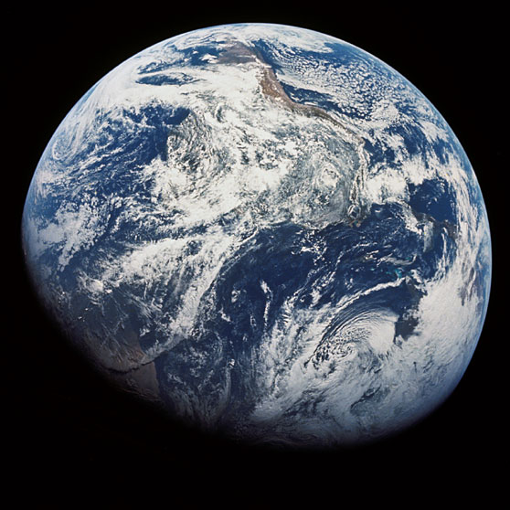
Water
The first image taken by humans of the whole Earth. Photographed by the crew of Apollo 8, the photo shows the Earth at a distance of about 30,000 km. Space has no respect for “North” and “South” as the southern most tip of South America is at the top of the photo.

Slide 5
Water
The only prevalent naturally occurring liquid on Earth’s surface
Ice is less dense than liquid water; it expands when it freezes
Water has a higher density than most other familiar liquids; hydrocarbons and other organic compounds that are insoluble in water and less dense than water float on its surface
Water has a high heat capacity and a high heat of vaporization
3/4 of Earth’s surface is covered with water, but nearly 98% is salty seawater, unfit for drinking and unsuitable for most industrial purposes

Slide 6
M.P. and B.P.
Substance | Formula Mass, g | Melting Point, °C | Boiling Point, °C
Water, H₂O | 18 | 0 | 100
Ammonia, NH₃ | 17 | -78 | -33
Methane, CH₄ | 16 | -183 | -161
Methanol, CH₃OH | 32 | -98 | 65
Ethanol, C₂H₅OH | 46 | -117 | 79
Sulfur dioxide, SO₂ | 64 | -73 | -10
Carbon dioxide, CO₂ | 44 | -57 @5.2 atm | -79 sublimes
Source: CRC Handbook of Chemistry and Physics

Slide 7
B.P. for Water at Altitude
Altitude, ft | Boiling point of water, °C
0' (0m) | 100.0°C
500' (152.4m) | 99.5°C
1,000' (304.8m) | 99.0°C
2,000' (609.6m) | 98.0°C
5,000' (1524m) | 95.0°C
6,000' (1828.8m) | 94.0°C
8,000' (2438.4m) | 91.9°C
10,000' (3048m) | 89.8°C
12,000' (3657.6m) | 87.6°C
14,000' (4267.2m) | 85.5°C
Source: NOAA

Slide 8
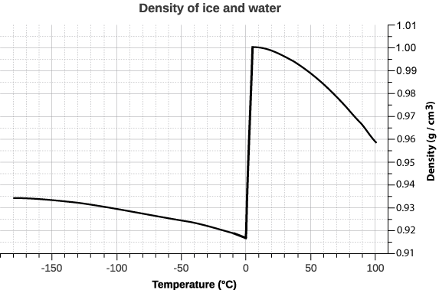
Density of Water
Maximum density (1.00 g/cm³) @ 3.98°C
Lower density on freezing

Slide 9
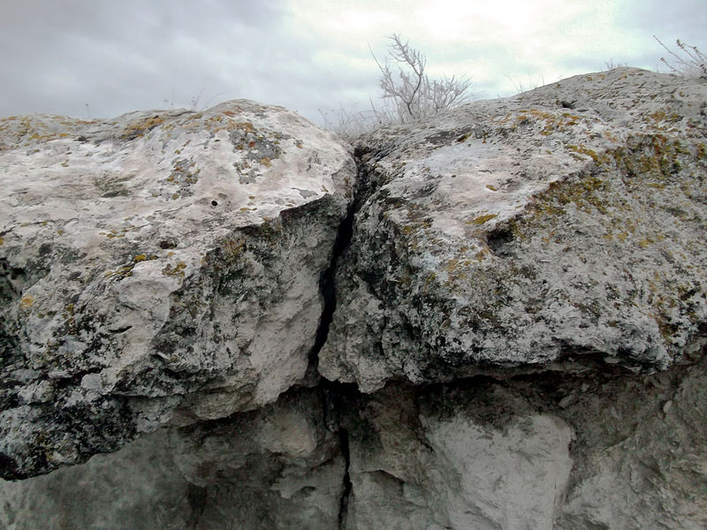
Rock Weathering
The expansion of freezing water exerts sufficient force to fracture rock, and is a significant cause of rock weathering.

Slide 10
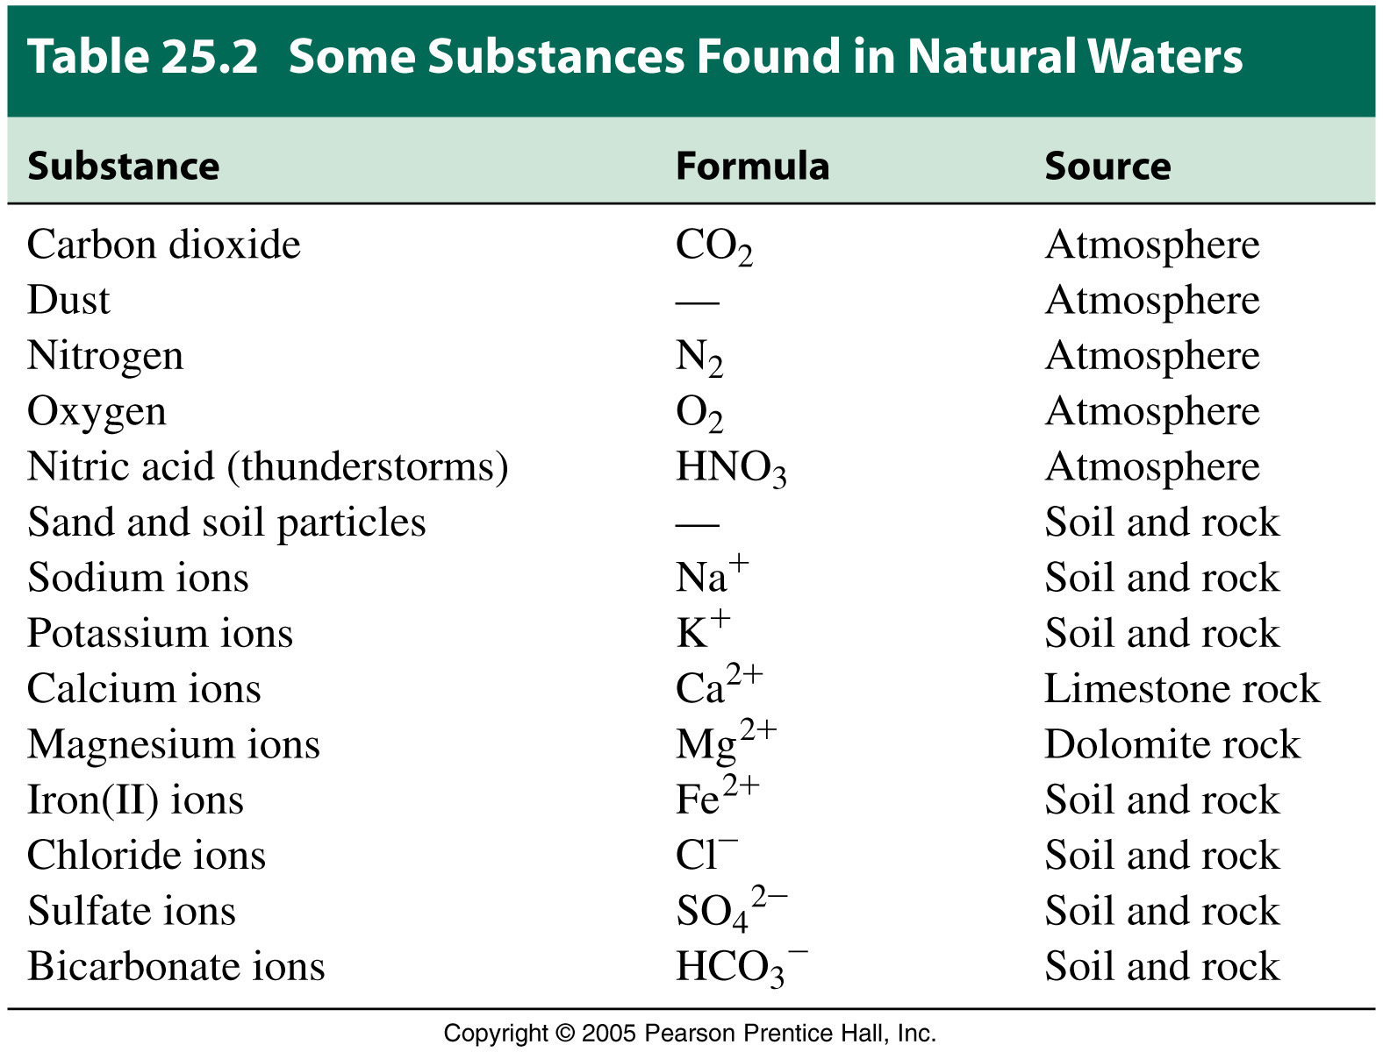

Slide 11
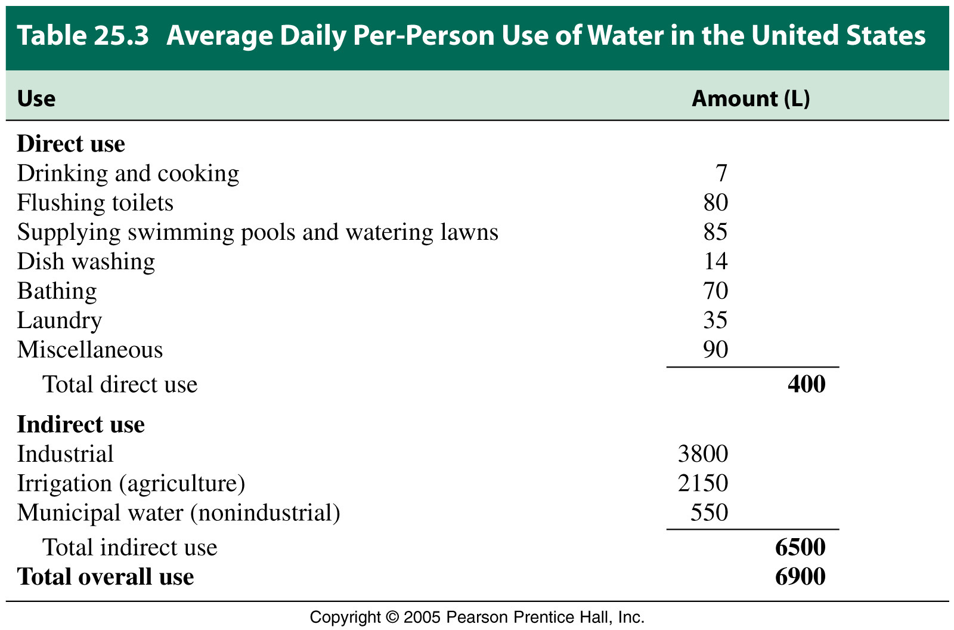

Slide 12
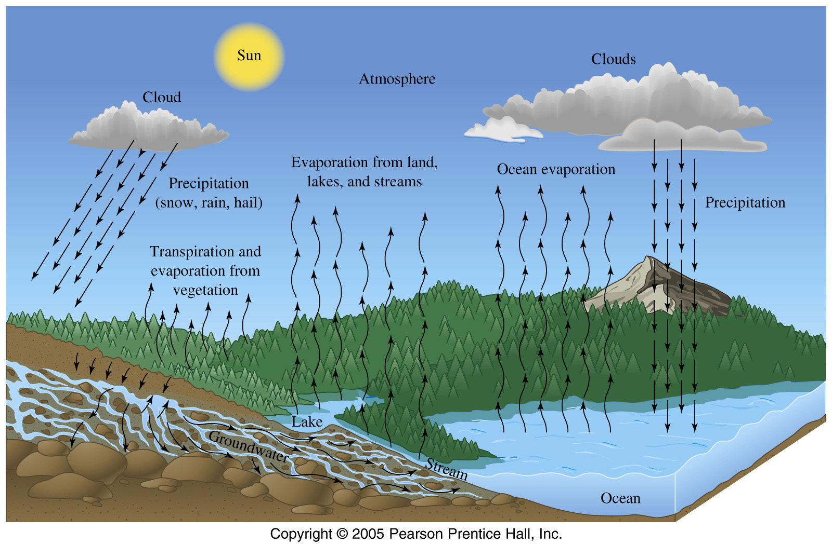
The Water Cycle

Slide 13
Water Treatment

Slide 14
Water Treatment
Most organic material can be degraded (broken down) by microorganisms.
  Aerobic oxidation occurs in the presence of dissolved oxygen.
  Anaerobic decay is the process by which bacteria reduce rather than oxidize organic matter; many of these reactions produce foul-smelling products.
The biochemical oxygen demand (BOD) measures the quantity of oxygen (mg) needed for the oxidation of the organic compounds in one liter of water.
When algae in water die, they become organic waste and increase BOD through a process called eutrophication.

Slide 15
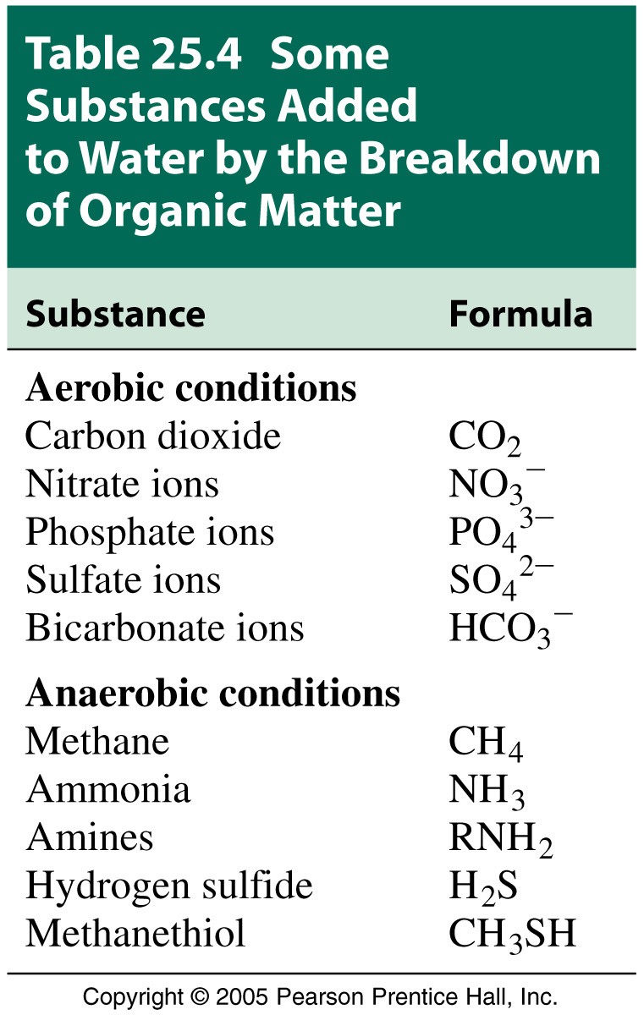

Slide 16
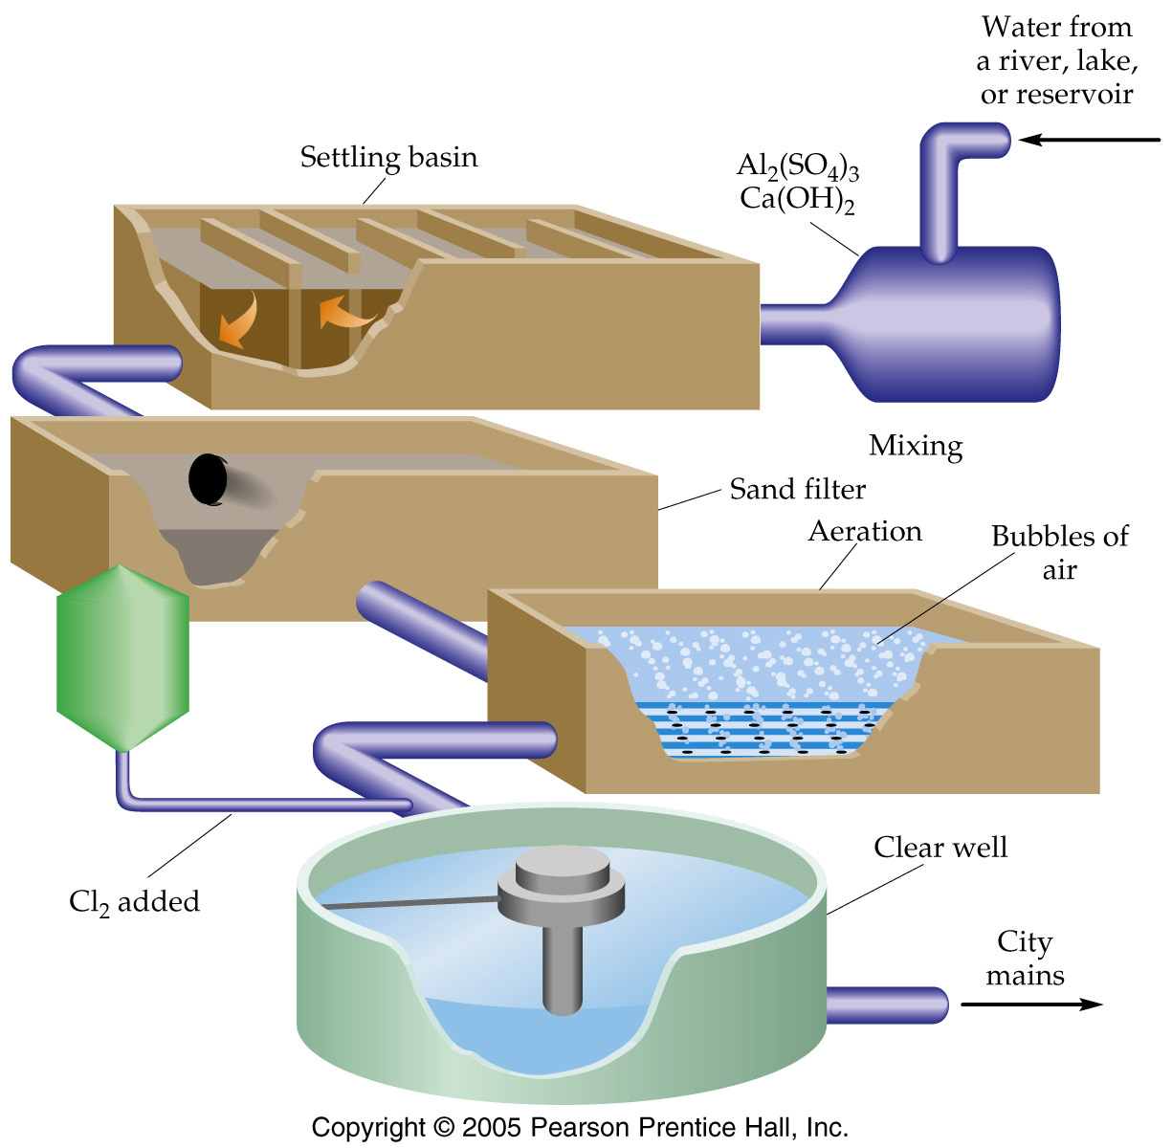
Water Treatment
Removes particulate matter
Removes odours, Improves taste
Kills any remaining bacteria

Slide 17
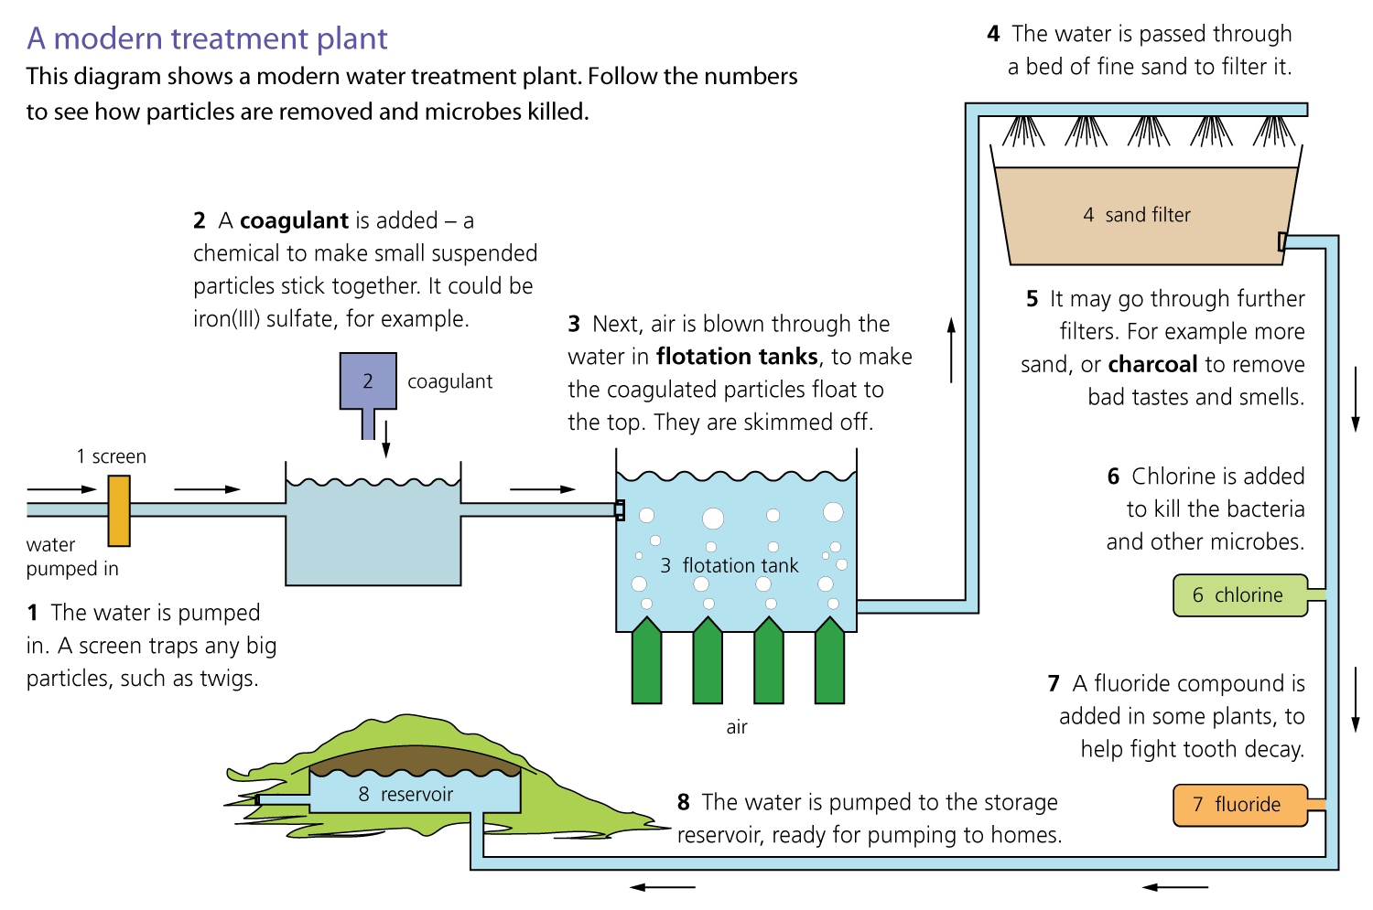
Water Treatment

Slide 18
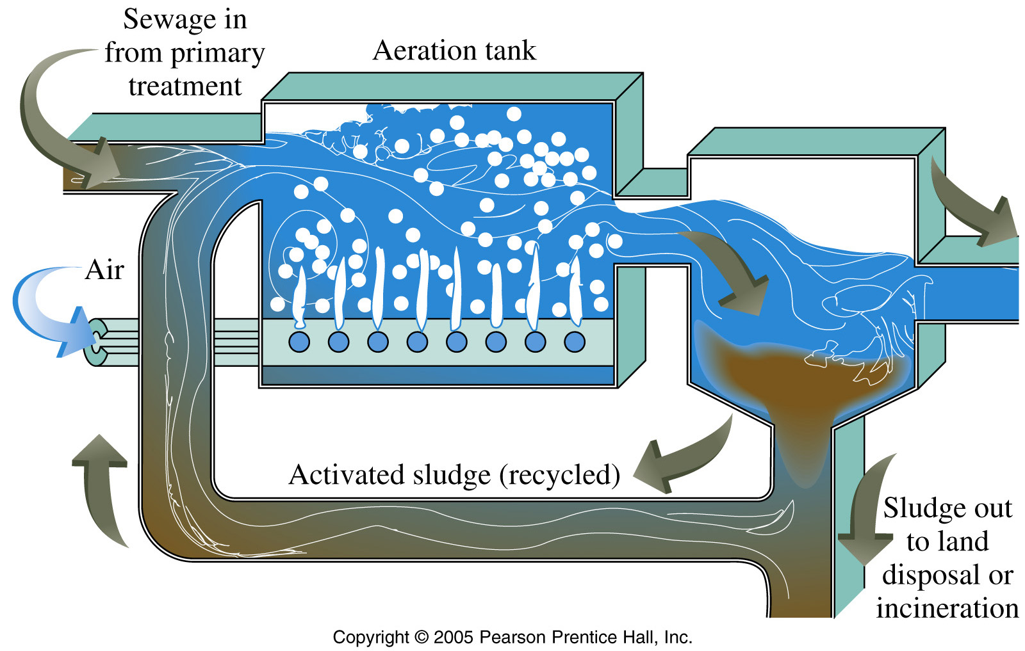
Water Treatment - Activated Sludge Method

Slide 19
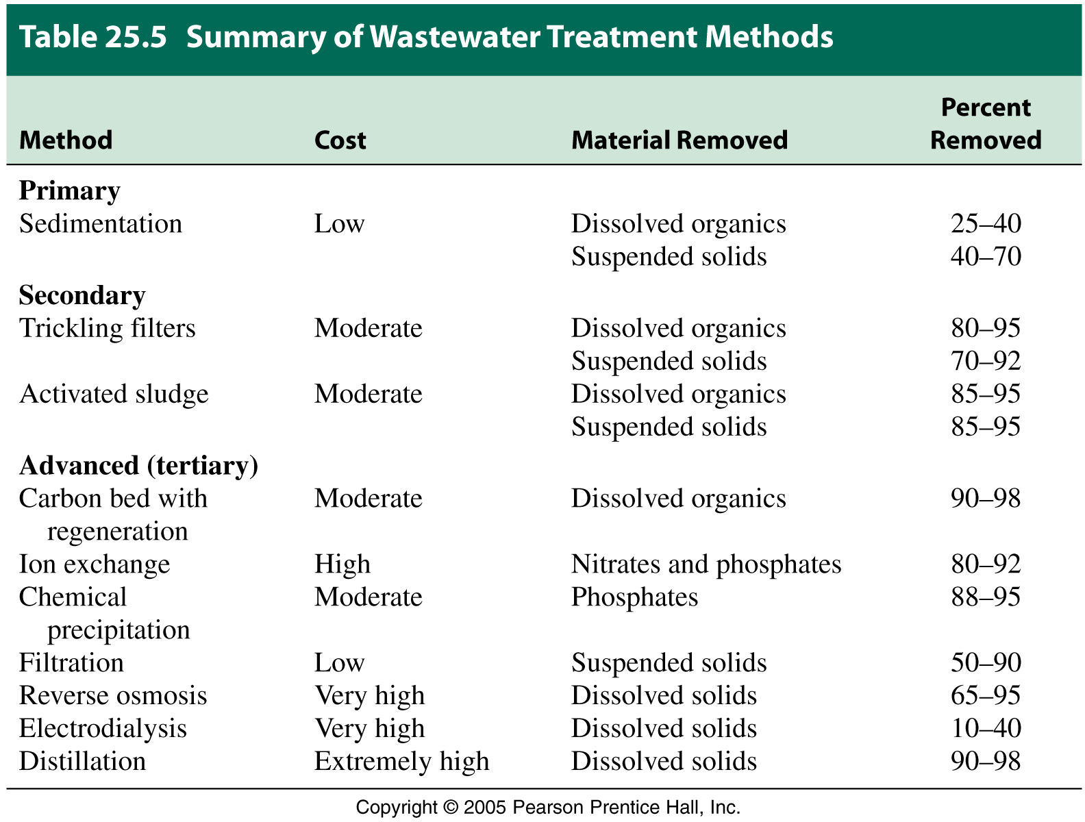

Slide 20
The Atmosphere

Slide 21
Air
11.2 Air
State the composition of clean, dry air as being approximately 78% nitrogen, 21% oxygen and the remainder as being a mixture of noble gases and carbon dioxide
Describe the separation of oxygen and nitrogen from liquid air by fractional distillation

Slide 22
The Atmosphere Today
Gas | Formula | %
Nitrogen | N₂ | 78%
Oxygen | O₂ | 21%
Argon | Ar | 0.9%
Carbon dioxide | CO₂ | 0.037%
Others |  | traces
© www.chemsheets.co.uk GCSE 1045 18-Feb-16

Slide 23
The Atmosphere Today
O₂ essential for
  respiration
  metabolism
N₂ dilutes O₂ lessening oxidation
CO₂ and H₂O are minor components in air, but they are the primary raw materials of the plant kingdom.
O₃ (ozone), is only present in trace quantities, but it plays vital roles in shielding Earth’s surface from U.V.

Slide 24
Water Vapour in the Atmosphere
Humidity is a general term describing the water vapor content of air.
Relative humidity of air is a measure of water vapor content as a percentage of the maximum possible.
partial pressure of water vapor
Relative humidity = –––––––––––––––––––––––––– = x 100
vapor pressure of water
The highest temperature at which water vapor can condense from an air sample is known as the dew point.
The condensation of water vapor on a solid followed by solution formation is called deliquescence.

Slide 25
Water Vapour in the Atmosphere
Example
The partial pressure of water vapor in a certain air sample at 20.0 °C is 12.8 mmHg. What is the relative humidity of this air?

Slide 26
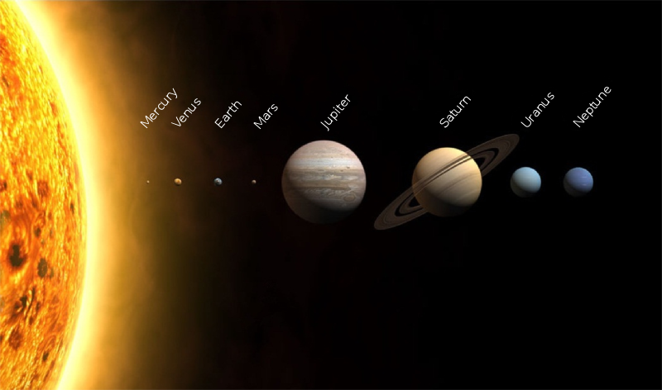
The Earth may have had an atmosphere like Venus and Mars when it was young
Image from Wikipedia

Slide 27
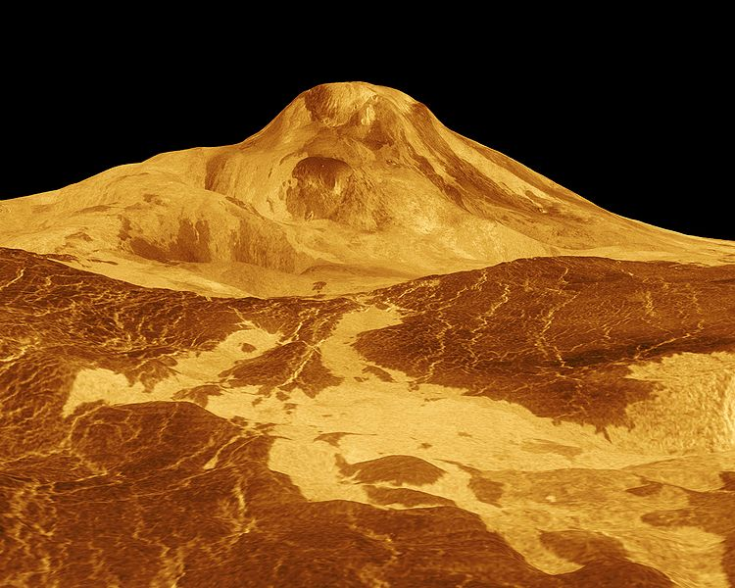
There was intense volcanic activity on the Earth when it was young
The gases in the early atmosphere may have come from inside planets through volcanoes
VENUS today
Image from Wikipedia

Slide 28

OCEANS may have formed as water vapour from volcanoes cooled and condensed as the Earth cooled down
Image from Open Image Bank:
http://www.openimagebank.com/en1/stromboli-island-volcano-in-sea-free-image-photo.php

Slide 29
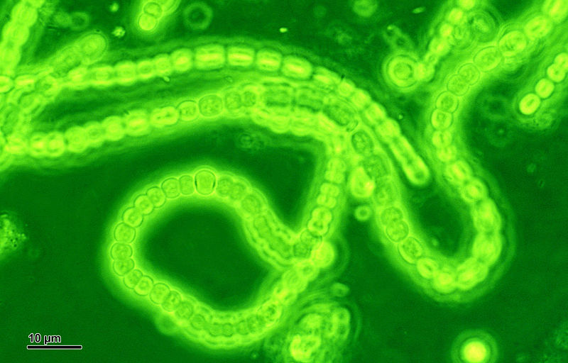
About 2.7 billion years ago - CYANOBACTERIA evolved
- first creature to photosynthesise
carbon dioxide + water ➔ oxygen + glucose
6CO₂ + 6H₂O ➔ 6O₂ + C₆H₁₂O₆
Image from Wikipedia

Slide 31
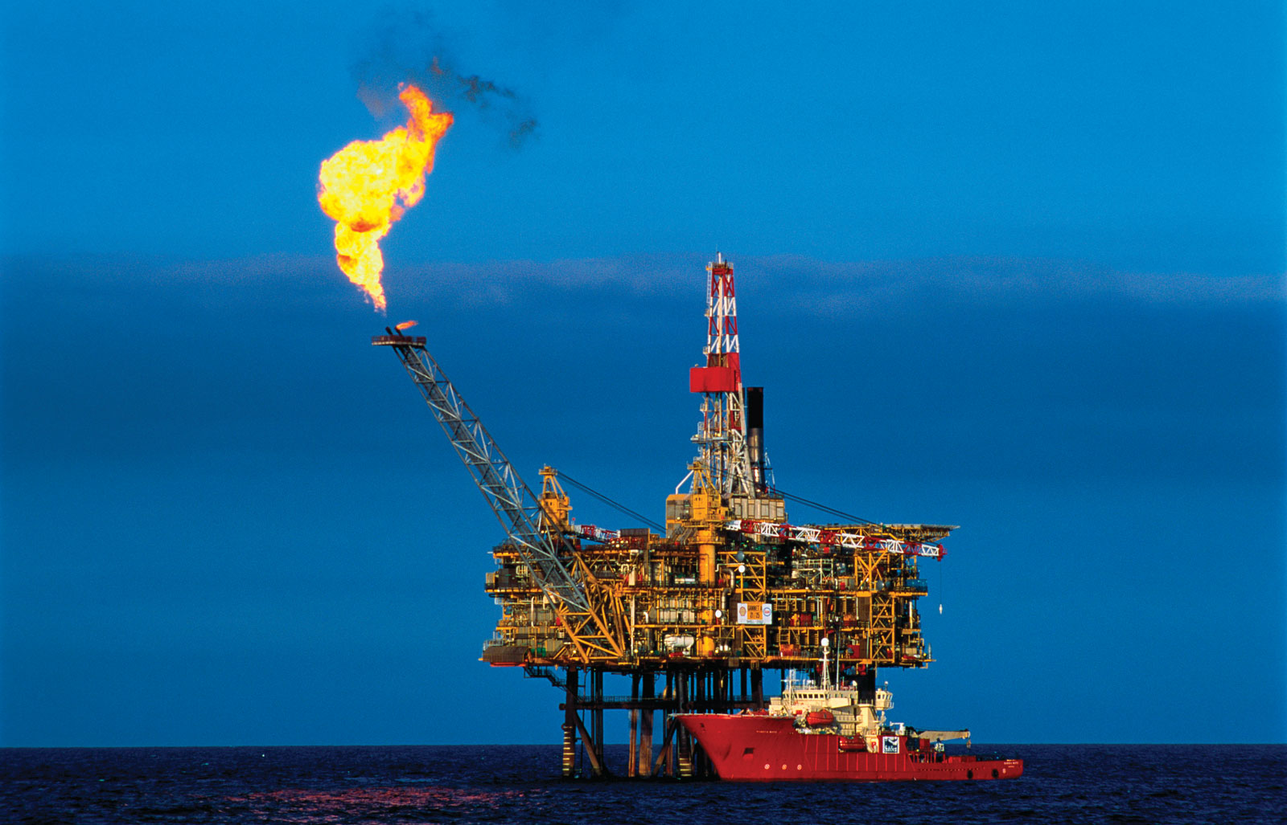
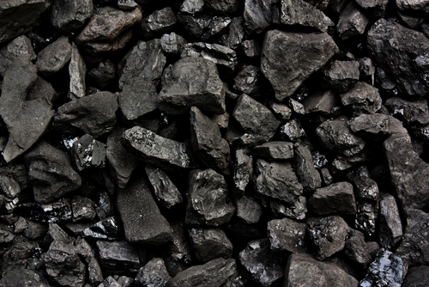
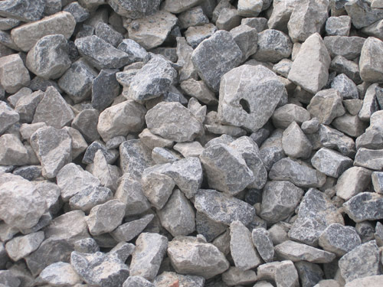
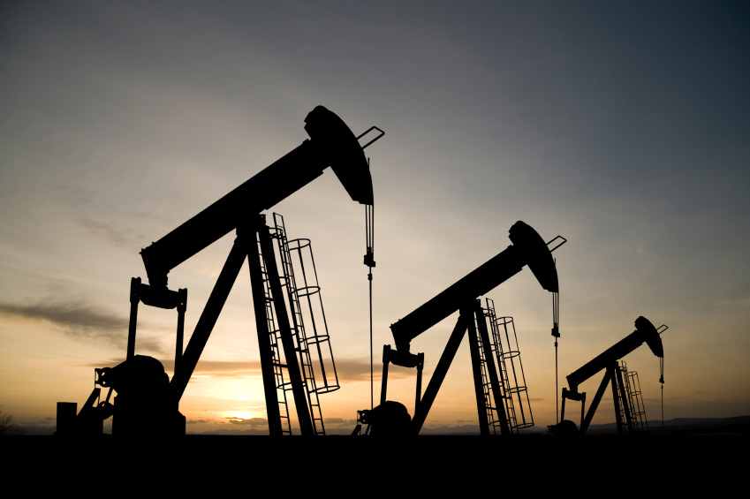
NATURAL GAS
COAL
Much of the C from the original CO₂ is now locked up in
OIL
SEDIMENTARY ROCK

Slide 32
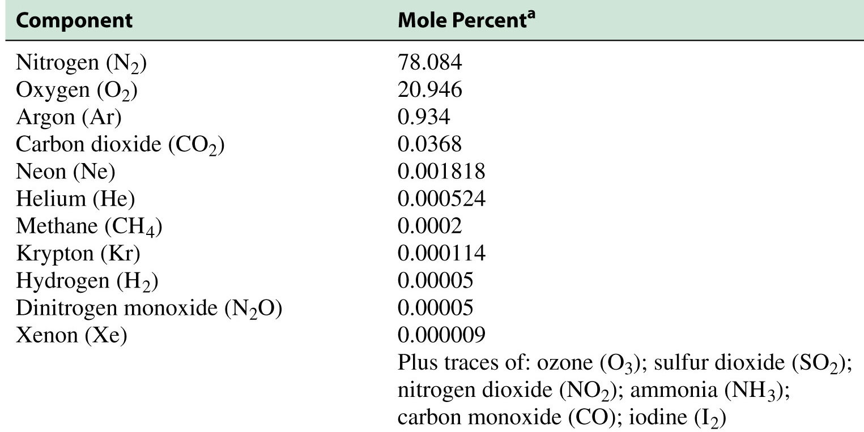
Composition of Dry Air

Slide 33
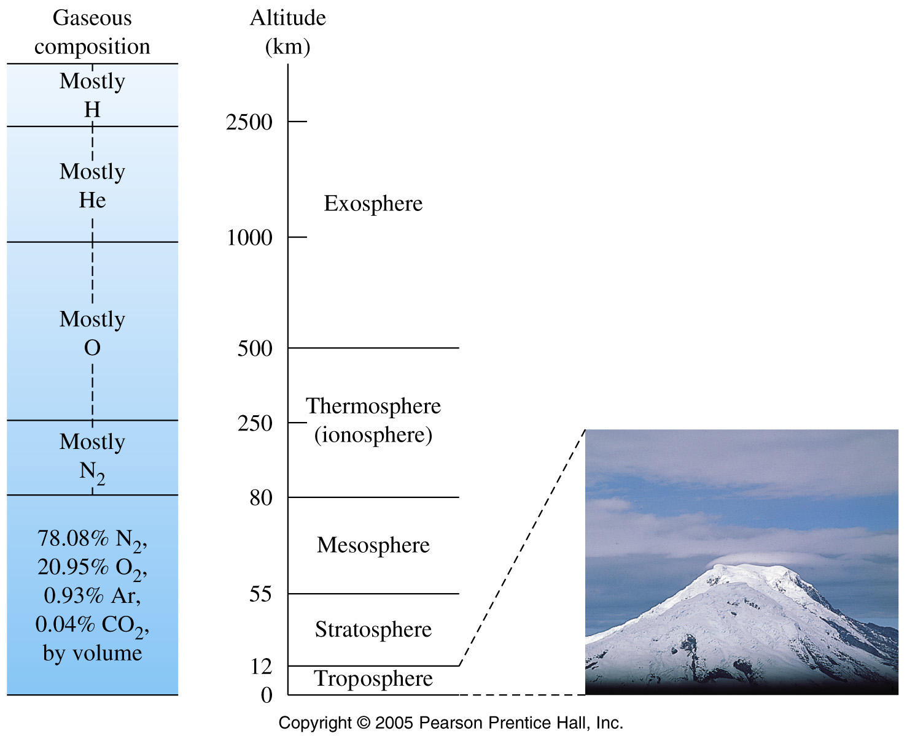
Layers of the Atmosphere

Slide 34
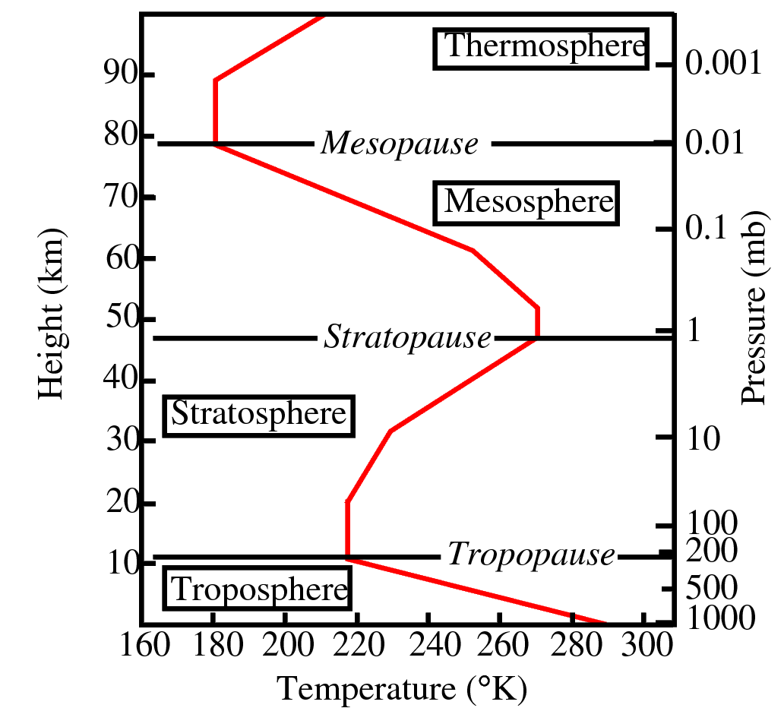
Temperature and Pressure in the atmosphere

Slide 35
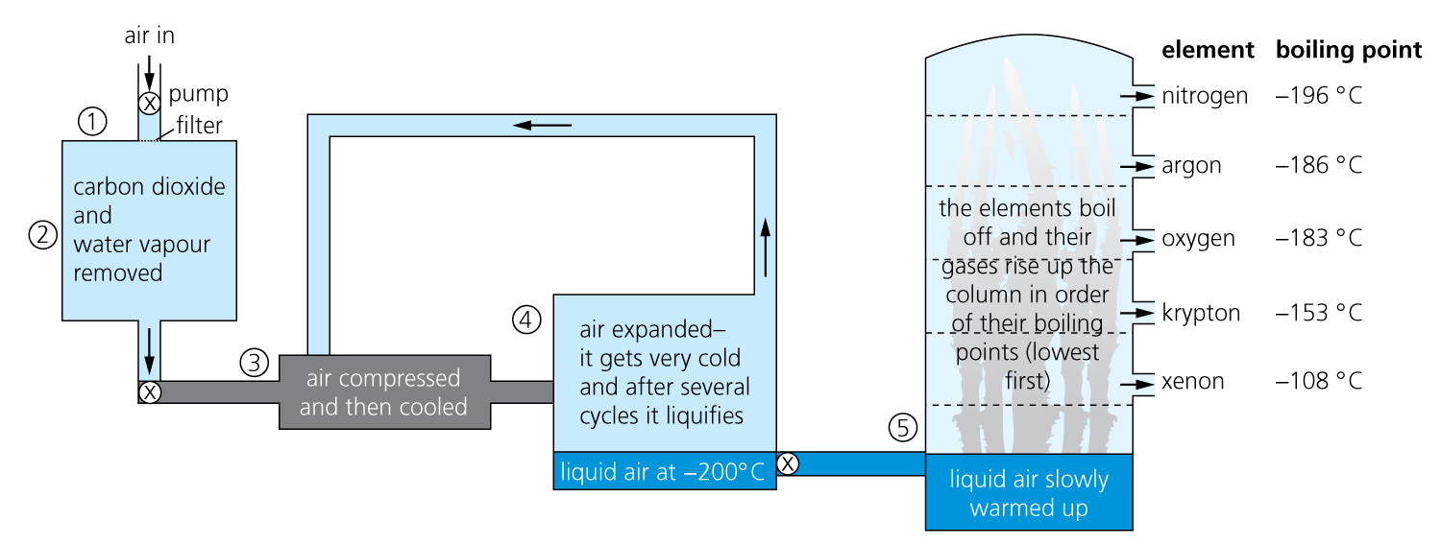
Fractional Distillation of Air

Slide 36
Atmosphere
9.5 Noble Gases
Describe the noble gases, in Group VIII or 0, as being unreactive, monoatomic gases and explain this in terms of electronic structure
State the uses of the noble gases in providing an inert atmosphere, i.e. argon in lamps, helium for filling balloons

Slide 37
CO₂ & CH₄

Slide 38
The Atmosphere
11.4 Carbon Dioxide and Methane
State the formation of carbon dioxide:
  as a product of complete combustion of carbon-containing substances
  as a product of respiration
  as a product of the reaction between an acid and a carbonate
  from the thermal decomposition of a carbonate.
Describe the carbon cycle, in simple terms, to include the processes of combustion, respiration and photosynthesis
State the sources of methane, including decomposition of vegetation and waste gases from digestion in animals

Slide 39
Decomposition of Group II Carbonates
Write a summary for the trend in the decomposition of the group II carbonates, include the observations made during the experiment including those seen inside the test-tube on heating and those of the gases given off and passed through limewater.
Carbonates at the top of group 2 thermally decompose faster than those at the bottom of the group. The evidence for this is in the time it takes for the gases which are relased to turn lime water cloudy and then clear. Further evidence for the release of carbon dioxide is in the agitation of the powder which flurries upwards on heating.
Video - thermal decomposition of group 2 carbonates

Slide 40
Carbon Cycle

Slide 41
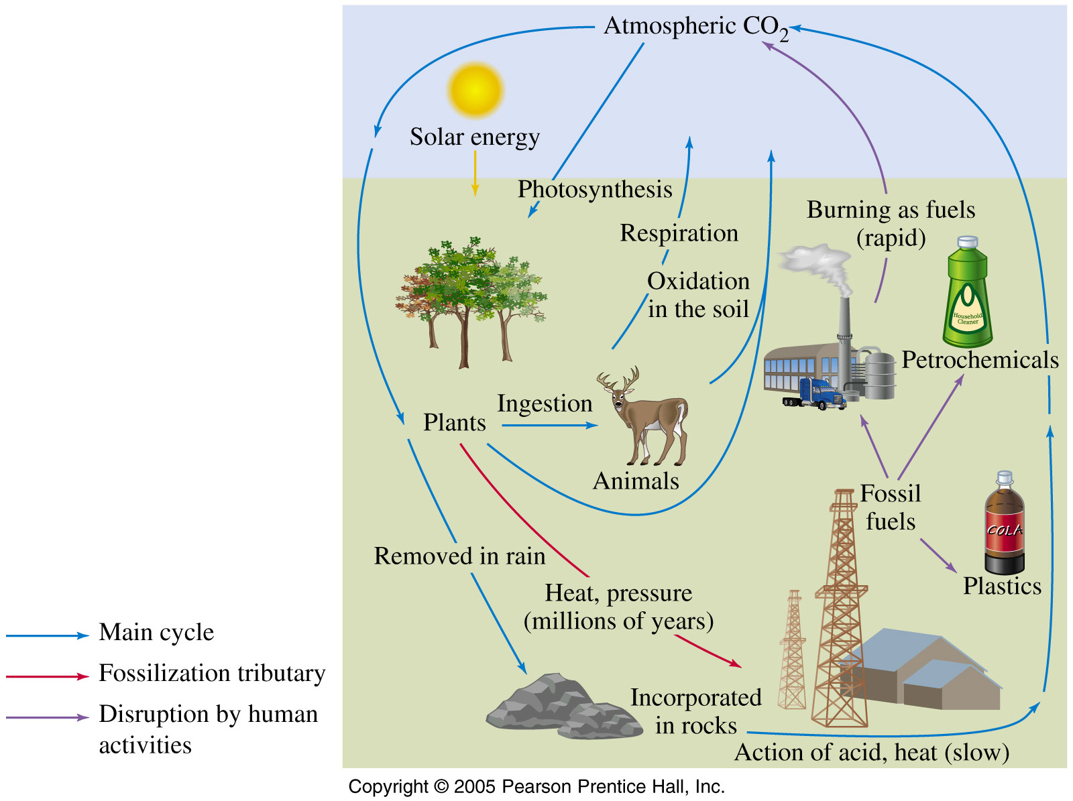
The Carbon Cycle

Slide 42
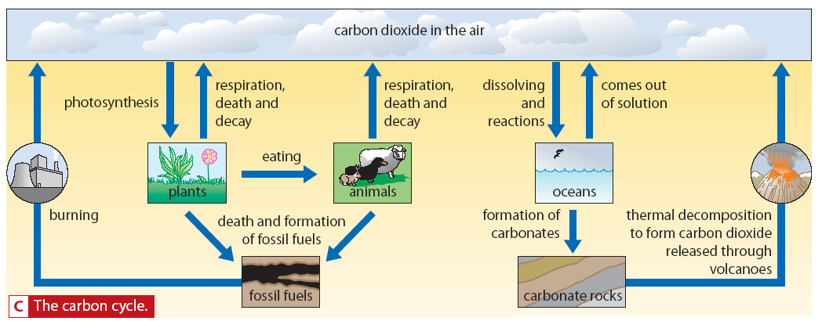
Carbon Cycle

Slide 43
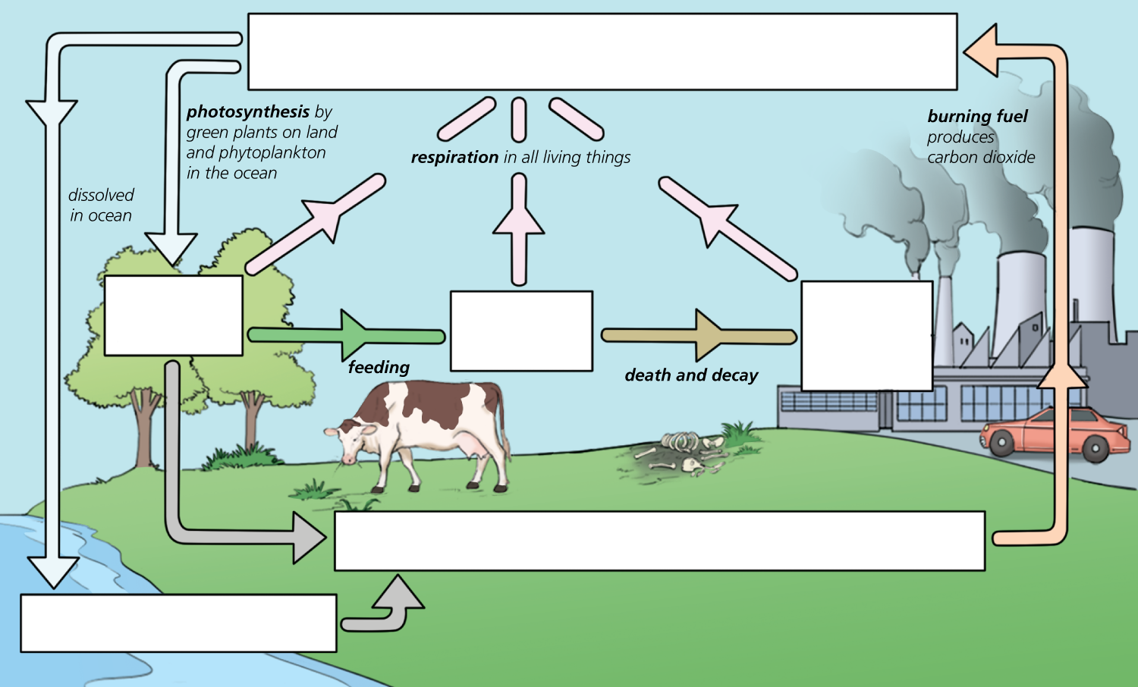
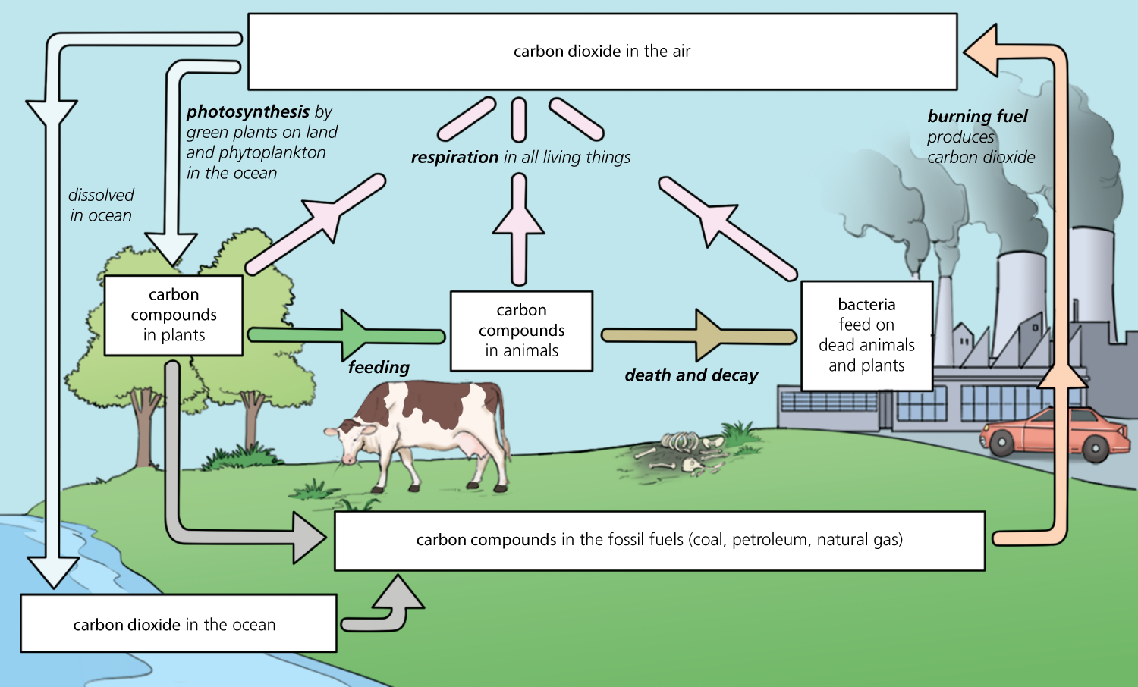

Slide 44
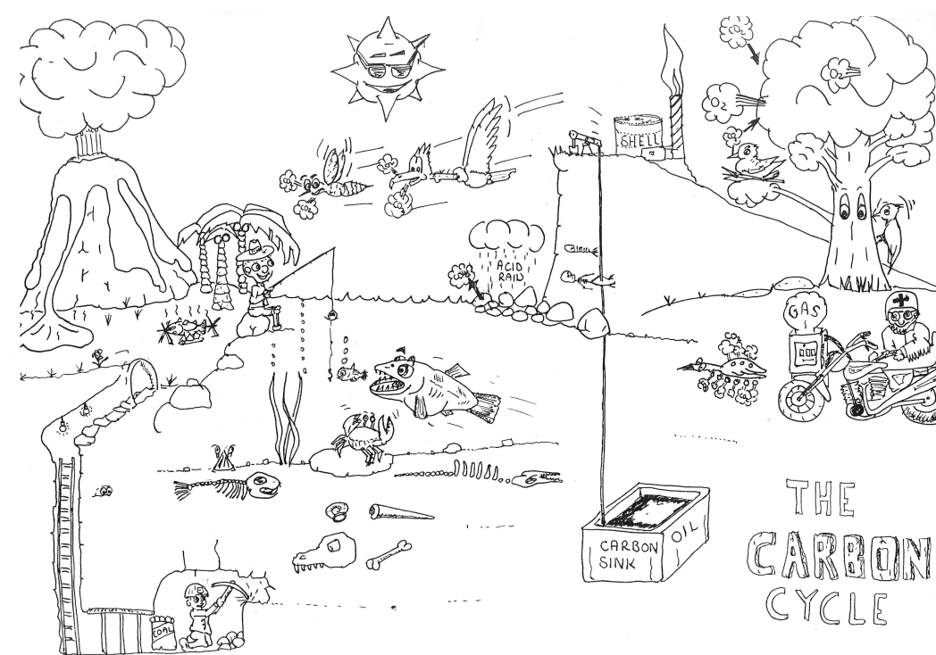
Discuss

Slide 45
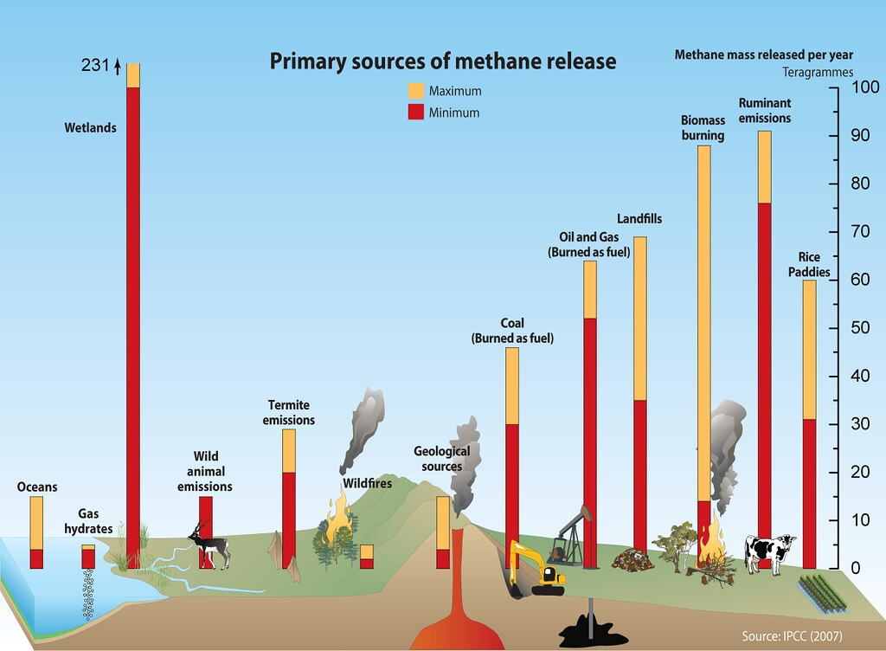

Slide 46
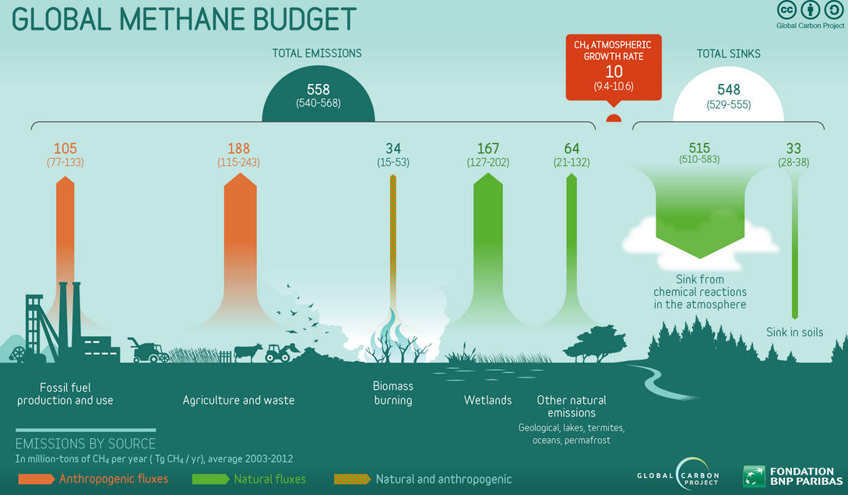

Slide 47
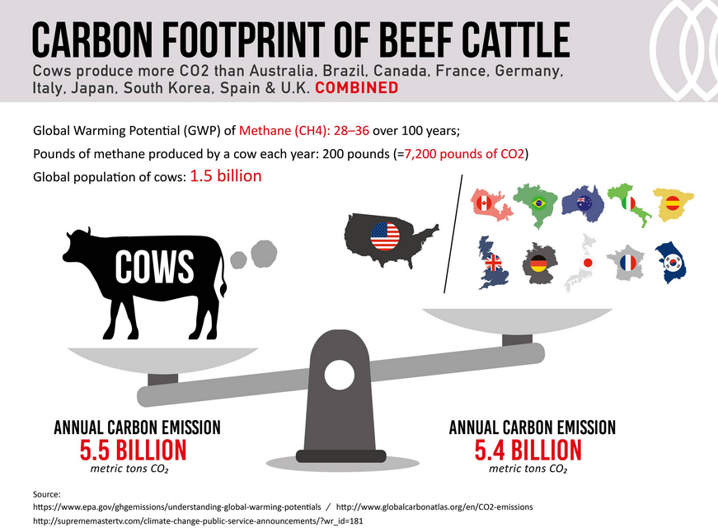

Slide 48
Nitrogen Cycle

Slide 49
The Nitrogen Cycle
Nitrogen gas cannot be used directly by plants or animals
Nitrogen fixation
  conversion of atmospheric nitrogen → nitrogen compounds
Nitrogen fixing bacteria
  atmospheric nitrogen → ammonia
  concentrated in the roots of leguminous plants
  e.g. in clover, soybeans, and peas
The decay of plant and animal life returns nitrogen to the environment as nitrates and ammonia

Slide 50
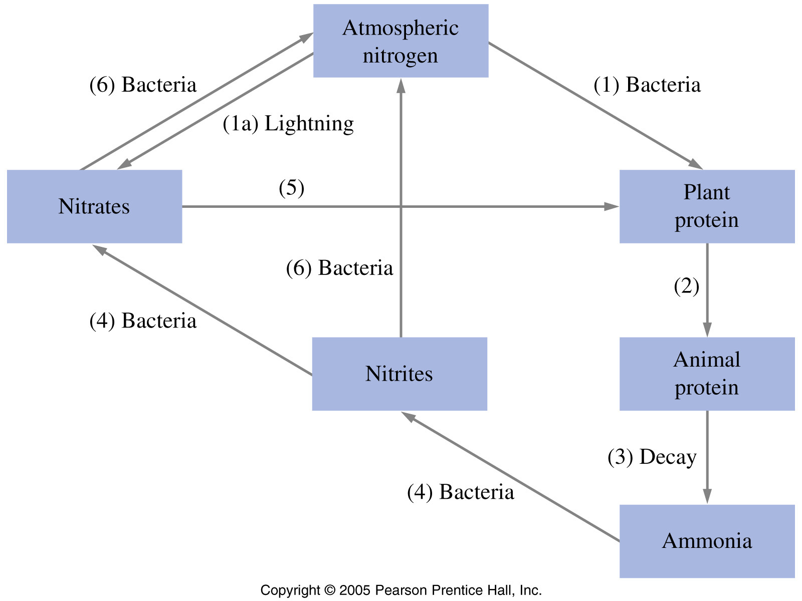
The Nitrogen Cycle

Slide 51
Pollution

Slide 52
Pollution
11.2 Air
Name the common pollutants in the air as being carbon monoxide, sulfur dioxide, oxides of nitrogen and lead compounds
State the source of each of these pollutants:
  carbon monoxide from the incomplete combustion of carbon-containing substances
  sulfur dioxide from the combustion of fossil fuels which contain sulfur compounds (leading to ‘acid rain')
  oxides of nitrogen from car engines
  lead compounds from leaded petrol.
Describe and explain the presence of oxides of nitrogen in car exhausts and their catalytic removal
State the adverse effect of these common pollutants on buildings and on health and discuss why these pollutants are of global concern
State that carbon dioxide and methane are greenhouse gases and may contribute to climate change

Slide 53
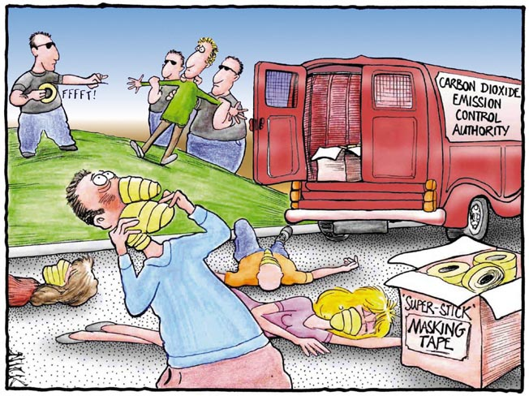
Earth’s Atmosphere
Comic courtesy of Lab-initio.com

Slide 54
Combustion Products

Slide 55
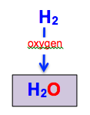
Combustion
When compounds react with oxygen each element in the compound bonds to oxygen
hydrogen + oxygen → water

Slide 56
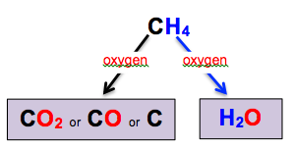
Combustion
methane + oxygen → carbon dioxide + water
methane + oxygen → carbon monoxide + water
methane + oxygen → carbon + water

Slide 57
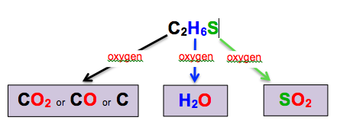
Combustion
ethanethiol + oxygen → carbon dioxide + water + sulfur dioxide
ethanethiol + oxygen → carbon monoxide + water + sulfur dioxide
ethanethiol + oxygen → carbon + water + sulfur dioxide

Slide 58
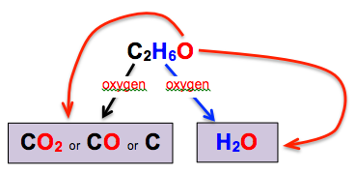
Combustion
ethanol + oxygen → carbon dioxide + water
ethanol + oxygen → carbon monoxide + water
ethanol + oxygen → carbon + water

Slide 59
Write a word equation to show what is formed when the following substances are burned.
Sodium (Na)
Magnesium (Mg)
Sulfur (S)
Hydrogen (H₂)
Carbon (C)
Methane (CH₄)
Hydrogen sulfide (H₂S)
Butane (C₄H₁₀)
Methanol (CH₃OH)
Carbon disulfide (CS₂)

Slide 60
Write a word equation to show what is formed when the following substances are burned.
Sodium + oxygen → sodium oxide
Magnesium + oxygen → magnesium oxide
Sulfur + oxygen → sulfur dioxide
Hydrogen + oxygen → water
Carbon + oxygen → carbon dioxide
Methane + oxygen → carbon dioxide + water
Hydrogen sulfide + oxygen → water + sulfur dioxide
Butane + oxygen → carbon dioxide + water
Methanol + oxygen → carbon dioxide + water
Carbon disulfide + oxygen → carbon dioxide
+ sulfur dioxide

Slide 61
Sources of Primary Air Pollutants

Slide 62
Natural

Slide 63
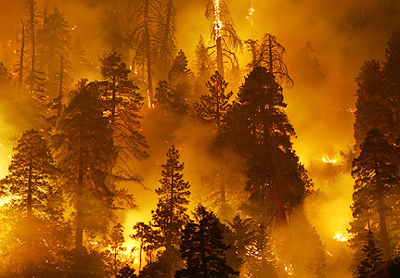
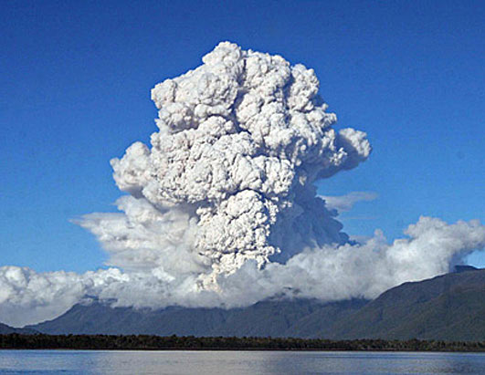
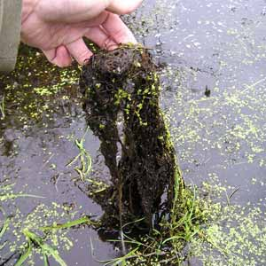
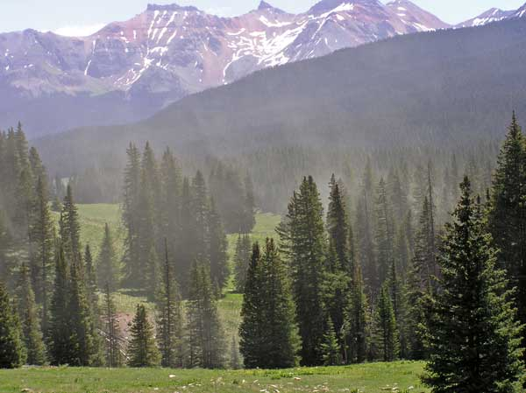
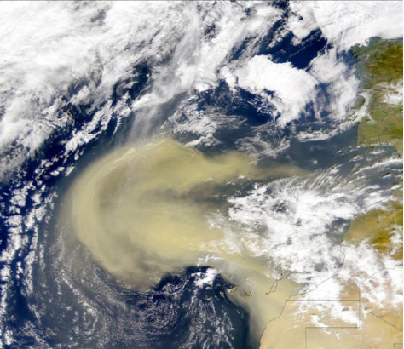
Forest Fires
Volcanoes
Decaying Plants
Wind Storms
Pollen Clouds

Slide 64
Anthropogenic
(man-made)
Sources

Slide 65
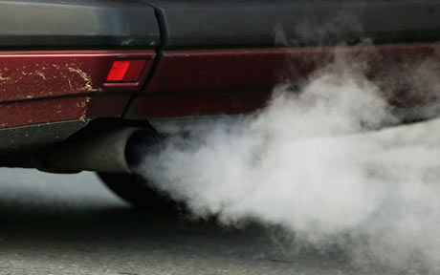
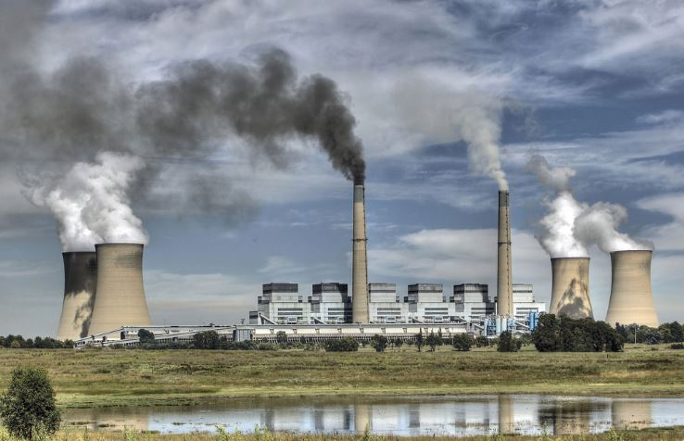
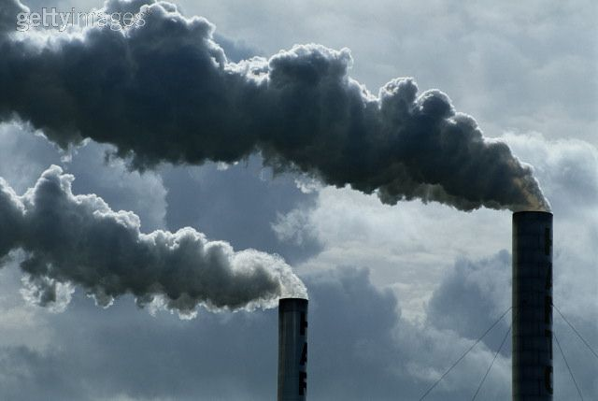
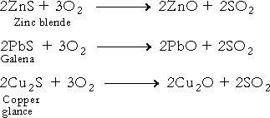
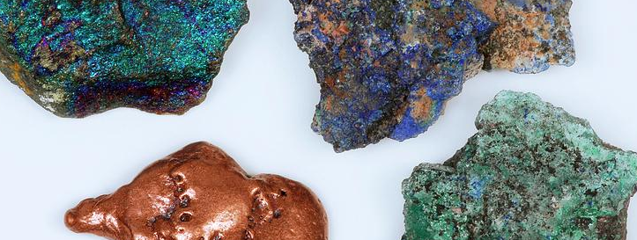
Internal Combustion Engines
Coal Burning Power Stations
Factory Chimneys
Roasting Ores

Slide 66
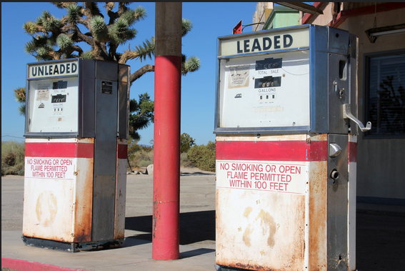
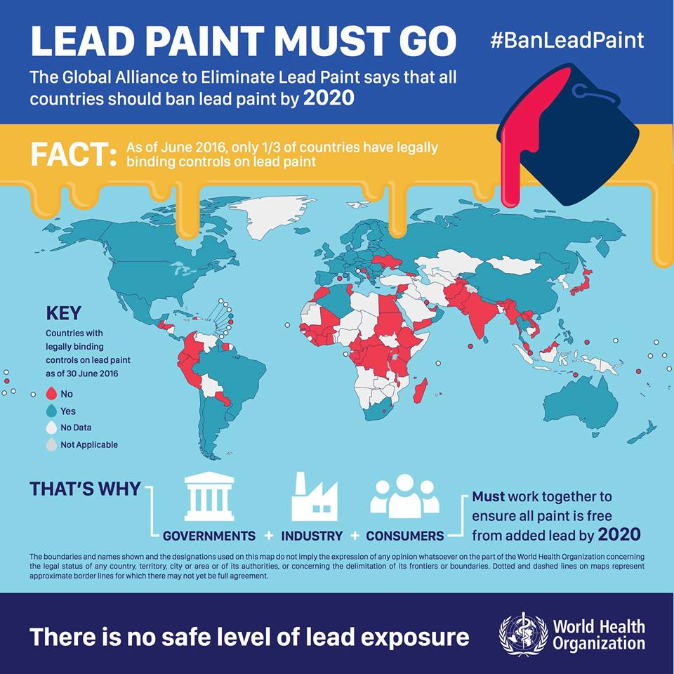
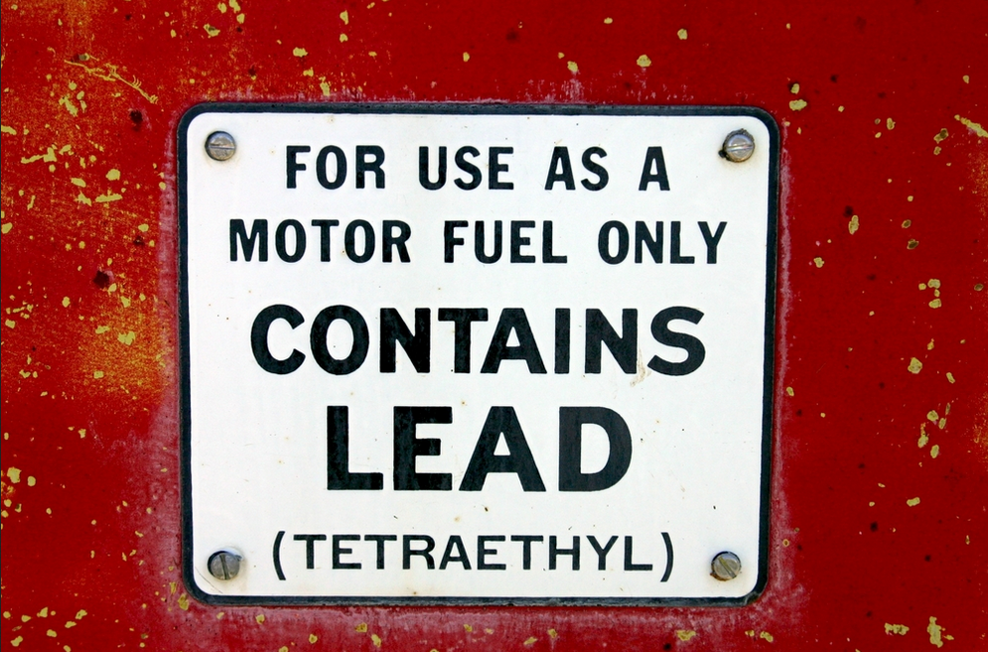
Leaded Fuel and Paint

Slide 67
Substance formed | How it is formed | Potential problems | Ways to reduce the problem
Carbon dioxide CO₂ | Complete combustion (reaction with oxygen) of C in fuel | Greenhouse gas causing global warming | Burn less fossil fuels
Carbon monoxide CO | Incomplete combustion (reaction with oxygen) of C in fuel | Toxic | Ensure there is a good supply of air/oxygen when burned
Carbon C | Incomplete combustion (reaction with oxygen) of C in fuel | Blackens buildings Global dimming | Ensure there is a good supply of air/oxygen when burned
Sulfur dioxide SO₂ | Combustion of S (reaction with oxygen) in fuel | Acid rain | Remove S from fuel before burning; or remove SO₂ from fumes after burning (flue gas desulfurization)
Nitrogen oxides NO & NO₂ | Reaction of N₂ in air with O₂ in air at very high temperatures (often in engines or furnaces) | Acid rain | For engines use a catalytic converter
Unburned fuel | Not all fuel burns | Harmful and a greenhouse gas | Ensure correct fuel:air mixture when fuel is burned

Slide 68
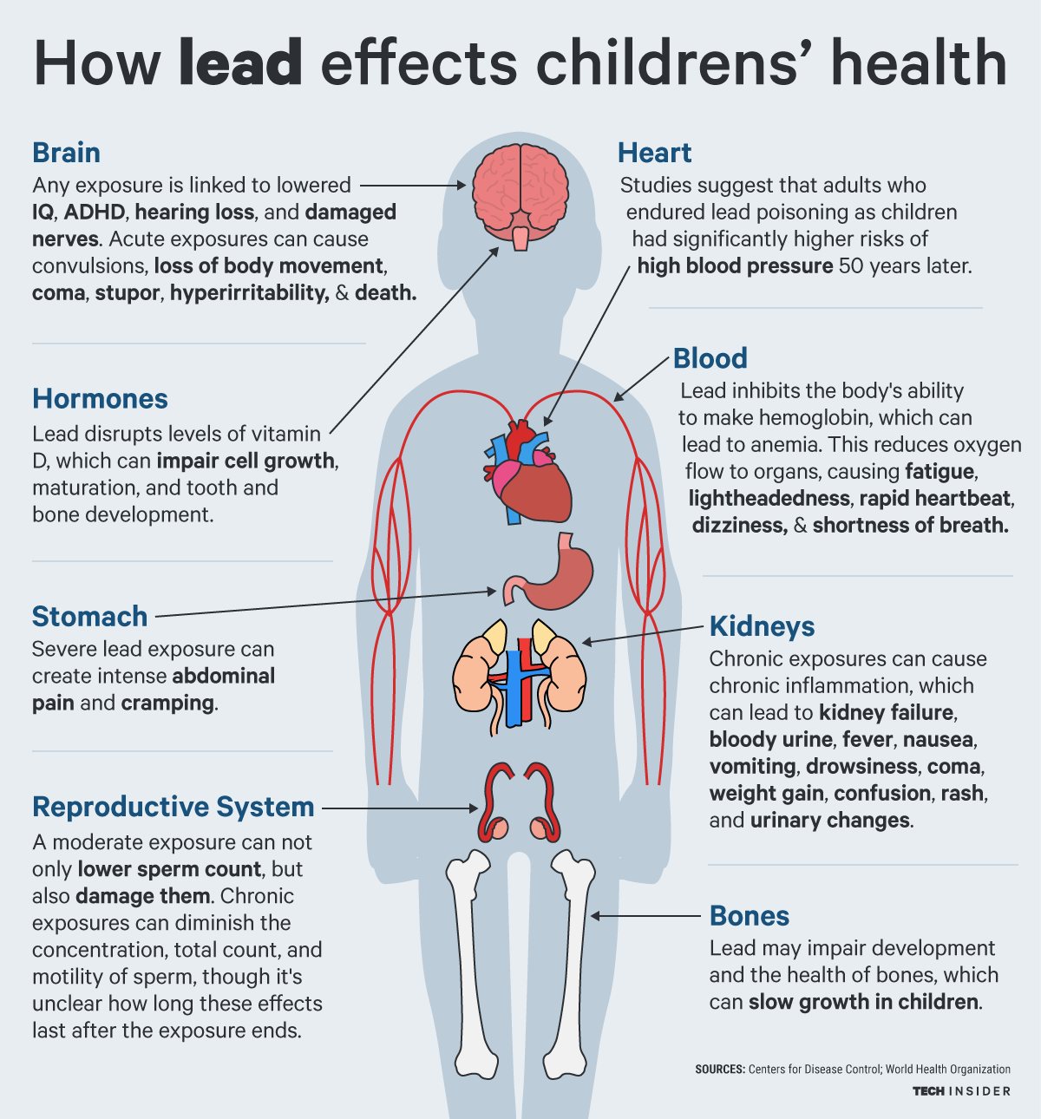

Slide 69


Slide 70
Activity
Primary Air Pollutant | Natural Sources | Man-Made Sources | Equations | Potential Problems | Solution
carbon dioxide | volcanoes, respiration | combustion of fossil fuels | CH₄ + 2O₂ → CO₂ + 2H₂O | global warming/climate change | carbon offset /capture
Only complete for man-made sources
Complete this table for homework

Slide 71

ACID RAIN
Damages plants

Slide 72

ACID RAIN
Damages plants
Branches from a tree in Germany's Black Forest show needle loss and yellowed boughs caused by acid rain

Slide 73

ACID RAIN
Kills fish

Slide 74

ACID RAIN
Damages stonework (e.g. limestone)
1908
1968

Slide 75

Much SO₂ from power stations
Much SO₂ from power stations

Slide 76

Much SO₂ from power stations
Remove SO₂ by flue gas desulfurisation
(reacts with CaO or CaCO₃)

Slide 77


Much SO₂ from power stations
Catalytic converters in cars remove NO_{x}

Slide 78

CO₂ is a greenhouse gas

Slide 79
Size of greenhouse effects
+ 477
T/ºC
+15
-18
-47
-46
-57
Mars
Earth
Venus

Slide 80
Mars has a small greenhouse effect as the carbon dioxide atmosphere is very thin.
Venus has a massive greenhouse effect (the surface temperature could melt lead) as there is a thick carbon dioxide atmosphere.
Earth has an atmosphere mostly composed of non-polar nitrogen and oxygen molecules that do not absorb ir radiation. The low concentrations of water vapour and carbon dioxide cause a small natural greenhouse effect 15ºC. A significant increase in greenhouse gases might be expected to have an appreciable affect on climate – global warming.

Slide 81
Carbon emissions

Slide 82


Slide 83

Global warming - the Earth is getting warmer
From NASA

Slide 84

Ice core data

Slide 85


Slide 86

Sea levels are rising
From thesilentearth.com

Slide 87
Interactive Flood Maps

Slide 88
Climate Change
Climate change refers to any significant change in the measures of climate lasting for an extended period of time. In other words, climate change includes major changes in temperature, precipitation, or wind patterns, among other effects, that occur over several decades or longer.
Global warming refers to the recent and ongoing rise in global average temperature near Earth's surface. It is caused mostly by increasing concentrations of greenhouse gases in the atmosphere. Global warming is causing climate patterns to change. However, global warming itself represents only one aspect of climate change.
Source: U.S. EPA

Slide 89

Greenhouse Gases
Gases that trap heat in the atmosphere are called greenhouse gases. Each gas's effect on climate change depends on three main factors:
U.S. Greenhouse Gas Emissions in 2012
Total Emissions in 2012 = 6,526 Million Metric Tons of CO₂ equivalent
How much of these gases are in the atmosphere?
How long do they stay in the atmosphere?
How strongly do they impact global temperatures? This is referred to as “Global Warming Potential, or GWP
Source: U.S. EPA

Slide 90

Carbon Dioxide
Carbon dioxide, CO₂, enters the atmosphere through burning fossil fuels (coal, natural gas and oil), solid waste, trees and wood products, and also as a result of certain chemical reactions (e.g., manufacture of cement). Carbon dioxide is removed from the atmosphere when it is absorbed by plants as part of the biological carbon cycle.
U.S. CO₂ Emission Sources
100-year GWP = 1
Source: U.S. EPA

Slide 91

Methane
U.S. Methane Emission Sources
Methane, CH₄, is emitted during the production and transport of coal, natural gas, and oil. Methane emissions also result from livestock and other agricultural practices and by the decay of organic waste in municipal solid waste landfills.
100-year GWP = 21
Source: U.S. EPA

Slide 92




Methane levels rising largely due to agriculture

Slide 93

Nitrous Oxide
U.S. N₂O Emission Sources
Nitrous oxide, N₂O, is emitted during agricultural and industrial activities, as well as during combustion of fossil fuels and solid waste.
100-year GWP = 31 0
Source: U.S. EPA

Slide 94

Fluorinated Gases
U.S. Fluorinated Gas Emission Sources
Hydrofluorocarbons, perfluorocarbons, and sulfur hexafluoride are synthetic, powerful greenhouse gases that are emitted from a variety of industrial processes. These gases are typically emitted in smaller quantities, but they are potent greenhouse gases.
100-year GWP HFCs: 140-11,700
PFCs: 6,500-9,200
SF₆: 23,900
Source: U.S. EPA

Slide 95

Changes in Atmospheric Levels of Greenhouse Gases
Source: U.S. EPA

Slide 96

Ocean
Acidity
Ocean carbon dioxide levels have risen in response to increased carbon dioxide in the atmosphere, leading to an increase in acidity (that is, a decrease in pH).
Source: U.S. EPA

Slide 97






CARBON MONOXIDE
Service gas fires & boilers
Get a detector

Slide 98


The effect of SOOT on buildings
1970
2010
(after clean up)

Slide 99
Ozone Layer
Ozone, O₃, is a colorless gas. Chemically, ozone is very active; it reacts readily with a great many other substances. Near the Earth’s surface, those reactions cause rubber to crack, hurt plant life, and damage people’s lung tissues. But ozone also absorbs harmful components of sunlight, known as “ultraviolet B”, or “UV-B”. High above the surface, above even the weather systems, a tenuous layer of ozone gas absorbs UV-B, protecting living things below.
Source: NASA Ozone Watch

Slide 100

The Ozone Cycle

Slide 101

Ozone Destruction
Small, mostly man-made organic molecules containing chlorine and/or bromine enter the atmosphere, and find their way to the stratosphere due to low reactivity.
CFCl₃, Freon-11
Once in the stratosphere:
CFCl₃ + radiation → CFCl₂ + Cl
The chlorine atom changes an ozone molecule to ordinary oxygen:
Cl + O₃ → ClO + O₂
The ClO from the previous reaction destroys a second ozone molecule and restores the chlorine atom, which can repeat the first reaction and continue to destroy ozone.
ClO + O₃ → Cl + 2 O₂

Slide 102

Sources of
Stratospheric
Chlorine

Slide 103


Southern Hemisphere Ozone Hole
September 24, 2006
Each year for the past few decades during the Southern Hemisphere spring, chemical reactions involving chlorine and bromine cause ozone in the southern polar region to be destroyed rapidly and severely. This depleted region is known as the “ozone hole”.
Source: NASA Ozone Watch

Slide 104
11.2 Air
State the conditions required for the rusting of iron
Describe and explain methods of rust prevention, specifically paint and other coatings to exclude oxygen
Describe and explain sacrificial protection in terms of the reactivity series of metals and galvanising as a method of rust prevention

Slide 105


Corrosion = reaction of metals with water and oxygen
Many metals corrode
Rusting = corrosion of iron or steel

Slide 106

Rust
4Fe(s) + 3O₂(g) + 4H₂O(l) → 2Fe₂O₃.2H₂O(s)
iron + oxygen+ water → hydrated iron (III) oxide (rust)

Slide 107
 | reactivity series of metals | reaction with oxygen | reaction with water | reaction with acid
Increasing reactivity | potassium, K | Burn in oxygen | Fizzes with cold water | Fizzes
 | sodium, Na
 | calcium, Ca
 | magnesium, Mg
 | aluminium, Al |  | No reaction
 | zinc, Zn
 | iron, Fe
 | nickel, Ni
 | tin, Sn
 | lead, Pb | Tarnish (metal oxide formed on surface) but do not burn
 | copper, Cu |  |  | No reaction
 | mercury, Hg
 | silver, Ag
 | gold, Au | No reaction
 | platinum, Pt
e⁻
More reactive than Fe, electrons will flow from Zn to Fe, reversing oxidation
None of these react with water alone
Less reactive than Fe, provides a protective coating on Fe
© www.chemsheets.co.uk GCSE 1122 24-Dec-2016

Slide 108








PROTECTIVE LAYER
DUSTBIN
BRIDGE
SHIP
DISHWASHER TRAYS
OIL RIG
RAILWAY LINES
BICYCLE CHAIN
CAR

Slide 109


PROTECTIVE LAYER
OIL on bike chain
PAINT on car
TIN COATING on steel can
PLASTIC on dishwasher trays

Slide 110

SACRIFICIAL PROTECTION
Zn blocks welded to ship hull

Slide 111

SACRIFICIAL PROTECTION
Bag of Mg powder connected to water tank

Slide 112

GALVANISING

Slide 113
Rust
In moist air, iron is oxidized to Fe²⁺, particularly at scratches, nicks, or dents. These areas are referred to anodic areas.
Other regions of the iron serve as cathodic areas, where the electrons from the anodic areas reduce O₂ to OH–.
Iron(II) ions migrate from the anodic areas to the cathodic areas where they combine with the hydroxide ions.
The iron(II) is then further oxidized to iron(III) by atmospheric oxygen.
Common rust is Fe₂O₃ · x H₂O.

Slide 114

Rust of an Iron Piling
One way to minimize rusting is to provide a different anode reaction.

Slide 115

Rust
  In the Figure below, iron nails are placed in a warm colloidal dispersion of agar in water. Phenolphthalein indicator and potassium ferricyanide, K₃[Fe(CN)₆], are also present in the dispersion. When the faintly yellow dispersion cools and stands for a few hours, it solidifies into a gel, and soon the colored regions begin to develop—pink along the middle part of the nail and blue at both ends. Explain what is happening.

Slide 116

A Titanic Rust Problem

Slide 117
Lateral Thinking Problems
A problem is given to which the answer is not straightforward
You need to ask questions (that can be answered yes or no) to find the solution to the problem

Slide 118
Lateral Thinking Problems
There are two shipwrecks. One in deep water and the other in shallow water. The one in deeper water is less rusty. Why?
Ask your teacher questions that can be answered yes or no to uncover the answer.

Slide 119
Lateral Thinking Ideas
The deep shipwreck was made of wood/aluminium/
better painted etc
The deep shipwreck was in fresh water and the shallow shipwreck in salt water
The deep shipwreck was carrying a cargo of zinc or magnesium metal
The shipwrecks have been there for different lengths of time
Divers visit the shallow shipwreck and add oxygen to the water
Fish excretion changes the pH of seawater
You may have thought of many others, if so well done.

Slide 120
Now let’s consider a fair test
Now let us consider what explanations could work if this was a ‘fair test’ - ie the ships are identical and the only factors about the seawater that change are those that depend on depth.
A fair test:
Two identical ships with identical cargoes are sunk in seawater
One sinks in shallow water and the other in deep water
Design a concept cartoon with four predictions with reasons for which shipwreck rusts faster.

Slide 121
Some hints for reasons for predictions in concept cartoon
The shallow seawater is warmer
The shallow seawater has more oxygen dissolved in it
The shallow seawater is moving with a faster current or is stirred about more
The concentration of salt in solution varies with depth

Slide 122
The best explanations take the reasoning further and explain why...
Further thinking
...the shallow water might be warmer?
...the shallow water might have more oxygen in it?
...the shallow water might get stirred up more?
...the shallow water might have a higher salt concentration?

Slide 123
Rust
Choose the prediction and explanation that you think are most likely.

Slide 124
Applications in real life
Who might be very interested in how the rate of rusting changes with depth at sea?

Slide 125
Planning
Plan an investigation to determine how temperature, the salt concentration, the dissolved oxygen concentration or the amount of stirring affect the rate of rusting of iron shipwrecks.

Slide 126
Hints
Real shipwrecks are unlikely to be available, so you will need to model the complex situation with something more simple... a nail perhaps?
You need to consider how you will measure the amount of rusting.
Rusting takes a long time. Your experiment needs to run for at least a week, perhaps longer.

