Slide 1


Cambridge Physics - iGCSE
2019-21
Unit 10 - Electrons and Electronics

Slide 2
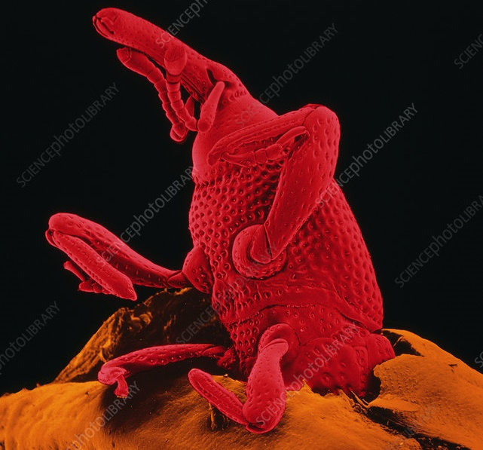
10 – ELECTRONS & ELECTRONICS
Page 227
10 – ELECTRONS & ELECTRONICS
ELECTRONIC COMPONENTS
TRANSDUCERS
DIODES AND RECTIFICATION
POTENTIAL DIVIDER
ELECTRONIC SWITCHING
LOGIC GATES
ELECTRON BEAMS
A grain weevil emerging from a grain of wheat. This picture, which is 50 times actual size, was produced by a scanning electron microscope. The instrument uses a narrow beam of electrons, rather than light, and the image is constructed by a computer. Unlike a light microscope, an electron microscope gives a three-dimensional image. However, the colours are false, and added by the computer.

Slide 3
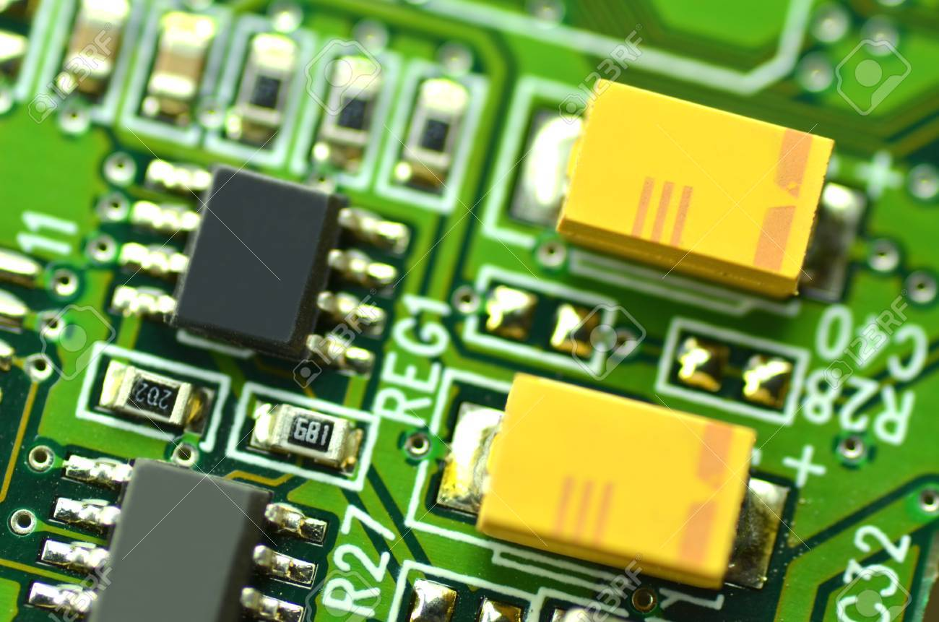
10.01 – Electronic Essentials
Page 228
Circuits with microchips and other semiconductor devices are called electronic circuits. They include the circuits in TV sets, computers, CD players, and amplifiers. Most handle very low currents, although they can control much more powerful circuits.
!
Essential ideas
Before working through this section, you need to understand the basic principles of circuits, covered in spreads 8.04-8.10.

Slide 4
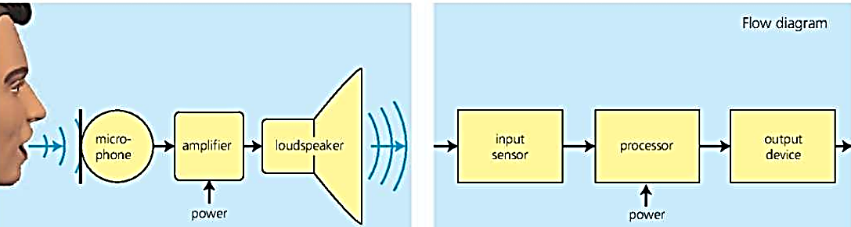
10.01 – Electronic Essentials
Page 228
An electronic system
The sound amplification system below is electronic. When you speak into the microphone, the sound waves cause tiny changes in the current in it. These changes are called signals. They are amplified (magnified) by the amplifier so that the loudspeaker gives out a louder version of the original sound. The extra power needed comes from the power supply.

Slide 5
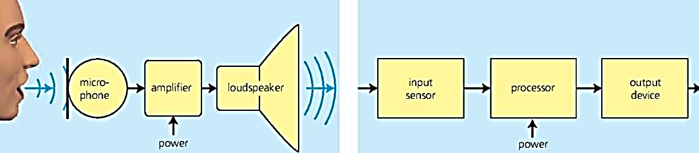
10.01 – Electronic Essentials
Page 228
An electronic system
The main features of an electronic system like this are shown in the flow diagram above right. An input sensor (the microphone) sends signals to a processor (the amplifier) which uses them to control the flow of power to an output device (the loudspeaker). Think of some more examples of input sensors and output devices.
In the system below, the current varies continuously, just like the incoming sound waves. Continuous variations like this are called analogue signals.

Slide 6
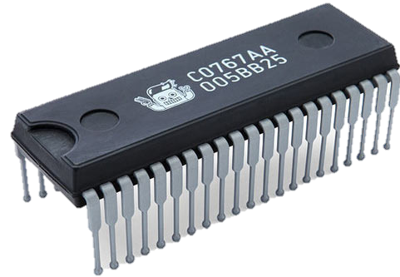

10.01 – Electronic Essentials
Page 228
Analogue and digital signals
But many systems use signals of a different type. For example, in the clock below, electronic circuits create the number display by switching strips on or off so that they light up in different combinations. Here, the signals represent only two states - on and off. They are digital signals.
Integrated circuit (IC) package with connecting pins. Components like this are used in many electronic circuits.
!
For more about analogue and digital signals and their uses, see spread 7.12.

Slide 7
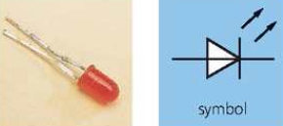
10.01 – Electronic Essentials
Page 229
Components
Here are some of the components (parts) used in electronic circuits:
Resistors keep currents and voltages at the levels needed for other components to work properly.
Capacitors* store small amounts of electric charge. They are used in smoothing circuits and time-delay circuits, in the tuning circuits in radios and TVs, and for passing on signals from one circuit to another.
Diodes let current flow in one
direction only. Most are made
from specially treated crystals
of silicon, a semiconductor.
Light-emitting diode (LED)

Slide 8
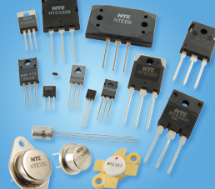
10.01 – Electronic Essentials
Page 229
Components
Light-emitting diodes (LEDs) glow when a small current passes through them. They are used as indicator (on/off) lights and in some alphanumeric (letter and number) displays like those on digital clocks.
Transistors* are used for amplifying signals and for switching. Most are made from specially treated crystals of silicon.
Relays are electromagnetic switches. With a relay, a high-power circuit can be switched on (or off) by a tiny current from an electronic circuit.
Light-emitting diode (LED)
Transistors

Slide 9
10.01 – Electronic Essentials
Page 229
Integrated circuits (ICs)*, or ‘microchips’, contain many complete circuits, with resistors, transistors, other components, and connections all formed on a tiny chip of silicon only a few millimetres square.
Input sensors examples
pressure switch (switch operated by pressing it)
reed switch (switch operated by a magnet)
variable resistor
thermistor (temperature-dependent resistor)
LDR (light-dependent resistor)
microphone
Output devices examples
LED (light-emitting diode) relay
lamp
electric heater
buzzer
electric bell
loudspeaker
electric motor
These are all transducers - devices that convert electrical signals into some other form, or vice versa.

Slide 10
10.01 – Electronic Essentials
Page 229
Q
resistor relay diode transducer LED
Which of the above components
  uses the small current from one circuit to switch a more powerful circuit
  converts signals into a different form
  lets current pass in one direction only
  emits light when a small current flows in it?
Give three examples of transducers.
When a door bell is rung, what is being used as
  the input sensor b. the output device?
Electronic systems handle either analogue signals or digital ones. Which type is used by each of these?
a. A simple sound amplification system, where you speak into a microphone and a louder version of your voice comes out of a speaker,
  A system which automatically opens a shop door when someone approaches.
?
Related topics: analogue and digital 7.12; resistors 8.06; resistor colour code page 321; diodes 8.07 and 10.02; relay 9.04,10.02 and 10.03; transistors 10.03

Slide 11
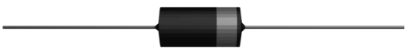
10.02 – More on Components
Page 230
Diodes
Diodes allow current to flow in them in one direction only. The circuits below show what happens when a diode is connected into a circuit one way round and then the other:
Diode
!
Circuit essentials
A.c. (alternating current) flows alternately backwards and forwards. D.c. (direct current) flows one way only.
When resistors are in series, each has the same current in it. The resistor with the highest resistance has the greatest p.d. (voltage) across it.

Slide 12
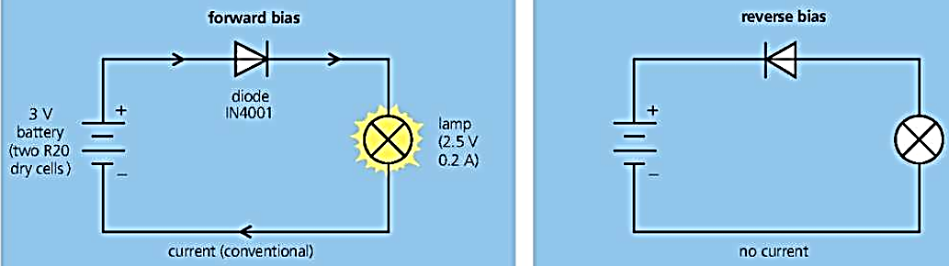
10.02 – More on Components
Page 230
Diodes
When the diode is forward biased, it has an extremely low resistance, so a current flows in it and the lamp lights up. In this case, the arrowhead in the symbol points the same way as the conventional (plus-to-minus) current direction.
When the diode is reverse biased, it has an extremely high resistance and the lamp does not light. In effect, the diode blocks the current.

Slide 13
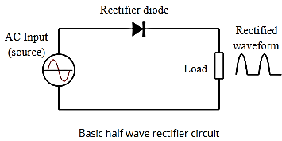
10.02 – More on Components
Page 230
Components
Diodes can be used to change a.c. to d.c. This process is called rectification. The diodes that do it are known as rectifiers. A simple rectifier circuit is shown below. The diode lets the forward parts of the alternating current through, but blocks the backward parts.
So the current in the resistor flows one way only. It has become a rather jerky form of d.c.
An oscilloscope can be used to show how the circuit changes the a.c. input. The bottom
half of the output waveform
is missing. The current is
flowing in surges, with short
periods of no current between.

Slide 14
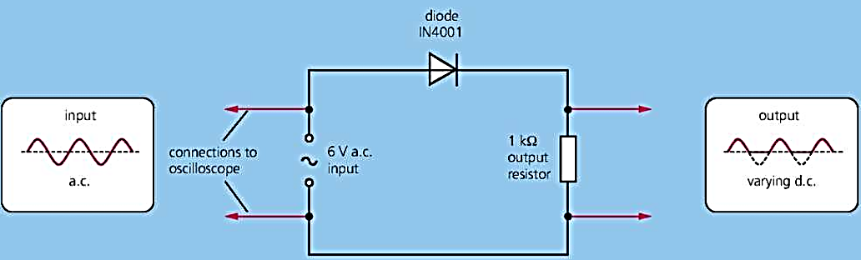
10.02 – More on Components
Page 230
Components
Smoothing* The pulsing current from a rectifier can be smoothed by connecting a capacitor across the output. The capacitor collects charge during the surges and releases it when the current from the rectifier falls. This makes the output more like the steady d.c. from a battery.

Slide 15
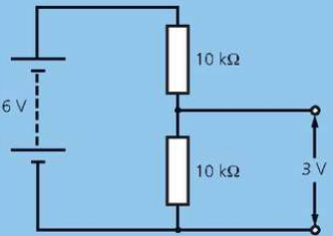
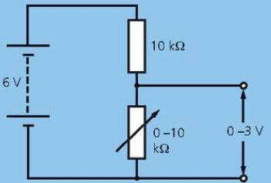
10.02 – More on Components
Page 231
Potential divider
A potential divider is an arrangement that delivers only a proportion of the voltage from a battery (or other source). Circuit A shows the principle:
A In this potential divider, the lower resistor has half the total resistance of the two resistors, so its share of the battery's voltage is also a half.
B If one of the resistors is replaced by a variable resistor, the output voltage can be varied. Here, it can range from 0 to 3 V, depending on the setting on the variable resistor.
Circuit B could be used as a volume control in a radio.

Slide 16
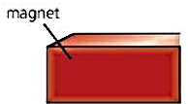
10.02 – More on Components
Page 231
!
Potential divider
Some electronic circuits are designed to switch on when a voltage reaches a set value. If the variable resistor in circuit B were replaced by an LDR (light- dependent resistor), then the circuit controlling a lamp could be switched on when it got dark.
Similarly, a fire alarm could be switched on by a potential divider containing a
thermistor
(temperature-
dependent resistor).
P.d. and voltage
Potential difference (p.d.) is the scientific name for voltage. It is measured in volts (V). However, for convenience, engineers dealing with electronic circuits tend to use the term voltage rather than p.d.

Slide 17
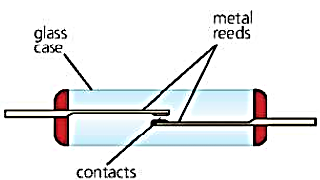
10.02 – More on Components
Page 231
Reed switch
A reed switch is operated by a magnetic field. In the example on the right, the contacts close if a magnet is brought near, then open again if it is moved away. Burglar alarm circuits often contain reed switches. The magnets are attached to the moving parts of windows and doors.
With a coil round it, a reed switch becomes a reed relay. The current in one circuit (through the coil) switches on another circuit (through the contacts).
A reed switch. When the magnet is moved near, the reeds become magnetized and attract each other.

Slide 18
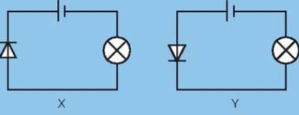
10.02 – More on Components
Page 231
Q
What does a diode do?
What is the purpose of a rectifier?
Look at circuits X and Y on the right. In which one
  does the lamp light up
  does the diode have a very high resistance?
If, in circuit A above, the lower resistor were replaced with one of 5 kΩ, how would this affect the output voltage of the
potential divider?
* How would you
close the contacts in
a reed switch?
?
Related topics: current direction 8.04; resistance 8.06; relay 9.04 and 10.03; a.c. and d.c. 9.09; temperature-sensitive switches 10.04

Slide 19
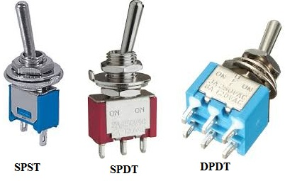
10.03 – Electronic Switching
Page 232
When you press a light switch, you close two contacts. This completes a circuit and bring on the lights. The diagrams below show another way of switching on a small lamp (or an LED), using a transistor. Normally, a transistor blocks current: it is like an open switch. But if a small voltage is applied across two of its terminals (B and E) as shown, it conducts and the lamp lights up.
!
Essential ideas
Before reading this spread, you need to understand how a potential divider works (see 10.02).

Slide 20
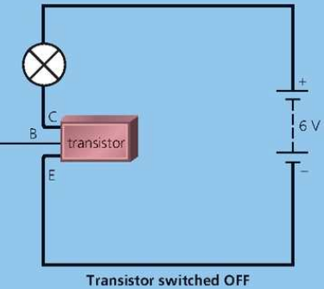
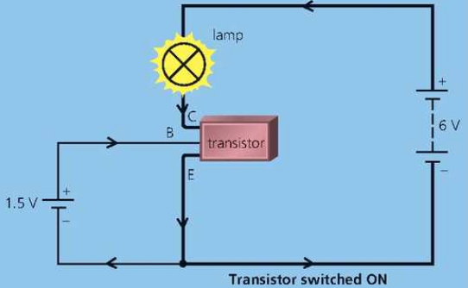
10.03 – Electronic Switching
Page 232
Here are two examples of this idea in action. Each uses a potential divider (see previous spread) to put a proportion of the battery voltage across terminals B and E. If the proportion is large enough, the transistor will switch on.

Slide 21
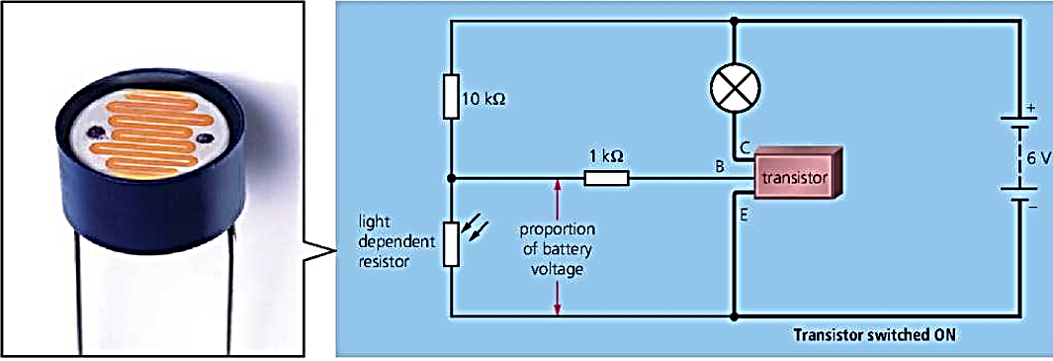
10.03 – Electronic Switching
Page 232
A light-sensitive switch
The circuit below contains a light-dependent resistor (LDR), a special type of resistor whose resistance falls when light shines on it. When the LDR is put in the dark, the lamp lights up. The principle is used in lamps which come on automatically at night:

Slide 22
10.03 – Electronic Switching
Page 232
A light-sensitive switch
The LDR is part of a potential divider. In daylight, the LDR has a low resistance, and a low share of the battery voltage - too low to switch the transistor on.
In darkness, the resistance of the LDR rises considerably, and so does its share of the battery voltage. Now, the voltage across the LDR is high enough to switch the transistor on, so the lamp lights up.
!
Practical switching circuits contain extra components, and often use an IC (integrated circuit) rather than a single transistor.

Slide 23
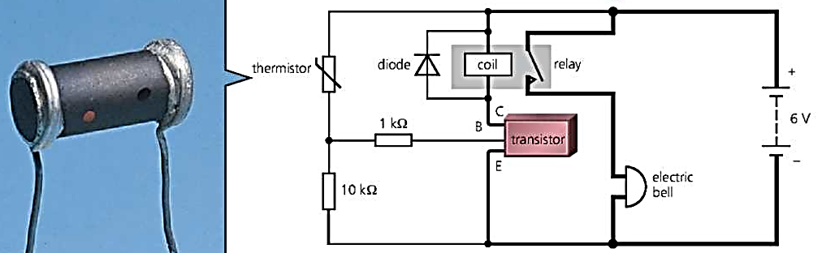
10.03 – Electronic Switching
Page 233
A temperature-sensitive switch
The circuit below contains a thermistor, a special type of resistor whose resistance falls considerably when its temperature rises. When the thermistor is heated, the bell rings. The principle is used in automatic fire alarms.
The extra resistor next to terminal B is to prevent too large a current flowing in or out of the transistor.
The diode protects the transistor from currents generated (by electromagnetic induction) when the relay coil is switched on or off.

Slide 24
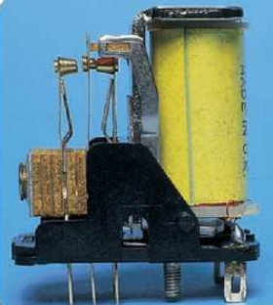
10.03 – Electronic Switching
Page 233
A temperature-sensitive switch
The thermistor is part of a potential divider. At room temperature, the thermistor has a high resistance and the major share of the battery voltage.
As a result, the voltage across the lower resistor is not enough to switch the transistor on. When the thermistor is heated, its resistance falls, and the lower resistor gets a much larger share of the battery voltage. So the transistor is switched on and the bell starts to ring.
Relay
How a Relay Works

Slide 25
10.03 – Electronic Switching
Page 233
A temperature-sensitive switch
In this circuit, the transistor does not switch on the bell directly. Instead it switches on a relay, and that switches on the bell.
As the current in the bell circuit does not have to flow through the transistor, a more powerful bell can be used - or even a mains-operated bell in a completely separate circuit. (A relay could also have been used in the light-sensitive switch circuit.)
Relay
How a Relay Works

Slide 26
10.03 – Electronic Switching
Page 233
Q
Give one practical use of
  a light-sensitive switch circuit
  a temperature-sensitive switch circuit.
Why is a relay often used with an electronic switch?
In the light-sensitive switch circuit on the opposite page, what would be the effect of interchanging the LDR and the 10 kΩ resistor so that the LDR is at the bottom?
In the temperature-sensitive switch circuit above:
  What would be the effect of replacing the 10 kΩ resistor with one of lower value?
  What change(s) would you make to the circuit so that you could vary the temperature level at which the bell sounds?
?
Related topics: resistors 8.06; relay 9.04 and 10.02; electromagnetic induction 9.07; diodes 10.02; potential divider 10.02

Slide 27
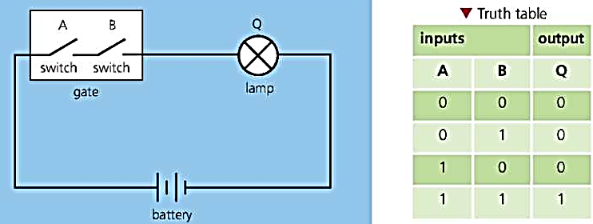
10.04 – Logic Gates (1)
Page 234
Video recorders, security lamps, alarm systems, and washing machines are just some of the things controlled by electronic switches called logic gates.
The diagram below shows a simple form of gate - although this one is not electronic. It is just two ordinary switches, A and B, in a box:

Slide 28

10.04 – Logic Gates (1)
Page 234
There has to be an unbroken circuit for the lamp to light up. So, if A and B are both on (closed), the lamp is on. But if either A or B is off (open), the lamp is off. The truth table gives the results of all the possible switch settings. It uses two logic numbers: 0 for off and 1 for on.
In practice, logic gates work electronically, using tiny transistors as switches. They are manufactured as integrated circuits (ICs), with each chip holding several gates. The chip also needs a d.c. power supply. Typically, this is a 5 volt supply, with one terminal marked +5 V and the other 0 V.
You are using logic gates when you press the buttons on a DVD player.

Slide 29
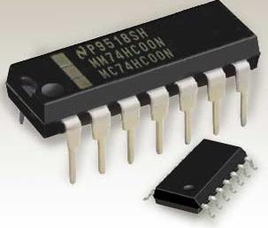
10.04 – Logic Gates (1)
Page 234
AND, OR, and NOT gates
There are different types of logic gate. Three of them are shown in symbol form on the opposite page. To help you remember which is which, the words AND, OR, and NOT have been written inside the symbols.
However, these words are not really part of the symbols. For simplicity, the input and output connections are shown as single wires rather than complete circuits.
!
Digital gates
Logic gates operate in only two states, OFF (0) and ON (1). So they are digital devices (see 10.01).
A logic IC package. Twelve of the 'pins' make connections to the gates on the chip. The other two are for the power supply.

Slide 30
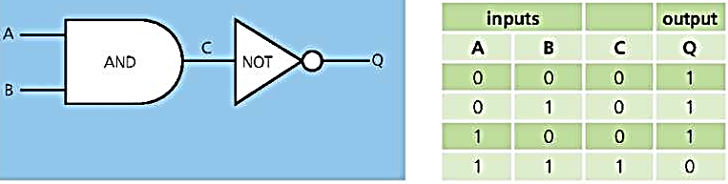
10.04 – Logic Gates (1)
Page 234
AND, OR, and NOT gates
Also, connections to the power supply have been omitted.
  Each input is made either high (for example, +5 V) or low (0 V). As a result, the output is either high or low, depending on the input state(s).
  In the truth tables, the output and input states are represented by the logic numbers 1 (high) and 0 (low).
Gates can be combined so that the output of one becomes the input of another. The diagram below shows one example:

Slide 31
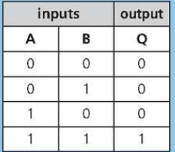
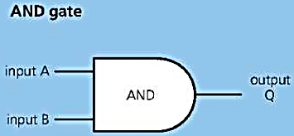
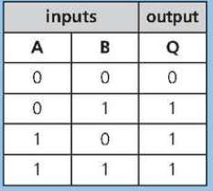
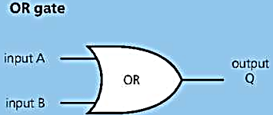
10.04 – Logic Gates (1)
Page 235
This has two inputs and one output.
For the output to be high, both inputs must be high.
In other words...
Output Q is high, if inputs A AND B are high.
This has two inputs and one output.
For the output to be high, at least one of the inputs must be high.
In other words...
Output Q is high if input A OR B (or both) is HIGH.

Slide 32
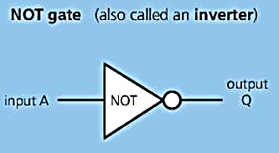
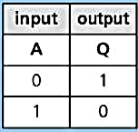
10.04 – Logic Gates (1)
Page 235
This has one input and one output.
The output is high if
the input is low, and vice versa.
In other words...
Output Q is high if input A is NOT high

Slide 33
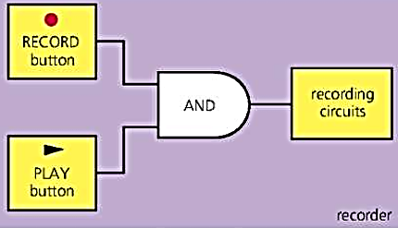
10.04 – Logic Gates (1)
Page 235
Using a gate
The diagram on the right shows one use for a logic gate. The recorder will only start recording if the record’ and play’ buttons are pressed together.
For most practical applications, combinations of gates are needed (see the next spread). Often, each input sensor forms part of a potential divider, as in a transistor switch, and the small output
current switches on
lamps, motors, and
other devices via a
relay.
Login Gates

Slide 34
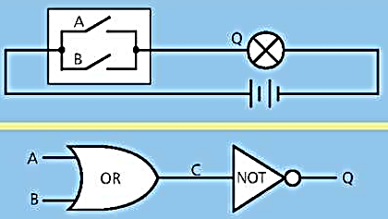
10.04 – Logic Gates (1)
Page 233
Q
Look at the simple two-switches-in-a-box gate on the opposite page. Decide what type of gate it is.
The upper diagram on the right shows another two- switches-in-a-box gate. Write a truth table for this gate and decide what type of gate it is.
The lower diagram shows a combination of gates.
  Write a truth table for this
  combination, showing all
  the possible states of
  A, B, C, and Q.
  What must the states of
  inputs A and B be for the
  output to be high?
?
Related topics: voltage (p.d.) 8.05; lamps and switches 8.09; relay 9.04 and 10.02; potential divider 10.02; transistor switches 10.03-10.04

Slide 35
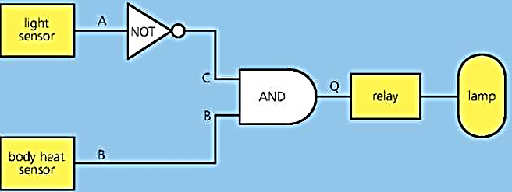
10.05 – Logic Gates (2)
Page 236
Using a Combination of Gates
The diagram above shows how sensors and logic gates can be used to control a security lamp. The sensors and gates have been connected so that, if it is dark and someone approaches, the lamp comes on automatically.
The last gate cannot provide enough power for the lamp, so it switches on a relay instead. This switches on a separate circuit with the lamp in it.

Slide 36
10.05 – Logic Gates (2)
Page 236
Using a Combination of Gates
To check that the combination behaves as intended, you can write a truth table for it (see question 1).
In this case, the light sensor’s output is low (0) in the dark; the body heat sensor’s output is high (1) if someone approaches; the final output Q must be high for the lamp to come on.

Slide 37
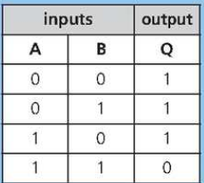
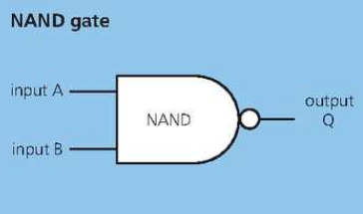
10.05 – Logic Gates (2)
Page 236
NAND and NOR gates
Two more gates are shown below. These are especially useful because all the other gates can be made by connecting or combining NAND gates (or alternatively NOR gates) in different ways.
logic 0 = low (OFF) logic 1 = high (ON)
This has two inputs and one output.
It is equivalent to an AND gate with its output inverted by a NOT gate.
In other words...
Output Q is high if inputs A AND B are NOT both high.

Slide 38
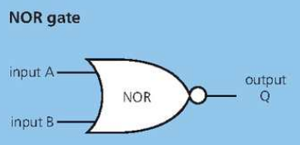
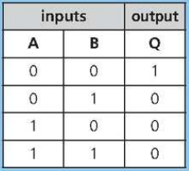
10.05 – Logic Gates (2)
Page 236
This has two inputs and one output.
It is equivalent to an OR gate with its output inverted by a NOT gate.
In other words...
Output Q is high if neither input A NOR input
B is high.

Slide 39
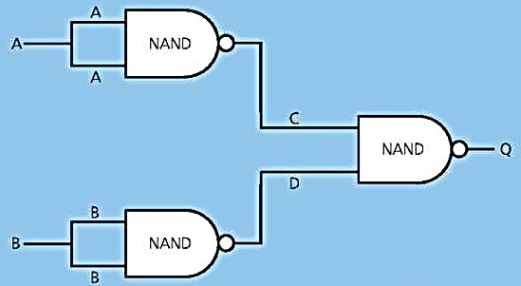
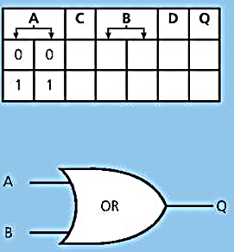
10.05 – Logic Gates (2)
Page 237
Every type of logic gate can be formed by connecting NAND (or NOR) gates in different combinations (see also question 2). The combination of three NAND gates above left is equivalent to an OR gate.
The diagram above shows how thee NAND gates can be connected to produce an OR gate.

Slide 40

10.05 – Logic Gates (2)
Page 237
Gates, more gates, and computers
To process data and images a computer must first convert them into binary form - long strings of 0's and 1's. To hold this data, a typical microprocessor might contain more than 100 million microscopic logic
gates, all formed with other
components on a tiny chip of
silicon.
The gates are formed from different combinations of NAND or NOR gates. And those gates are themselves formed by linking microscopic transistors in different combinations.
A microprocessor like this contains over 100 million logic gates.

Slide 41
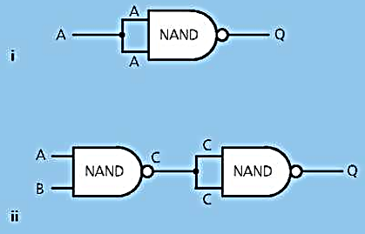
10.05 – Logic Gates (2)
Page 237
Q
Q
Look at the security lamp
system on the right,
  Write a truth table
  for the system, showing
  all the possible states
  of A, B, C, and Q.
  From your table, work out the state of Q when it is dark
  and someone is approaching the sensors.
NAND gates can be used to make other types of gate. There
are two examples on the right.
  Write a truth table for each
  arrangement, showing all the
  possible states of A, (B, C), and Q.
  Decide what type of gate each is
  equivalent to.
?
Related topics: binary numbers 7.12 sensors 10.01; use of relay 9-04,10.02, and 10.03

Slide 42

10.06 – Electron Beams
Page 238
Given enough energy, electrons can escape from a conductor and move through a vacuum (empty space) or through a gas at low pressure.
!
Charge and current essentials
In a circuit, the current is a flow of tiny, charged particles called electrons, which come from atoms.
Electrons have a negative (-) charge. If a material loses electrons, it is left with a positive (+) charge.
Like charges repel, unlike charges attract.

Slide 43
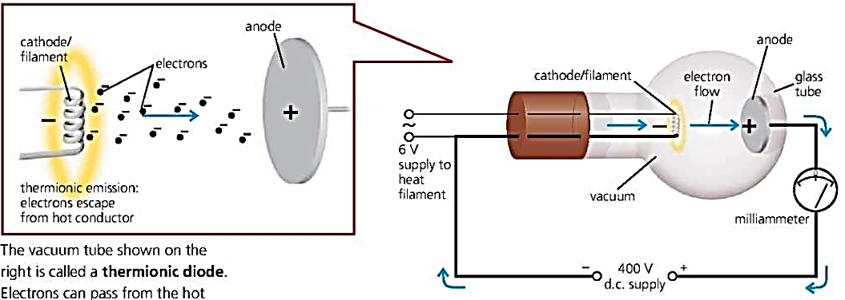
10.06 – Electron Beams
Page 238
Thermionic emission*
If a tungsten filament is heated to about 2000 °C, some of the electrons in the white hot metal gain enough energy to escape from its surface. The effect is called thermionic emission and it occurs in other metals and metal oxides as well. The diagram below shows an experiment to demonstrate the effect.
The vacuum tube shown on the right is
called a thermionic diode
Electrons can pass from the hot cathode
to the anode, but not the other way, so the tube acts as a one-way valve for current.

Slide 44
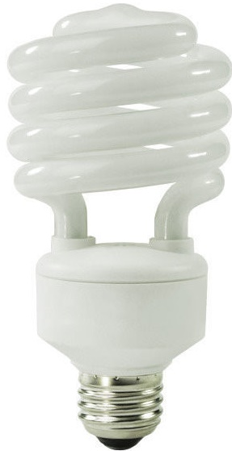
10.06 – Electron Beams
Page 238
Low energy lamps*
With these changes, the tube in the above experiment behaves like a lamp:
  Putting a small amount of gas (mercury vapour) in the tube.
  Increasing the voltage. This makes the electrons move faster. When they collide with mercury atoms, ultraviolet radiation is emitted. (Also, more electrons are freed, so
  the filament doesn’t then need to be heated.)
  Coating the inside of the tube with suitable phosphors. Although ultraviolet is invisible, it makes the phosphors fluoresce (see spread 7.11): they give off visible light - the tube glows white.
The features above are used in fluorescent tubes and in compact fluorescent lamps (CFLs) - commonly known as low energy lamps.
Compact fluorescent lamp (CFL)

Slide 45
10.06 – Electron Beams
Page 238
Low energy lamps*
A typical CFL is shown on the left. The tube has a spiral shape to keep it compact.
In the base of the lamp, there are electronic circuits to start and maintain the flow of electrons, produce the required voltage, and provide ‘ballast’ - rather like resistance - to restrict the current in the gas.
Compact fluorescent lamp (CFL)

Slide 46
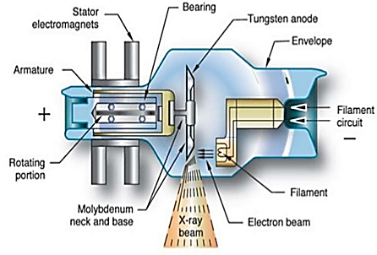
10.06 – Electron Beams
Page 239
X-ray tube*
When very fast electrons are suddenly stopped, most of their kinetic energy is changed into thermal energy (heat). However, X-rays are also produced.
This principle is used in the X-ray tube shown on the right, where X-rays are emitted from a tungsten target when electrons strike it. (Tungsten
is used because of its high
melting point.)
The higher the accelerating
voltage between cathode
and anode, the shorter the
wavelength of the X-rays
and the more penetrating
they are.
X-ray tube

Slide 47
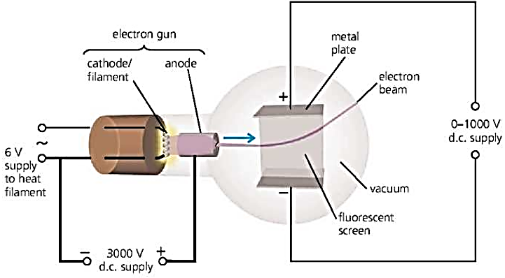
10.06 – Electron Beams
Page 239
Deflection tube*
The properties of a beam of electrons can be investigated using the deflection tube above. The electron gun produces a narrow beam of electrons. The screen is coated with a fluorescent material which glows when electrons strike it. It shows the path of the beam.

Slide 48
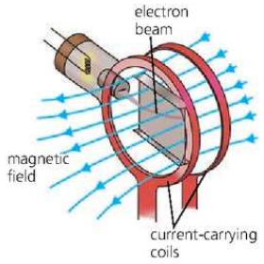
10.06 – Electron Beams
Page 239
Deflection tube*
Electric deflection* Above and below the beam, there are two metal plates. When a voltage is applied across these, the beam is deflected (bent) towards the positive (+) plate.
Magnetic deflection The beam can also be deflected by a magnetic field, produced by passing a current in a pair of coils as on the right. The direction of the force is given by Fleming’s left-hand rule (remembering that the conventional current direction is opposite to that of the electron flow).
If the field direction is reversed, the force direction is also reversed.
Magnetic deflection

Slide 49
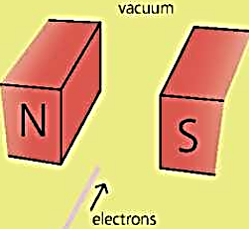
10.06 – Electron Beams
Page 237
Q
Q
Q
Look at the experiment with
the deflection tube right:
  Why is the screen coated
  with a fluorescent material?
  What type of charge do
  electrons have, - or +?
  * Why is the beam of
  electrons deflected
  upwards?
The diagram on the right shows a beam of
electrons about to pass between the poles of a
magnet.
  What is the conventional current direction in
  this case?
  Use Fleming's left-hand rule (see spread 9.05) to work out which way the electron beam will be deflected.
?
Related topics: ultraviolet, fluorescence, X-rays 7.11; charge and electrons 8.01; voltage 8.05; magnetic fields and Fleming's left-hana rule 9.05

Slide 50
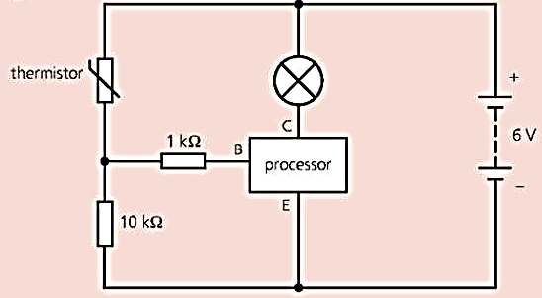
10.06 – Electron Beams
Page 240
In the circuit above, the
processor (a transistor) is
switched on when the voltage
between terminals E and B is
more than 0.6 V. This means that
a current can then flow between
E and C, so the lamp will light up.
  The circuit includes a thermistor. If there is an increase in temperature, what effect does this have on the thermistor? [1]
  The thermistor and the 10 kΩ resistor form a potential divider. What is the purpose of a potential divider? [1]
  If there is an increase in temperature, how does this affect the voltage between E and B, and what happens as a result? [3]
  How could the circuit be improved so that it can control a more powerful lamp (or buzzer, or bell)? [2]
  What practical use could be made of the system described above? [1]
?

Slide 51

10.06 – Electron Beams
Page 240
Select from the above list:
  an input device which detects changes in light [1]
  an output device which produces a sound [1]
  a processing device which only gives an output when both inputs are high. [1]
a. All electronic systems have input sensors, processors and an output device. Explain the function of
    input sensors [1]
    processors. [1]
?

Slide 52

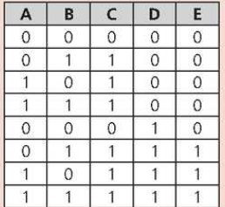
10.06 – Electron Beams
Page 240
  The block diagram below shows an electronic system that can be used as a burglar alarm.
  A, B and D are the inputs. The processor contains logic gates X and Y. The alarm is the output device. The truth table for the circuit is shown at the top of the next column
    Use a truth table to identify the
    logic gates. [2]
    State an input, A, B or D which
    could be connected to a sensor
    in order to detect a burglar. [1]
    Name a suitable device which
    could be used as an input
    processor. [1]
?

Slide 53
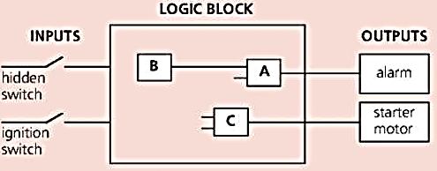
10.06 – Electron Beams
Page 240
A truck is fitted with a security device. To start the truck, two keys are needed. The first key operates a 'hidden’ switch, the second key operates the ignition switch.
If the ‘hidden’ switch and the ignition switch are both on, the engine will start. Turning the ignition switch without operating the ‘hidden’ switch will not allow the engine to start and will activate an alarm.
A, B and C are the three
gates needed for the
design of the logic block,
  a Identify gate
    A ‘ [1]
    B [1]
    C [1]
  Copy the diagram and show how the inputs and logic gates are connected together. [2]
  The logic gates used in the logic block are called digital devices. Explain what this means. [1]
?

Slide 54

10.06 – Electron Beams
Page 240
The diagram below
shows part of an
electronic circuit.
  What is component Z called? What does it do? [2]
  Give two ways in which the output of the circuit is different from the input. [2]
  What difference would it make if resistor Y were to have a lower value? [1]
?

Slide 55

10.06 – Electron Beams
Page 241
The devices below
are all used in
electronic circuits.
Which of the above is best described by each of the following statements?
  * Glows when a small current flows in it. [1]
  Links two circuits so that a small current in one can switch on or off a larger current in the other. [1]
  Has a lower resistance when it is heated. [1]
  Has a lower resistance when light shines on it. [1]
  Lets current pass in one direction only. [1]
?

Slide 56

10.06 – Electron Beams
Page 241
The diagram shows a circuit for a temperature sensor.
The temperature of the thermistor rises,
  What happens to the resistance of the thermistor? [1]
  What happens to the voltage across resistor R? [1]
?

Slide 57
10.06 – Electron Beams
Page 241
A simple burglar alarm has two sensors:
  A heat source, which gives a high output when someone is nearby.
  A light sensor, which gives a high output when light shines on it.
  A thermistor is used in the heat sensor,
    What happens to the thermistor to cause a change in the sensor output? [1]
    Suggest a suitable component for the light sensor. [1]
?

Slide 58

10.06 – Electron Beams
Page 241
Diagrams X and Y above show the symbols for two logic gates.
  Which symbol represents an AND gate? [1]
  With an AND gate, if one input is 1 (high) and the other is 0 (low), what is the output state? [1]
  What would be the effect of connecting a NOT gate to the output of the AND gate? [1]
  What type of gate is represented by the other symbol? [1]
  With this gate, if one input is 1 (high) and the other is 0 (low), what is the output state? [1]
?

Slide 59

10.06 – Electron Beams
Page 241
A deflection tube is placed
between the poles of an
electromagnet. A beam of
electrons travels through the
tube in the direction shown in
the diagram,
  Which of the following
  statements most accurately
  describes what happens to
  the beam when the electromagnet is switched on? [1]
  A It is deflected (bent) towards one of the poles.
  B It is deflected upwards or downwards,
  The direction of deflection can be found using Fleming's left-hand rule. To use it, you need to know the conventional current direction. How is that related to the direction of electron flow? [1]
  Use Flemings left-hand rule to work out the direction in which the beam is deflected. [1]
?

Slide 60
10 – Revision Summary
Page 241
Use the list below when you revise for your IGCSE examination. You can either photocopy it or print it from the file on the CD accompanying this book.
The spread number, in brackets, tells you where to find more information.
Core Level
Examples and uses of transducers. (10.01)
The action of a potential divider. (10.02)
The action of a thermistor. (8.06 and 10.01)
The action of a light-dependent resistor (LDR). (8.06 and 10.01)
The action of a relay. (9.04 and 10.01)

Slide 61
10 – Revision Summary
Page 241
Extended Level
As for Core Level, plus the following:
The difference between analogue and digital signals.
(7.12 and 10.01)
The action of a diode. (10.02)
Using a diode as a rectifier for changing a.c. to d.c. (10.02)
Using circuit diagrams and symbols, including the diode.
(10.02-10.03 and page 321)
Using an LDR in a light-sensitive switch. (10.03)
Using a thermistor in a temperature-sensitive switch. (10.03)
Using a relay in an electronic switching circuit. (10.03)
Logic gates and their symbols. (10.04 and 10.05)
AND, OR, and NOT gates and their truth tables. (10.04)
NAND and NOR gates and their truth tables. (10.05)
Using combinations of logic gates. (10.04 and 10.05)
How a beam of electrons is deflected by a magnetic field. (10.06)

