Slide 1
Types of Energy

Slide 2
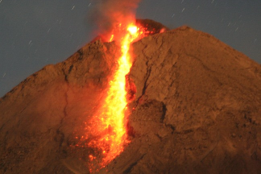

Forms of Energy
Energy can exist in many forms.
1. THERMAL
or HEAT ENERGY
This is the energy of an object due to its temperature.
2. LIGHT ENERGY
This is energy in the form of visible electromagnetic radiation.

Slide 3
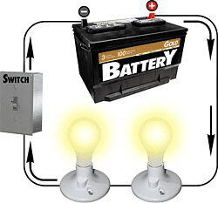
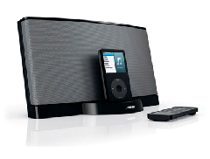
Forms of Energy
3. ELECTRICAL ENERGY
This is the energy transferred by an electric current.
4. SOUND ENERGY
This is energy in the form of a sound wave.

Slide 4

Forms of Energy
5. KINETIC ENERGY
This is the energy possessed by a moving object.
Kinetic energy increases is the object’s speed is increased.
Also often called ‘Movement energy’

Slide 5
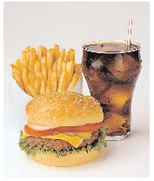
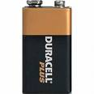
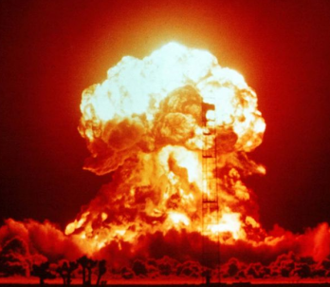
Forms of Energy
6. CHEMICAL ENERGY
This is energy that is released when chemical reactions take place.
Sources of chemical energy include:
fuel, food and batteries.
7. NUCLEAR ENERGY
This is energy that is released when nuclear reactions take place.
This is the source of the Sun’s energy.

Slide 6
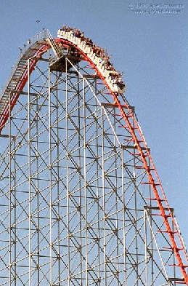
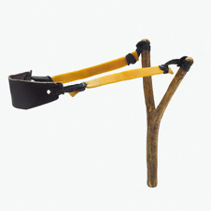
Forms of Energy
8 & 9. POTENTIAL ENERGY
This is the energy possessed an object due to its position.
Gravitational Potential Energy
The gravitational potential energy of an object increases if it is raised upwards.
Elastic Potential Energy
This is the energy stored in a stretched or squashed object
- also known as strain energy
Gravitational potential energy being converted into kinetic energy.

Slide 7
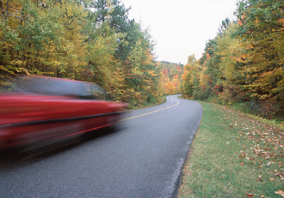
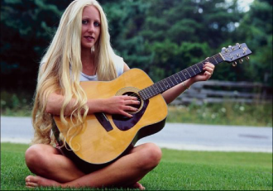
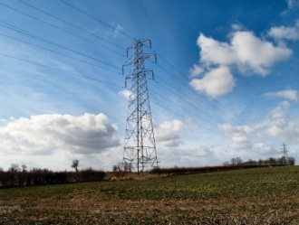
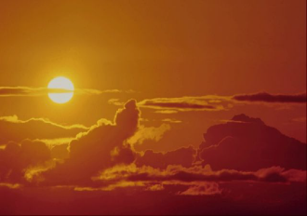
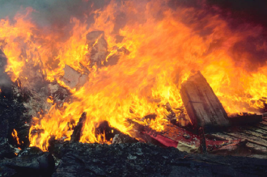
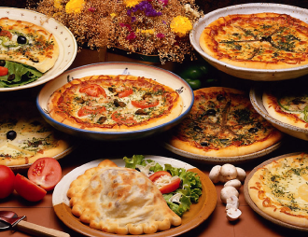
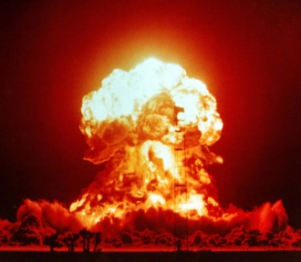
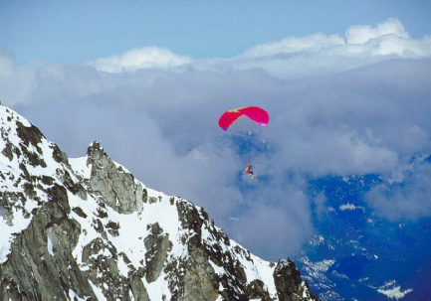
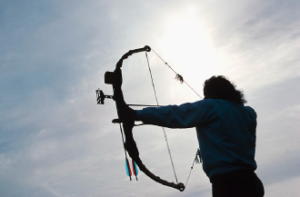
What are the 9 main types of energy?
Kinetic
energy
Sound
energy
Electrical
energy
Light
energy
Thermal
energy
Chemical energy
Nuclear
energy
Gravitational
potential energy
Elastic potential
energy

Slide 8
Kinetic Energy

Slide 9
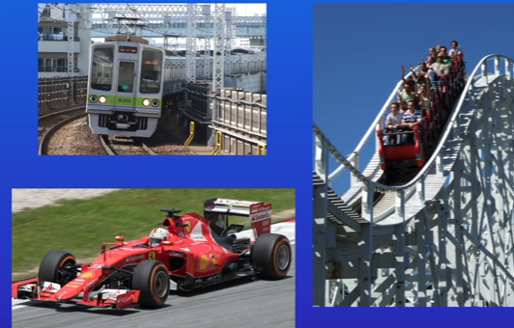
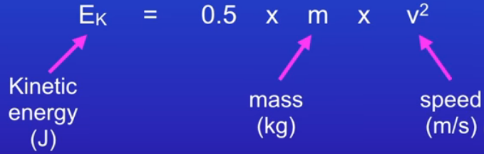
Kinetic Energy
Kinetic Energy is the energy stored in moving objects
Stationary objects have no kinetic energy
K.E. = 0.5 mv²
You must memorise this equation,it is not given in the exam

Slide 10
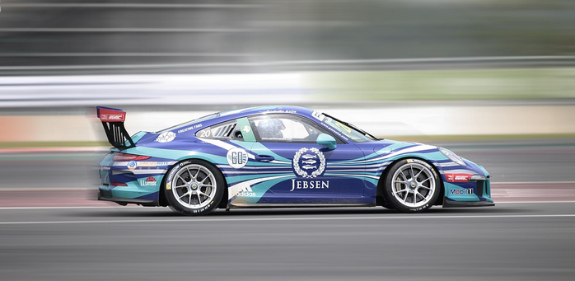
Energy Changes
Chemical potential energy → kinetic energy
(stored in petrol)

Slide 11
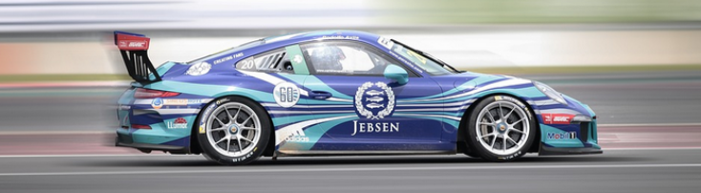
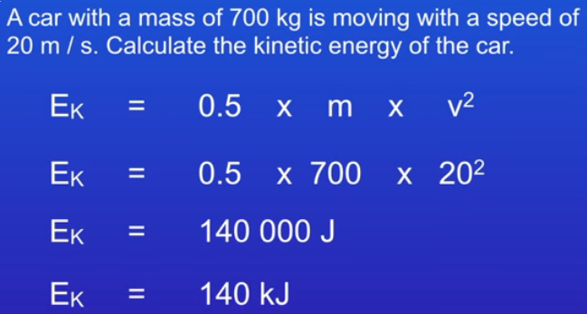
Kinetic Energy
20 m/s

Slide 12
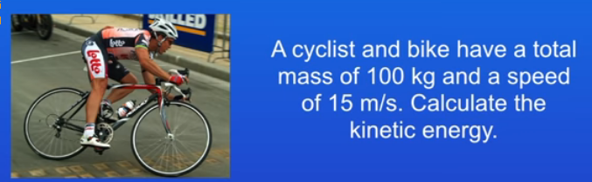
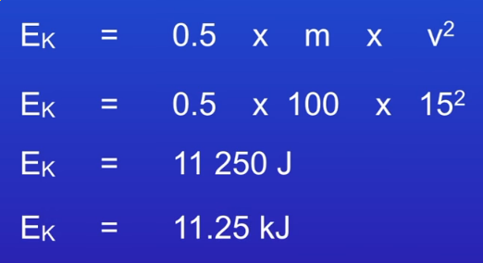
Kinetic Energy

Slide 13
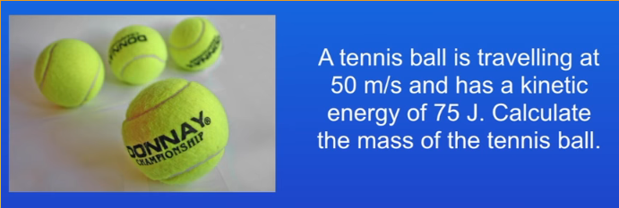
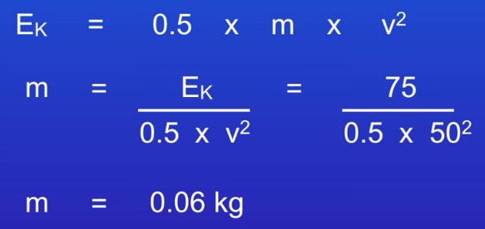
Kinetic Energy

Slide 14
Question 1
Calculate the kinetic energy of a car of mass 1000kg moving at 5 m/s.
kinetic energy = ½ x mass x (speed)²
kinetic energy = ½ x 1000kg x (5m/s)²
kinetic energy = ½ x 1000 x 25
kinetic energy = 500 x 25
kinetic energy = 12 500 joules

Slide 15
Question 2
Calculate the kinetic energy of a child of mass 60kg moving at 3 m/s.
kinetic energy = ½ x mass x (speed)²
k.e. = ½ x 60kg x (3m/s)²
k.e. = ½ x 60 x 9
k.e. = 30 x 9
kinetic energy = 270 J

Slide 16
Question 3
Calculate the kinetic energy of a apple of mass 200g moving at 12m/s.
kinetic energy = ½ x mass x (speed)²
k.e. = ½ x 200g x (12m/s)²
k.e. = ½ x 0.200kg x 144
k.e. = 0.100 x 144
kinetic energy = 14.4 J

Slide 17
Question 4
Calculate the mass of a train if its kinetic energy is 2MJ when it is travelling at 4m/s.
kinetic energy = ½ x mass x (speed)²
2MJ = ½ x mass x (4m/s)²
2 000 000J = ½ x mass x 16
2 000 000 = 8 x mass
2 000 000 ÷ 8 = mass
mass = 250 000 kg

Slide 18
Question 5
Calculate the speed of a car of mass 1200kg if its kinetic energy is 15 000J.
kinetic energy = ½ x mass x (speed)²
15 000J = ½ x 1200kg x (speed)²
15 000 = 600 x (speed)²
15 000 ÷ 600 = (speed)²
25 = (speed)²
speed = √25
speed = 5 m/s

Slide 19
Question 6
Calculate the speed of a ball of mass 400g if its kinetic energy is 20J.
kinetic energy = ½ x mass x (speed)²
20J = ½ x 400g x (speed)²
20 = ½ x 0.400kg x (speed)²
20 = 0.200 x (speed)²
20 ÷ 0.200 = (speed)²
100 = (speed)²
speed = √100
speed = 10 m/s

Slide 20
Complete
kinetic energy | mass | speed
J | 4 kg | 2 m/s
27 J | kg | 3 m/s
1000 J | 80 kg | m/s
kJ | 200 kg | 8 m/s
3.2 J | 3.03g | 4 m/s
8
6
5
6.4
400

Slide 21
Gravitational Potential Energy

Slide 22
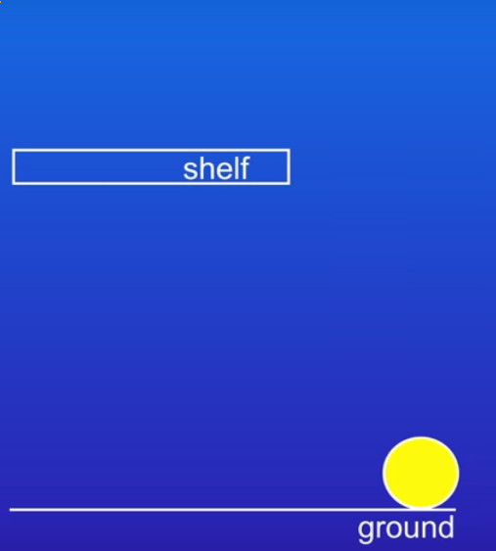
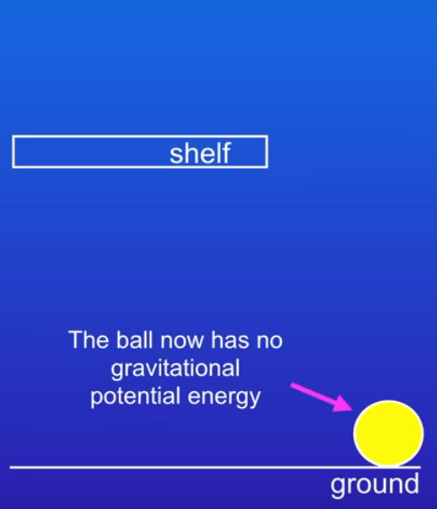
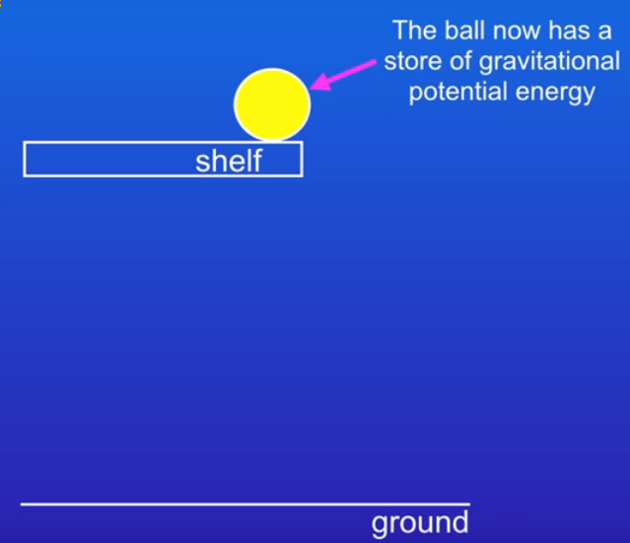
Gravitational Potential Energy
Gravitational potential energy is the energy stored in an object due to its position above the Earth's surface.
This is due to the force of of gravity acting on an object.
When the ball falls its G.P.E. converts to kinetic energy,
sound and thermal energy.
Chemical potential energy stored in the muscles
converts to kinetic energy, which is stored as G.P.E.

Slide 23
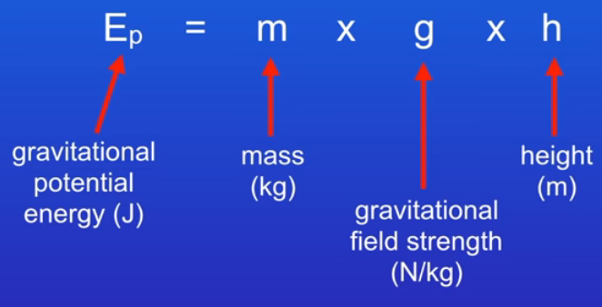
Gravitational Potential Energy
the value of g will be given in the exam question
the equation must be memorised, it is not given in the exam

Slide 24
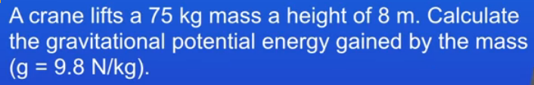
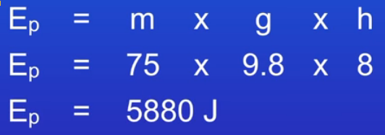
Gravitational Potential Energy

Slide 25
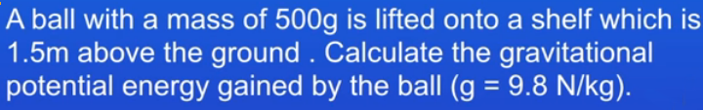
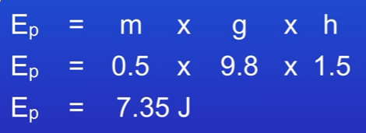
Gravitational Potential Energy

Slide 26
Question
Calculate the gravitational potential energy gained by a student of mass 70kg climbing a flight of stairs of height 4m.
weight = mass × gravitational field strength
= 70kg x 10N/kg
= 700N
GPE = weight x height
= 700N x 4m
Gravitational potential energy = 2 800 joules

Slide 27
Question
A child of mass 40kg climbs a wall of height 3m and then steps off. Calculate the speed at which the child reaches the bottom of the wall.
Child’s weight = mass × gravitational field strength
= 40kg x 10N/kg
Child’s weight = 400N
Child’s intial gravitational potential enery = weight x height
= 400N x 4m
GPE = 1 600 J
If air resistance is insignificant then all of this GPE is converted into kinetic energy
kinetic energy = ½ x mass x (speed)²
1600 J = ½ x 40kg x (speed)²
1 600 = 20 x (speed)²
1 600 ÷ 20 = (speed)²
80 = (speed)²
speed = √80
speed = 8.94 m/s

Slide 28
Complete
Gravitational potential energy (J) | mass (kg) | height (m)
 | an apple | 2
1500 |  | an adult human
1000 | an adult human
 | 200 | the third floor of the school
3.2 | 3.0 | 4
2
≈ 0.1 kg
75-115
≈ 1.3-2m
1-2
≈ 50-100 kg
20,000
≈ 10m
0.08

Slide 29
Review of concepts so far

Slide 30
Choose appropriate words to fill in the gaps below:
Elastic ________ energy is the energy stored when an object is stretched or ________. This energy is released when the object ________ to its original shape.
Kinetic energy is the energy possessed by an object due to its _______ and mass. If the mass of an object is ________ its kinetic energy doubles. If the speed is doubled the kinetic energy will increase by ______ times.
When a __________ elastic band is released elastic potential energy is converted into _________ energy.
potential
squashed
returns
speed
doubled
four
stretched
kinetic
WORD SELECTION:
returns
speed
four
kinetic
potential
squashed
doubled
stretched

Slide 31
Elastic Potential Energy

Slide 32
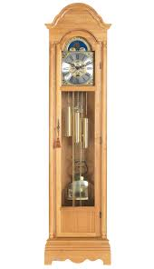
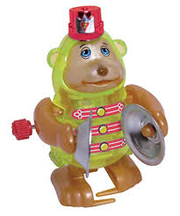
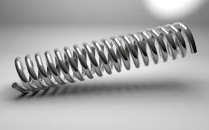
Elastic Potential Energy
What do they have in common?

Slide 33
Elastic Potential Energy
Stretching a spring uses a force to change the length of the spring. Applying a force like this is doing work.
The energy put in to stretch the spring is stored as elastic potential energy.

Slide 34
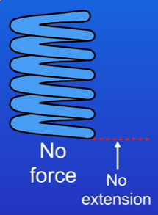
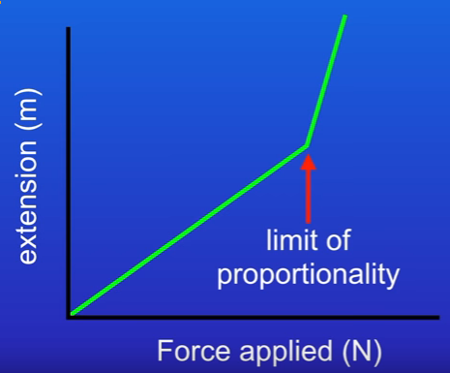
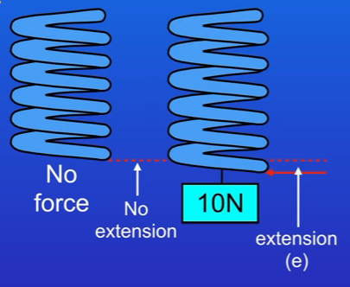
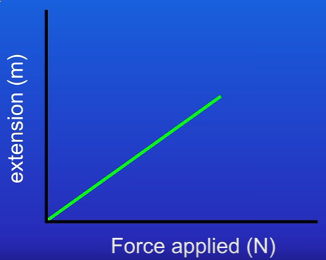
Elastic Potential Energy
If too large a force is applied to a spring, it deforms and will not return to its original shape. This force is called the limit of proportionality.

Slide 35
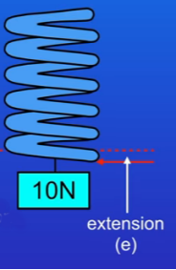
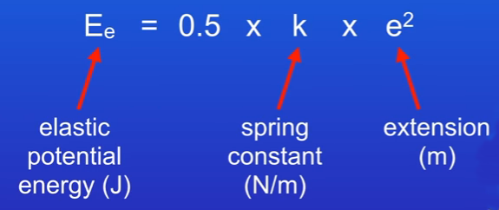
Elastic Potential Energy
Note: the extension is in m, you will probably be given extensions in cm, make sure you convert to m

Slide 36

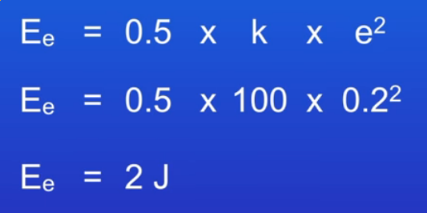
Elastic Potential Energy

Slide 37
Energy Transfers: Pendulum

Slide 38
Energy Transfers
Definitions to memorise
Kinetic energy:
the energy stored in a moving object.
Gravitational potential energy:
the energy stored due to an object’s position above the ground.
Elastic potential energy:
the energy stored in a stretched spring.
Thermal energy:
the energy stored due to an object’s temperature.

Slide 39
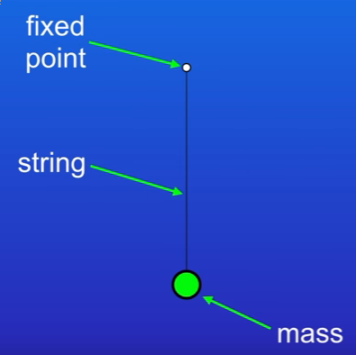
The Law of Conservation of Energy
Definition to memorise
Energy can be transferred usefully, stored or dissipated, but it cannot be created or destroyed
A system is an object or group of objects
← This is a system it contains:
mass
string
fixed point
air particles
No energy can enter or leave a closed system.
Energy can enter/leave open systems

Slide 40
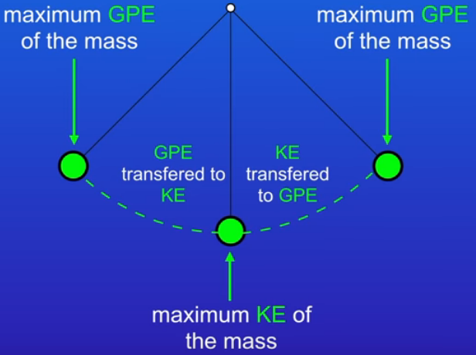
The Law of Conservation of Energy

Slide 41
The Law of Conservation of Energy

Slide 42
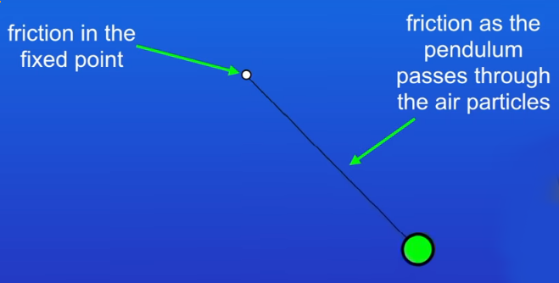
The Law of Conservation of Energy
Friction causes energy to be transferred to thermal energy
The fixed point and air around the pendulum gradually get warmer. The energy is dissipated (wasted), as this thermal energy is not useful.

Slide 43
The Law of Conservation of Energy
How can we reduce energy losses to friction?
reduce friction
lubricate the fixed point
remove the air particles (vacuum)

Slide 44
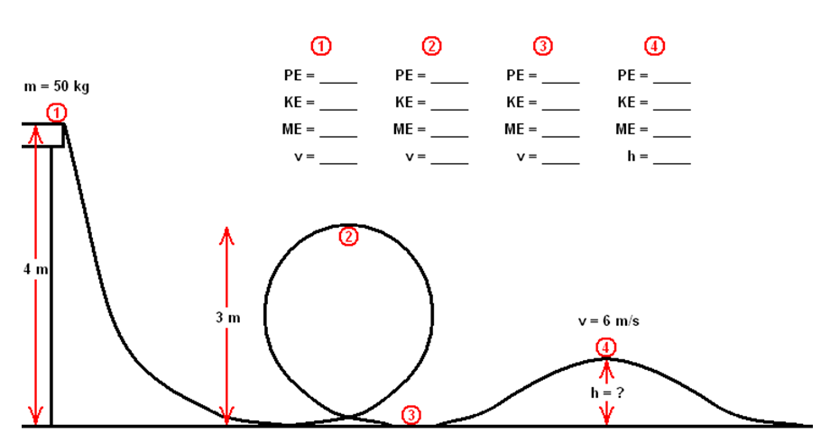
The Law of Conservation of Energy

Slide 45
Energy Transfers: Bungee Jumper

Slide 46
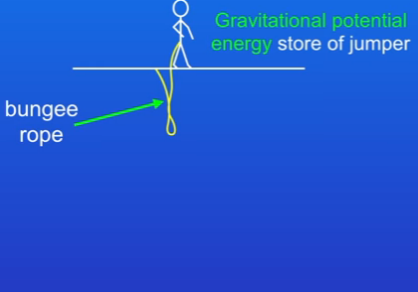
The Law of Conservation of Energy
At the start of the jump all of the energy in the system is the store of gravitational potential energy

Slide 47
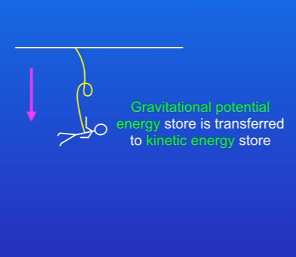
The Law of Conservation of Energy
As the jumper falls energy is transferred from the store of gravitational potential energy to the kinetic energy store

Slide 48

The Law of Conservation of Energy
When the bungee rope just starts to tighten the kinetic energy store is at its maximum

Slide 49

The Law of Conservation of Energy
When the bungee rope is fully extended the kinetic energy store is zero and the jumper is not moving. All of the energy has been transferred to the elastic potential energy store

Slide 50

The Law of Conservation of Energy
When the rope recoils, the energy is transferred from the elastic potential energy store to the kinetic energy store.

Slide 51

The Law of Conservation of Energy
During the ascent energy is transferred from the kinetic energy store back to the gravitational potential energy store

Slide 52

The Law of Conservation of Energy
At the top of the ascent all of the energy is in the gravitational potential energy store

Slide 53
The Law of Conservation of Energy
The jumper never returns to the original position.
some energy is dissipated
  as thermal energy (friction)
  as thermal energy (non-elastic stretch)

Slide 54
The Law of Conservation of Energy

Slide 55
Efficiency

Slide 56


Efficiency
Old style incadescent light bulb Newer energy efficient LED bulb
Efficiency is defined as how much of the total energy that enters a system is transformed into useful energy

Slide 57

Efficiency
You must memorise these equations, they are not given in your exam

Slide 58



Efficiency
The final value can be given as a decimal with no units, or converted into a %
Note: the value should always be less than 1 or less than 100%

Slide 59

Efficiency
This is inefficient, most of input energy is lost as heat

Slide 60



Efficiency
How can you reduce energy/heat losses?
wider base and lid
putting the heating element directly in the water, means there are no heat losses to the base of the pan
Plastic walls in the kettle insulate and increase efficiency, this is not possible in the pan

Slide 61
Improving efficiency
Efficiency
Decrease loss to heat by:
  Reducing friction by using a lubricant (eg oil).
  Reducing electrical resistance in electrical circuits.
  Reducing air resistance by using streamlined shapes.
Reduce loss to sound by tightening the loose parts of machinery.

Slide 62
Question 1
Efficiency
Calculate the efficiency of an electric motor if it produces 48J of useful kinetic energy when supplied with 80J of electrical energy.
useful energy output
efficiency =
total energy input
efficiency = 48J ÷ 80J
efficiency of the motor = 0.6

Slide 63
Question 2
Efficiency
Calculate the useful light output of a light bulb of efficiency 0.20 when it is of an electric motor if it supplied with 400J of electrical energy.
useful energy output
efficiency =
total energy input
0.20 = useful energy ÷ 400J
useful energy = 0.20 x 400J
light output = 80J

Slide 64
Question
Efficiency
Calculate the percentage efficiency of a light bulb if it produces 30J of light when supplied with 240J of electrical energy.
useful energy output
efficiency =
total energy input
efficiency = 30J ÷ 240J
= 0.125
% efficiency = efficiency x 100
Percentage efficiency of light bulb = 12.5%

Slide 65
Complete
Answers
Input energy (J) | Useful energy (J) | Wasted energy (J) | Efficiency | Percentage efficiency
100 | 40
250 |  | 50
50 |  |  | 0.20
80 |  |  |  | 30%
 | 60 | 60
60
0.40
40%
200
0.80
80%
10
40
20%
24
56
0.30
120
0.50
50%

Slide 66
Energy Transfers
Sankey Diagrams

Slide 67
Energy flow diagrams
The Law of Conservation of Energy
GENERAL DIAGRAM
USEFUL OUTPUT ENERGY
INPUT ENERGY
DEVICE CAUSING ENERGY CHANGE
WASTED ENERGY

Slide 68

The Law of Conservation of Energy
An electric light bulb
electrical energy
light energy
lightbulb
heat energy

Slide 69

The Law of Conservation of Energy
Microphone
sound energy
electrical energy
microphone
heat energy

Slide 70

The Law of Conservation of Energy
Car engine
chemical energy
kinetic energy
car engine
heat & sound energy

Slide 71

The Law of Conservation of Energy
Photosynthesis
light energy
chemical energy
plants
heat energy

Slide 72
Complete the table below:
The Law of Conservation of Energy
Device | Input energy | Main output energy
Electric motor | electrical
Car brakes |  | heat
 | gravitational potential | kinetic
Candle |  | light
Generator |  | electrical
kinetic
kinetic
Falling object
chemical
kinetic

Slide 73

D
Accurate Sankey Diagrams
Notice how this diagram is completed to scale. The vertical part of the scale is 2 squares = 10J of energy.
The width of the flow arrows is proportional to the amount of energy
Useful energy is shown flowing straight ahead
Try and draw these 4 in a similar way on one sheet of graph paper.
Torch with Chemical -> Light 5J & Heat 95J
Car with Chemical -> Kinetic 25J & Heat 75J
Bunsen Burner with Chemical -> Heat 85J, Light 10J, Sound 5J
Hairdryer -> Electrical -> Sound 5J, Heat 20J, Kinetic 75J

Slide 74




Further notes...

Slide 75


The Law of Conservation of Energy
Draw a sankey diagram for a coal fired power station that is only 30% efficient, choose suitable labels for each arrow
Draw a sankey diagram for a nuclear power station that is 42% efficient, choose suitable labels for each arrow

Slide 76


The Law of Conservation of Energy
There are 840 kJ of energy in an average mango, if this is the input energy, draw a sankey diagram for a person who eats the mango and then runs, assume the efficiency of the human body is 25%. Label the arrows appropriately.
630 kJ
840 kJ
210 kJ

Slide 77
Choose appropriate words to fill in the gaps below:
Energy is required to do ________.
Energy is measured in ________ (J)
Energy cannot be created or ___________ but can only change ________.
Kinetic energy is the energy possessed by __________ bodies.
When an object is lifted up it gains gravitational _____________ energy.
Heat or __________ energy is often produced as a _________ energy form.
work
joules
destroyed
form
moving
potential
thermal
wasted
WORD SELECTION:
potential
moving
joules
thermal
destroyed
wasted
form
work

Slide 78
Work

Slide 79
Work
  Work is done whenever energy is transferred from one store to another
  Mechanical work:
  using a force to move an object
  Electrical work:
  involves a current transferring energy

Slide 80

Work
Energy is transferred between 3 different stores therefore work is being done

Slide 81


Work
Memorise this equation, it is not given in the exam

Slide 82

Work Done
20 m/s
The moving car has a kinetic energy store
The driver applies the brakes and the car comes to a stop
The brake presses against the wheel creating friction
The kinetic energy of the car is transferred to thermal energy of the brakes

Slide 83


Work Done

Slide 84
Question 1
Calculate the work done when a force of 5 newtons moves through a distance of 3 metres.
work = force x distance
= 5N x 3m
work = 15 joules

Slide 85
Question 2
Calculate the work done when a force of 6 newtons moves through a distance of 40 centimetres.
work = force x distance
= 6 N x 40 cm
= 6 N x 0.40 m
work = 2.4 joules

Slide 86
Question 3
Calculate the value of the force required to do 600 joules of work over a distance of 50 metres.
work = force x distance
becomes:
force = work done ÷ distance
= 600 J ÷ 50 m
force = 12 newtons

Slide 87
Question 4
Calculate the distance moved by a force of 8 newtons when it does 72 joules of work.
work = force x distance
becomes:
distance = work done ÷ force
= 72 J ÷ 8 N
distance moved = 9 metres

Slide 88
Question 5
Calculate the work done by a child of weight 300N who climbs up a set of stairs consisting of 12 steps each of height 20cm.
work = force x distance
The child must exert an upward force equal to its own weight.
Therefore: force = 300N
This force is exerted upwards and so the distance must also be measured upwards.
= (12 x 20cm)
= 2.4m
therefore:
work = 300 N x 2.4 m
work = 720 J

Slide 89
Question 6
Calculate the work done by a person of mass 80kg who climbs up a set of stairs consisting of 25 steps each of height 10cm.
work = force x distance
the person must exert an upward force equal their weight
the person’s weight = (80kg x 10N/kg) = 800N
the distance moved upwards equals (10 x 25cm) = 2.5m
work = 800 N x 2.5 m
work = 2000 J

Slide 90
Complete
Answers
work | force | distance
J | 50 N | 3 m
800 J | N | 20 m
500 J | 250 N | m
kJ | 4000 N | 2 m
2 MJ | 3.03 N | 5 km
150
40
2
80
400

Slide 91
Choose appropriate words to fill in the gaps below:
Work is done when a _______ moves through a distance.
The amount of _______ transferred is also equal to the work done. When a car brakes energy is transformed to ______.
Work done is ______ to the force _________ by the distance moved in the __________ of the force. The work done is measured in ______ if the force is measured in newtons and the _________ in metres.
force
energy
heat
equal
multiplied
direction
joules
distance
WORD SELECTION:
energy
direction
force
equal
multiplied
distance
heat
joules

Slide 92
Power

Slide 93

Power
Power is the rate at which energy is transferred or the rate at which work is done
1 Watt is an energy transfer of 1 Joule per second

Slide 94
Power comparisons
Device | Power rating
Torch
1W
Electric kettle
2 000 W or 2 kW
Car
50 000 W or 50 kW
Space rocket
100 000 000 W or 100 MW
Power station
10 000 MW
The Sun
100 000 000 000 000 000 000 MW

Slide 95

Power

Slide 96
Power

Slide 97


Power

Slide 98

Power

Slide 99
Question 1
Calculate the power of a light bulb that uses 2400 joules of electrical energy in 60 seconds.
electrical power = electrical energy
time
= 2400 J
60 s
electrical power = 40 watts

Slide 100
Question 2
Calculate the energy used in joules by a toaster of power 2kW in 5 minutes.
electrical power = electrical energy
time
becomes:
electrical energy = power x time
= 2 kW x 5 minutes
= 2000 W x 300 seconds
electrical energy used = 600 000 joules (or 600 kJ)

Slide 101
Complete:
Answers
Electrical energy used | Time | Power
600 J | 30 s
 | 20 s | 500 W
600 J |  | 15 W
90 kJ | 5 minutes
20 W
10 000 J
40 s
300 W

Slide 102
Choose appropriate words to fill in the gaps below:
Electrical energy is convenient to use as it is easily____________ into useful forms of energy. Electrical energy is measured in ________, symbol J.
The electrical _________ of a device is equal to the rate at which a device transforms ___________ energy to other forms of energy.
Power is measured in _________, symbol W. A one kilowatt device uses one ____________ joules of electrical energy every __________.
transferred
joules
power
electrical
watts
thousand
second
WORD SELECTION:
second
transferred
power
thousand
watts
joules
electrical

Slide 103
Electricity Production

Slide 104
Electricity Production
BOILER
TURBINES
GENERATOR
BOILER
Fuel is burnt to turn water into high pressure steam.
TURBINE
High pressure steam turns a turbine (like a windmill)
GENERATOR
The turbine rotates the coils of a generator to produce electricity.

Slide 105

Electricity Production

Slide 106

Electricity Production

Slide 107
Choose appropriate words to fill in the gaps below:
Most of our electricity is produced by __________ power stations. These use the _______ produced by burning _____ or the fission of __________ to generate electricity.
The heat produced is used to change ________ into high pressure steam. This steam is used to turn a _________ which in turn _________ an electrical generator.
Over _______ of our electricity is generated by using thermal power stations.
thermal
heat
fuels
uranium
water
turbine
rotates
90%
WORD SELECTION:
rotates
fuels
heat
90%
uranium
turbine
water
thermal

Slide 108
Energy from fossil fuels

Slide 109



Energy from fossil fuels
Transport
Heating / Cooling
Generating Electricity

Slide 110

Energy from fossil fuels
Supply around 80% of the world's energy needs
Advantages
- reliable (always provide energy when we need it)
- release a large amount of energy
- abundant and cheap
- portable and versatile (can be used in many ways)

Slide 111

Energy from fossil fuels
Dis-advantages
- releases large amount of carbon dioxide
- non-renewable
- release pollutants

Slide 112
Nuclear Power

Slide 113

Nuclear Power
Nuclear power is non-renewable
It runs on the elements uranium and plutonium

Slide 114
Nuclear Power
Advantages:
It does not release carbon dioxide
It does not contribute to climate change
It is reliable

Slide 115

Nuclear Power
Dis-advantages:
The plants contain highly dangerous radioactive materials, which could be released into the environment if there was an accident
A tsunami flooded Fukushima in 2011 and 150,000 people living nearby had to be evacuated

Slide 116


Nuclear Power
Dis-advantages:
Decommissioning nuclear power plants is extremely expensive and takes many years
Nuclear power plants generate large amounts of radioactive waste, this must be stored for thousands of years before it is safe

Slide 117
The UK's Energy Mix

Slide 118


The UK's Energy Mix
Abundant reserves of coal
<1950s almost all electricity came from coal
<1950s also used for heating and cooking

Slide 119

The UK's Energy Mix
Nuclear power production began in 1950s
By 1980s 20% of total energy supplied by nuclear

Slide 120

The UK's Energy Mix
In the 1970s oil and gas from the North Sea started to replace coal
By 2000, gas = coal electricity production

Slide 121
The UK's Energy Mix
Advantages of gas
Less CO₂ produced → less climate change
Flexible, they have a short start-up time they can be switched on quickly in periods of high demand

Slide 122


The UK's Energy Mix
In the 1970s scientists realised that burning fossil fuels → climate change
Politicians did not see it as an important factor
There was an economic factor: switching away from fossil fuels meant a loss of jobs and it would cost money
In 2005 countries commited to the Kyoto protocol, to reduce greenhouse gas emissions

Slide 123

The UK's Energy Mix
The UK has one of the best locations in the world for generating electricity by wind power.
Wind accounts for 11% of the total UK energy needs and this number is increasing

Slide 124


The UK's Energy Mix
Renewable energy can be unreliable
A baseload (a constant supply of electricity), can come from nuclear power
Gas-fired power stations can be used in times of peak demand

Slide 125
Renewable Energy

Slide 126
Renewable Energy
A renewable energy resource is one that is being (or can be) replenished as it is being used
You must memorise this definition

Slide 127







Renewable Energy
Wind
power
Solar
power
Hydroelectric power
Tidal power
Biofuels
Geothermal
Wave power

Slide 128
Renewable Energy
Advantages
Will never run out
Once in place they do not add any carbon dioxide to the atmosphere
Do not contribute to climate change

Slide 129
Renewable Energy
Dis-advantages
Wind and solar are unreliable
  wind power is not effective at low wind speeds
  solar power is not effective on cloudy days
Hydroelectric and tidal power is reliable but,
  habitats are destroyed when dams are created
  needs many rivers to be effective
  tidal power barrages can be harmful to wildlife

Slide 130

Wave Power
Wave power
As a wave approaches, the water level rises in the air chamber. This forces air out past the turbine, causing the turbine to rotate.
As the wave passes, the water level falls and air is drawn into the air chamber, causing the turbine to
rotate in the opposite dlrectlon.
Wave power
Currently very small scale
Experimental

Slide 131

Geothermal energy
In some volcanic areas hot water and steam rise to the surface. The steam can be tapped and used to drive turbines. This is known as geothermal energy.
Geothermal
Uses heat from the earth
Reliable
Currently small scale

Slide 132


Slide 133


Biofuels
Almost all the cars in the UK run on fossil fuels
Some cars are electric
Biofuels are produced from plant matter
They do not add extra carbon dioxide to the atmosphere (carbon neutral)
Growing crops for fuel could increase the price of food

Slide 134

Hydroelectric Dam

Slide 135


Hydroelectric Dam
Falling water is used to drive a turbine directly which rotates an electrical generator.
The Hoover Dam near Las Vegas

Slide 136


Slide 137


Slide 138

Hydroelectric Tidal Power
Electricity is generated when the tide comes in and again when it goes out. The turbines are driven by the power of the sea in both directions.

Slide 139



Solar Heating
Solar panels are used to heat water saving electricity or gas use.

Slide 140

Solar Electricity
Solar electric panels which contain photovoltaic cells that convert light into electricity.

Slide 141

Solar Electricity
Solar electric panels contain many photovoltaic cells each of which converts solar light into electricity.
Sunlight hits the solar panel, moves through the glass and is absorbed by the two layers of silicon (separated at the junction).
The photons in the sunlight knock electrons out of the silicon atoms. The upper n-type silicon takes on a negative charge and the lower p-type silicon takes on a positive charge.
The electrons and positively charged particles flow in opposite directions across the p-n junction.

Slide 142
Choose appropriate words to fill in the gaps below:
Renewable energy sources will not _____ out and they do not cause __________ gases, acid rain or radioactive waste.
However, most of our ___________ is produced using non-renewable sources such as ______ fuels (coal, gas and oil) and _________. These are highly concentrated and ________ energy sources.
In the near future we hope to use more renewable sources such as wind, wave and _______ power. This will help us to conserve the remaining _______________ energy sources.
run
greenhouse
electricity
fossil
uranium
reliable
tidal
non-renewable
WORD SELECTION:
fossil
non-renewable
electricity
uranium
greenhouse
tidal
reliable
run

Slide 143
List the renewable energy sources
oil
hydroelectric power
tidal energy
geothermal power
wind power
coal
gas
nuclear energy
solar energy

Slide 144
Match words, A, B, C and D, with the statements 1 – 4.
A biomass B coal
C hydroelectricity D uranium
1 a non-renewable fuel
2 a nuclear fuel
3 a renewable energy source
4 a renewable fuel

Slide 145
Match words, A, B, C and D, with the statements 1 – 4.
A cheap B efficient
C flexible D reliable
Fossil fuel power stations are designed to waste less energy, so they are more ____ 1 ____. At the moment, fossil fuels are ____ 2 ____ but their price will rise when supplies get low. Solar cells cannot generate electricity when it is dark or cloudy because they are not ____ 3 ____. In some places, spare electricity is used to pump water behind dams so hydroelectric stations can provide electricity in seconds, making it very ____ 4 ____.

Slide 146

















Energy resources
Choose three images that make you feel hopeful!
Choose three images that make you feel safe!
Choose three images that make you feel happy!
Choose three images that make you feel worried!
Click on the question marks above and select three pictures. Which one is the odd one out?
Thinking images!
Notes:
Instructions:
Find 16 images relevant to your topic
Crop and resize each image so that it fits inside each red square (3 x 3 cm)
Put your images inside the red boxes and make sure you put them in the background, i.e. select the images, click the Arrange button in the Home ribbon and select Send Backward. This is necessary because in the middle of the red squares there are transparent rectangles that trigger the red squares to appear when you click on them, but if you add a new image it will sit on top of those invisible rectangles and make them unusable!

