Slide 1

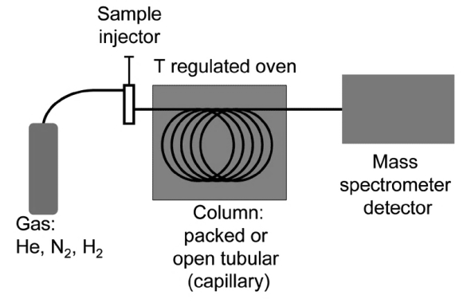
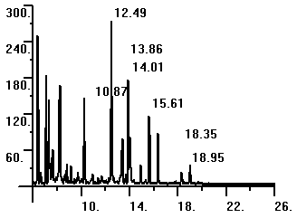
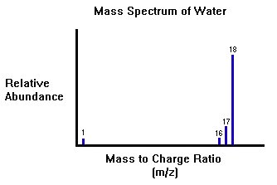
Analytical techniques
Elements and compounds can be detected and identified using instrumental methods.
GC, GC-MS
Advantages | Disadvantages
Highly accurate and sensitive. They are quicker. Enable very small samples to be analysed | Equipment is very expensive. Takes specialist training to use. results can ONLY be analysed by comparison with known data
Relative abundance
Retention time
Different substances, carried by a gas, travel through a column packed with a solid material at different speeds, so that they become separated the number of peaks on the output of a gas chromatograph shows the number of compounds present. The position of the peaks on the output indicates the retention time.
Chemical analysis can be used to identify additives in foods. Artificial colours can be detected/identified by paper chromatography
The output from the gas chromatography column can be linked to a mass spectrometer, which can be used to identify the substances leaving the end of the column by relative molecular mass
The molecular mass is given by the molecular ion peak.
A B C D
Components in a mixture can be identified by the distance they move relative to the solvent. This is the R_{f} value:
Distance moved by component
Distance moved by solvent

Slide 2
10 Questions
How can you separate…
  A solid from a liquid
  A liquid from a gas
  A liquid from a liquid
What is an E-number?
State one advantage and one disadvantage of chromatography.
What do we call the filter paper after the chromatography experiment has ended?
What colours are present in blank inks?
What does the R_{f} value represent?
What do the initials GC-MS stand for?
Give an example of a typical carrier gas in a GC-MS.
What is the period of time a gas remains in the column of a GC-MS called?
Give a use for chromatography.
Analytical techniques

Slide 3
Mark Scheme
Analytical techniques
(a) Filtering
(b) take the lid off
(c) chromatography
Codes for chemicals which can be used as food additives for use within the EU.
Advantages:
Highly accurate and sensitive.
They are quicker.
Enable very small samples to be analysed
Disadvantages:
Equipment is very expensive.
Takes specialist training to use.
results can ONLY be analysed by comparison with known data.
Chromatogram
All colours
Distance compound travels up chromatogram
Gas Chromatography – Mass Spectrometry
He (or) N₂ (or) H₂
Retention time
Separating a mixture of liquids (or) Money and cheques can be proven as fakes using this scientific technique - others
Calculations and moles
The relative formula mass of a substance, in grams, is known as one mole of that substance.
35.5
Na₂O
= (2xNa) + (1xO)
= (2x23) + (1x16)
= 46 + 16
= 62
% of Na = (⁴⁶/₆₂) x 100 = 74.2%
Mr of (NH₄)₂SO₄ = 132
% of O = (⁶⁴/₁₃₂) x 100 = 48.5%
The amount of a product obtained is known as the yield.
MgCO₃ → MgO + CO₂
(24+12+48) (24+16)
84g 40g
42g 20g
Yield = (¹⁸/₂₀) x 100 = 90%
C H
⁷⁵/₁₂ ²⁵/₁
6.25 25
1 4 CH₄

