Slide 1

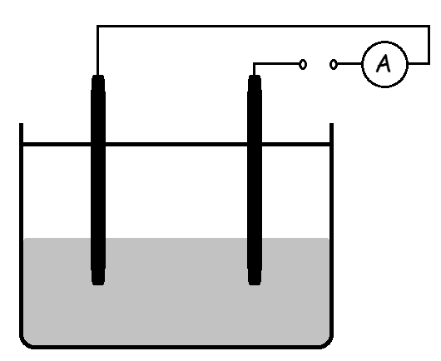
Electrolysis – Molten
When ionic compounds are melted or dissolved in water the ions can move.
This means that molten ionic compounds and solutions of ionic compounds conduct electricity.
Positive ions (CATIONS) move to the negative electrode (CATHODE).
Negative ions (ANIONS) move to the positive electrode (ANODE).
The solution or melt that is electrolysed is called the ELECTROLYTE.
+
-
Br₂
Anode
Cathode
Br⁻
Br⁻
Pb²⁺
Electrolysis of molten compounds
All ionic compounds contain positive and negative ions. We can predict the ions present from the formula and the charges on the ions using the formula and the data sheet.
During electrolysis:
The CATIONS move to the negative electrode where they GAIN electrons
The ANIONS move to the positive electrode where they LOSE electrons
e.g. lead bromide
PbBr₂ → Pb²⁺ + 2Br⁻
Pb²⁺ ions move to the cathode and gain electrons:
Pb²⁺ + 2e⁻ → Pb
Br⁻ ions move to the anode and lose electrons:
2Br⁻ → Br₂ + 2e⁻
O xidation | R eduction
I s | I s
L oss | G ain
OF ELECTRONS

Slide 2
10 Questions
Why can’t ionic solids conduct electricity?
What is the name given to the positive electrode?
What is a compound split up into using electrolysis?
What is the solution or melt that is electrolysed called?
What does the acronym O I L R I G stand for?
Br⁻ ions reach the positive electrode and loose electrons to form bromine gas, is this process oxidation or reduction?
What ions are present in calcium iodide and which electrode would each ion go to?
Balance and complete the following reactions:
__Ca²⁺ + __e⁻ → __Ca
__Cl⁻ → Cl₂ + __e⁻
__CaCl₂ → __Ca²⁺ + __Cl⁻
Electrolysis – Molten

Slide 3
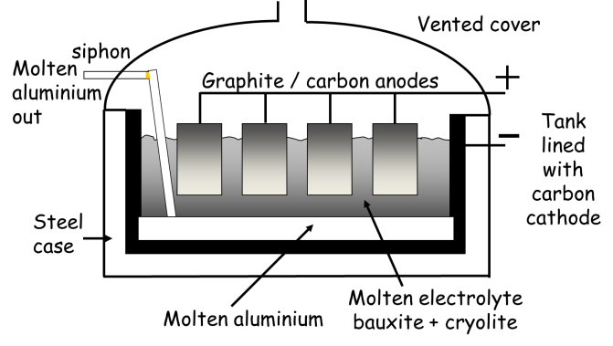
Electrolysis - Solutions
At the negative electrode, positively charged ions gain electrons (reduction) and at the positive electrode, negatively charged ions lose electrons (oxidation).
If there is a mixture of ions, the products formed depend on the reactivity of the elements involved.
Electroplating
Electrolysis is used to electroplate objects. This may be for a variety of reasons and includes copper plating and silver plating.
Passing a current through a solution containing Cu2+ ions or Ag+ ions will result in the silver or copper being deposited on the cathode.
Extraction of aluminium
Bauxite – aluminium ore containing aluminium oxide
Aluminium oxide has a very high melting point
The electrolysis takes place when the aluminium oxide is molten. It is dissolved in molten cryolite to reduce the temperature at which it melts.
This reduces energy costs
The cathode and anode are made of graphite
Brine
Compounds: sodium chloride (NaCl) and water (H₂O)
Ions: Na⁺ + Cl⁻ (Anode) --- OH⁻ + H⁺ (Cathode)
Positive electrode
2Cl⁻ → Cl₂ + 2e⁻
Negative electrode
2H⁺ + 2e⁻ → H₂
Negative electrode
3Al⁺ + 3e⁻ → Al
When the chloride ions and hydrogen ions have been discharged……NaOH is left behind
Products in the electrolysis of brine:
Chlorine (Cl₂) - used in bleach and plastics.
Hydrogen (H₂) - used in the hydrogenation of vegetable oil to make butter.
Sodium hydroxide (NaOH) - used in soap.
Positive electrode
2O²⁻ → O₂ + 4e⁻
Oxygen is released at the anode where it reacts with the graphite to form carbon dioxide. Therefore the anode needs to be replaced often

Slide 4
Electrolysis - Solutions
What is the chemical formula of salt in the sea?
What ions are present in brine?
What are the 3 products made when brine undergoes electrolysis? Give a use of each one.
What ions move towards the anode?
What ions move towards the cathode?
What gas discharged at the anode (write the ionic equation as well)?
What gas discharged at the cathode (write the ionic equation as well)?
What ions are left in solution?
What is the name of the compound left in the solution
When bauxite undergoes electrolysis what metal is formed and why does the carbon anode need to be frequently replaced?
Electrolysis – Molten

Slide 5
Mark Scheme
Electrolysis – Molten
Ions cannot move
Anode (Remember PANIC: Positive Anode Negative Is Cathode).
Elements
Electrolyte
OILRIG – Oxidation Is Loss, Reduction Is Gain (of electrons).
Oxidation
Ca²⁺ would go to the cathode, I⁻ would go to the anode.
Ca²⁺ + 2e⁻ → Ca
2Cl⁻ → Cl₂ + 2e⁻
CaCl₂ → Ca²⁺ + 2Cl⁻
Electrolysis - Solutions
NaCl
Na⁺, H⁺, OH⁻, Cl⁻
Hydrogen, chlorine, sodium hydroxide.
Negative ions (OH⁻, Cl⁻)
Positive Ions (H⁺, Na⁺)
Chlorine, 2Cl⁻ → Cl₂(g) + 2e⁻
Hydrogen, 2H⁺ + 2e- → H₂(g)
Na⁺ and OH⁻
Sodium hydroxide
Aluminium. Oxygen is released at the anode where it reacts with the graphite to form carbon dioxide. Therefore the anode needs to be replaced often.

