Slide 1

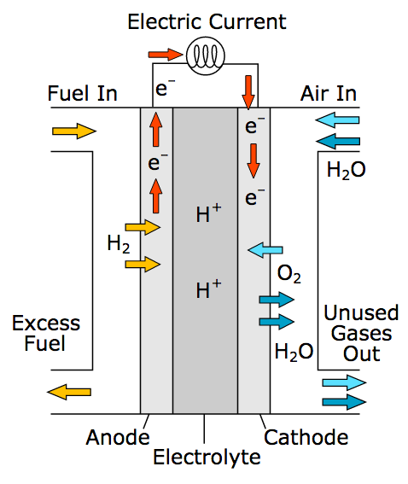
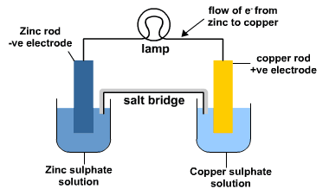
Electrochemical cells
Remember OILRIG:
Oxidation is loss of electrons
Reduction is gain of electrons
We can represent this using half equations e.g.
Oxidation of Lithium: Li → Li⁺ + e⁻
Reduction of aluminium: Al³⁺ + 3e⁻ → Al
Metals are always trying to lose electrons but more reactive ones will do so more easily. We say they have a greater potential.
If a circuit is arranged which connects two different metals then this potential difference will force electrons from one metal into the other, creating a current.
Hydrogen fuel cells
H₂ cells have 2 stages:
H₂ is oxidised to provide a supply of electrons
The H⁺ ions are reduced again alongside oxygen to produce water
H₂ is highly explosive but these cells produce clean exhaust.
Anode (reduction): 2H₂ → 4H⁺ + 4e⁻
Cathode (oxidation): 4H⁺ + O₂ + 4e⁻ → 2H₂O
Overall: 2H₂ + O₂ → 2H₂O
If the reaction in a cell is reversible then a current can be applied to force electrons the other way, charging a battery.
More reactive metal, higher potential to give away electrons

Slide 2
10 Questions
________ is defined as the gain of electrons.
What determines how reactive a metal is?
What sorts of metals will have the greatest potential difference?
In a cell with silver and aluminium electrodes, which way will electrons flow?
How can a rechargeable battery be charged up?
At which electrode does oxidation take place?
What is the overall product of a hydrogen fuel cell?
Give one advantage and one disadvantage of H₂ cells.
HT: give the two half equations for a cell of silver and aluminium
HT: give the two half equations of a hydrogen cell.
Electrochemical cells

Slide 3
Mark Scheme
Electrochemical cells
reduction
How easily it loses its valent electrons to form an ion
Very reactive paired with very unreactive
From aluminium (reactive) to silver (unreactive)
By applying DC counter to the current generated by the cell
The cathode (positive in an electrochemical cell but negative in electrolysis)
Water, H₂O
No waste; dangerous, costly
HT: Al → Al³⁺ + 3 e⁻ 3Ag⁺ + 3e⁻ → 3Ag
HT: 2H₂ → 4H⁺ + 4e⁻
4H⁺ + O₂ + 4e⁻ → 2H₂O

