Slide 1
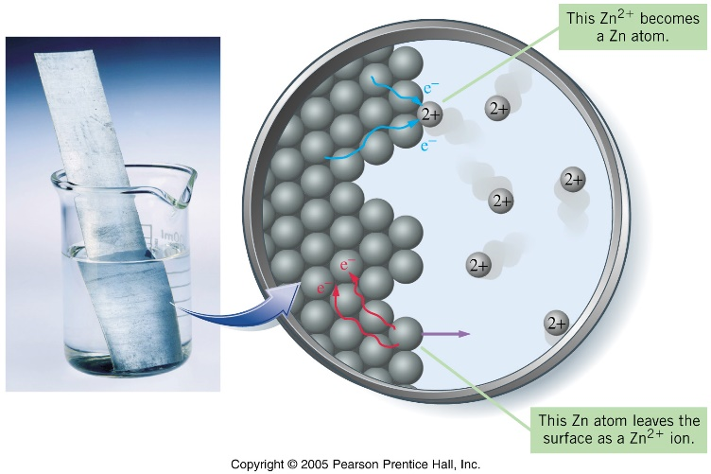
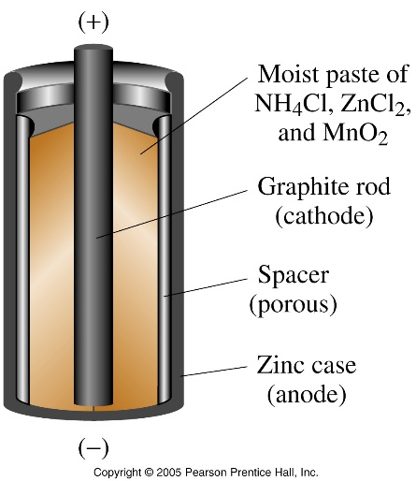
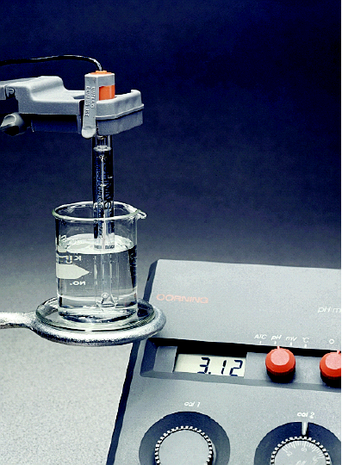
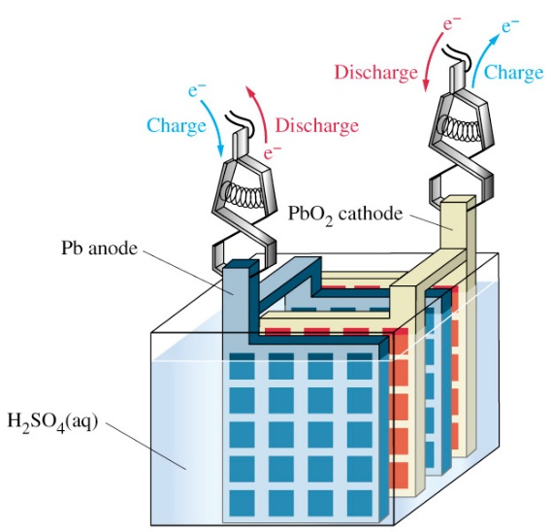
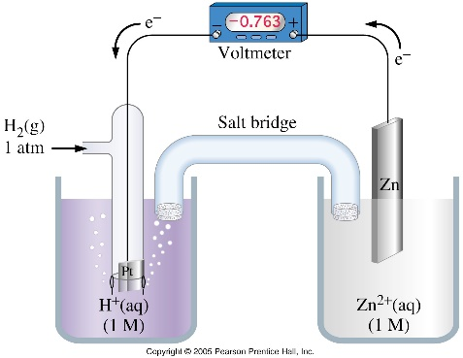
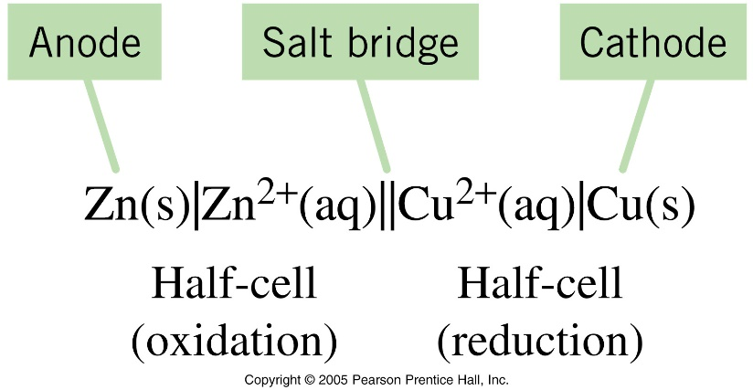
Electrochemistry

Slide 2
Oxidation and Reduction

Slide 3
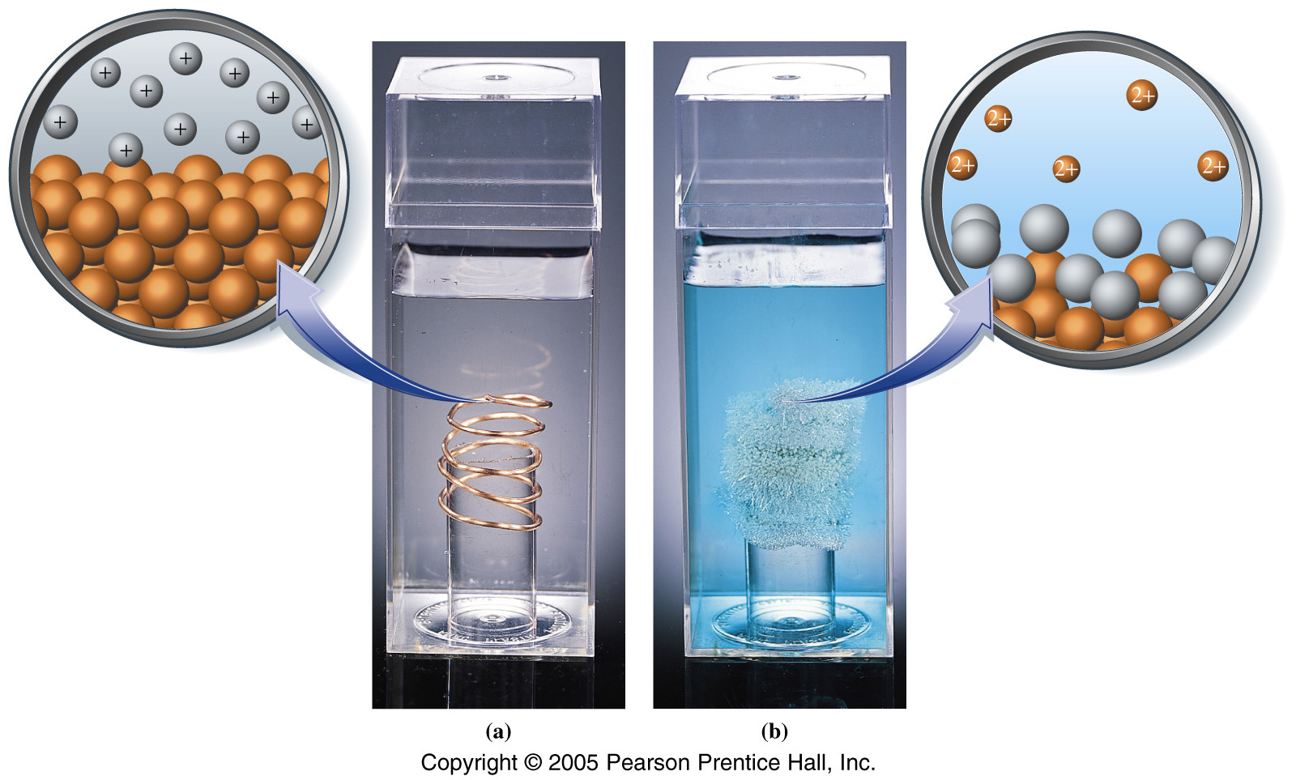
Oxidation–Reduction: The Transfer of Electrons
Silver metal is formed, and the solution turns blue from copper(II) ions formed.
Electrons from copper metal are transferred to silver ions.

Slide 4
Oxidation–Reduction
19.1 Redox Reactions (SB p.172)
Oxidation | Reduction
Addition of oxygen | Removal of oxygen
Removal of hydrogen | Addition of hydrogen
Loss of electron | Gain of electron
Increase in O.N. | Decrease in O.N.
(An 'imaginary charge')
Al → Al³⁺ + 3e⁻
Mg + CuSO₄ → Cu + MgSO₄
H₂ + O₂ → H₂O₂
CH₄ + H₂O → CO + 3H₂

Slide 5
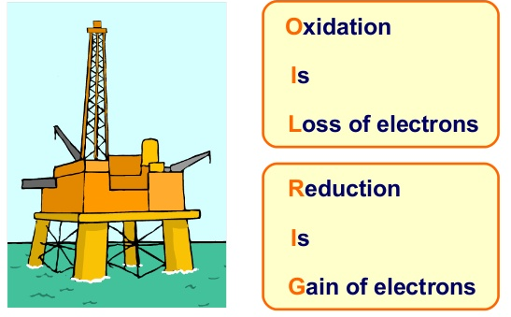
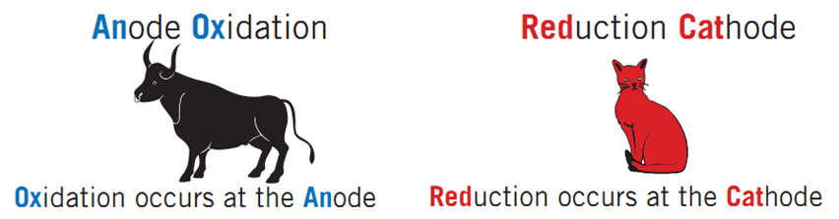
Oxidation–Reduction

Slide 6
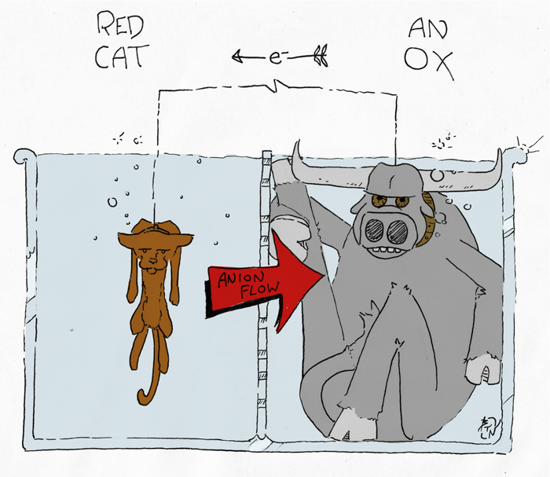
Oxidation–Reduction

Slide 7
Definition of oxidizing and reducing agents
19.1 Redox Reactions (SB p.172)
Oxidizing agent | Reducing agent
1. Undergoes reduction. | Undergoes oxidation.
2. Oxidizes a reducing agent. | Reduces an oxidizing agent.
3. Gain of electron(s). | Loss of electron(s).
4. Decrease in oxidation number. | Increase in oxidation number.
Fe₂O₃ + 3CO → 2Fe + 3CO₂
Mg + CuSO₄ → Cu + MgSO₄
H₂ + O₂ → H₂O₂
CH₄ + H₂O → CO + 3H₂

Slide 8
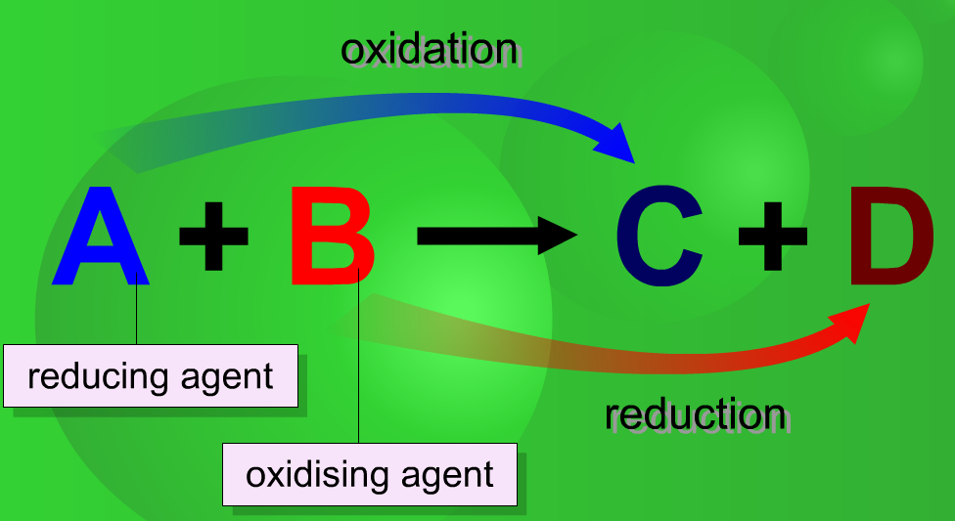
Definition of oxidizing and reducing agents
19.1 Redox Reactions (SB p.172)

Slide 9
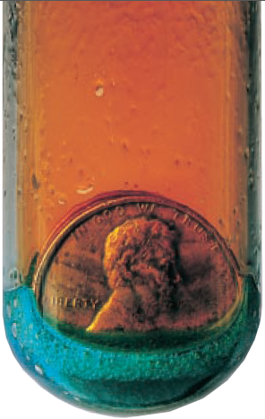
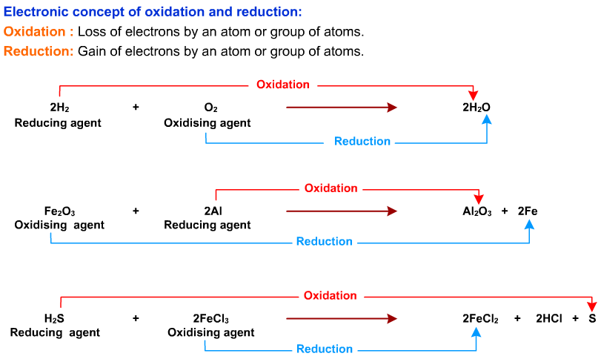
Oxidation–Reduction
Explain the copper and nitric acid reaction here

Slide 10
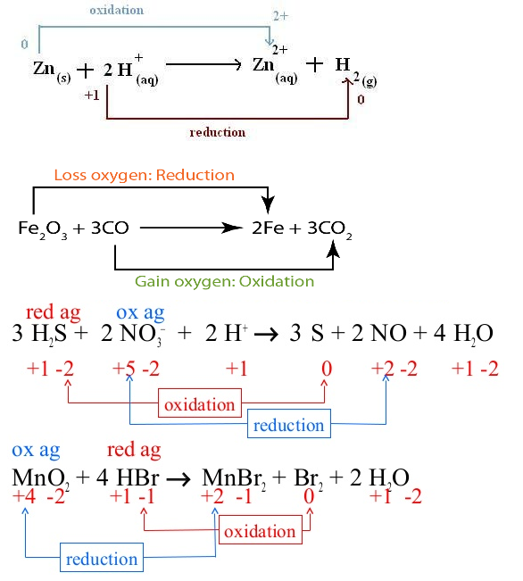

Slide 11
Nomenclature

Slide 12
Nomenclature
Transition metals can have varied oxidation states, therefore in compounds we show the state by using Roman Numerals, other elements also require this notation: e.g. mercury, tin, lead and covalent compounds which have a generic name e.g. carbon dioxide = carbon (IV) oxide
manganese(IV) oxide shows that Mn is in the +4 oxidation state in MnO₂
sulphur(VI) oxide for SO₃ S is in the +6 oxidation state
dichromate(VI) for Cr₂O₇²⁻ Cr is in the +6 oxidation state
phosphorus(V) chloride for PCl₅ P is in the +5 oxidation state
phosphorus(III) chloride for PCl₃ P is in the +3 oxidation state
Q. Name the following... PbO₂ lead(IV) oxide
SnCl₂ tin(II) chloride
SbCl₃ antimony(III) chloride
TiCl₄ titanium(IV) chloride
BrF₅ bromine(V) fluoride

Slide 13
Galvanic/Voltaic
Cells

Slide 14

A Qualitative Description of Voltaic Cells
A voltaic cell uses a spontaneous redox reaction to produce electricity.
A half-cell consists of an electrode (strip of metal or other conductor) immersed in a solution of ions.
This Zn²⁺ becomes a Zn atom.
Both oxidation and reduction occur at the electrode surface, and equilibrium is reached.
This Zn atom leaves the surface to become a Zn²⁺ ion.

Slide 15
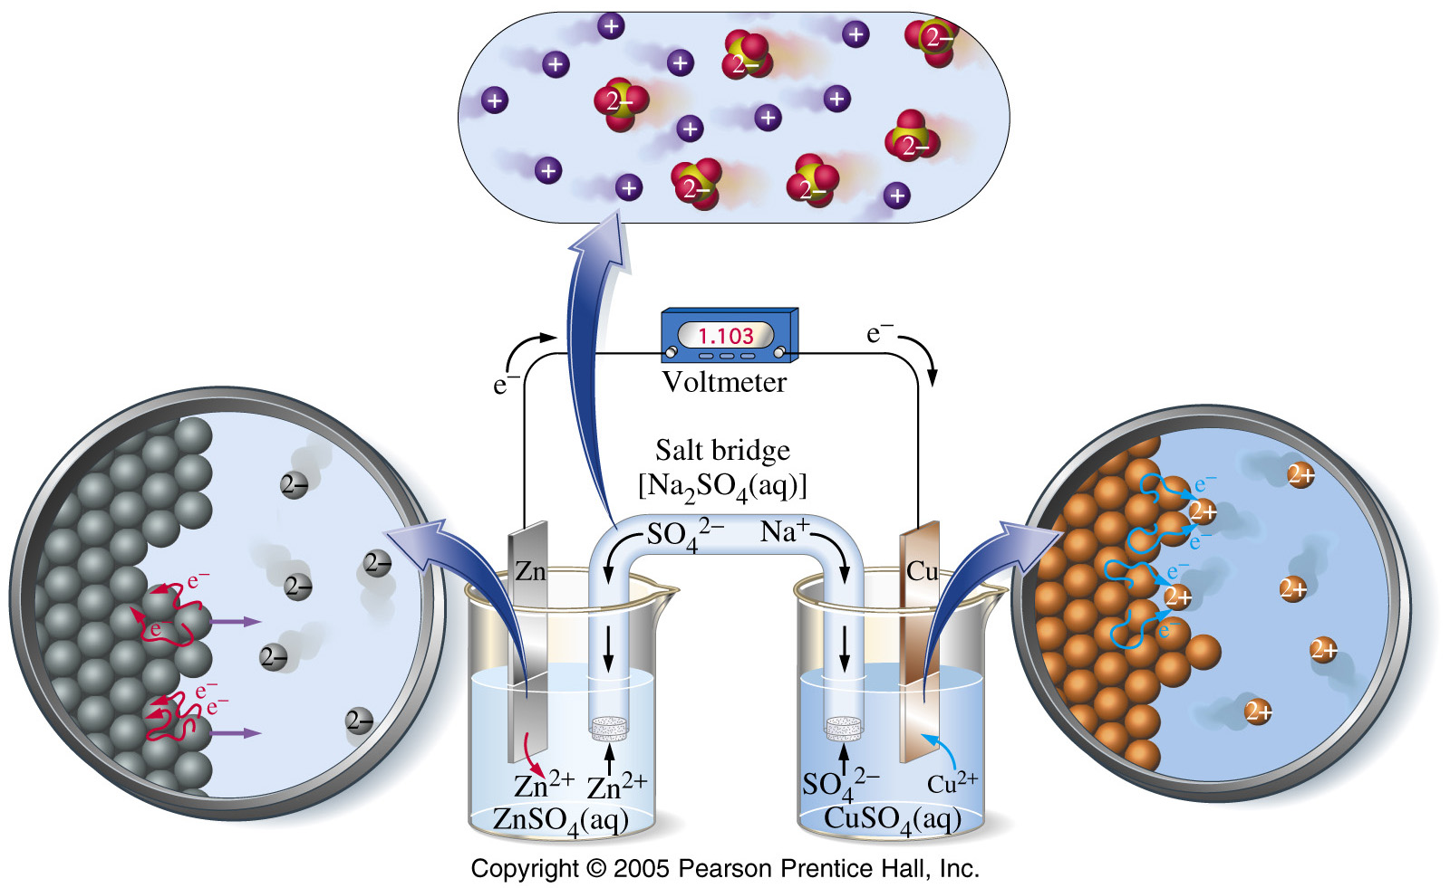
Voltaic Cell
Cell potential (Ecell) is the potential difference in volts between anode and cathode.
Salt Bridge
Cathode
(Red Cat.)
Anode
(An Ox.)
Reaction: Zn(s) + Cu²⁺(aq) → Cu(s) + Zn²⁺(aq)

Slide 16
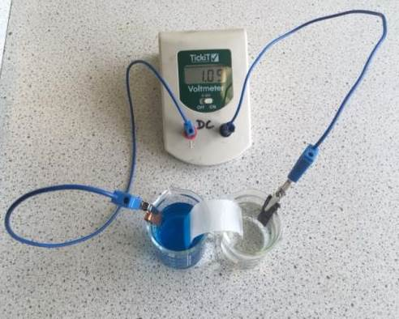
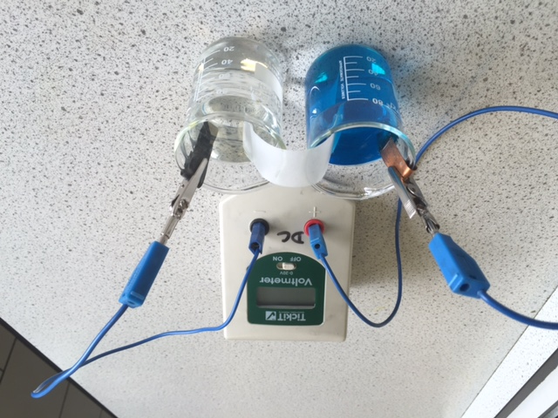
One of the two half cells [a piece of zinc in a solution of zinc nitrate(aq)]
Salt bridge [strip of filter paper soaked in saturated KNO₃(aq)]

Slide 17
A Zinc–Copper Voltaic Cell
Positive and negative ions move through the salt bridge to equalize the charge.
… the electrons produced move through the wire …
… to the Cu(s) electrode, where they are accepted by Cu²⁺ ions to form more Cu(s).
Zn(s) is oxidized to Zn²⁺ ions, and …
Reaction: Zn(s) + Cu²⁺(aq) → Cu(s) + Zn²⁺(aq)

Slide 18
Electrolytic Cells

Slide 19
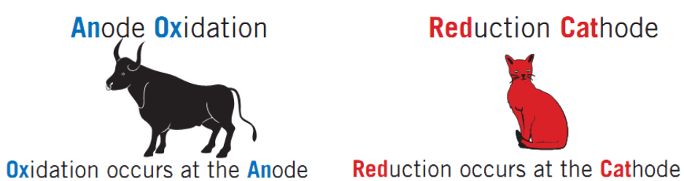
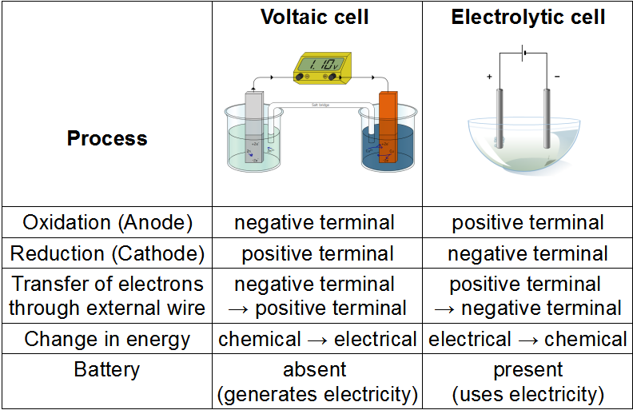
Electrolytic Cells
voltaic cells → spontaneous cell reactions
electrolytic cells → nonspontaneous cell reactions (electrolysis)
Oxidation still happens at the anode and reduction at the cathode
The polarities of the electrodes are reversed from those in the voltaic cell, because now the external source controls the flow of electrons.

Slide 20
Molten (liquid) Cells

Slide 21
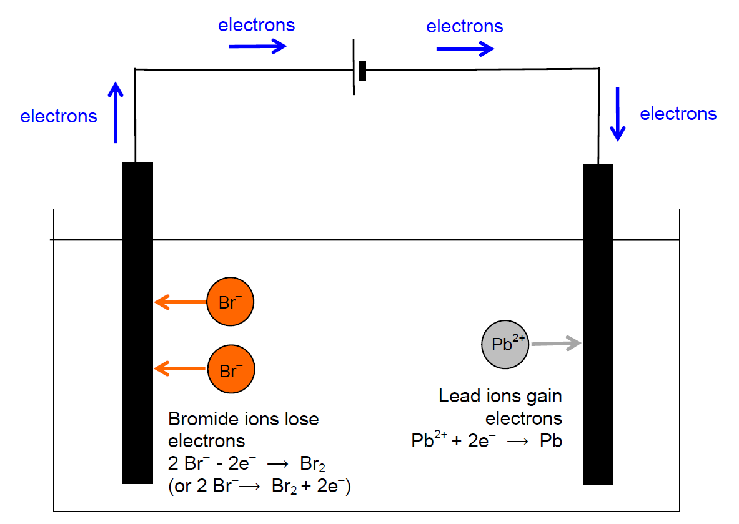
Electrolytic Cells
Electrolysis of molten lead bromide
+ electrode
(anode)
– electrode
(cathode)
OXIDATION
REDUCTION

Slide 22
LEAD BROMIDE (l), PbBr₂
(contains Pb²⁺, Br⁻)
-ve electrode
Pb²⁺ ions attracted
Pb²⁺ → Pb (lead made)
Pb²⁺ + 2 e⁻ → Pb
gains electrons ∴ reduction
+ve electrode
Br⁻ ions attracted
Br⁻ → Br₂ (bromine made)
2 Br⁻ → Br₂ + 2 e⁻
loses electrons ∴ oxidation
DO THE SAME FOR: NaCl(l) and Al₂O₃(l)
© www.chemsheets.co.uk GCSE 1141 27-Dec-2016

Slide 23
SODIUM CHLORIDE (l), NaCl
(contains Na⁺, Cl⁻)
-ve electrode
Na⁺ ions attracted
Na⁺ → Na (sodium made)
Na⁺ + e⁻ → Na
gains electrons ∴ reduction
+ve electrode
Cl⁻ ions attracted
Cl⁻ → Cl₂ (chlorine made)
2 Cl⁻ → Cl₂ + 2 e⁻
loses electrons ∴ oxidation
© www.chemsheets.co.uk GCSE 1141 27-Dec-2016

Slide 24
ALUMINIUM OXIDE (l), Al₂O₃
(contains Al³⁺, O²⁻)
-ve electrode
Al³⁺ ions attracted
Al³⁺ → Al (aluminium made)
Al³⁺ + 3 e⁻ → Al
gains electrons ∴ reduction
+ve electrode
O²⁻ ions attracted
O²⁻ → Cl₂ (chlorine made)
2 O²⁻ → O₂ + 4 e⁻
loses electrons ∴ oxidation
© www.chemsheets.co.uk GCSE 1141 27-Dec-2016

Slide 25
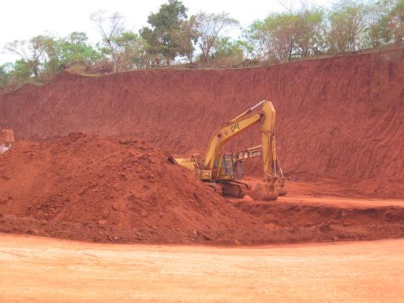
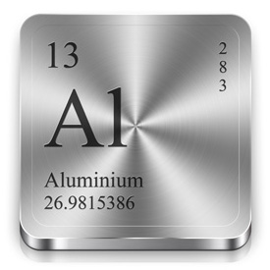
ALUMINIUM
extracted from Al₂O₃ (bauxite)
by electrolysis

Slide 26
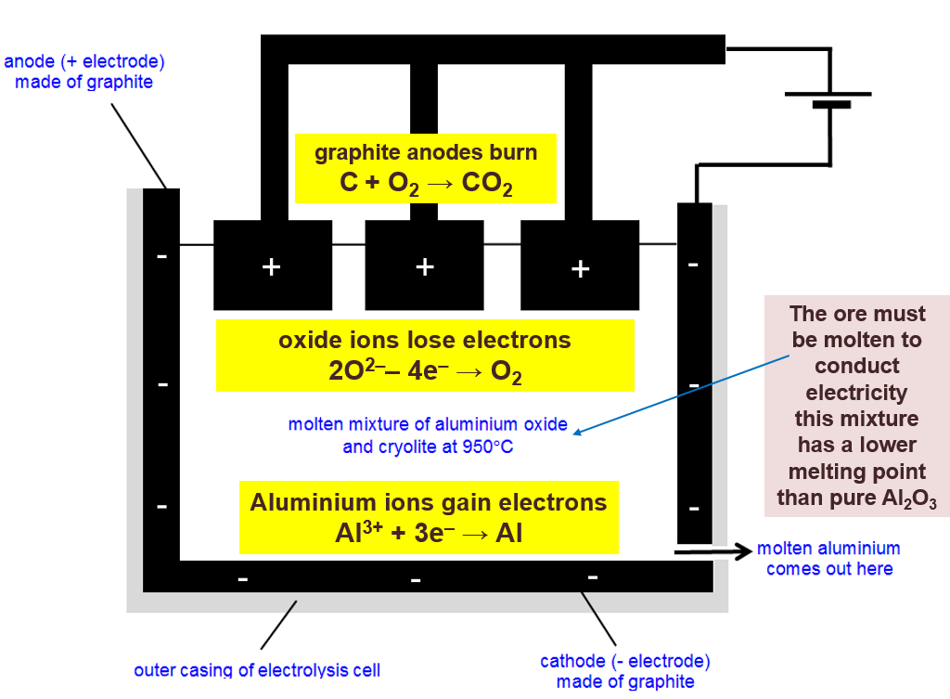
ALUMINIUM

Slide 27
Aqueus (aq.) Cells

Slide 28
Predicting Electrolysis Reactions
The ions separate when an ionic substance dissolves in water

Slide 29
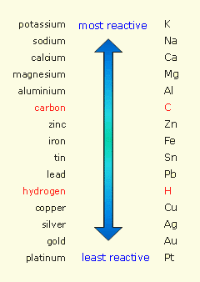
Predicting Electrolysis Reactions
+ IONS v H⁺
Metals less reactive than hydrogen | Metals more reactive than hydrogen
e.g. Cu²⁺, Ag⁺, Au⁺... | e.g. Na⁺, Mg²⁺, Zn²⁺
Metal ions discharged (forms metal) | Hydrogen ions discharged (forms H₂)
e.g. Ag⁺ + e⁻ → Ag | e.g. 2H⁺ + 2e⁻ → H₂

Slide 30
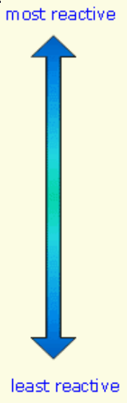
Predicting Electrolysis Reactions
– IONS v OH–
– IONS v OH–
Sulfate (SO₄²⁻)
Nitrate (NO₃⁻)
Hydroxide(OH⁻)
Chloride (Cl⁻)
Bromide (Br⁻)
Iodide (I⁻)
Halide ions | Other – ions
e.g. Cl–, Br–, I– | e.g. SO₄^{2–}, NO₃–
Halide ions discharged (forms Cl₂, Br₂, I₂) | Hydroxide ions discharged (forms O₂)
e.g. 2Cl⁻ → Cl₂ + 2e- | 4OH⁻ → O₂ + 4e⁻ + 2H₂O

Slide 31
A Diaphragm Cell
Cl₂(g)
H₂(g)
At Anode
2Cl⁻(aq) → Cl₂(g) + 2e⁻
At Cathode
2H⁺(aq) + 2e⁻ → H₂(g)
Saturated brine, NaCl(aq)
PTFE diaphragm
Steel anode (+)
Titanium cathode (-)
Na⁺
This accounts for 1% of the whole U.K.’s electricity usage!
Na⁺ remain
OH⁻ remain
NaOH(aq)
PTFE membrane allows cations (Na⁺) to pass through
→ aqueous sodium hydroxide produced around the cathode

Slide 32
Predicting Electrolysis Reactions
compound | + ions | – ions | + electrode | – electrode
NaCl (aq) | Na⁺, H⁺ | Cl– , OH– | Cl– → Cl₂ | H⁺ → H₂
AgNO₃ (aq) | Ag⁺, H⁺ | NO₃– , OH– | OH– → O₂ | Ag⁺ → Ag
K₂SO₄ (aq) | K⁺, H⁺ | SO₄^{2–} , OH– | OH– → O₂ | H⁺ → H₂
Sulfate (SO₄²⁻)
Nitrate (NO₃⁻)
Hydroxide(OH⁻)
Chloride (Cl⁻)
Bromide (Br⁻)
Iodide (I⁻)

Slide 33
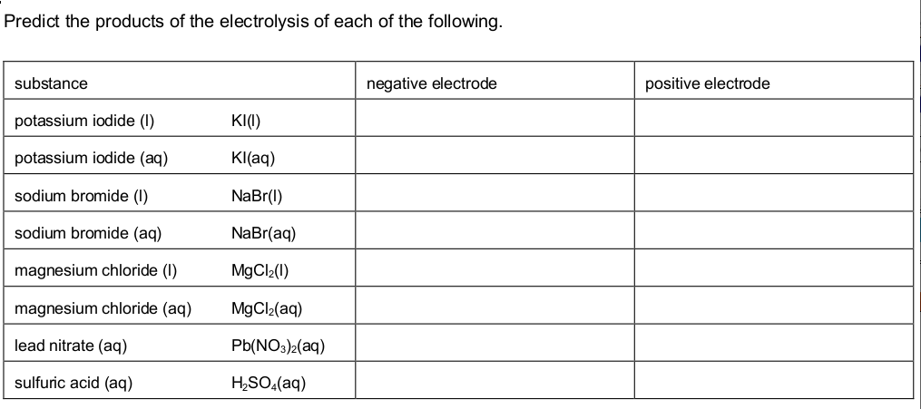
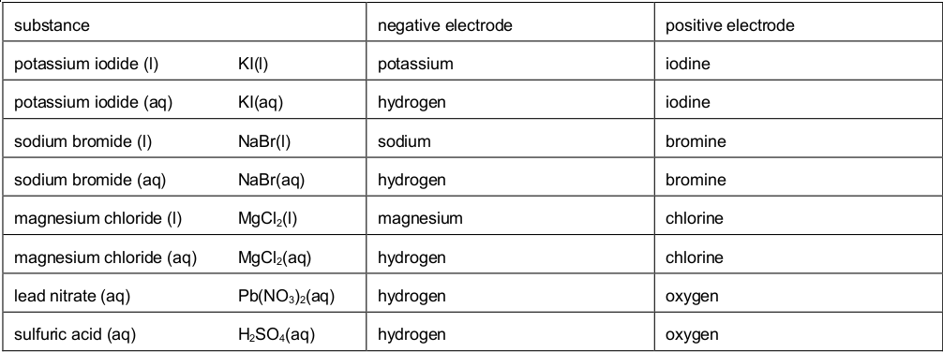
Predicting Electrolysis Reactions
Sulfate (SO₄²⁻)
Nitrate (NO₃⁻)
Hydroxide(OH⁻)
Chloride (Cl⁻)
Bromide (Br⁻)
Iodide (I⁻)

Slide 34
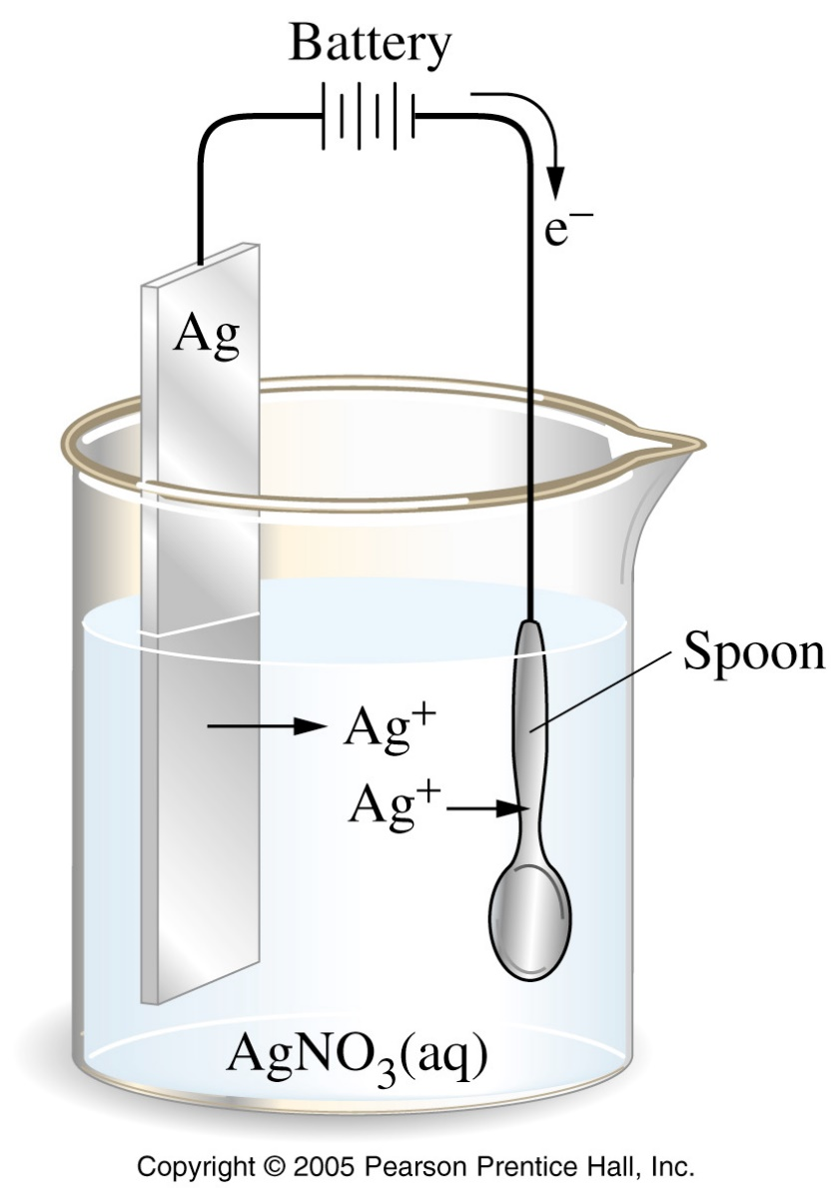

Electroplating
Electrolysis can be used to coat one metal onto another, a process called electroplating.
Usually, the object to be electroplated, such as a spoon, is cast of an inexpensive metal. It is then coated with a thin layer of a more attractive, corrosion-resistant, and expensive metal, such as silver or gold.

Slide 35
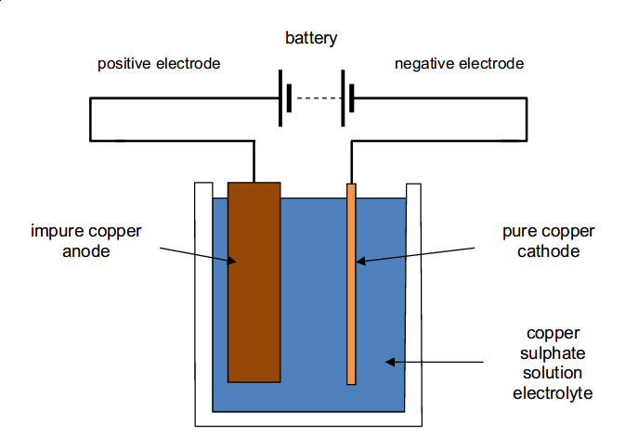
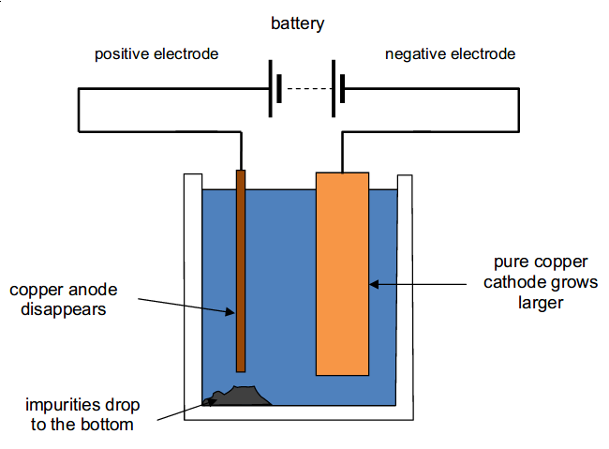
Purifying Copper
Copper should have high purity (99.995%) if it's used in water pipes, electrical wiring.

Slide 36
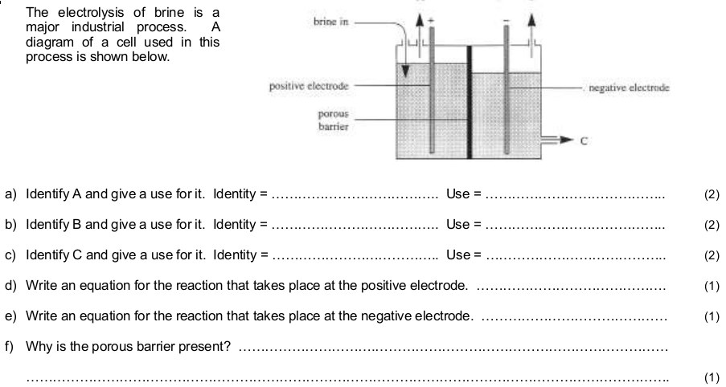
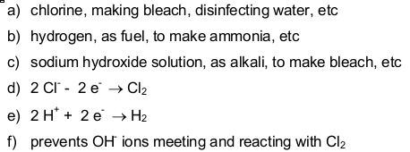
Brine Cell

