Slide 1
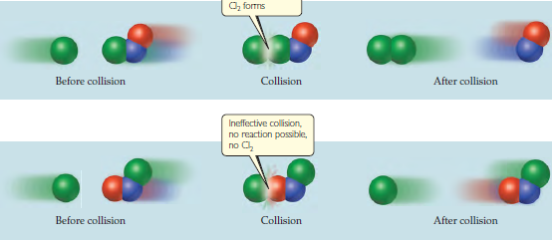
Chemical Kinetics

Slide 2
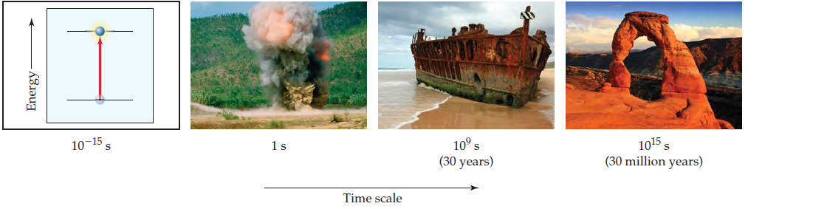

Chemical Kinetics
Chemical kinetics is the study of:
  the rates of chemical reactions
  factors that affect these rates
  the mechanisms by which reactions occur

Slide 3
Calculating Rates

Slide 4
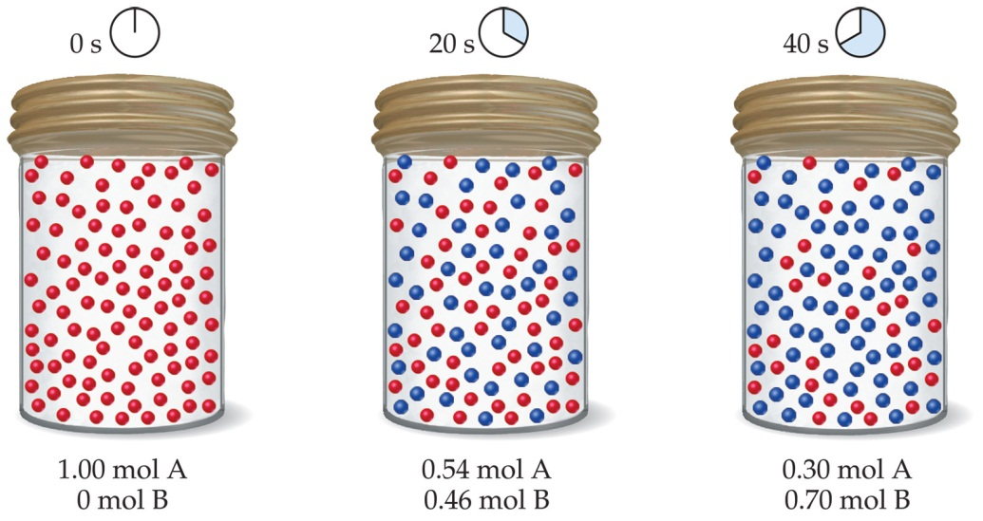
Rates of Reaction
Change in concentration of a species per unit time
Example: rate of formation of product A → P
Or …
Appearance of product
Disappearance of reactant
Units: moles per liter per (unit of) time
mol dm^{–3} s^{–1}

Slide 5
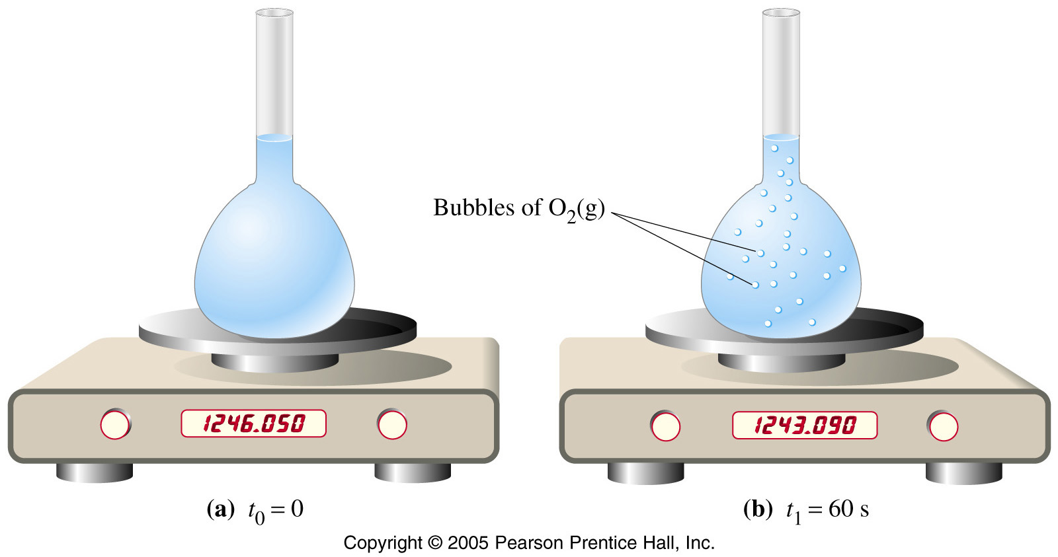
2H₂O₂ → 2H₂O + O₂
1 L
2.960 g O₂ (0.09250 mole) produced in 60 s means …
0.1850 mol H₂O₂/L
Rate =
60 s
… 0.1850 mol H₂O₂ reacted in 60 s.
= 0.00131 M H₂O₂ s^{–1}

Slide 6
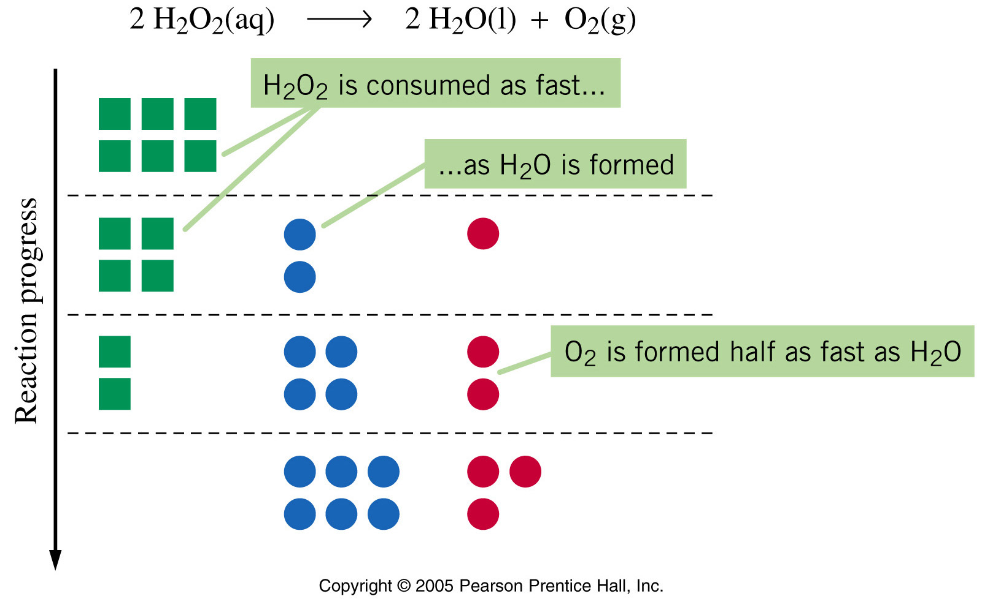
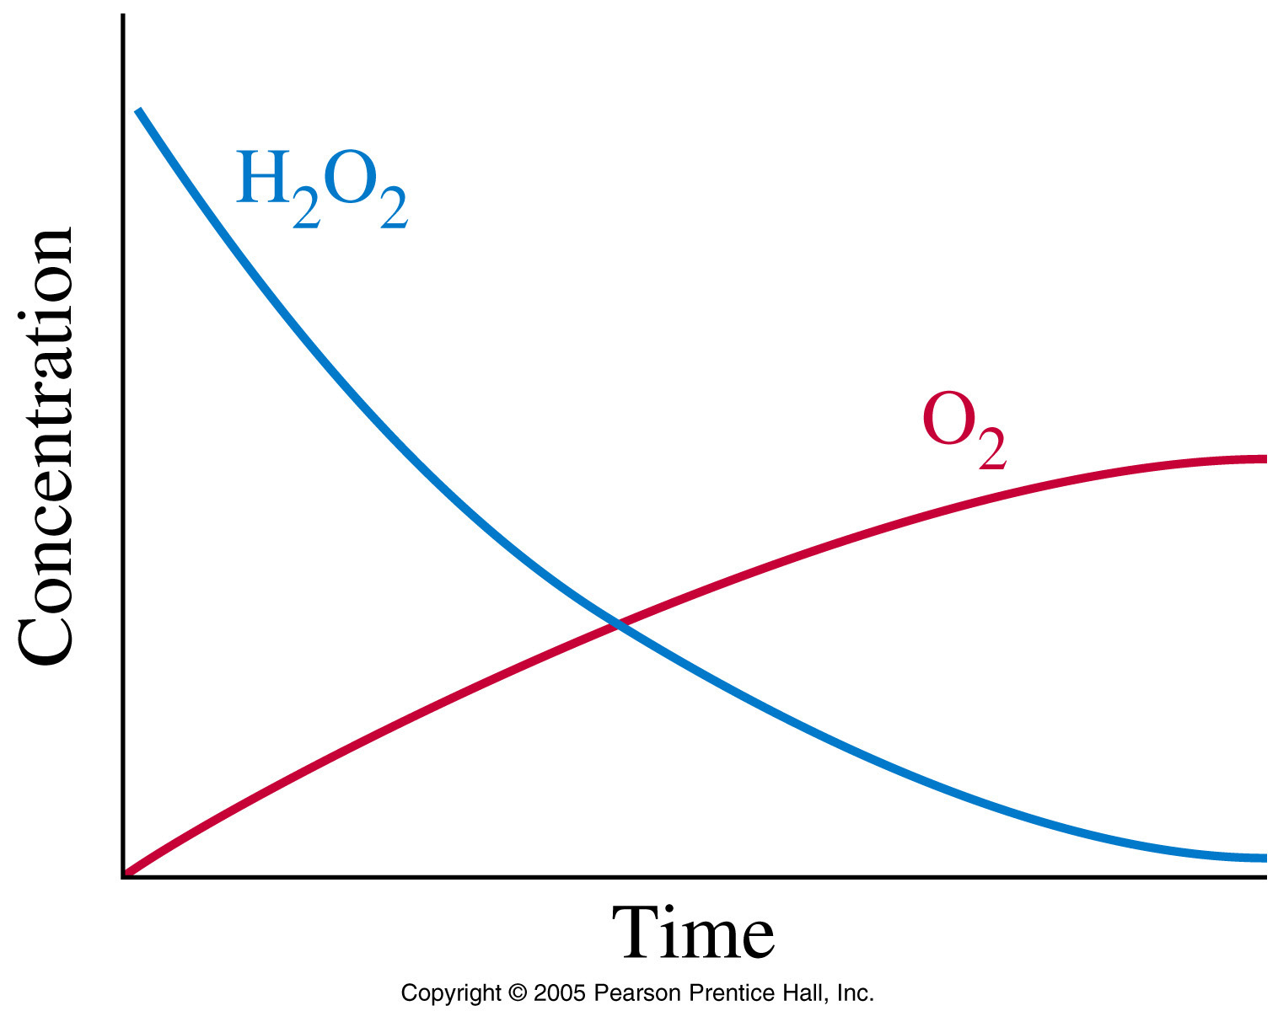
2H₂O₂ → 2H₂O + O₂
If the rate of consumption of H₂O₂ is 4.6 M/h, then …
… the rate of formation of H₂O must also be 4.6 M/h, and …
… the rate of formation of O₂ is 2.3 M/h

Slide 7
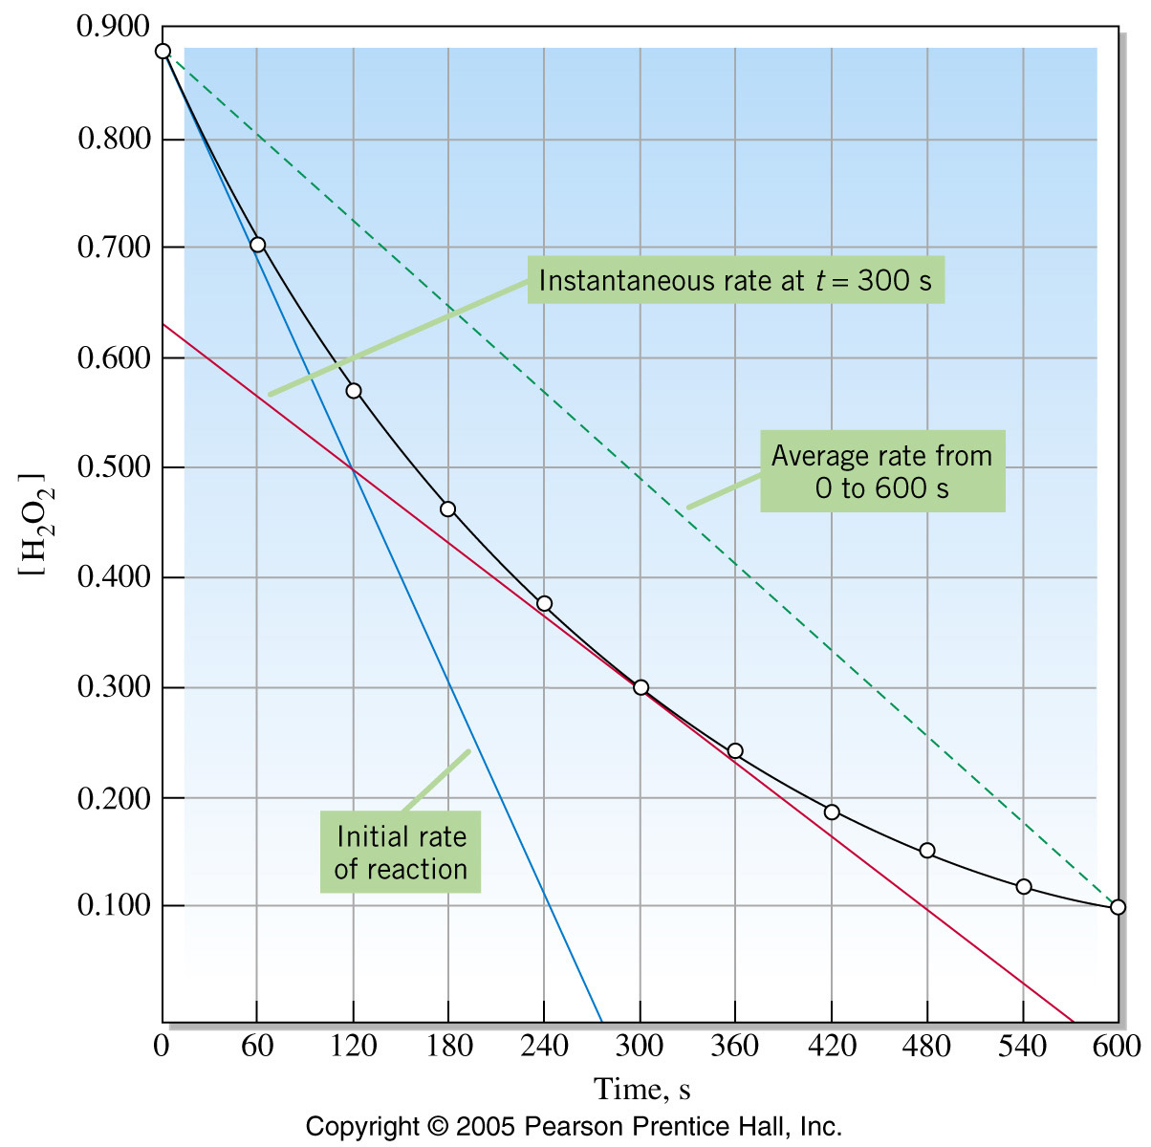
Average vs. Instantaneous Rate
Instantaneous rate is the slope of the tangent to the curve at a particular time.
We often are interested in the initial instantane-ous rate; for the initial concentrations of reactants and products are known at this time.

Slide 8
Gas Collection Methods

Slide 9
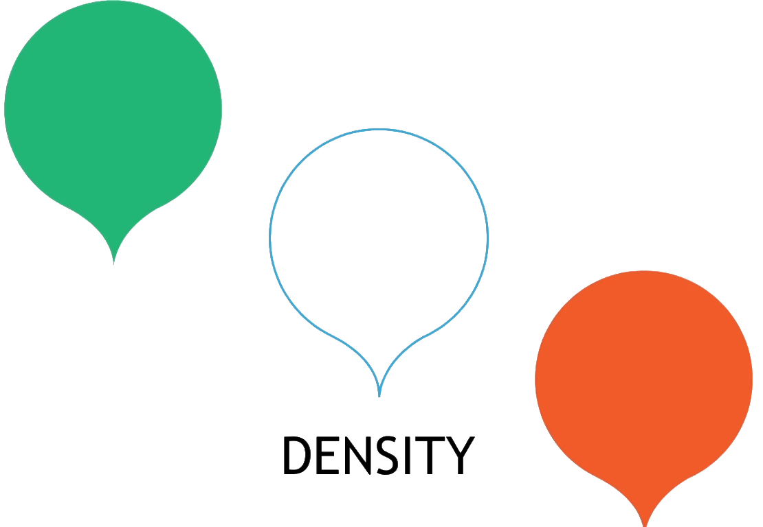
Gas Collection Methods
4g mol⁻¹
He
28g mol⁻¹
Air
Density = mass
volume
80% N₂
44g mol⁻¹
All gases occupy 22.4L at 25°C and 1 atm.
CO₂
Density is proportional to molar mass

Slide 10

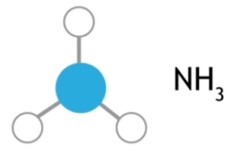


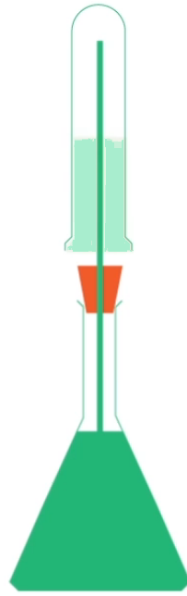
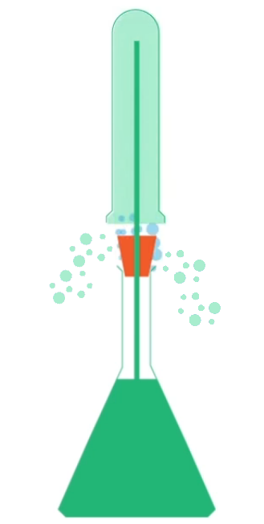
Gas Collection Methods

Slide 11



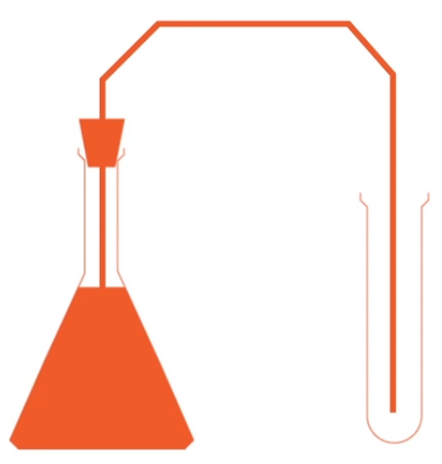
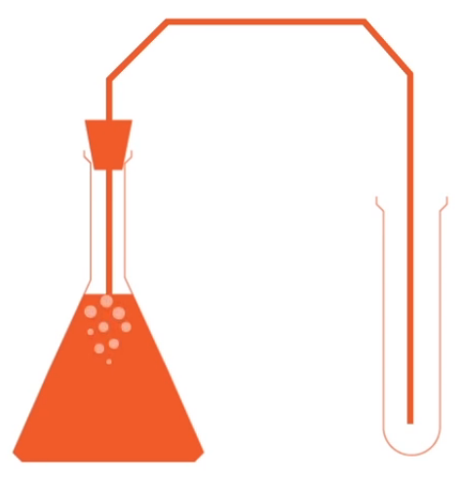
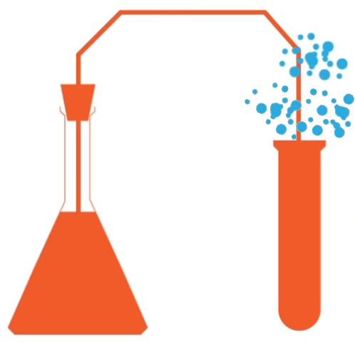
Gas Collection Methods

Slide 12
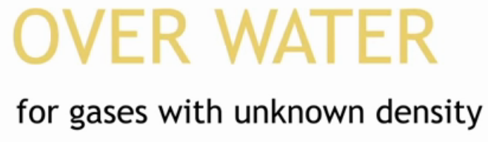
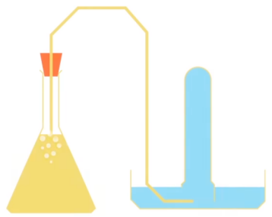
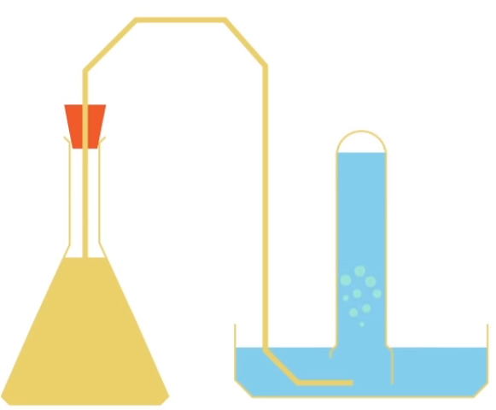
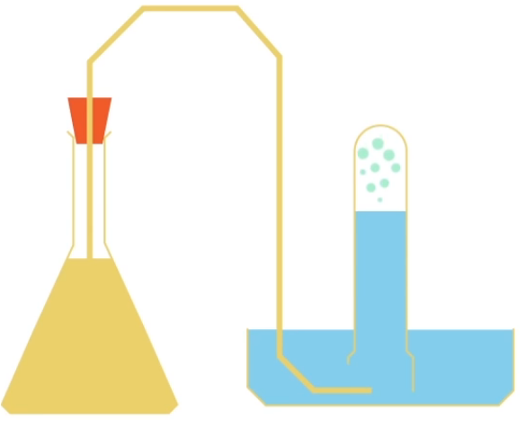
Gas Collection Methods

Slide 13
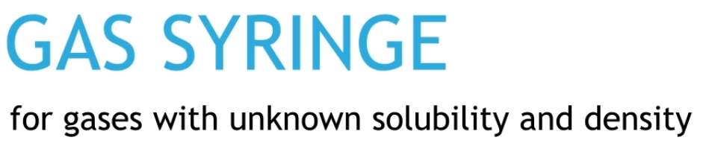
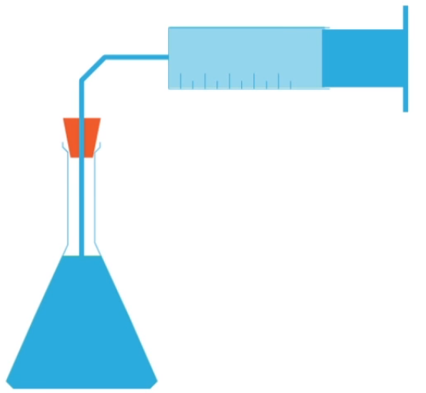
Gas Collection Methods

Slide 14
Measuring Rates

Slide 15
Methods to measure the rate of reaction
If we want to understand how fast a reaction is happening we have to investigate the reaction as it is happening
How much product is formed over a period of time?
How much reactant is used up over time?
The choice of method depends on the reaction

Slide 16
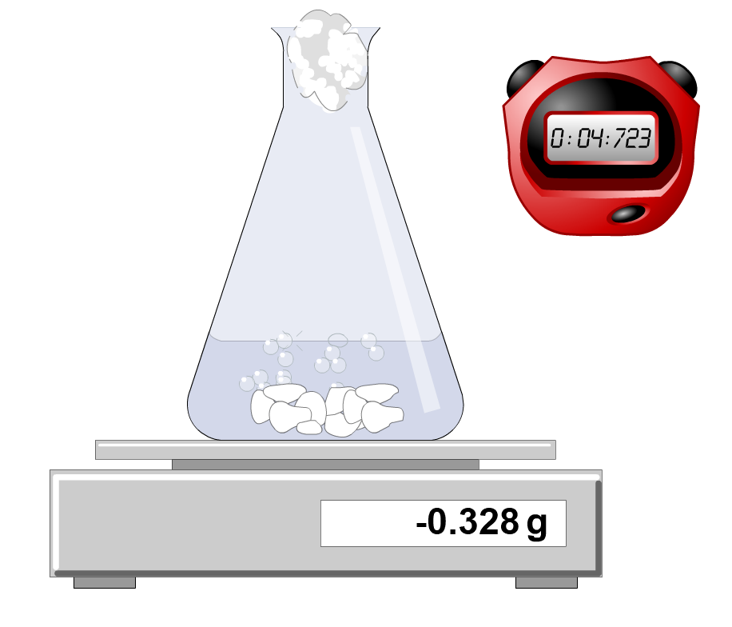
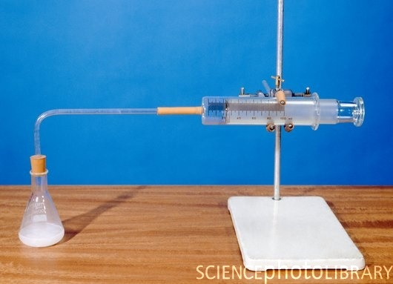
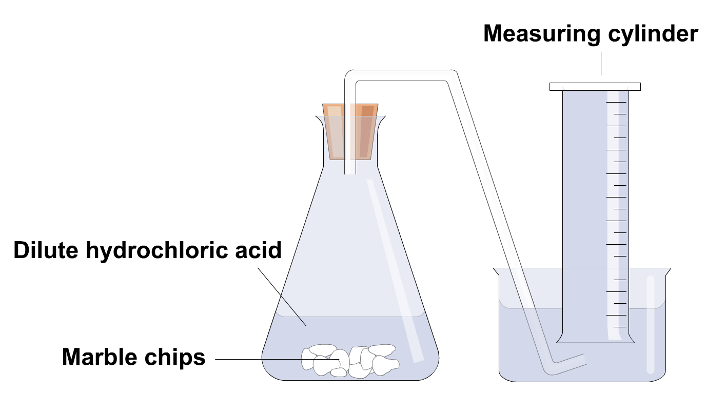
Methods to measure the rate of reaction
State 3 methods to measure the rate of a reaction in which a gas is evolved.

Slide 17
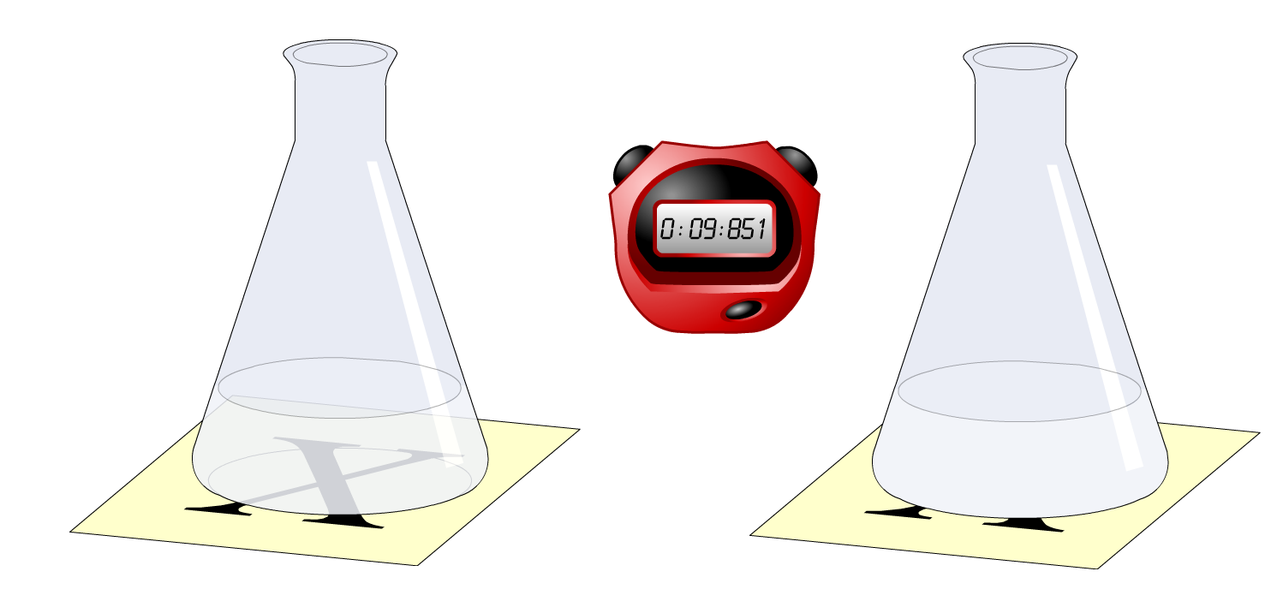
Methods to measure the rate of reaction
Explain how you would measure the rate of a reaction in which a precipitate is produced

Slide 18
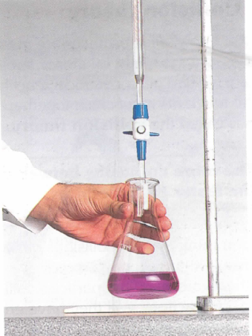
Methods to measure the rate of reaction
Directly measure the concentrations of products or reactants by titration
Take a sample of the reacting solution at specific time intervals
Stop or quench as quickly as possible
Titrate with a suitable standard solution
Quenched by:
1. rapidly cooling in ice
2. removing the catalyst
3. removing one of the reactants
by another chemical reaction
4. diluting with a large vol. of
cold water

Slide 19
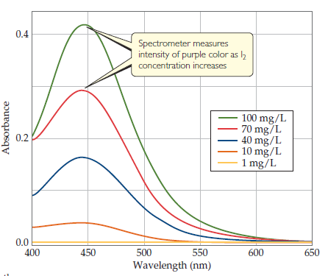
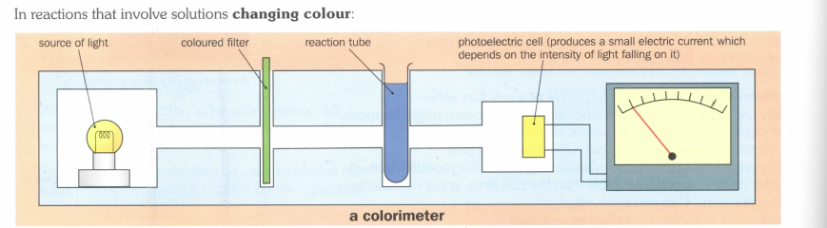
Methods to measure the rate of reaction
Coloured reactions can be monitored using a spectrometer
Spectrometers measure the amount of light absorbed or transmitted by a sample at selective wavelengths

Slide 20
Collision
Theory

Slide 21
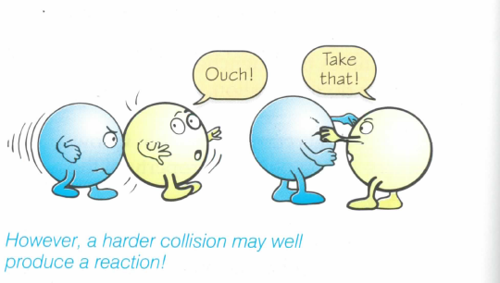
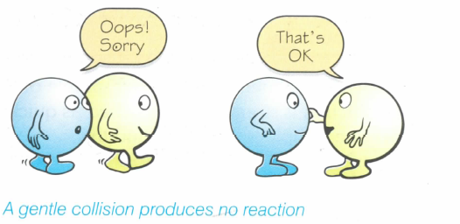
Collision Theory
In order for reactions to occur particles must collide with each other in
The correct orientation
With sufficient energy
Is this a successful collision?

Slide 22
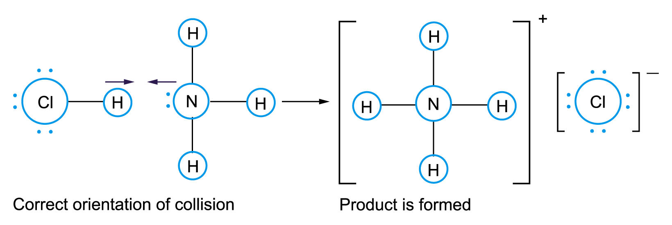
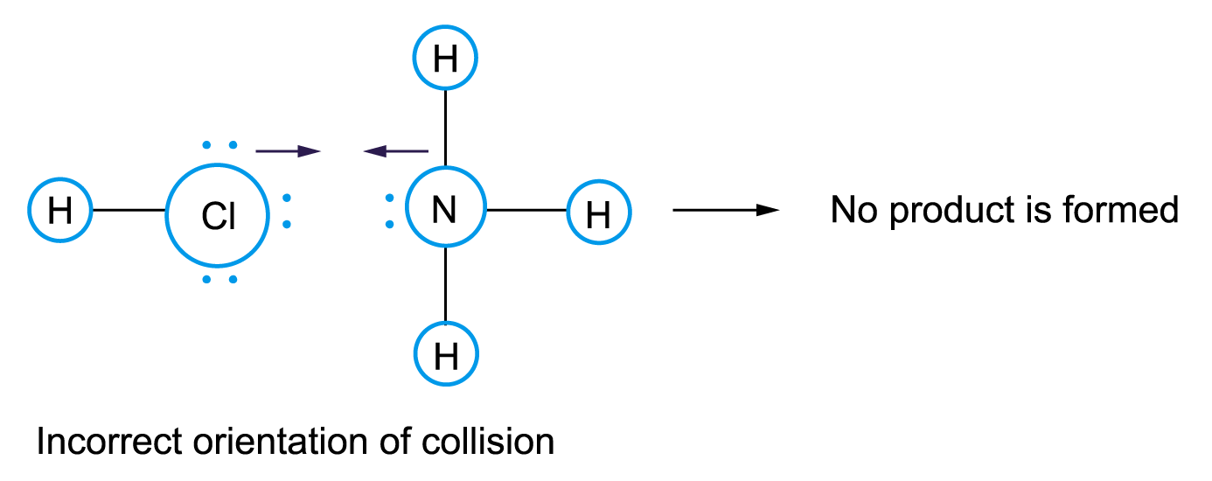
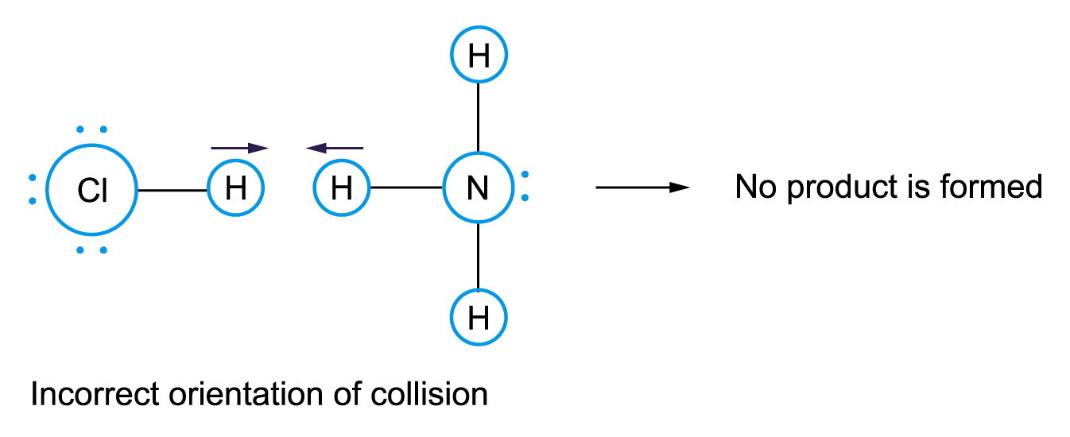
Collision Theory - Orientation
Not all collisions are successful

Slide 23
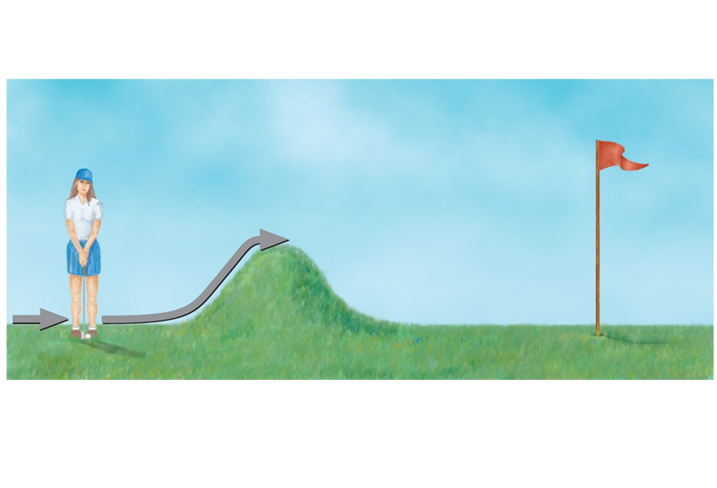
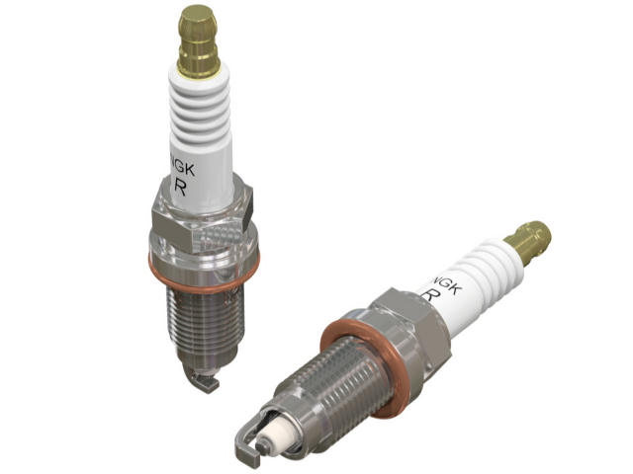
An Analogy for Reaction Profiles and Activation Energy
Collision Theory

Slide 24
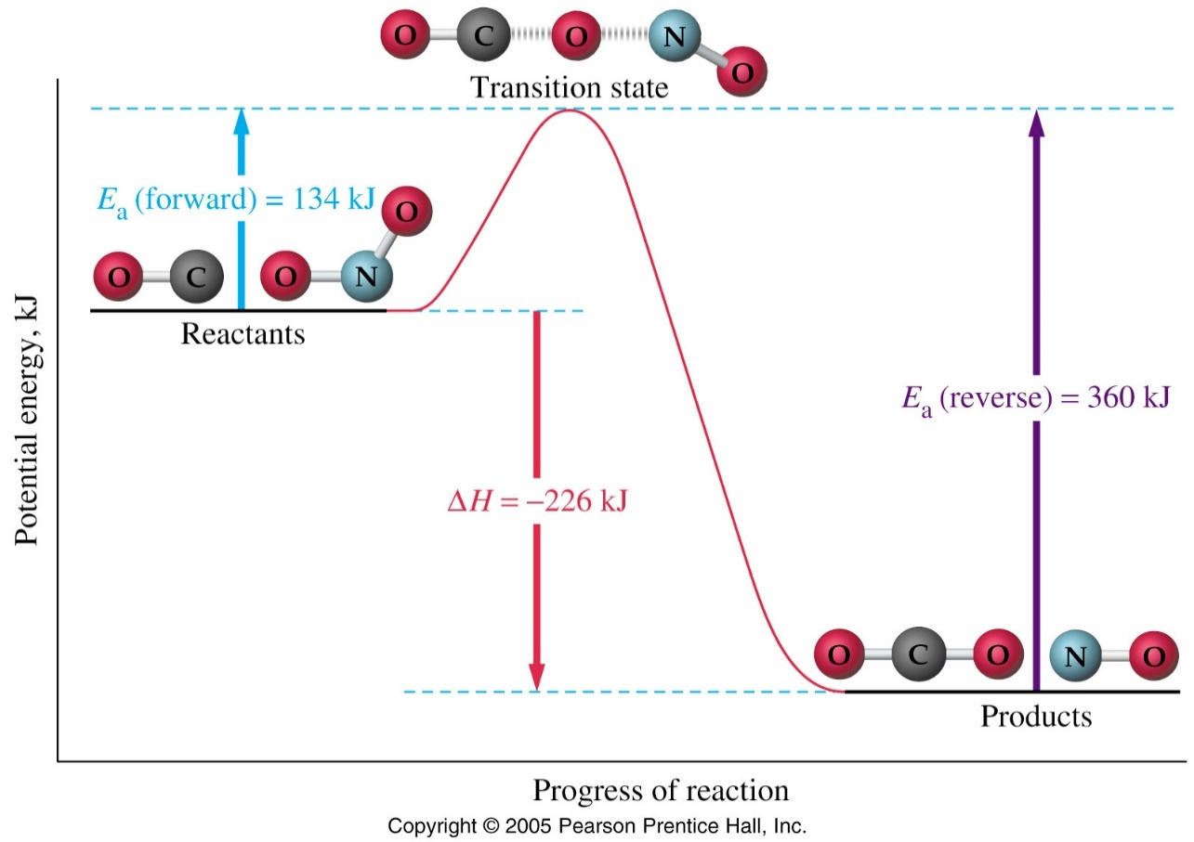
Collision Theory
The configuration of the atoms at the time of the collision is called the transition state (activated complex)
Activation Energy
Heat (enthalpy) of reaction (ΔH)

Slide 25
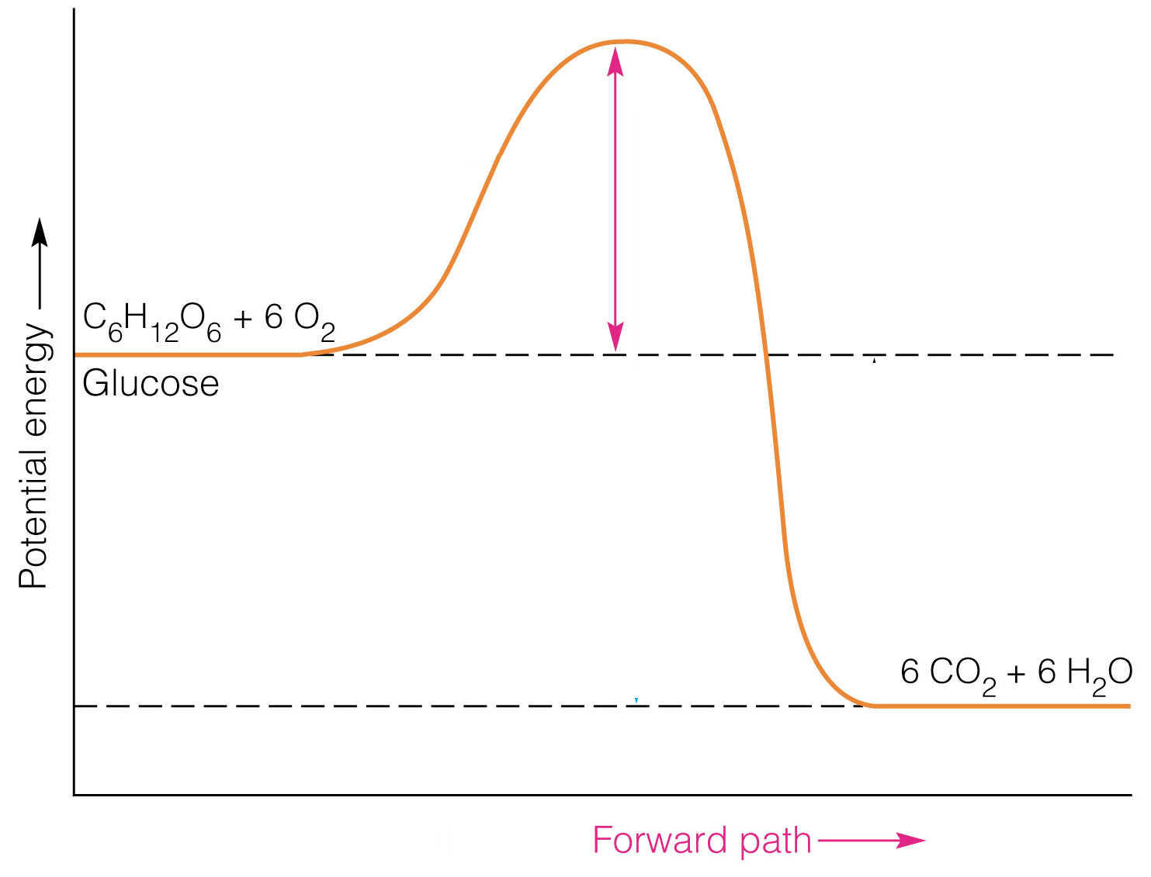
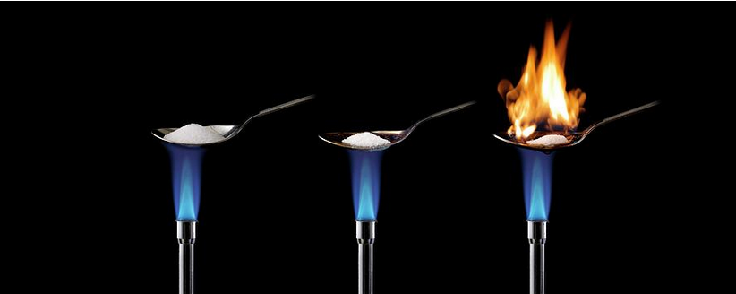
Collision Theory – Activation Energy
Even highly exothermic reactions are not guaranteed to be fast! Why?
E_{a}
Activation Energy
If a reaction is endothermic you must keep supplying heat
If the reaction is exothermic it releases energy and this energy can provide the activation energy for following reactions
Why does sugar in your sugar bowl not spontaneously burst into flames?

Slide 26
Collision Theory
To increase the rate of reaction requires...
more frequent collisions
  increased particle speed (a higher temperature)
  more particles present (a higher concentration)
more successful collisions
  particles with more energy (a higher temperature)
  a lower activation energy (use of a catalyst)

Slide 27
Factors affecting rates of reaction

Slide 28
Factors affecting rates of reaction
Concentrations of reactants:
↑Concentration = ↑Reaction rate
  Solids = surface area
  Liquids = concentration
  Gases = pressure
Temperature:
↑Temperature = ↑Reaction rate
Catalysts:
Catalysts = ↑ Reaction rate
Inhibitors = ↓ Reaction rate
Light can be a catalyst in some reactions.
concentration
pressure
temperature
surface area
catalyst
light

Slide 29
Concentration
Liquids
(concentration)

Slide 30
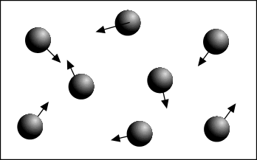
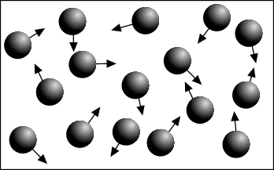
Factors affecting rates of reaction - Concentration
Increasing concentration = more frequent collisions
= increased rate of reaction
Low concentration
fewer collisions
Higher concentration
more collisions
However, increasing the concentration of some reactants
can have a greater effect than increasing others

Slide 31
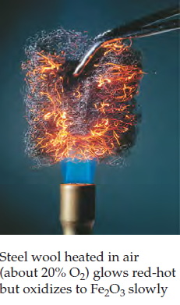
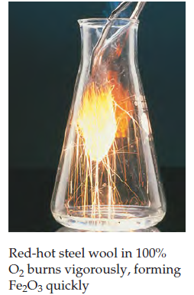
Factors affecting rates of reaction - Concentration

Slide 32
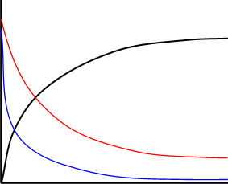
Factors affecting rates of reaction - Concentration
Reactions are fastest at the start
Gradient = rate of reaction ..... why?
A + 2B → C
High concentration = more collisions
C
CONCENTRATION
B
A
Low concentration = few collisions
TIME

Slide 33
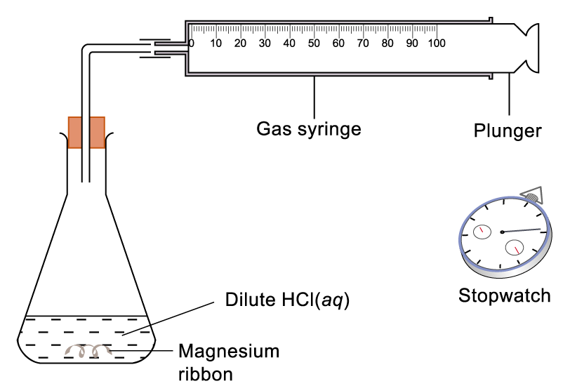
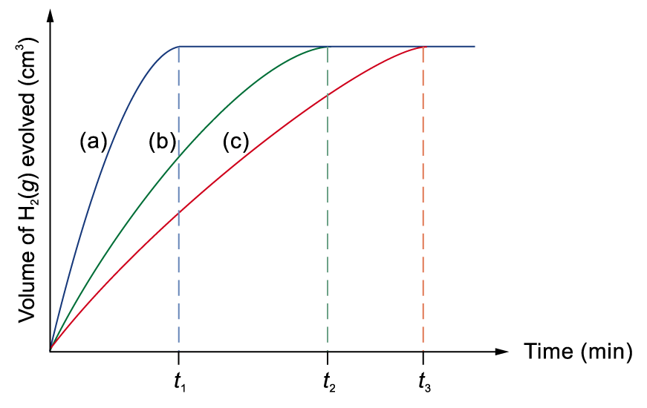
Factors affecting rates of reaction - Concentration
Expt. run 3 times:
(a) 2.0M HCl
(b) 1.0M HCl
(c) 0.5M HCl
Mg(s) + 2HCl(aq) → MgCl₂(aq) + H₂(g)
Reaction rate: (a) > (b) > (c)

Slide 34
Concentration
Gases
(pressure)

Slide 35
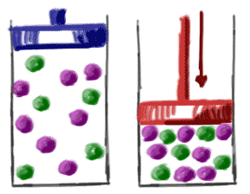
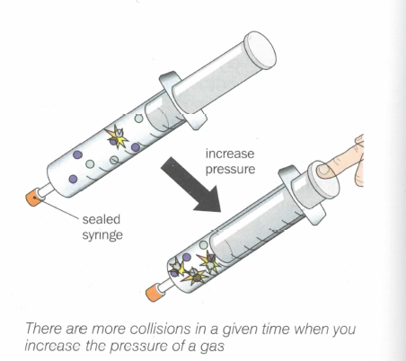
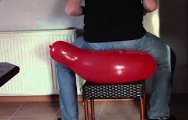
Factors affecting rates of reaction - Pressure
↑ pressure = gas particles closer together = ↑ concentration
↑ frequency of collisions
many industrial processes occur at high pressure to increase the rate...
but it can adversely affect the position of equilibrium and yield
pressure ∝ 1/volume
No effect on reaction with ONLY (s) and (l) because they are incompressible

Slide 36
Concentration
Solids
(surface area)

Slide 37
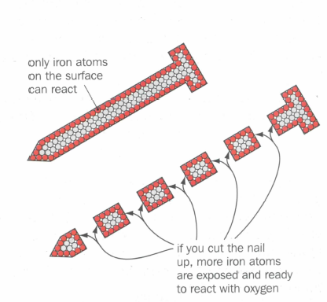
Factors affecting rates of reaction - Concentration
More particles are exposed with smaller pieces, powdered solids react quicker than larger lumps. Catalysts (e.g. in catalytic converters) are finely divided for this reason
In many organic reactions there are two liquid layers, one aqueous, the other non-aqueous. Shaking the mixture increases the reaction rate as an emulsion is often formed and the area of the boundary layers is increased giving more collisions.
1
1
CUT THE SHAPE INTO SMALLER PIECES
1
1
3
3
SURFACE AREA
9+9+3+3+3+3 = 30 sq units
SURFACE AREA
9 x (1+1+1+1+1+1) = 54 sq units

Slide 38
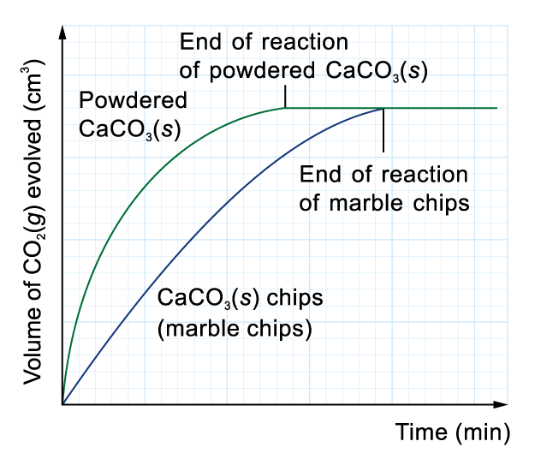
Factors affecting rates of reaction - Concentration
CaCO₃(s) + 2HCl(aq) CaCl₂(aq) + H₂O(l) + CO₂(g)
Reaction A is faster than reaction B
a
b

Slide 39
Temperature

Slide 40
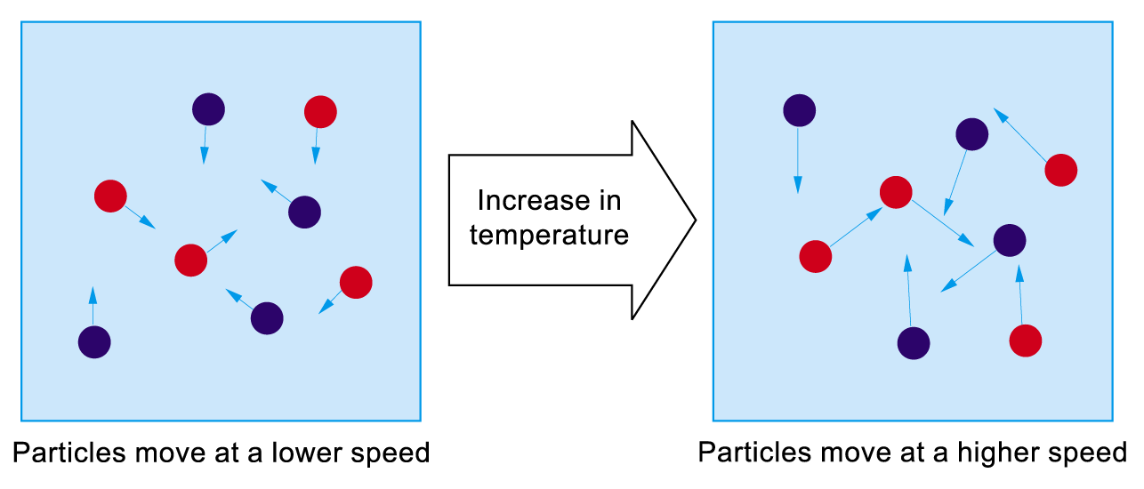
Factors affecting rates of reaction - Temperature
1. ↑T ⇒ ↑kinetic energies (speed) of reactant particles
2. ↑kinetic energies (speed) of reactant particles
⇒ ↑ no. of effective collisions per unit time
(↑ collision frequency & ↑proportion of high energy collisions)

Slide 41

Factors affecting rates of reaction - Temperature
Na₂S₂O₃(aq) + 2HCl(aq) 2NaCl(aq) + SO₂(g) + H₂O(l) + S(s)
t = time taken for the disappearance of the cross
rate α 1/t
Time t₂ < t₁
Rate 2 > 1

Slide 42
Light

Slide 43

Factors affecting rates of reaction - Light
Consider the following reaction:
C₆H₁₄ + Br₂ → C₆H₁₃Br → ………
light (substitution reactions)
UV
Br₂ 2Br·
Reddish brown Colourless
Light provides energy to split up Br₂ molecules into Br. radicals which are highly reactive.

Slide 44
Factors affecting rates of reaction - Light
shining a suitable light source onto some reactants increases the rate of reaction
the light - often U.V. - provides energy to break bonds and initiate a reaction
the greater the intensity of the light, the greater the effect
Examples a) the reaction between methane and chlorine - see alkanes
b) the darkening of silver salts - as used in photography
c) the reaction between hydrogen and chlorine
Equation H₂(g) + Cl₂(g) → 2HCl(g)
Bond enthalpies H-H 436 kJ mol⁻¹ Cl-Cl 242 kJ mol⁻¹
Mechanism Cl₂ → 2Cl• - - - - - INITIATION
H₂ + Cl• → HCl + H• - - - - - PROPAGATION H• + Cl₂ → HCl + Cl•
2Cl• → Cl₂ - - - - - TERMINATION
2H• → H₂
H• + Cl• → HCl

Slide 45
Catalysts

Slide 46
INTRODUCTION
Catalyst = substance that speeds up reaction without undergoing any permanent change.
Often the catalyst is consumed in one step of the mechanism, but is regenerated in another step.
They provide an alternative mechanism with lower activation energy.
© www.chemsheets.co.uk A2 044 12-Jul-12

Slide 47

INTRODUCTION

Slide 48




Types of catalysts
Heterogeneous
Homogeneous
different state to the reactants
same state as the reactants
Adsorb
(Surface)
Absorb
(Body)

Slide 49


Slide 50

HETEROGENEOUS CATALYSTS
Hydrogen is adsorbed onto the surface of a nickel catalyst. A C=C approaches …
… and is adsorbed.
Hydrogen atoms attach to the carbon atoms, and the molecule is desorbed.

Slide 51



HETEROGENEOUS CATALYSTS
Nature of catalyst
Large surface area.
Spread thinly over ceramic honeycomb.

Slide 52


HETEROGENEOUS CATALYSTS
Nature of catalyst – Catalytic Converter
Large surface area.
Spread thinly over ceramic honeycomb.

Slide 53
HOMOGENEOUS CATALYSTS
Catalyst reacts with a reactant to form intermediate.
2) Intermediate reacts to form product faster than original reactant (and regenerates catalyst).
e.g. acid catalyst
X + Y → products
X + H⁺ → HX⁺
2) HX⁺ + Y → products + H⁺
© www.chemsheets.co.uk A2 044 12-Jul-12

Slide 54
HOMOGENEOUS CATALYSTS
e.g. transition metal catalyst
works by metal varying oxidation state
Fe²⁺ or Fe³⁺
e.g. 2 I⁻ + S₂O₈²⁻ → I₂ + 2 SO₄²⁻
Slow because both –ve ions so repel.
2 Fe²⁺ + S₂O₈²⁻ → 2 Fe³⁺ + 2 SO₄²⁻
2) 2 Fe³⁺ + 2 I⁻ → 2 Fe²⁺ + I₂
© www.chemsheets.co.uk A2 044 12-Jul-12

Slide 55
Graphs Summary

Slide 56

Which graph is which?
X
C
B
A
2g of Mg turnings + 50cm³ 1M HCl (excess) at 25°C
2g of Mg ribbon + 50cm³ 1M HCl (excess) at 25°C
2g of Mg powder + 50cm³ 1M HCl (excess) at 25°C
2.5g of Mg turnings + 50cm³ 1M HCl (excess) at 25°C

