Slide 1

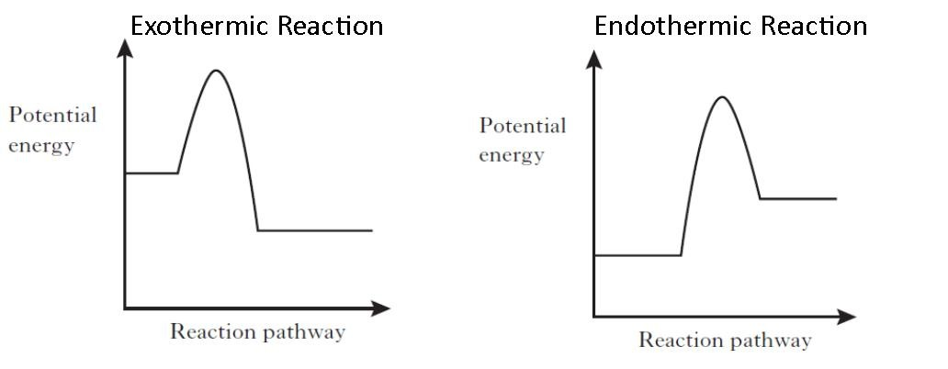
Energy changes
For a reaction to occur:
Step 1: Energy must be SUPPLIED to break bonds.
Step 2: Energy is RELEASED when new bonds are made.
A reaction is EXOTHERMIC if more energy is RELEASED then SUPPLIED (hotter). If more energy is SUPPLIED then is RELEASED then the reaction is ENDOTHERMIC (older).
We can represent the transfer of energy using reaction profiles (energy change diagrams). The uphill portion of the graph shows energy being absorbed, and the downhill shows it being released.
i.e. if the downhill section is larger then there is a net loss of energy and the reaction is exothermic.
Activation energy
In some chemical reactions, the products of the reaction can react to produce the original reactants. Such reactions are called reversible reactions and are represented:
A
+
B
C
+
D
ammonium
chloride
hydrogen
chloride
ammonia
+
NH₄Cl (s)
NH₃ (g) + HCl (g)
Energy change
If a reversible reaction is exothermic in one direction, it is endothermic in the opposite direction. The same amount of energy is transferred in each case.
The total energy change can be calculated by subtracting the bond energies of all the bonds being made (energy released) from those being broken (energy absorbed).
SO₃

Slide 2
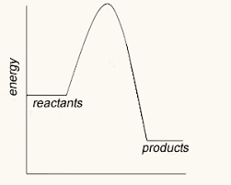
10 Questions
For a reaction to occur why is energy supplied?
Why is energy released during a reaction?
If more energy is supplied than released is the reaction exothermic or endothermic?
If a reaction is endothermic will the surroundings get warmer or colder?
What do we call the energy supplied to initiate a reaction?
What is the symbol for a reversible reaction?
Give an example of a reversible reaction.
If a reversible reaction is exothermic in 1 direction what must it be in the other?
Is this reaction exothermic or endothermic?
Explain your answer.
HT: how can you calculate the energy change of a reaction?
Energy changes

Slide 3
Mark Scheme
Reaction rates
Balance (or) Scales
There are no reactants remaining
Amount of product formed (and) Amount of reactant used.
Reactions occur when particles collide with sufficient energy. The minimum amount of energy required for particles to react on collision is called the activation energy.
Catalysts lower the activation energy.
Speeds it up
Rate increases as frequency and energy of collisions increases.
Rate decreases as only the frequency of collisions decreases.
Rate increases as only the frequency of collisions increases.
Rate increases as the surface area is increased, therefore increasing the frequency of collisions increases.
Energy changes
To break bonds
Bonds are made
Endothermic
Colder
Activation energy
Endothermic
Exothermic – more energy is released than absorbed
Subtract the energy released from that absorbed
NH₄Cl (s)
NH₃ (g) + HCl (g)

