Slide 1

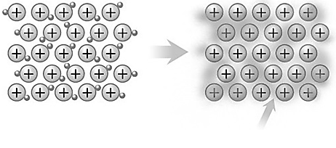
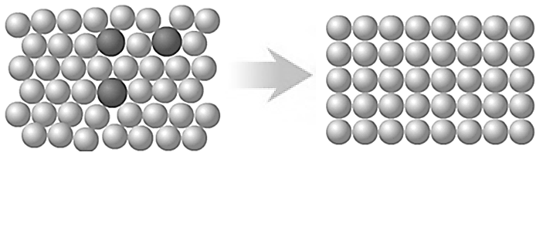
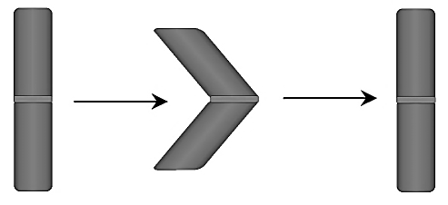
Metallic bonding
Alloys
Alloys are usually made from two or more different metals. The different sized atoms of the metals distort the layers in the structure, making it more difficult for them to slide over each other and so make alloys harder than pure metals.
Conduction depends on the ability of electrons to move throughout the metal.
Positive ions in a sea of delocalised electrons
Metals
Metals consist of giant structures of atoms arranged in a regular pattern.
The electrons in the highest occupied energy levels (outer shell) of metal atoms are delocalised and so free to move through the whole structure.
a structure of positive ions with electrons between the ions holding them together by strong electrostatic attractions.
Metals conduct heat and electricity because of the delocalised electrons in their structures.
The layers of atoms in metals are able to slide over each other and so metals can be bent and shaped.
Different sized atoms do not form a regular pattern.
Shape memory
Alloys can return to their original shape after being deformed, eg Nitinol used in dental braces.
force
heat

Slide 2
10 Questions
What type of bonding do metals have?
Draw a diagram to show the arrangement of atoms in a metal.
Do metals have a regular or irregular structure?
What is the main purpose of alloying metals?
What are alloys called that can return to their original shape?
How can we return them to their original shape?
What happens to valence (outer) electrons in a metal?
What forces of attraction hold metal atoms together?
Why can metals conduct electricity?
Draw a diagram to show the bonding present in solid sodium.
Metallic bonding

Slide 3
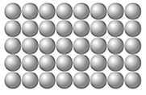
Mark Scheme
Metallic bonding
Metallic
Regular
To make them harder
Shape memory alloys
Heat them up
The outer electrons of metal atoms are delocalised and so free to move through the whole structure.
Strong electrostatic attractions.
Metals conduct heat and electricity because of the delocalised electrons.
Positive ions in a sea of delocalised electrons
Polymers and Nanoscience
High Density (HD)
Thermosoftening
Thermosetting
Cross-links in the structure
The melting point of a thermosoftening polymer is determined by the strength of the INTERMOLECULAR FORCES
Gets bigger
Nanoscience is the science of very small particles and looks at the properties of nanoparticles.
A nanoparticle is about 100 atoms
Advantages:
Large surface area makes them effective catalysts.
Nanotubes can be used in small scale circuits as nanowires.
Disadvantages:
So small they can enter the skin and therefore the bloodstream.
Easily become airborne, breathing in can potentially damage the lungs.
Sun screens (or) Bandages - others

