Slide 1

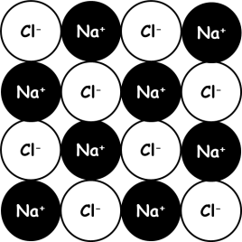
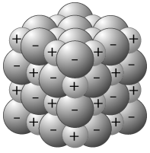
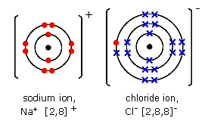
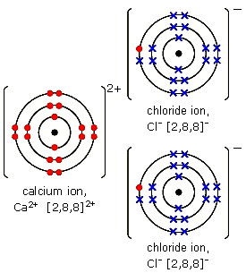
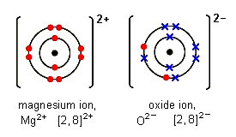
Ionic bonding
Metal and non-metal – electron transfer
Metals lose electrons and become positive ions.
Non-metals gain electrons and become negative ions.
Writing formulae
The charges on the positive and
negative ions need to balance out
Na⁺ Cl⁻ → NaCl
Mg²⁺ O²⁻ → MgO
Ca²⁺ Cl⁻ Cl⁻ → CaCl₂
Metals in group 1 form ions with a +1 charge
Metals in group 2 form ions with a +2 charge
…
Non-metals in group 6 form ions with -2 charge
Non-metals in group 7 form ions with -1 charge
Properties of ionic compounds
Ionic compounds have regular
structures (giant ionic lattices)
in which there are strong
electrostatic forces in all
directions between oppositely
charged ions.
These compounds have high melting points and high boiling points because of the large amounts of energy needed to break the many strong bonds.
When melted or dissolved in water, ionic compounds conduct electricity because the ions are free to move and carry the current
sodium chloride
calcium chloride
magnesium oxide

Slide 2
10 Questions
Do ionic bonds transfer or share electrons?
Ionic bonds exist between..
(a) Metals and Non-metals,
(b) Non metals and Non-metals
(c) Metals and Metals
Elements in group 7 form ions with what charge?
Elements in group 3 form ions with what charge?
Ionic compounds are held together by strong forces in all directions between oppositely charged ions.
Under what 2 conditions will ionic compounds conduct electricity?
Draw a diagram to show the electron arrangement in a fluorine ion.
Draw a diagram to show the electron arrangement in a magnesium ion.
What is the electron configuration of a fluorine ion?
What is the formula of calcium fluoride?
E _ _ _ _ _ _ _ _ _ _ _ C
Ionic bonding

Slide 3


Mark Scheme
Atomic Structure
35
17
17 protons, 18 neutrons, 17 electrons
2,8,7
0
0
shells (or) orbitals
35.5
Isotopes - Atoms of the same element that have different numbers of neutrons
³⁵Cl – 18 neutrons
³⁷Cl – 20 neutrons
MgCl₂
= (1xMg) + (2xCl)
= (1x24) + (2x35.5)
= 24 + 71
= 95
Ionic bonding
Transfer
(a) Metals and Non-metals
-1
+3
Electrostatic
Molten (l) or in solution (aq)
8.
[2,8]⁻
CaF₂

