Slide 1

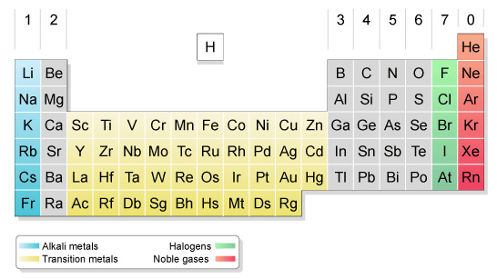
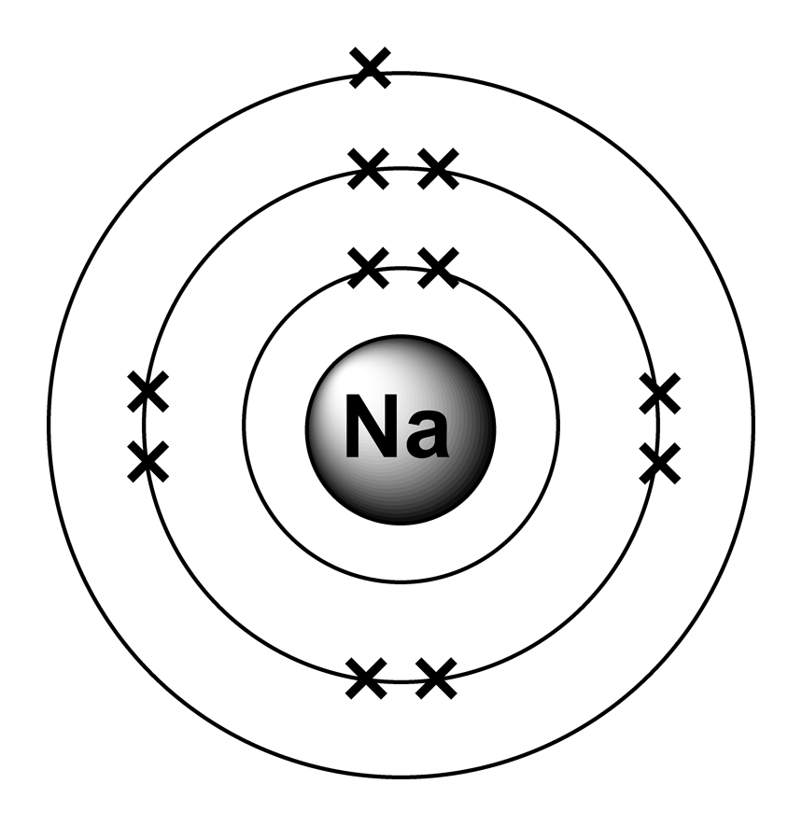
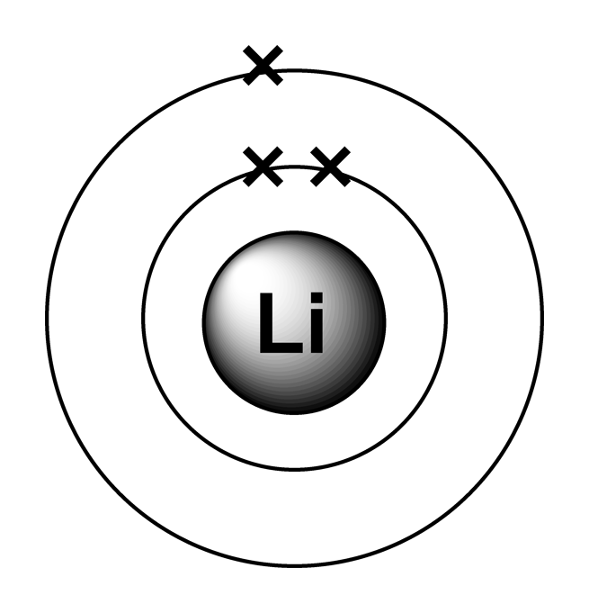
The Periodic Table
Group 7 (halogens) are most reactive at the top. The trends going down the group are:
Increasing boiling point
Decreasing reactivity
The modern table arranges elements by proton number in horizontal periods and vertical groups.
Group 1 (alkali metals) are most reactive at the bottom. They will react violently in water to produce hydrogen and a metal hydroxide. Compared to other metals they’re:
Softer
Have a lower melting point
More reactive
Group 0 (or 8) are the noble gases. They are noteworthy for being completely unreactive due to their full outer shells, and are colourless and tasteless.
Lower in the table elements have more shells. This causes shielding and decreases attraction for the valent electrons. In metals this means electrons are more easily lost i.e. they are more reactive. In non-metals they’re harder to gain so those elements are less reactive.
Sodium + water → sodium hydroxide + hydrogen
2Na_{(s)} + 2H₂O_{(l)} → 2NaOH_{(aq)} + H_{2(g)}

Slide 2
10 Questions
How do properties of group 1 metals differ from typical metals?
Complete the equation: K + H₂O →
Give 3 observations you would expect to make upon adding sodium to water.
Draw the electron configuration for a chloride ion.
Describe and explain the trend in reactivity in alkali metals.
What name do we usually use for elements in group 7?
What do these elements have in common about their electron configurations?
Why is helium so unreactive?
The Periodic Table

Slide 3
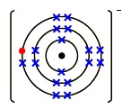
Mark Scheme
Atomic Structure
35
17
17 protons, 18 neutrons, 17 electrons
2,8,7
0
0
shells (or) orbitals
35.5
Isotopes - Atoms of the same element that have different numbers of neutrons
³⁵Cl – 18 neutrons
³⁷Cl – 20 neutrons
MgCl₂
= (1xMg) + (2xCl)
= (1x24) + (2x35.5)
= 24 + 71
= 95
The Periodic Table
More reactive, softer, lower melting point
2K + 2H₂O → 2KOH + H₂
Effervescence (fizzing), disappears/dissolves, melts/changes shape, turns UI purple (alkali), floats/moves on the surface, steam given off (not smoke)
Increases down the group due to more shells, more shielding, weaker attraction for valent electron.
halogens
7 valent electrons
Full shells

