Slide 1

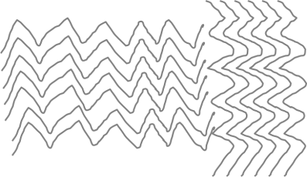
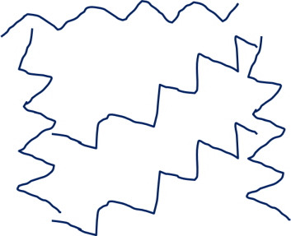
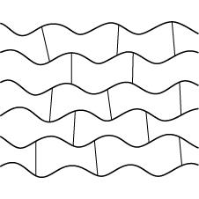
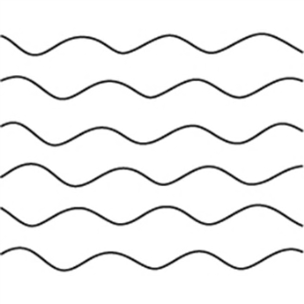
Polymers and Nanoscience
 | High density polymer – chains close together
 | Low density polymer - chains far apart
 | Some do not melt when heated, these are called thermosetting polymers. These cross-links make the material tougher and less flexible.
 | Some will soften easily, and can be moulded into shape before they are cooled down, these are called thermosoftening polymers.
The melting point of a thermosoftening polymer is determined by the strength of the INTERMOLECULAR FORCES
Nanoscience is the science of very small particles and looks at the properties of nanoparticles.
These are particles with in the range of 0·1nm to 100nm. The name 'nano' means 10⁻⁹.
A nanoparticle is about 100 atoms
Advantages | Disadvantages
Large surface area makes them effective catalysts. Nanotubes can be used in small scale circuits as nanowires. | So small they can enter the skin and therefore the bloodstream. Easily become airborne, breathing in can potentially damage the lungs.
Nanoparticles are present in sun screens
May be used to develop faster computers, lighter construction materials and new coatings

Slide 2
10 Questions
Are hydrocarbons tightly packed together in HD or LD polystyrene?
Some plastics melt when heated, what do we call them?
Some plastics do not melt when heated, what do we call them?
Why do they not melt?
What is the melting point of a thermosoftening plastic determined by?
When we grind solids up into small particles, what happens to the surface area of the solid?
What is nanoscience?
Approximately how many atoms are in a nanoparticle?
State one advantage and one disadvantage of nanoparticles?
State one use for nanoparticles.
Polymers and Nanoscience

Slide 3
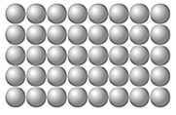
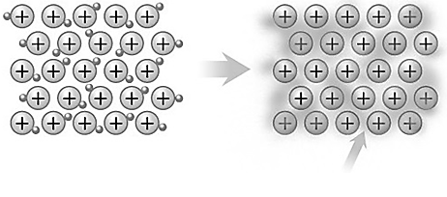
Mark Scheme
Metallic bonding
Metallic
Regular
To make them harder
Shape memory alloys
Heat them up
The outer electrons of metal atoms are delocalised and so free to move through the whole structure.
Strong electrostatic attractions.
Metals conduct heat and electricity because of the delocalised electrons.
Positive ions in a sea of delocalised electrons
Polymers and Nanoscience
High Density (HD)
Thermosoftening
Thermosetting
Cross-links in the structure
The melting point of a thermosoftening polymer is determined by the strength of the INTERMOLECULAR FORCES
Gets bigger
Nanoscience is the science of very small particles and looks at the properties of nanoparticles.
A nanoparticle is about 100 atoms
Advantages:
Large surface area makes them effective catalysts.
Nanotubes can be used in small scale circuits as nanowires.
Disadvantages:
So small they can enter the skin and therefore the bloodstream.
Easily become airborne, breathing in can potentially damage the lungs.
Sun screens (or) Bandages - others

