Slide 1
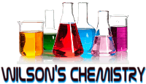
www.CHEMSHEETS.co.uk
and
AMOUNT OF SUBSTANCE
© www.chemsheets.co.uk AS 1028 25-Jun-2016

Slide 2
The Mole

Slide 3

THE MOLE
Can you think of any others?
pair
2
Some more
Trio = 3
Quarter = 4
Half-Dozen = 6
Baker’s Dozen = 13
Century = 12
Grand = 1000
Myriad = 10,000
dozen
12
score
20
gross
144
mole
602204500000000000000000
6.02 x 10²³

Slide 4
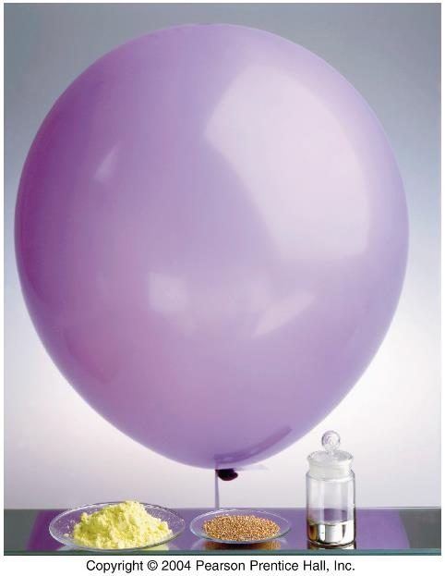
One Mole of Four Elements
One mole each of helium, sulfur, copper, and mercury.
How many atoms of helium are present? Of sulfur? Of copper? Of mercury?
The mole is the amount of substance containing as many elementary particles as the number of atoms in 12 g of carbon-12.

Slide 5
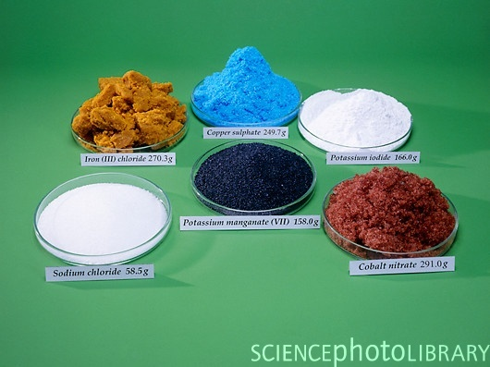
One mole of various chemicals

Slide 6

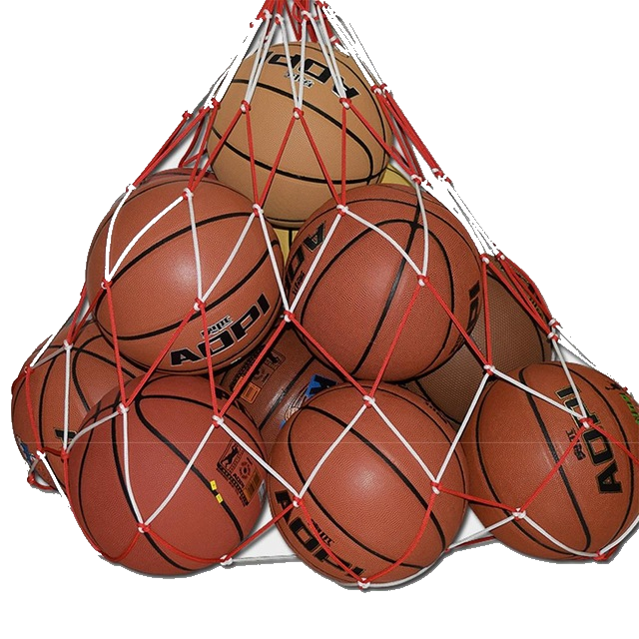
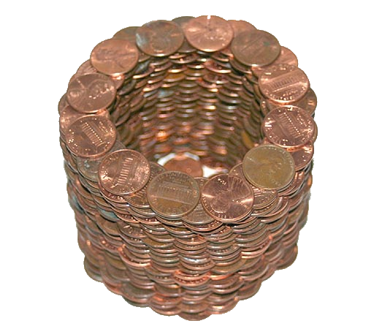
MOLES
1 mole of hockey pucks would equal the mass of the moon!
1 mole of basketballs would fill a bag the size of the earth!
1 mole of pennies would cover the Earth ¼ mile deep!

Slide 7
MOLES
1 mole of H₂O molecules has mass 18.0 g
(M_{r} of H₂O = 18.0)
1 mole of C atoms has mass 12.0 g
(M_{r} of C = 12.0)
THIS IS NOT A COINCIDENCE!
Chemists have worked how many particles are in the M_{r} in grams of any substance – this number is the mole (6.02 x 10²³)
The number is Avogadro’s number (N_{A})

Slide 8
MOLES – Comparisons….Find out/Calculate
Avogadro’s number of water molecules has a volume of…
18 cm³ (that’s about the size of an ice cube)
If Avogadro’s number of 1p was stretched around the Earth’s equator, it would go round the Earth …..
330 billion times
Suppose the Greek god Zeus, after observing the Big Bang 15 billion years ago, became bored and decided to count one mole of atoms. Zeus is omnipotent. He can count very fast (one million atoms per second) and, of course, never sleeps. He has currently completed over
3/4 of the task, and will be finished in just another four billion years
Avogadro's number (6.02 x 10²³ ) is the approximate number of milliliters of water in ....
the Pacific Ocean (7 x 10⁸km³ or 7 x 10²³ mL)
(Analogy by M. Dale Alexander, Gordon J. Ewing, and Floyd T. Abbott, 1984.)
If an Avogadro number of pennies were distributed evenly among the 4.9 x 10⁹ human inhabitants of earth, each man, woman, and child would have enough money to spend a million dollars every hour-day and night-and still have ...
over half of it unspent at death.

Slide 9
MOLES - SOLIDS

Slide 10
MOLES
n= m
M_{r}
Moles (mol.) =
Mass (g)
Molar mass (g mol⁻¹)
The mole is the amount of substance containing as many elementary particles as the number of atoms in 12 g of carbon-12.

Slide 11

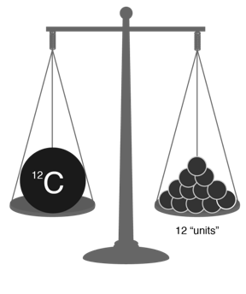


Atomic and Molar mass
Mass of 1 mole of an element or compound.
Atomic mass tells the...
    atomic mass units per atom (amu)
    grams per mole (g/mol)
The relative atomic mass of an element is the weighted average of the masses of the isotopes on a scale on which a carbon-12 atom has a mass of exactly 12 units.

Slide 12




Atomic and Molar mass
  H₂O
  = 2(1.0) + 16.0 = 18.0 gmol⁻¹
  NaCl
  = 23.0 + 35.5 = 58.5 gmol⁻¹

Slide 13
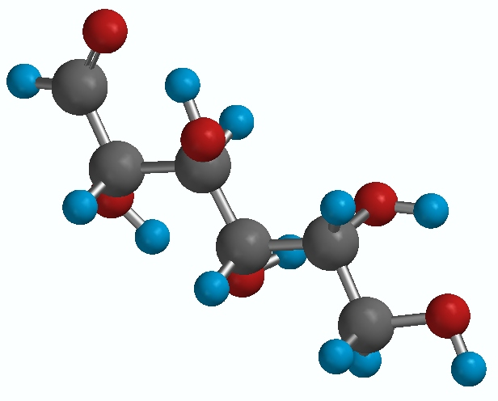
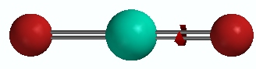
Atomic and Molar mass
Sulfur dioxide - SO₂
= 32 + 2(16)
= 64 amu
Glucose - C₆H₁₂O₆
= 6(12) + 12(1) + 6(16)
= 180 amu

Slide 14
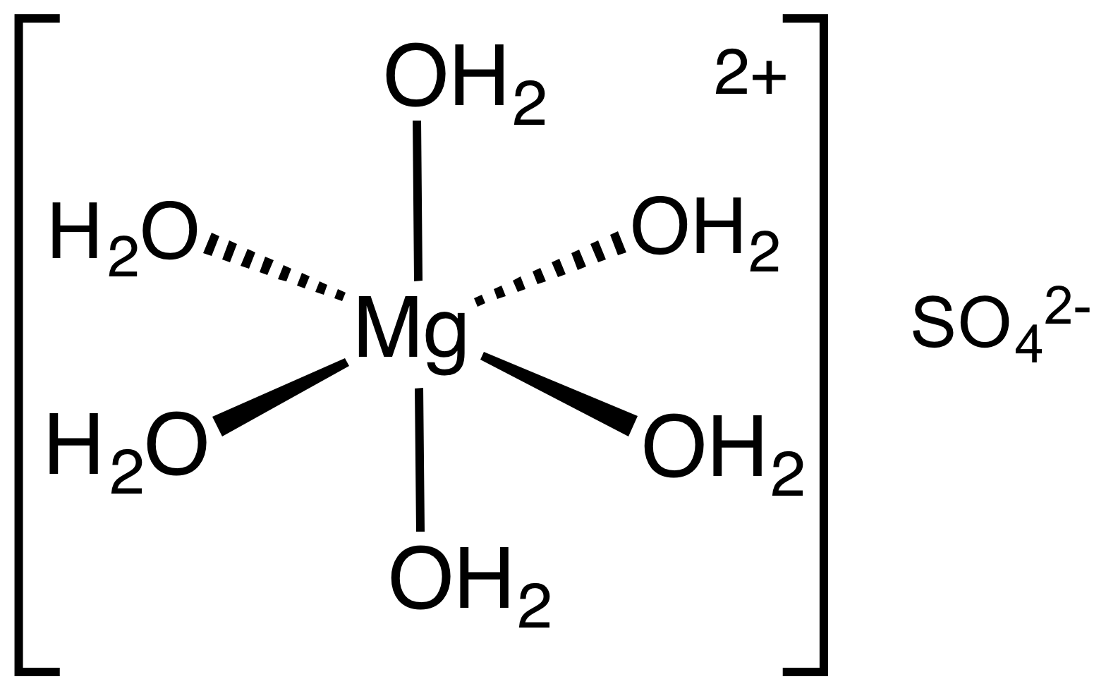
Atomic and Molar mass
MgSO₄.6H₂O
This means a magnesium ion with 6 waters around it and an aqueous sulphate ion
  24 + 32 + 4(16) + 12(1) + 6(16)
  = 228 g/mol

Slide 15
Atomic and Molar mass
  (NH₄)₂SO₄ (Ammonium Sulphate)
  2(14) + 8(1) + 32 + 4(16) = 132 g/mol
  Al(NO₃)₃ (Aluminium Nitrate)
  27 + 3(14) + 9(16)
  = 213 g/mol

Slide 16
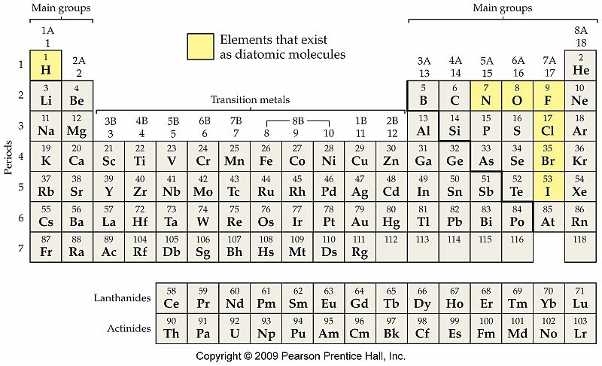
Diatomics X₂

Slide 17
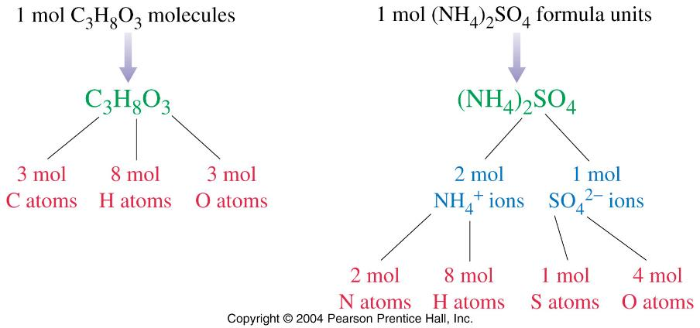
Formulae - moles of atoms/ moles of ions

Slide 18
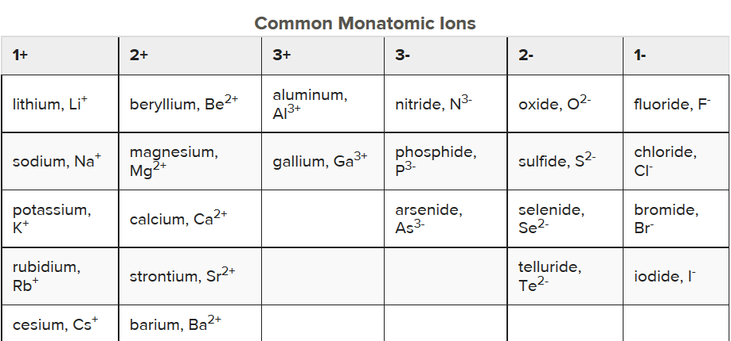
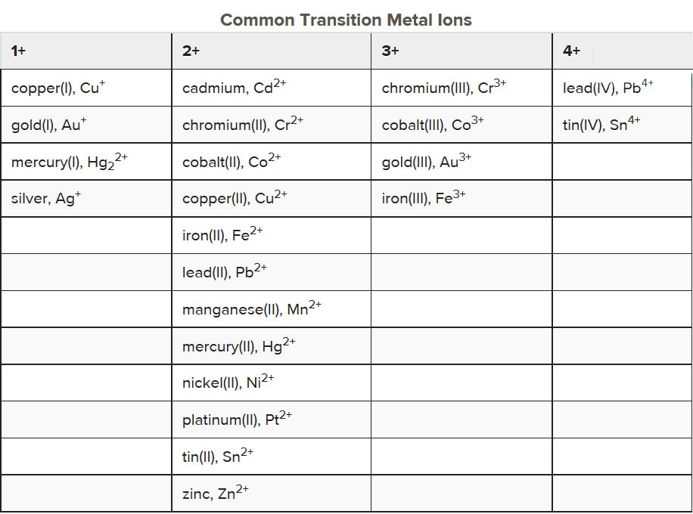
IONIC
Lithium phosphide
Li₃P
Charges must balance
(3 × 1+) + (3-) = 0
Calcium Nitride
Ca₃N₂
Charges must balance
(3 × 2+) + (2 ×3-) = 0
Nickel (II) Chloride
NiCl₂
Charges must balance
(2+) + (2 ×1-) = 0

Slide 19

MOLES
n= m
M_{r}
Moles (mol.) =
Mass (g)
Molar mass (g mol⁻¹)
How many moles of carbon are in 26 g of carbon?
n= m = 26 = 2.2 moles
M_{r} 12

Slide 20
2.1 The Mole (SB p.32)
MOLES AND MOLECULES
n= m
M_{r}
Find the mass in grams of 0.01 mole of zinc sulphide (R.A.M.: S = 32.1, Zn = 65.4)
n= m
M_{r}
m = n x M_{r}
m = 0.01 x (65.4 + 32.1)
m = 0.975g

Slide 21
MOLES AND MOLECULES
n= m
M_{r}
What is the mass of 0.2 moles of calcium carbonate? (R.A.M.* : C = 12.0, O = 16.0, Ca = 40.1)
m = n x M_{r}
M_{r} = (40.1 + 12.0 + 3 x 16.0) g mol⁻¹ = 100.1 g mol⁻¹
m = 0.2 mol x 100.1 g mol⁻¹
m = 20.02g

Slide 22
MOLES and MOLECULES
n= N
N_{A}
Moles (mol.) =
number of particles
Avogadro's number (mol⁻¹)
How many moles of helium are present in 1.20x10²⁴ atoms of helium?
n = N
N_{A}
n = 1.20x10²⁴
6.02x10²³
n = 2 moles
Avogadro's number = 6.02 x 10²³

Slide 23
MOLES and MOLECULES
n= N
N_{A}
How many molecules are in 2.50 moles of C₁₂H₂₂O₁₁?
n = N
N_{A}
N = N_{A}× n
N = 6.02×10²³ × 2.5
N = 1.51×10²⁴ molecules
Avogadro's number = 6.02 x 10²³

Slide 24
MOLES AND MOLECULES
(a)What is the mass of 4 moles of water molecules?
(b) How many molecules are there?
(c) How many atoms are there?
a) n = m
M_{r}
m = n x M_{r}
m = 4 mol x 18.0 g mol⁻¹
m = 72.0 g

Slide 25
MOLES AND MOLECULES
(a)What is the mass of 4 moles of water molecule?
(b) How many molecules are there?
(c) How many atoms are there?
b) n = N
N_{A}
N = n x N_{A}
N = 4 mol x 6.02 x 10²³ mol⁻¹
N = 2.408 x 10²⁴ water molecules

Slide 26
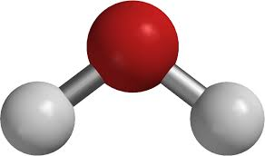
MOLES AND MOLECULES
(a)What is the mass of 4 moles of water molecule?
(b) How many molecules are there?
(c) How many atoms are there?
(c) 1 water molecule has 3 atoms
4 moles water → 12 moles atoms
n = N
N_{A}
N = n x N_{A}
N = 12 mol x 6.02 x 10²³ mol⁻¹ = 7.224 x 10²⁴ atoms

Slide 27
MOLES and MOLECULES
n= N
N_{A}
AND
n= m
M_{r}
IF...... n=n
n= N = m = n
N_{A} M_{r}

Slide 28
MOLES AND MOLECULES
n= N = m
N_{A} M_{r}
Find the mass of 2.1×10²⁴ units of NaHCO₃
N = m
N_{A} M_{r}
m = N × M_{r}
N_{A}
m= 2.1×10²⁴ × 84.0
6.0×10²³
m= 294g

Slide 29
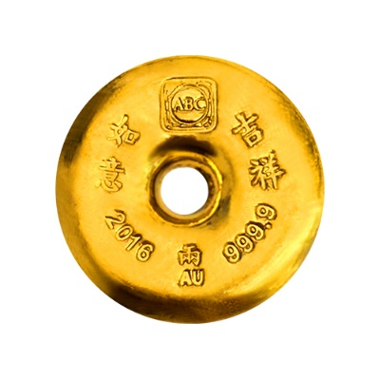
MOLES AND MOLECULES
n= N = m
N_{A} M_{r}
Calculate the number of gold atoms in 20g of gold atoms (R.A.M. : Au = 197.0)
N = m x N_{A}
M_{r}
= 20 x 6.02 x 10²³ mol⁻¹
197.0
= 6.11 x 10²² mol

Slide 30
MOLES AND MOLECULES
A magnesium chloride solution contains 10g of MgCl₂ solid
(a) Calculate the number of moles of MgCl₂ in the solution.
(b) Calculate the number of magnesium ions in the solution.
(c) Calculate the number of chloride ions in the solution.
(d) Calculate the total number of ions in the solution.
(R.A.M.: Mg = 24.3, Cl = 35.5)
a) n = m = 10 = 0.105 mol
M_{r} 95.3

Slide 31
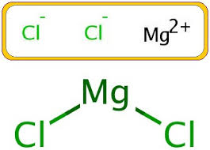
MOLES AND MOLECULES
A magnesium chloride solution contains 10g of MgCl₂ solid
(a) Calculate the number of moles of MgCl₂ in the solution.
(b) Calculate the number of magnesium ions in the solution.
(c) Calculate the number of chloride ions in the solution.
(d) Calculate the total number of ions in the solution.
(b) MgCl₂ → Mg²⁺ + 2Cl⁻
1 mol. 1 mol. + 2 mol.
0.105 mol. 0.105 mol. + 2(0.105 mol.)
n = N
N_{A}
N = n x N_{A}
N = 0.105 mol x 6.02 x 10²³ mol⁻¹
N = 6.321 x 10²²

Slide 32
MOLES AND MOLECULES
A magnesium chloride solution contains 10g of MgCl₂ solid
(a) Calculate the number of moles of MgCl₂ in the solution.
(b) Calculate the number of magnesium ions in the solution.
(c) Calculate the number of chloride ions in the solution.
(d) Calculate the total number of ions in the solution.
(c) MgCl₂ → Mg²⁺ + 2Cl⁻
1 mol. 1 mol. + 2 mol.
0.105 mol. 0.105 mol. + 2(0.105 mol.)
n = N
N_{A}
N = n x N_{A}
N = 0.210 mol x 6.02 x 10²³ mol⁻¹
N = 1.264 x 10²³

Slide 33
MOLES AND MOLECULES
A magnesium chloride solution contains 10g of MgCl₂ solid
(a) Calculate the number of moles of MgCl₂ in the solution.
(b) Calculate the number of magnesium ions in the solution.
(c) Calculate the number of chloride ions in the solution.
(d) Calculate the total number of ions in the solution.
(d) MgCl₂ → Mg²⁺ + 2Cl⁻
1 mol. 1 mol. + 2 mol.
0.105 mol. 0.105 mol. + 2(0.105 mol.)
n = N
N_{A}
N = n x N_{A}
N = (0.105 + 0.210) x 6.02 x 10²³ mol⁻¹
N = 1.896 x 10²³

Slide 34
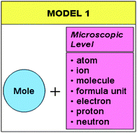
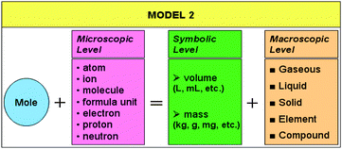
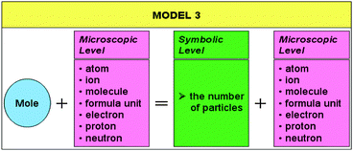
MOLES

Slide 35
MOLES – LIQUIDS

Slide 36
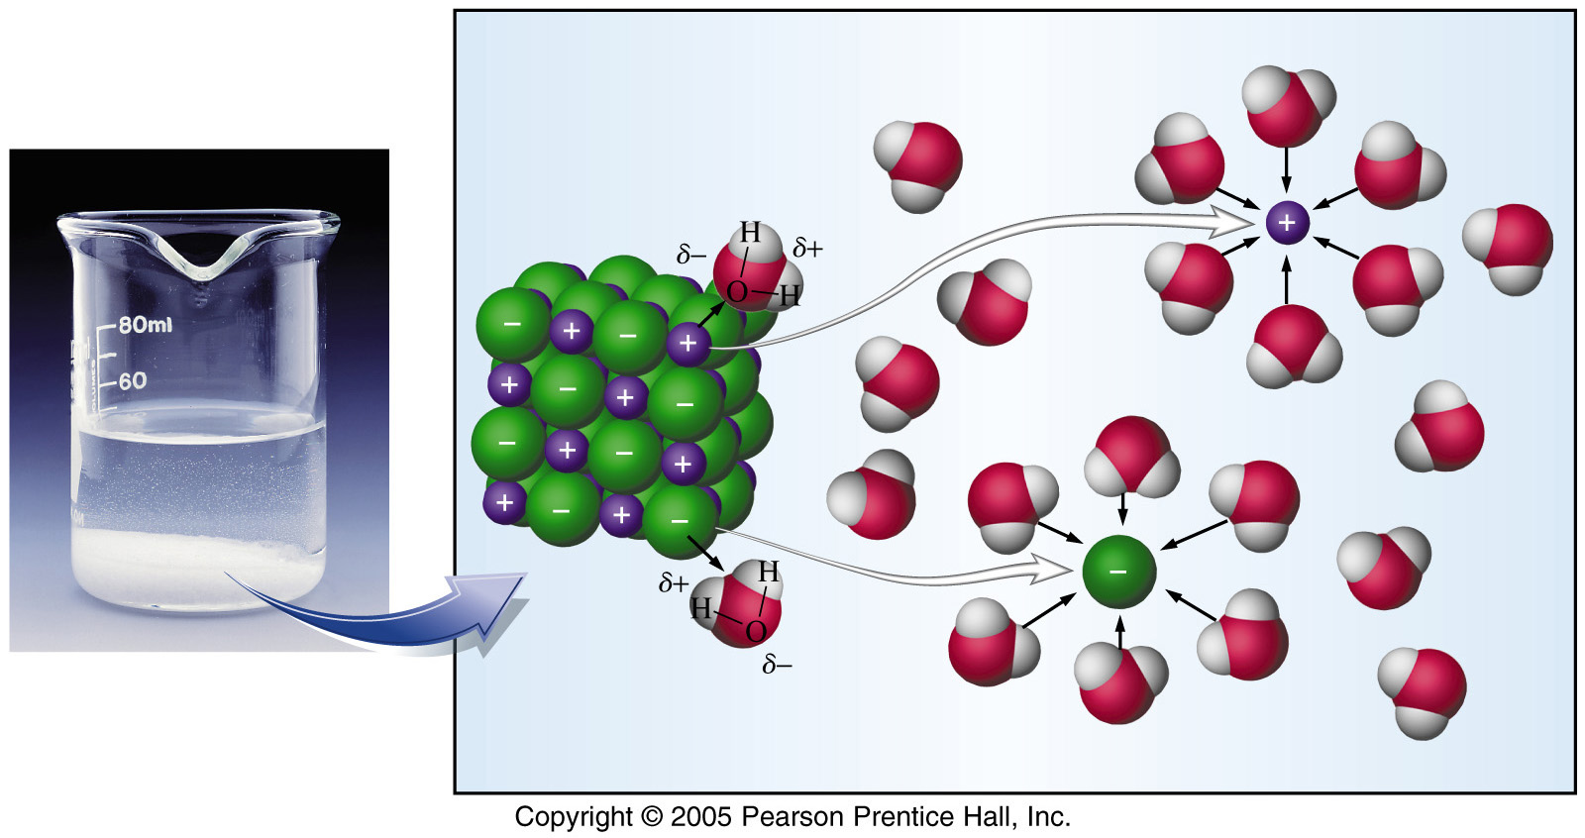
MOLES AND LIQUIDS
n= CV
moles (mol.) = concentration (mol dm⁻³) × volume (dm³)
molar concentration (M): is the amount of solute, in moles, per liter of solution
1 Litre = 1 dm³
1 mol dm⁻³ = 1 M
Solvent
Solute
Solution

Slide 37
MOLES AND LIQUIDS
n= CV
How many moles of NaOH are required to prepare 0.50 dm³ of 6.68 mol dm⁻³ NaOH?
  n = CV
  n = 6.68 × 0.50
  n = 3.34 moles

Slide 38
MOLES and Liquids
n= CV
AND
n= m
M_{r}
IF...... n=n
n = CV = m = n
M_{r}

Slide 39
MOLES AND LIQUIDS
n = CV = m = n
M_{r}
  What mass of KMnO₄ is needed to prepare 1dm³ of 0.010 M KMnO₄
  m = CVM_{r}
  m = 0.010 x 1 x (39+55+(4x16))
  m = 0.010 x 1 x 158
  m = 1.58g

Slide 40
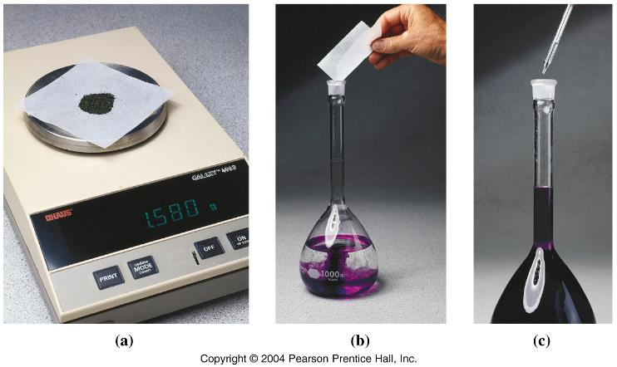
Preparing 0.01000 M KMnO4
Weigh 0.01000 mol (1.580 g) KMnO₄.
Add more water to reach the 1.000 liter mark.
Dissolve in water.

Slide 41
MOLES AND LIQUIDS
n = CV = m = n
M_{r}
  How many liters of 6.68 M NaOH can we prepare with 2.35 kg NaOH?
  V = m
  MrC
  V = (2.35 × 1000)___
  (23 + 16 + 1) × 6.68
  V = 2350 × 6.68 = 8.80L
  40.0

Slide 42
MOLES AND LIQUIDS
n = CV = m = n
M_{r}
What is the concentration of a solution in which 333 g potassium hydrogen carbonate is dissolved in enough water to make 10.0 L of solution?
C = m
M_{r}V
C = 333__________
(39 + 1 + 12 + (16×3)) x 10.0
C = 333 = 0.33M
100x 10.0

Slide 43
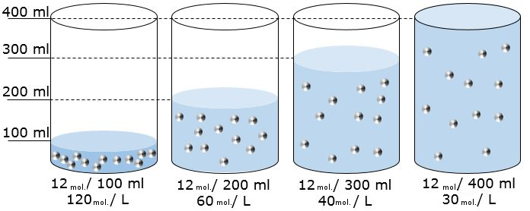
Dilution Calculations …
The moles of solute is constant
n_{conc} = n_{dil}
The volume and concentration change
C_{conc} × V_{conc} = C_{dil} × V_{dil}

Slide 44
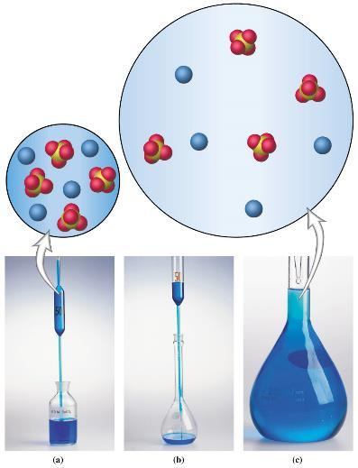
Visualizing the Dilution of a Solution
Same number of solute molecules after dilution
Added solvent volume, therefore less concentrated
Concentrated
solution
Dilute
solution

Slide 45
Dilution Calculations …
C_{conc} × V_{conc} = C_{dil} × V_{dil}
How many liters of a 2.00 M CuSO₄ stock solution are needed to prepare 0.250 L of 0.400 M CuSO₄?
V_{conc} = C_{dil} × V_{dil}
C_{conc}
V_{conc} = 0.400 × 0.250
2.00
V_{conc} = 0.05 L

Slide 46
Dilution Calculations …
C_{conc} × V_{conc} = C_{dil} × V_{dil}
What is the new concentration if 500ml of water is added to 250ml of 2.0M HCl?
C_{dil} =C_{conc} x V_{conc}
V_{dil}
C_{dil} =2.0 x 250
(250 + 500)
C_{dil} = 0.66M

Slide 47

A standard solution
Required equipment
Equations needed
Steps to make it

Slide 48
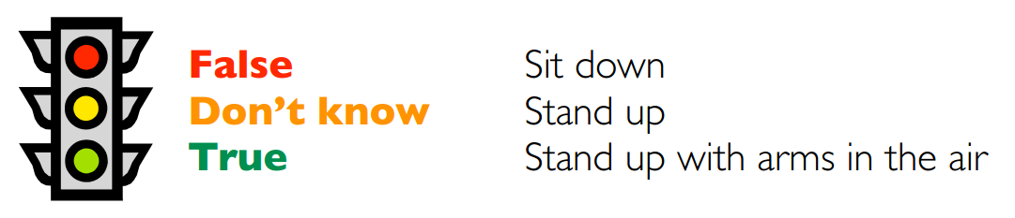

Mole Traffic Lights
The mole is a unit.
The mole is a mass.
One mole of water (H₂O) and one mole of glucose (C₆H₁₂O₆) have the same mass.
One mole of H₂ contains the same number of molecules as one mole of CO₂.
One mole of H₂ contains the same number of atoms as one mole of CO₂.
There are more atoms in 12 g of carbon than in 12 g of copper.
A mole is a molecule.
The mole is a number.
One mole of a substance contains Avogadro’s number of elementary entities.
One mole of a substance contains 6.02 x 10²³ elementary entities.
I understand what a mole is.

Slide 49
MOLES – GASES

Slide 50
AVOGADRO’S LAW

Slide 51
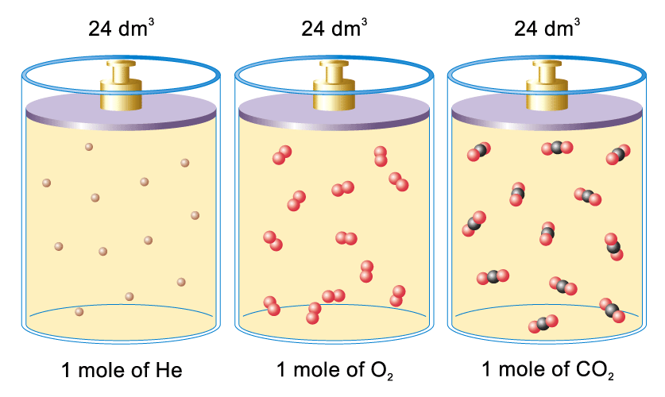
Molar volume of a gas
24 dm³
24 dm³
24 dm³
22.4
22.4
22.4
at 298K (25⁰C) & 1 atm
room temperature and pressure (RTP)

Slide 52
Avogadro’s Law (mole:volume)
V = 24 x n
If temperature and pressure are constant
molar volume
= volume of one mole of a gas at RTP
(RTP = 298K (25ºC) and 1 atm.)
This part is not tested at iGCSE
V = 24
n
V_{initial} = V_{final}
n_{initial} n_{final}

Slide 53
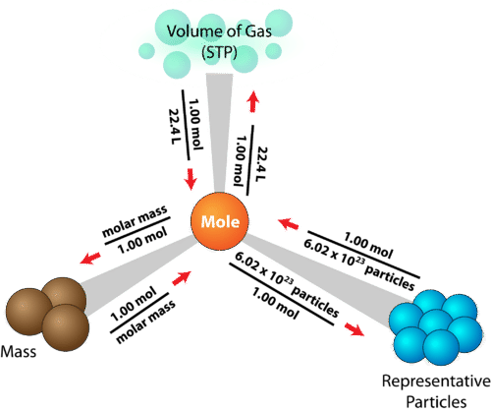
24L
24L

Slide 54
Avogadro’s Law (mole:volume)
V = 24 x n
Calculate the volume occupied by 2 moles of hydrogen gas at RTP.
V = 24 x n
V = 24 x 2
V = 48 L = 48 dm³

Slide 55
Avogadro’s Law (mole:volume)
V = 24 x n
Calculate the volume occupied by 4.11 kg of methane gas, CH₄(g), at RTP.
V = 24 x n and n= m
M_{r}
V = 24 x m
M_{r}
V = 24 x 4.11 x 1000 = 6165 L = 6165 dm³
(12+(4x1))

Slide 56
Avogadro’s Law (mole:volume)
V = 24 x n
1.6 g of a gas occupies 1.2 dm³ at room temperature and pressure. What is the relative molecular mass of the gas?
V = 24 x n and n= m
M_{r}
V = 24 x m rearranges to M_{r} = 24 x m
M_{r} V
M_{r} = 24 x 1.6 = 32 g mol⁻¹
1.2

Slide 57
Molar volume of a gas
V = 24 x n
Find the volume occupied by 3.55 g of chlorine gas at room temperature and pressure (RTP)
V = 24 x n and n= m
M_{r}
V = 24 x m
M_{r}
V = 24 x 3.55
(35.5x2)
V = 1.2dm³
Chlorine is diatomic = Cl₂

Slide 58
Molar volume of a gas
V = 24 x n
Find the number of molecules in 4.48 cm³ of carbon dioxide gas at room temperature and pressure.
V = 24 x n and n= N
N_{A}
V = 24 x N
N_{A}
N = VN_{A}
24
N = 4.48x10⁻³ x 6.02 x 10²³ mol⁻¹
24
N = 1.12 x 10²³ molecules
see next slide

Slide 59
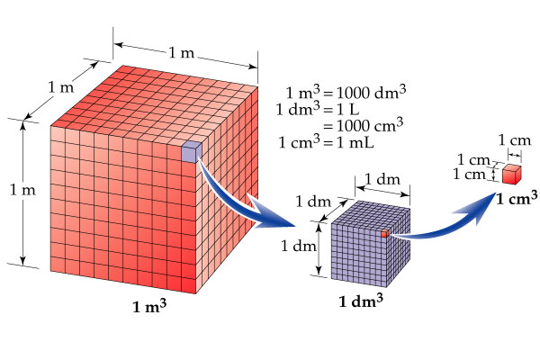
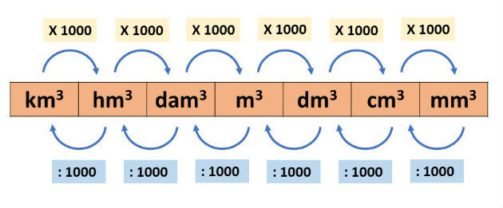

Slide 60
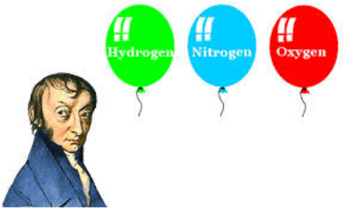
Avogadro’s Law?
The definition
2 equations related to it
A graph and an explanation

Slide 61
Rearranging Equations

Slide 62
The Equations so far...
n= N
N_{A}
n= m
M_{r}
n= V
24
n= CV
because n = n for any closed system
n= N = m = V = CV
N_{A} M_{r} 24

Slide 63
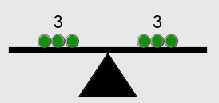
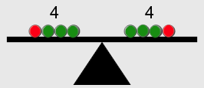
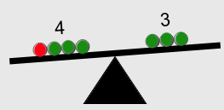
Rearranging Equations Rules
Equations must balance, if you make a change to one side of the equation, make the same change to the other side
  3 = 3
  3+1 = 3+1
  3+1 ≠ 3

Slide 64
Rearranging Equations Rules
Remove terms by performing the opposite operation...
remove + x by performing the opposite operation; subtraction
y + x = 9
y + x - x = 9 - x
y = 9 - x
remove multiplied terms by dividing
y × x = 9
y × x = 9
x x
y = 9
x
REMEMBER: changes made to the left hand side of the equation, must be made on the right hand side of the equation

Slide 65
Rearranging Equations Rules
remove divided terms by multiplying
y = 9
x
yx = 9x
x
remove squared terms by square rooting
y² = 9
√(y²) = √(9)
y = 3
REMEMBER: changes made to the left hand side of the equation, must be made on the right hand side of the equation

Slide 66
BIDMAS
B | Brackets | 10 × (4 + 2) = 10 × 6 = 60
I | Indices | 5 + 2² = 5 + 4 = 9
D | Division | 10 + 6 ÷ 2 = 10 + 3 = 13
M | Multiplication | 10 - 4 × 2 = 10 - 8 = 2
A | Addition | 10 × 4 + 7 = 40 + 7 = 47
S | Subtraction | 10 + 2 - 3 = 5 - 3 = 2

Slide 67
Invisible Brackets
Can you spot the implied/invisible brackets?
2³⁺² = 2⁽³⁺²⁾ = 2⁵ = 32
7 + 5 = ( 7 + 5 ) = 12 = 2
2 + 4 ( 2 + 4 ) 6
‌‌ x‌‌ = ( ‌‌ x‌‌ ) = x
5 + 3 ( 5 + 3 ) 8
When you rearrange equations use BIDMAS in reverse
Remove additions and subtractions 1st
unless they’re in a hidden bracket...

Slide 68
Rearranging Equations
n= N = m = V = CV
N_{A} M_{r} 24
Give a formula for m given C:
we must use a formula that contains m and one that contains C
m = CV multiply both sides by M_{r}
M_{r}
M_{r}m = CVM_{r} M_{r} ÷ M_{r} = 1, they cancel out
M_{r}
m = CVM_{r}

Slide 69
Rearranging Equations
n= N = m = V = CV
N_{A} M_{r} 24
Give a formula for N given V_{gas}:
we must use a formula that contains N and one that contains V_{gas}
N = V multiply both sides by N_{A}
N_{A} 24
N_{A}N = V N_{A} N_{A} ÷ N_{A} = 1, they cancel out
N_{A} 24
N = V N_{A}
24

Slide 70
Rearranging Equations
n= N = m = V = CV
N_{A} M_{r} 24
Give a formula for M_{r} given V_{gas}:
m = V
M_{r} 24
M_{r}m = VM_{r}
M_{r} 24
24m = VM_{r}24
24
24m = VM_{r}
V V
M_{r} = 24m
V
multiply both sides by M_{r}
(M_{r} ÷ M_{r} = 1, they cancel)
multiply both sides by 24
(24 ÷ 24 = 1, they cancel)
divide both sides by V
(V ÷ V = 1, they cancel)

Slide 71
Rearranging Equations
n= N = m = V = CV
N_{A} M_{r} 24
Give a formula for N_{A} given m:
N = m
N_{A} M_{r}
N_{A}N = mN_{A}
N_{A} M_{r}
M_{r}N = mN_{A}M_{r}
M_{r}
M_{r}N = mN_{A}
m m
N_{A} = M_{r}N
m
multiply both sides by N_{A}
(N_{A} ÷ N_{A} = 1, they cancel)
multiply both sides by M_{r}
(M_{r} ÷ M_{r} = 1, they cancel)
divide both sides by m
(m ÷ m = 1, they cancel)

Slide 72
Substituting and Rearranging Equations
Substitute m = M_{r}CV in the equation, n = m
M_{r}
n = m
M_{r}
n = M_{r}CV
M_{r}
n = CV
substitute m for m = M_{r}CV
(M_{r} ÷ M_{r} = 1, they cancel)

Slide 73
Substituting and Rearranging Equations
Substitute M_{r} in the equation: N_{A} = M_{r}N , using n = m
m M_{r}
n = m
M_{r}
M_{r}n = mM_{r}
M_{r}
M_{r}n = m
n n
M_{r} = m
n
N_{A} = M_{r}N = mN
m nm
N_{A} = N
n
multiply both sides by M_{r}
(M_{r} ÷ M_{r} = 1, they cancel)
divide both sides by n
(n ÷ n = 1, they cancel)
substitute Mr, in N_{A} = M_{r}N
m
(simplify, m ÷ m = 1, they cancel)
Do you recognize this equation?

Slide 74
Substituting and Rearranging Equations
Rearrange s = ut + ½at² for a
subtract ut from both sides
s - ut = ut -ut + ½at²
s - ut = ½at²
multiply both sides by 2
2(s - ut) = 2½at²
2(s - ut) = at²
divide both sides by t²
2(s - ut) = at²
t² t²
2(s - ut) = a
t²

Slide 75

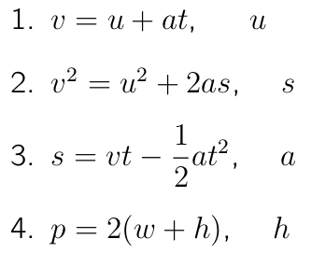
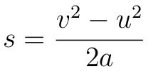

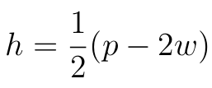
Substituting and Rearranging Equations
Rearrange each of the following to make the quantity shown the subject

Slide 76
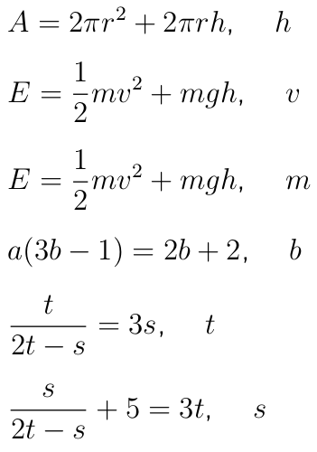






Substituting and Rearranging Equations
Rearrange each of the following to make the quantity shown the subject

Slide 77
Relative Atomic Mass

Slide 78
Relative Atomic Mass
Relative atomic mass, Ar:
is the average mass of naturally occurring atoms of an element on a scale where the 12C atom has a mass of exactly 12 units

Slide 79
Relative Atomic Mass
Average mass
2 balls with mass 100 g
3 balls with mass 200 g
10 balls with mass 400 g
average mass = total mass of all balls
number of balls
= (2x100)+(3x200)+(10x400)
2+3+10
= 4800 = 320 g
15
© www.chemsheets.co.uk AS 1011 15-July-2016

Slide 80
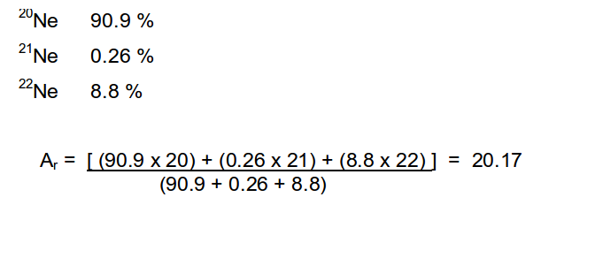
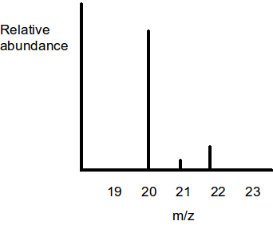
Relative Atomic Mass
Neon
A_{r} = (% abundance × mass atom 1) + (% abundance × mass atom 2) + .... 100 100

Slide 81
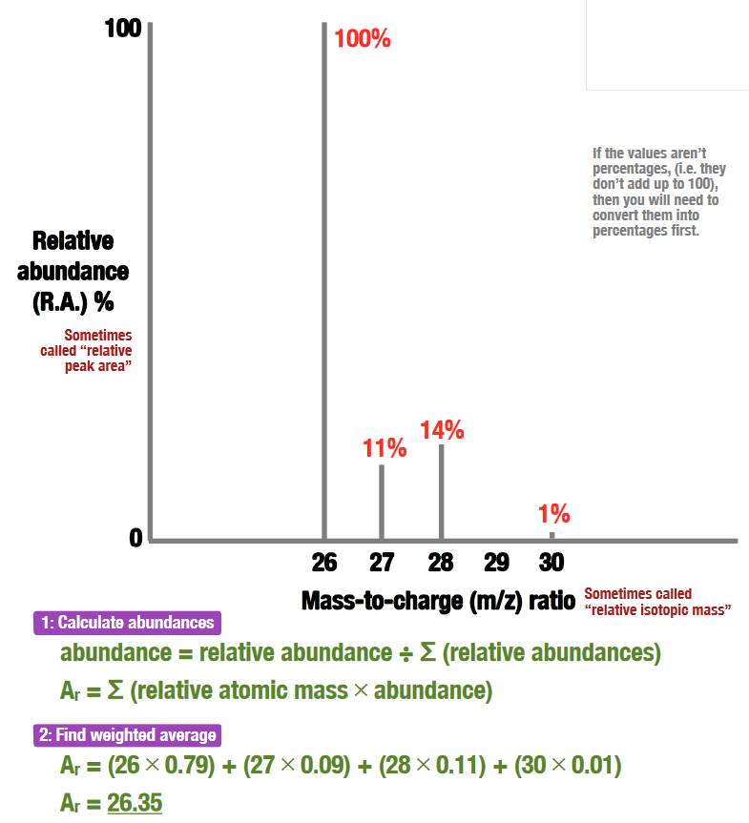
Relative Atomic Mass

Slide 82


Relative Atomic Mass
Example: Find the relative atomic mass (A_{r}) of naturally occurring lead from the data below.
Isotopic mass | Relative abundance | % relative abundance
203 | 0.2 | 2
204 | 2.4 | 24
205 | 2.2 | 22
206 | 5.2 | 52

Slide 83
Formulae, Nomenclature and Equations

Slide 84
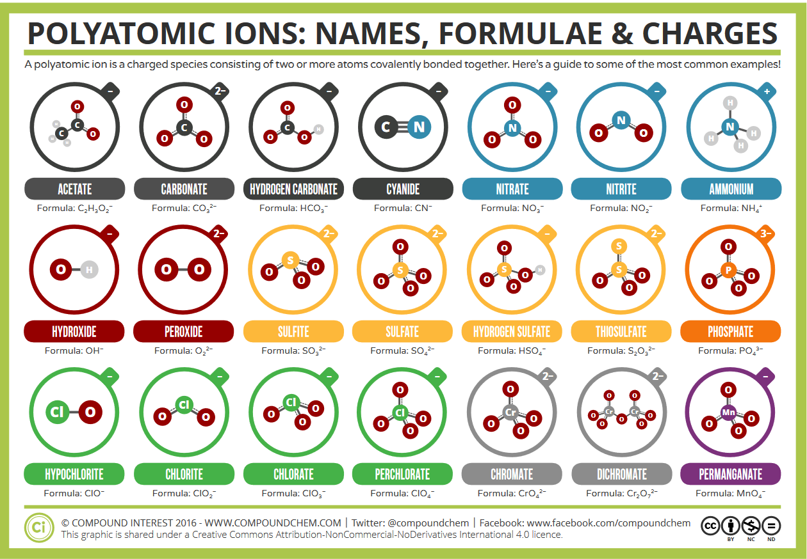
Learn these common ions

Slide 85
COVALENT
Number of atoms | Prefix
1 | mono-
2 | di-
3 | tri-
4 | tetra-
5 | penta-
6 | hexa-
7 | hepta-
8 | octa-
9 | nona-
10 | deca-
S₂Cl₂
disulphur dichloride
CCl₄
carbon tetrachloride
germanium monoxide
GeO
Nitrogen trihydride
(ammonia)
NH₃
Write the less electronegative element first
  (the element closest to Fr in the periodic table)
Add the prefix, unless there is only one atom of the first element
Change the ending of the second element’s name to –ide, always add a prefix

Slide 86
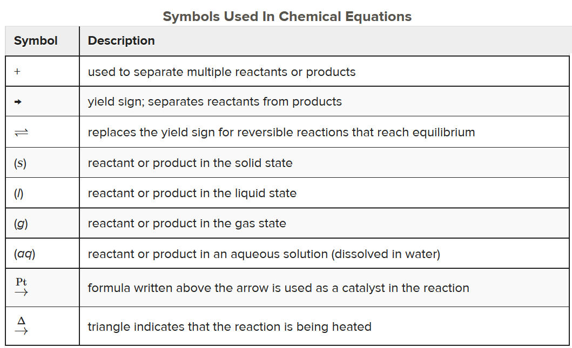
BALANCING EQUATIONS

Slide 87
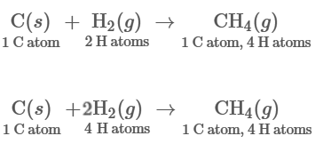
A balanced equation is a chemical equation in which mass is conserved and there are equal numbers of atoms of each element on both sides of the equation
BALANCING EQUATIONS
Unbalanced
Balanced

Slide 88
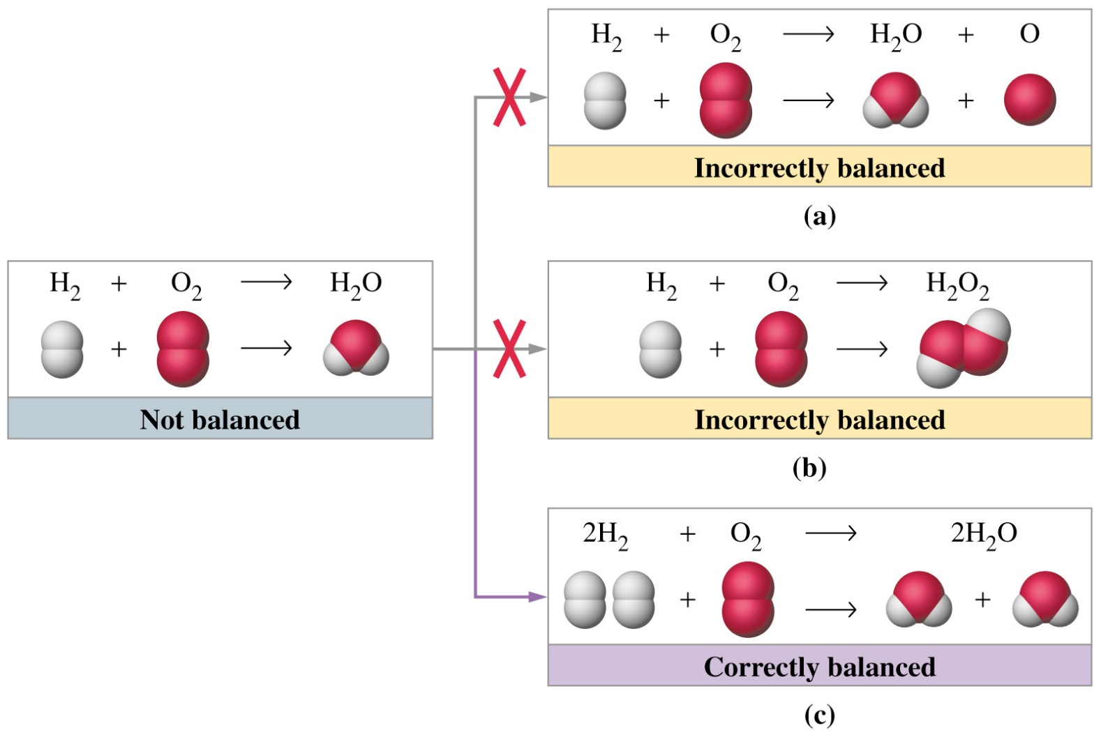
BALANCING EQUATIONS

Slide 89
BALANCING EQUATIONS
If an element is present in just one compound on each side of the equation, try balancing that element first.
Balance any reactants or products that exist as the free element last.
In some reactions, certain groupings of atoms (such as polyatomic ions) remain unchanged. In such cases, treat these groupings as a unit.
At times, an equation can be balanced by first using a fractional coefficient(s). The fraction is then cleared by multiplying each coefficient by a common factor.

Slide 90
BALANCING EQUATIONS
Q. Are the equations balanced ?
a) 2H₂ + O₂ → 2H₂O Y / N
b) CH₄ + O₂ → CO₂ + H₂O Y / N
c) H₂ + Cl₂ → 2HCl Y / N
d) NaOH + H₂SO₄ → Na₂SO4 + H₂O Y / N
e) Ag₂CO₃ + 2HNO₃ → 2AgNO₃ + CO₂ + H₂O Y / N

Slide 91
BALANCING EQUATIONS
Example 1
  Balance the equation
  Fe + O₂ → Fe₂O₃
Example 2
  Balance the equation
  C₂H₆ + O₂ → CO₂ + H₂O
Example 3
  Balance the equation
  H₃PO₄ + NaCN → HCN + Na₃PO₄
A Conceptual Example
  Write a plausible chemical equation for the reaction between water and a liquid molecular chloride of phosphorus to form an aqueous solution of hydrochloric acid and phosphorus acid. The phosphorus-chlorine compound is 77.45% Cl by mass.

Slide 92
BALANCING EQUATIONS
Q. Balance the following equations.
a) Mg + HCl → MgCl₂ + H₂
b) Na + O₂ → Na₂O
c) Ca(OH)₂ + HNO₃ → Ca(NO₃)₂ + H₂O
d) Ca + H₂O → Ca(OH)₂ + H₂
e) NaNO₃ → NaNO₂ + O₂
f) Mg(NO₃)₂ → MgO + NO₂ + O₂
g) Cu + H₂SO₄ → CuSO₄ + SO₂ + H₂O
h) Al + O₂ → Al₂O₃
i) Fe + Cl₂ → FeCl₃
j) C₂H₆ + O₂ → CO₂ + H₂O
k) Al₂O₃ + NaOH + H₂O → NaAl(OH)₄
l) Cu + HNO₃ → Cu(NO₃)₂ + H₂O + NO
m) KOH + F₂ → KF + F₂O + H₂O
n) KOH + Cl₂ → KCl + KClO₃ + H₂O

Slide 93
BALANCING EQUATIONS
Q. Balance the following equations.
a) Mg + HCl → MgCl₂ + H₂
b) Na + O₂ → Na₂O
c) Ca(OH)₂ + HNO₃ → Ca(NO₃)₂ + H₂O
d) Ca + H₂O → Ca(OH)₂ + H₂
e) NaNO₃ → NaNO₂ + O₂
f) Mg(NO₃)₂ → MgO + NO₂ + O₂
g) Cu + H₂SO₄ → CuSO₄ + SO₂ + H₂O
h) Al + O₂ → Al₂O₃
i) Fe + Cl₂ → FeCl₃
j) C₂H₆ + O₂ → CO₂ + H₂O
k) Al₂O₃ + NaOH + H₂O → NaAl(OH)₄
l) Cu + HNO₃ → Cu(NO₃)₂ + H₂O + NO
m) KOH + F₂ → KF + F₂O + H₂O
n) KOH + Cl₂ → KCl + KClO₃ + H₂O
2
4
2
2
2
2
2
2
2
2
4
2
2
4
3
2
2
3
2
2
7
4
6
2
3
2
3
8
3
4
2
2
2
2
6
3
5
3

Slide 94
COMMON EQUATIONS TO LEARN
metal + water → metal hydroxide + hydrogen
metal + acid → salt + hydrogen
metal oxide + acid → salt + water
metal hydroxide + acid → salt + water
metal carbonate + acid → salt + water + carbon dioxide

Slide 95
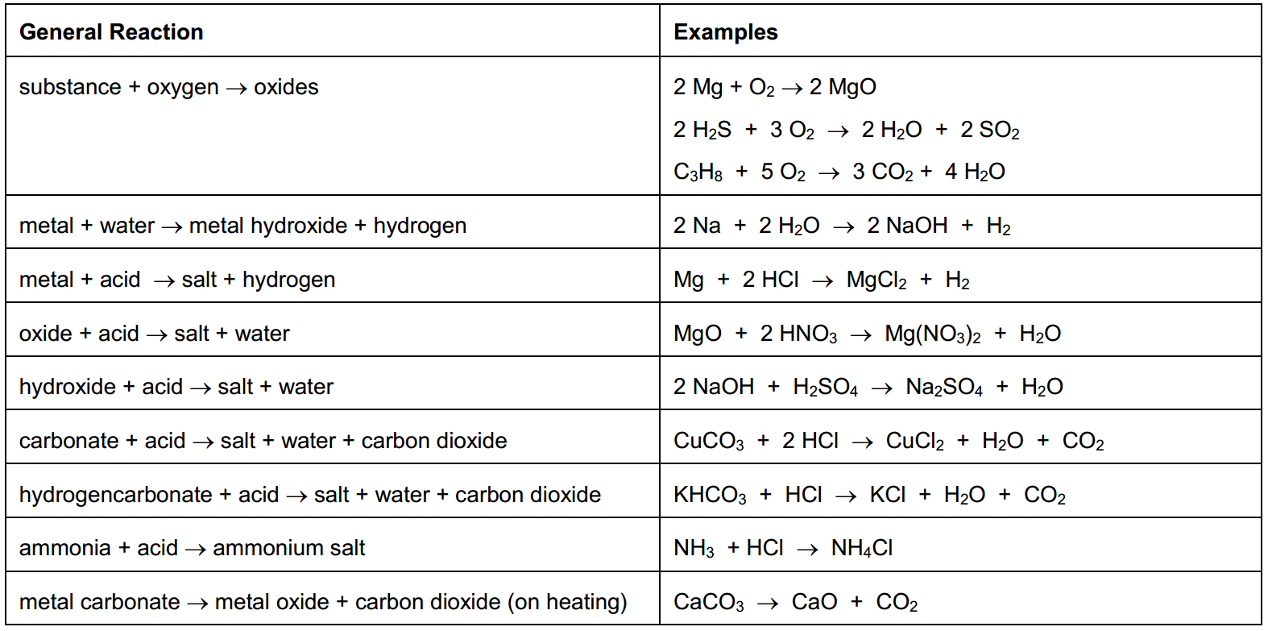
COMMON EQUATIONS TO LEARN

Slide 96
COMMON EQUATIONS TO LEARN

Slide 97
REACTING RATIOS
LIMITING REACTANTS
YIELDS & ATOM ECONOMY

Slide 98
REACTING QUANTITIES
N₂ + 3 H₂
2 NH₃
1 molecule
3 molecules
2 molecules
12
36
24
12 x 3 = 36
1
1 dozen
3 dozen
2 dozen
6 x 10²³
18 x 10²³
12 x 10²³
600000000000000000000000
1800000000000000000000000
1200000000000000000000000
1 mole
3 moles
2 moles
3 x 2 = 2
3
© www.chemsheets.co.uk AS 1028 25-Jun-2016

Slide 99
REACTING QUANTITIES
C₃H₈ + 5 O₂
3 CO₂ + 4 H₂O
1 molecule
5 molecules
3 molecules
4 molecules
10 moles
50 moles
30 moles
40 moles
2 moles
10 moles
6 moles
8 moles
0.5 moles
2.5 moles
1.5 moles
2 moles
0.03 moles
0.15 moles
0.09 moles
0.12 moles
© www.chemsheets.co.uk AS 1028 25-Jun-2016

Slide 100
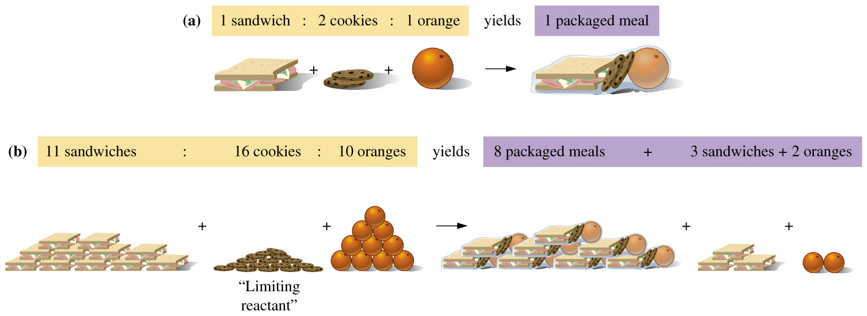
LIMITING REAGENTS
Chemical reactant that is completely consumed in a reaction and therefore limits the quantity of product formed.
How many meals can be made from 105 sandwiches, 202 cookies, and 107 oranges?

Slide 101
LIMITING REAGENTS
How many meals can be made from 105 sandwiches, 202 cookies, and 107 oranges?
Cookies limit the total number of whole meals with excess sandwiches and oranges

Slide 102
LIMITING REAGENTS
N₂ + 3 H₂
2 NH₃
IF WE ARE
GIVEN
3 moles
3 moles
FROM THE
RATIO WE NEED
3 moles
9 moles
EXCESS
some left
at end
LIMITING
all used
HOW MANY
REACT?
3 moles
1 moles
3 moles
1 moles

Slide 103
LIMITING REAGENTS
N₂ + 3 H₂
2 NH₃
IF WE ARE
GIVEN
16 moles
32 moles
FROM THE
RATIO
WE NEED
16 moles
48 moles
EXCESS
some left
at end
LIMITING
all used
HOW MANY
REACT?
10.6 moles
32 moles

Slide 104
LIMITING REAGENTS
N₂ + 3 H₂
2 NH₃
START
1 mole
10 moles
1 mole of N₂ needs 3 moles of H₂ for it all to react
∴ there is more than enough H₂ not all of the H₂ reacts
∴ N₂ is limiting reagent (and H₂ is in excess)
so only 3 mole of H₂ can react (and 7 moles of H₂ is left over)
CHANGES
–1 mole
–3 moles
+2 moles
END
1–1 =
0 moles
10–3 =
7 moles
0+2 =
2 moles
© www.chemsheets.co.uk AS 1028 25-Jun-2016

Slide 105
LIMITING REAGENTS
2 SO₂ + O₂
2 SO₃
START
10 moles
8 moles
10 moles of SO₂ needs 5 moles of O₂ for it all to react
there is more than enough O₂
SO₂ is limiting reagent (and O₂ is in excess)
∴ so only 5 moles of O₂ can react (and 3 moles of O₂ is left over)
CHANGES
–10 mole
–5 moles
+10 moles
END
10–10 =
0 moles
8–5 =
3 moles
0+10 =
10 moles
© www.chemsheets.co.uk AS 1028 25-Jun-2016

Slide 106
REACTING MASS CALCULATIONS (Examples)
What mass of oxygen reacts with 12 g of magnesium?
2Mg + O₂ → 2MgO
✓
?
Moles Mg = mass
M_{r}
= 12
24
= 0.5
Moles O₂
= 0.25
Mass O₂ = M_{r} x moles
= 32 x 0.25
= 8 g
© www.chemsheets.co.uk GCSE 1116 24-Dec-2016

Slide 107
REACTING MASS CALCULATIONS (Examples)
2) What mass of calcium hydroxide is made from 14 kg of calcium oxide?
CaO + H₂O → Ca(OH)₂
✓
?
Moles CaO = mass
M_{r}
= 14000
56
= 250
Moles Ca(OH)₂
= 250
Mass Ca(OH)₂ = M_{r} x moles
= 74 x 250
= 18500 g
© www.chemsheets.co.uk GCSE 1116 24-Dec-2016

Slide 108
REACTING MASS CALCULATIONS (Examples)
3) What mass of aluminium is needed to react with 640 g of iron oxide?
Fe₂O₃ + 2 Al → 2 Fe + Al₂O₃
✓
?
Moles Fe₂O₃ = mass
M_{r}
= 640
160
= 4
Moles Al
= 8
Mass Al = M_{r} x moles
= 27 x 8
= 216 g
© www.chemsheets.co.uk GCSE 1116 24-Dec-2016

Slide 109
REACTING MASS CALCULATIONS (Examples)
4) What mass of titanium chloride reacts with 460 g of sodium?
TiCl₄ + 4 Na → Ti + 4 NaCl
?
✓
Moles Na = mass
M_{r}
= 460
23
= 20
Moles TiCl₄
= 5
Mass TiCl₄ = M_{r} x moles
= 190 x 5
= 950 g
© www.chemsheets.co.uk GCSE 1116 24-Dec-2016

Slide 110
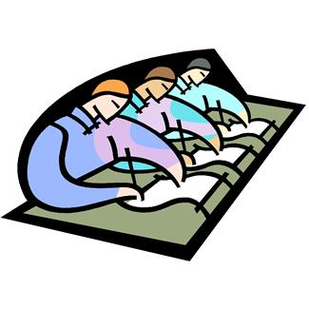
SAMPLE EXAM QUESTION
Barium metal can be extracted from barium oxide, BaO, by reduction with aluminium.
6BaO + 2Al → 3Ba + Ba₃Al₂O₆
Calculate the mass of barium metal that could be produced from reduction of 500 g of barium oxide using this method.
answer = ............................... g [Total 4 marks]

Slide 111
SAMPLE EXAM QUESTION ANSWER
method 1
Mr of BaO = 137 + 16 = 153 (1)
moles of BaO = 500/153 or 3.268 mol (1)
moles of Ba = 3.268/2 or 1.634 mol (1)
mass of Ba formed = 1.634 x 137 = 224 g (accept 223.85g) (1)
if 6 mol of BaO forms 3 mol of Ba, award 3rd mark
OR
method 2
mass of 6BaO=918 g (1)
mass of 3Ba = 411 g (1)
1g BaO forms 411/918 g Ba = 0.4477 (1)
500 g BaO forms 223.85g (1)
[4]

Slide 112
SAMPLE EXAM QUESTION
Antimony is found naturally in a number of minerals including stibnite. Stibnite typically contains 5% of Sb₂S₃. Antimony can be obtained by reducing Sb₂S₃ with scrap iron.
Sb₂S₃ + 3Fe → 2Sb + 3FeS
(i) How many moles of Sb₂S₃ are in 500 kg of a typical sample of stibnite containing 5% by mass of Sb₂S₃?
  molar mass of Sb₂S₃ = 340 g mol^{–1}; relative atomic mass of Sb = 122
……………… mol [2]
(ii) Calculate the mass of antimony that could be obtained by processing 500 kg of stibnite.
mass = ……………… kg [2]
[Total 4 marks]

Slide 113
SAMPLE EXAM QUESTION
(i) Mass of Sb₂S₃ in stibnite = 5% of 500 kg = 25.0 kg
Moles of Sb₂S₃ = 73.5/ 73.529 /73.53/ 74 mol
  (calculator value: 73.52941176)
If 5% is not used, 1471 mol; ecf for 2nd mark
  (calculator value: 1470.588235)
If 5% is used 2nd, 73.6 mol: OK for both marks 2
(ii) moles of Sb = 2 x 73.5 mol
mass of Sb = 2 x 73.5 x 0.122 kg = 17.9 kg
If the 2 isn’t used, answer = 73.5 x 0.122kg = 8.95kg
  ecf answer from (i) x 2 or ecf answer above x 2
OR
% Sb = 244/340 = 71.7%
mass Sb = 25.0 x 71.7/100 = 17.9 kg (ecf as above) 2
[4]

Slide 114
YIELD AND PERCENTAGE YIELD
Theoretical yield
predicted amount of product formed from the limiting reagent
If all worked perfectly ...
2H₂(g) + O₂(g) → 2 H₂O(g)
Example: 2 mol H₂ will
produce 2 mol of water
Yield (Actual yield)
amount of product produced in reality
  yield < theoretical: errors, poor technique, etc. ...

Slide 115
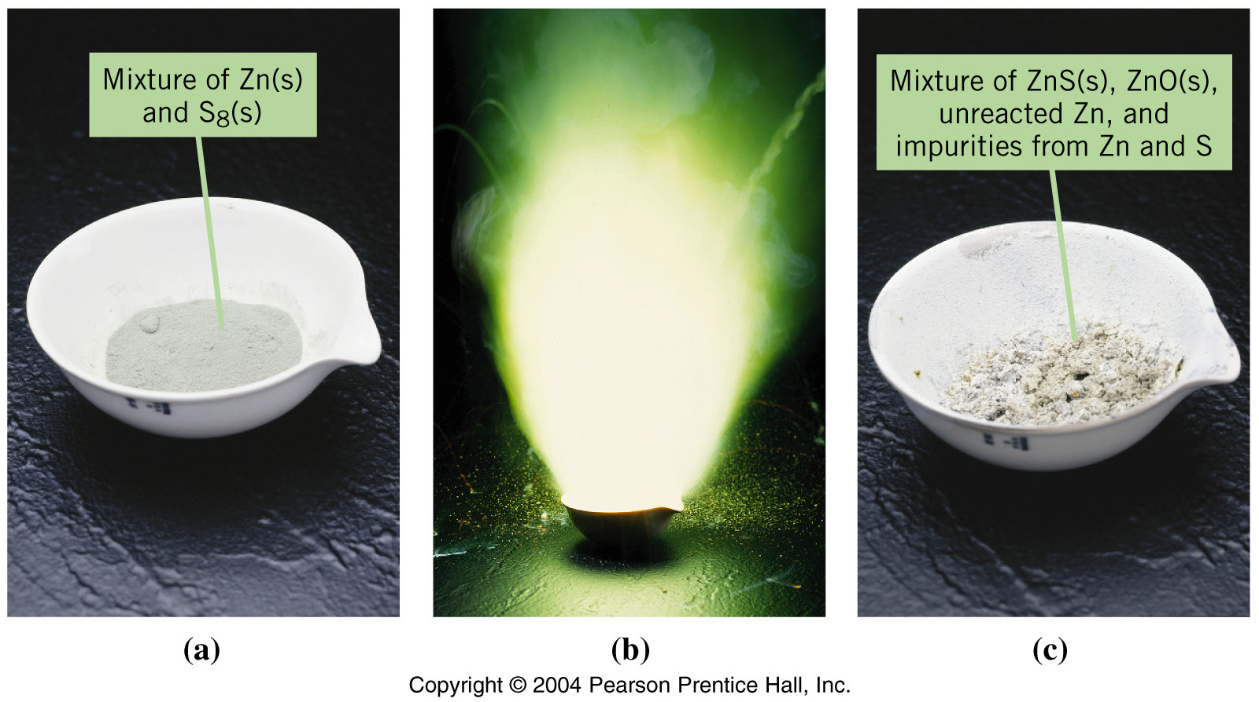
Actual Yield of ZnS Is Less than the Theoretical Yield
YIELD AND PERCENTAGE YIELD

Slide 116
YIELD AND PERCENTAGE YIELD
In the commercial production of the element arsenic, arsenic(III) oxide is heated with carbon, which reduces the oxide to the metal according to the following equation:
2As₂O₃ +_x0001_ 3C → 3CO₂ +_x0001_ 4As
If 8.87 g of As₂O₃ is used in the reaction and 5.33 g of As is produced, what is the percent yield?
percent yield = 5.33 x 100 = 79.3% yield
8.87

Slide 117
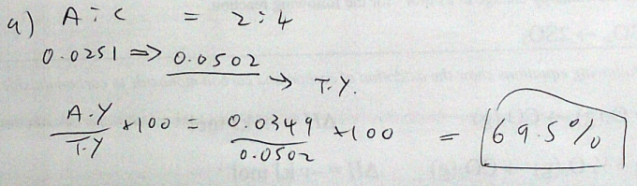
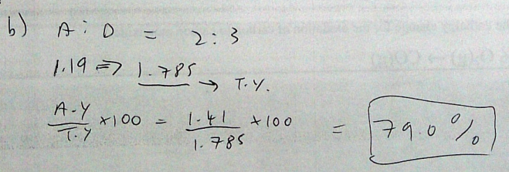
YIELD AND PERCENTAGE YIELD
Assume the following hypothetical reaction takes place.
2A + 7B → 4C + 3D
Calculate the percent yield in each of the following cases:
a. The reaction of 0.0251 mol of A produces 0.0349 mol of C.
b. The reaction of 1.19 mol of A produces 1.41 mol of D.

Slide 118
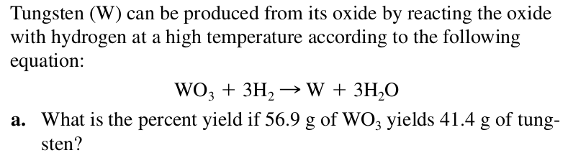

YIELD AND PERCENTAGE YIELD

Slide 119
PERCENTAGE COMPOSITION AND EMPIRICIAL/MOLECULAR FORMULAE

Slide 120

Percentage Composition
The mass % of each element in a compound

Slide 121
Percentage Composition
A simple example:
Calculate the percent composition, by colour, of the collection of blocks below
Fraction of colours

Slide 122
Percentage Composition
% composition of Cu₂S.
127.10 g Cu
159.17 g Cu₂S
%Cu =
× 100
=
79.85% Cu
32.07 g S
159.17 g Cu₂S
%S =
× 100
=
20.15% S

Slide 123
Percentage Composition
Find the percentage composition of a sample that is 28 g Fe and 8.0 g O
28 g
36 g
%Fe =
× 100 =
78% Fe
8.0 g
36 g
%O =
× 100 =
22% O

Slide 124

Percentage Composition (Butane)

Slide 125
EMPIRICAL FORMULAE
Smallest whole number ratio of atoms in a compound
C₂H₆
reduce subscripts
CH₃

Slide 126

EMPIRICAL FORMULAE
Silicon dioxide (silica)
SiO₂ Ratio of Si:O = 1:2

Slide 127

EMPIRICAL FORMULAE
Sodium chloride (salt)
NaCl Ratio of Na:Cl = 1:1

Slide 128

EMPIRICAL FORMULAE
Benzene
Empirical formula = CH Ratio of C:H = 1:1
Molecular formula = C₆H₆ In one molecule: 6C & 6H atoms

Slide 129
FINDING THE EMPIRICAL FORMULAE
1. Find mass (or %) of each element.
2. Find moles of each element n=m/M_{r}
3. Find mole ratio (÷ smallest mole #)
4. Change to whole #’s.
6.72%
H
6.72 g
H
53.27%
O
53.27 g
O
40.01%
C
40.01 g
C

Slide 130
EMPIRICAL FORMULAE
Find the empirical formula for a sample of 25.9% N and 74.1% O.
1. Find mass (or %) of each element.
2. Find moles of each element n=m/M_{r}
n_{N} = 25.9 / 14.01 = 1.85 moles nitrogen
n_{O} = 74.1 / 16.00 = 4.63 moles oxygen
3. Find mole ratio (÷ smallest mole #)
n_{N} : n_{O}
1.85/1.85 : 4.63 / 1.85
1 : 2.5
4. Change to whole #’s.
1:2.5 (×2) = 2:5
N₂O₅

Slide 131

EMPIRICAL FORMULAE
Hydrocarbons burn to produce:
water and carbon dioxide only

Slide 132

EMPIRICAL FORMULAE
… H₂O, which is absorbed by MgClO₄, and …
… CO₂, which is absorbed by NaOH.
The sample is burned in a stream of oxygen gas, producing …

Slide 133
Percentage Composition
Example 1
  Phenol, a general disinfectant, has the composition 76.57% C, 6.43% H, and 17.00% O by mass. Determine its empirical formula.
Example 2
  Diethylene glycol, used in antifreeze, as a softening agent for textile fibers and some leathers, and as a moistening agent for glues and paper, has the composition 45.27% C, 9.50% H, and 45.23% O by mass. Determine its empirical formula.
76.57/12.0 = 6.375 = C
6.43/1.0 = 6.43 = H
17.00/16.0 = 1.063 = O
6.43/1.063 = 6
C₆H₆O
45.27/12.0 = 3.772 = C
9.50/1.0 = 9.50 = H
45.23/16.0 = 2.827 = O
3.360:1.334:1
10:4:3

Slide 134
Molecular Formula
“True Formula” - the actual number of atoms in a compound
empirical
formula
CH₃
molecular
formula
C₂H₆

Slide 135
Molecular Formula
To find the molecular formula:
1. Find the empirical formula mass
2. molecular mass = multiplier ratio
empirical mass
3. Multiply empirical formulae by multiplier

Slide 136
Molecular Formula
The empirical formula for ethene is CH₂. Find the molecular formula if the molecular mass is 28.1 gmol⁻¹
empirical mass = 14.03 g/mol
28.1 g/mol
14.03 g/mol
= 2.00
(CH₂)₂ ⇒ C₂H₄

Slide 137


Use your knowledge of gases and moles to create an experiment that we’ll do next lesson to find the gas in this lighter…..
Hints: What data would you like?
What data can you collect?

